Slide 1
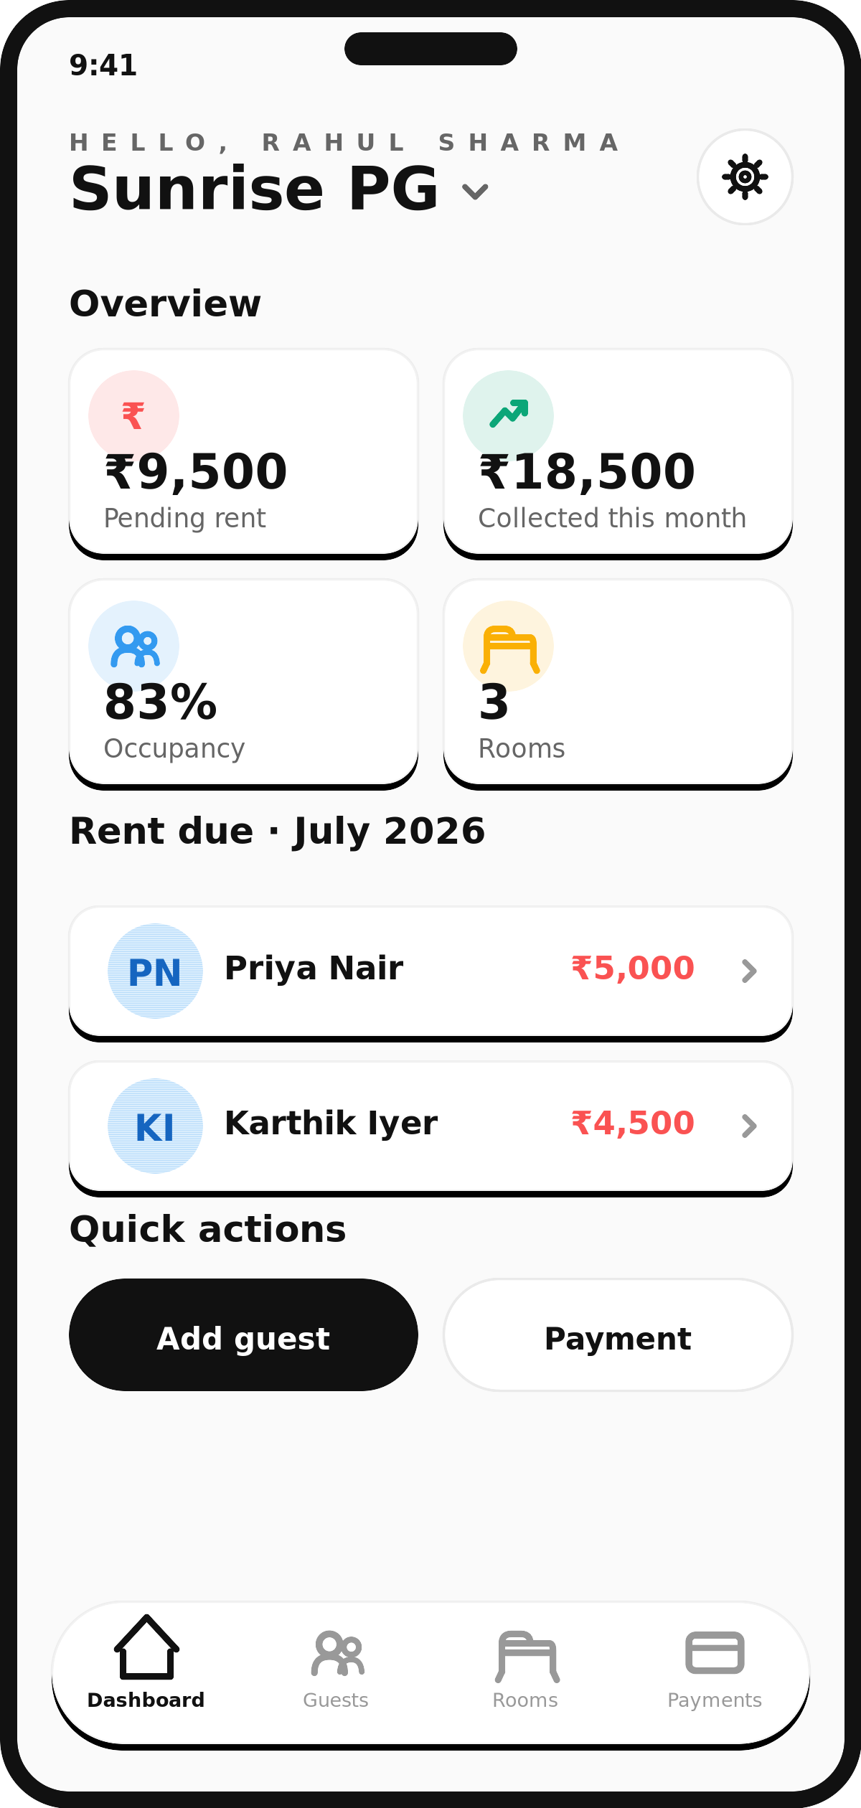
PG & HOSTEL MANAGEMENT
PG Manager
Everything your rent register does.
Nothing it loses.
Property management for Indian PG & hostel owners — rooms, guests and rent, off the notebook and onto your phone.
01

Slide 2




THE PROBLEM
The notebook works. Until it doesn't.
One copy, one place
It lives on a desk at the property. Lose it, damage it, or leave it at home, and there's no record to work from that day.
Math you redo every month
Splitting room rent per guest, tallying who's paid, chasing who hasn't — done by hand, from scratch, every single month.
Corrections nobody can trust
A crossed-out number reads exactly the same whether it was an honest mistake or something else.
No visibility from off-site
An owner running the PG from another city has no way to know what's happening there today.
02

Slide 3



HOW IT WORKS
Four steps, no paperwork
PG Manager replaces the register with a system that does the arithmetic, keeps the history, and works from any phone.
1
2
3
4
→
→
→
Set up your rooms
Add your guests
Record rent as it lands
See everything, live
Capacity, AC or non-AC, and the room's total rent.
Rent per guest is calculated for you, split evenly by bed.
UPI, cash, bank transfer or card — the balance due is prefilled.
Occupancy, collections and dues — from any phone, anywhere.
03

Slide 4
INSIDE THE APP
One screen. The whole property.
Pending rent and this month's collections
at a glance, the moment you open the app.
Occupancy across every room
how many beds are full, and how many are free.
Exactly who owes what
guests who haven't paid, ranked highest first.
Add a guest or record a payment
in two taps, from the same screen.
04

Slide 5
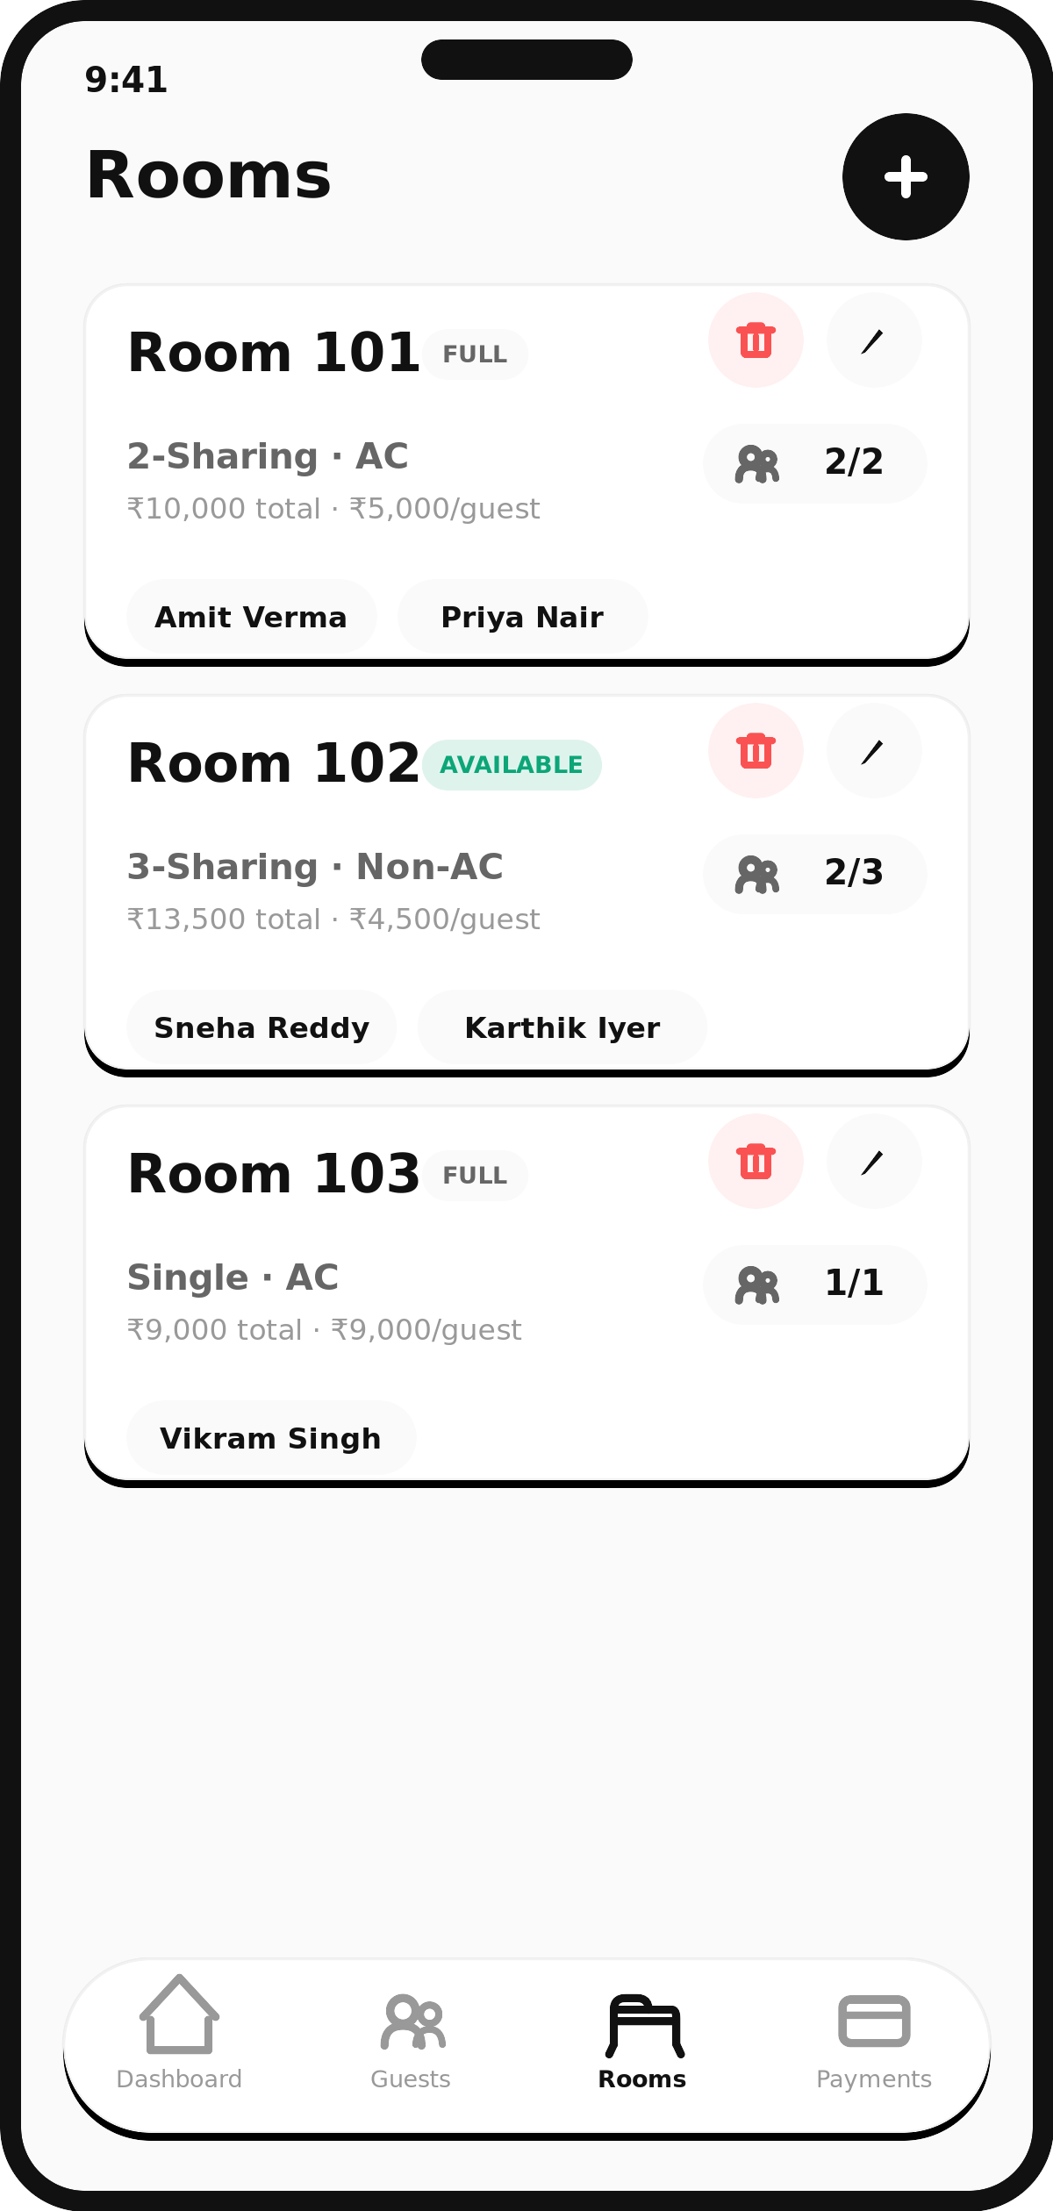
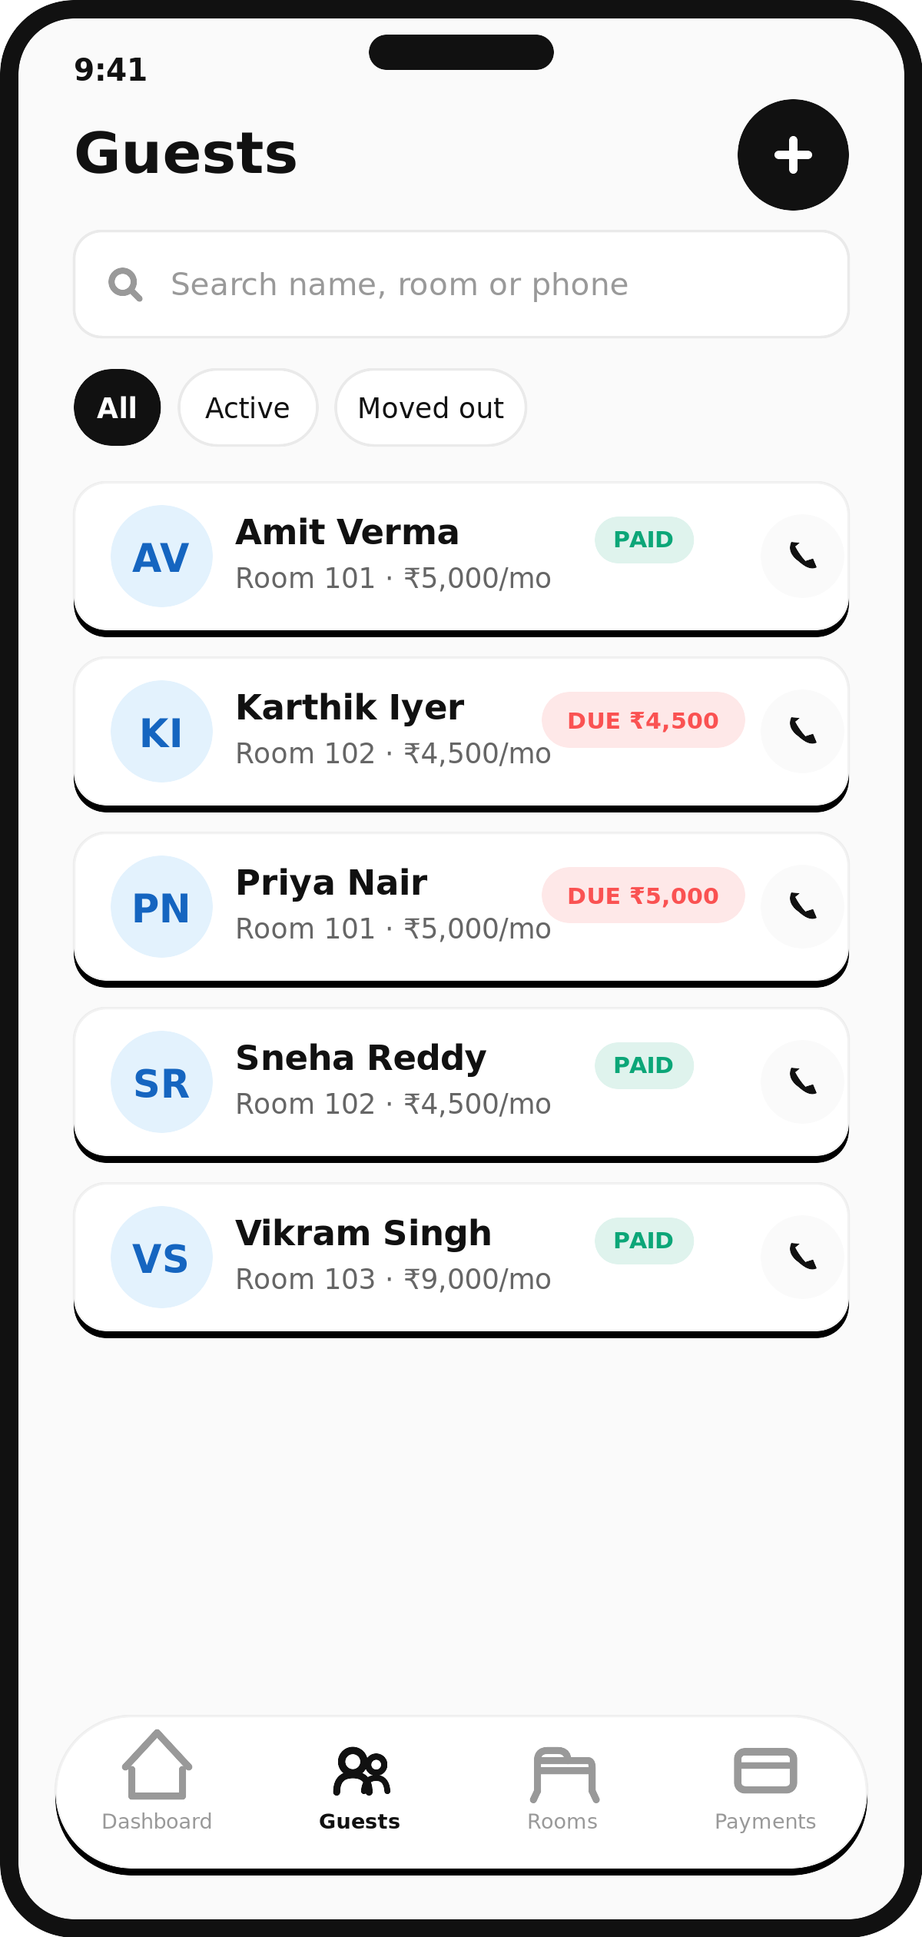
INSIDE THE APP
Rooms and guests that stay in sync
Set a room's rent once — every guest assigned to it gets their share calculated automatically, split evenly by bed. Every guest's profile — contact, ID, food preference, move-in date — is searchable in seconds.
05

Slide 6
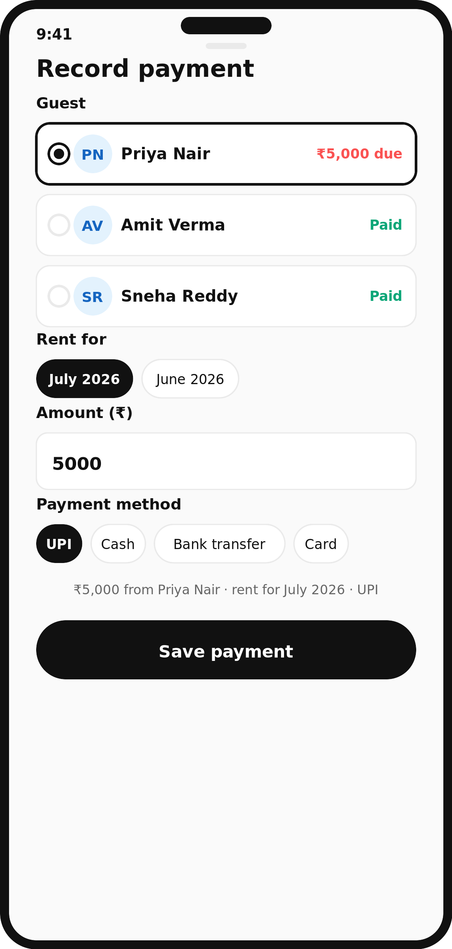
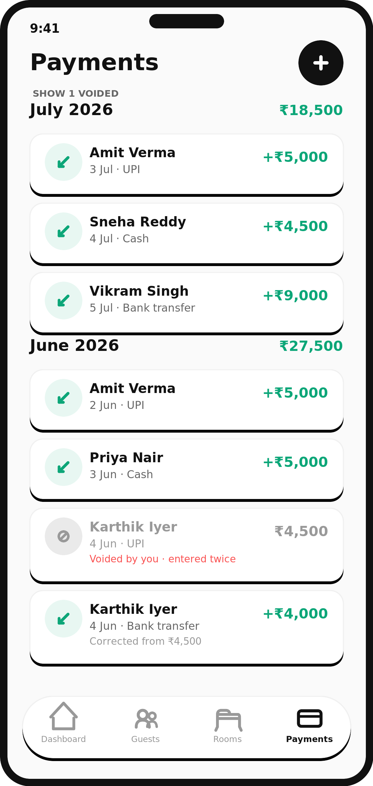
INSIDE THE APP
Collect rent without doing the math
Recording a payment prefills the exact balance due. Every entry is timestamped and attributed. Made a mistake? Nothing is edited or erased — the wrong entry is voided and the correct one takes its place, both visible, forever.
06

Slide 7





FEATURES
Built for how a PG actually runs
Multi-property, one login
Owner / Manager / Staff roles
Automatic rent splitting
Run one PG or five. Switch between them instantly.
Give staff access without handing over control.
Whole-room rent, divided per guest, every time.
Fat-finger guard
Live dashboard
Full guest history
Flags a payment that looks like a typo before it saves.
Occupancy, collections and dues — always current.
Every guest, every stay — searchable long after move-out.
Search & one-tap calling
Move-out, not delete
Built for India
Find anyone by name, room or phone; call from the app.
A guest who leaves keeps their whole record intact.
₹ formatting, DD/MM/YYYY dates, IST by default.
07

Slide 8



WHY IT MATTERS
Nothing is ever thrown away.
A paper register has a ceiling. It fills up, and the history goes in a box — or the bin. PG Manager doesn't have that wall.
Every payment stays in the ledger.
Mistakes are voided and re-entered, never deleted — the full trail survives.
Every guest is still there.
Full stay and payment history, searchable years after they've moved out.
Your history only grows.
The longer you use it, the more complete your property's record becomes — nothing resets.
08

Slide 9
HEAD TO HEAD
The notebook vs. PG Manager
Paper register
PG Manager
Where it lives
One desk, one property
Any phone, any property, anywhere
Rent math
By hand, every month
Calculated automatically
A correction
A crossed-out number
A linked, timestamped entry
When it fills up
Archived in a box, or binned
Keeps growing — never resets
Running more than one PG
A separate register per property
One login, every property
Who wrote what
No record
Every entry attributed
Finding an old entry
If you remember which page
One search
09

Slide 10

ACCESS CONTROL
Control who can do what
Three roles — Owner, Manager, Staff — each with different limits. The ledger is append-only by design: there is no “edit” button that quietly rewrites history.
Owner
Manager
Staff
Full control of every property, including who else has access.
Runs day-to-day operations — can void or correct a payment.
Can record guests and payments, but can't undo one.
Every payment records who entered it — and who voided it, if it was.
Voiding never deletes a row. It stays visible, struck through, excluded from totals.
10

Slide 11
ROADMAP
What's next
COMING SOON
ON THE ROADMAP
Invite staff by email, with scoped roles
Automated rent-due reminders
Attach guest ID & photo documents
Online rent collection inside the app
Encrypted storage for ID numbers
Multi-month arrears tracking
A full audit log of every change
A guest-facing view of their own rent status
11

Slide 12



Stop running your PG
from a notebook.
PG Manager — built for Indian PG & hostel owners.
+91 63744 26001
info@devworthtechonologies.com
devworthtechnologies.com
12

