Slide 1

Omni-LED
A Wifi-controlled
Omnipresent light source

Slide 2
Need of Solution
Scientifically , in order to read without any stress on eyes a 50 lumen of light is required
For that much of light, A dedicated light source is required for reading
If we analyze all location in our home at which we read newspaper, books maybe proper lightning is improper
Our project solves that problem with better efficiency and lesser price

Slide 3
The Design
Controlling
Circuit
Servo assembly
LED panel

Slide 4

Wireless control
What enabled to make a wireless connection?

Slide 5
WIFI controller
To make the led controller wirelessly a WiFi controller is used
The board named ESP8266 proved to be a suitable solution
It is economical and low power wifi module used world wide for communication purpose
The ESP8266 is a Wi-Fi SoC integrated with a Tensilica Xtensa LX106 core, widely used in IoT applications

Slide 6
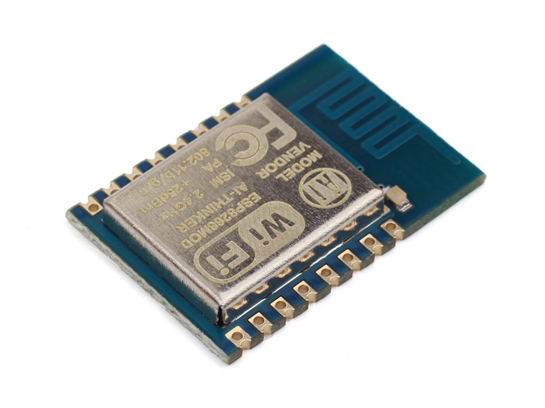
ESP8266 Breakout board
The ESP8266 is a low-cost Wi-Fi chip with full TCP/IP stack and microcontroller capability produced by Shanghai-based Chinese manufacturer, Espressif.

Slide 7
Node MCU
For the development purpose Node microcontroller is used
As it has on board USB to UART bridge IC which is necessary for development
NodeMCU is an open source IoT platform. It uses the Lua scripting language. It is based on the eLua project, and built on the ESP8266 SDK 1.4
It uses many open source projects, such as lua-cjson and spiffs It includes firmware which runs on the ESP8266 Wi-Fi SoC and hardware which is based on the ESP-12 module.

Slide 8
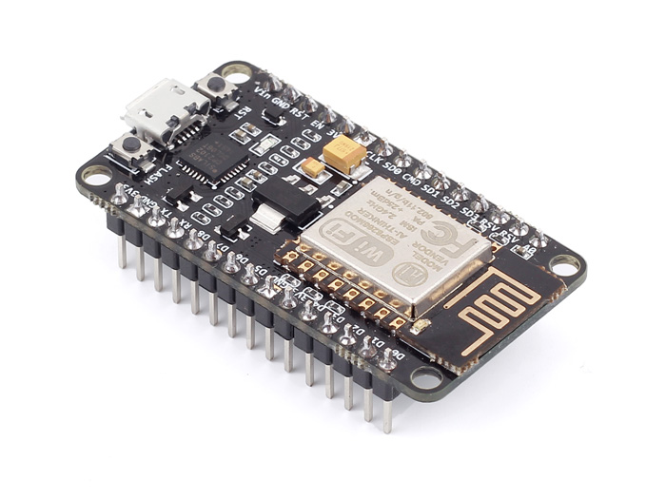
In the Figure Amica NODE-mcu
NodeMCU is an open source IoT platform.[4][5] It uses the Lua scripting language. It is based on the eLua project, and built on the ESP8266 SDK 1.4.

Slide 9

Brightness Control
Dimming control of led

Slide 10
Dimming Techniques
Most popular technique for controlling LED brightness is PWM
By definition, Pulse-width modulation (PWM), or pulse-duration modulation (PDM), is a modulation technique used to encode a message into a pulsing signal.
Although this modulation technique can be used to encode information for transmission, its main use is to allow the control of the power supplied to electrical devices, especially to inertial loads such as motors or LED panel

Slide 11
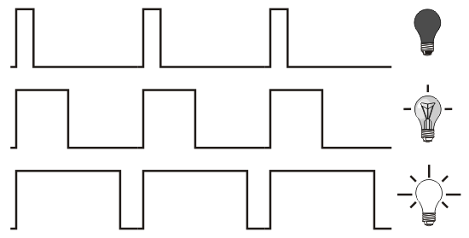
PWM dimming
1 % Brightness
50% Brightness
100% Brightness

Slide 12
Implementing With H-bridge
As node mcu have TTL logic levels , hence it can provide a PWM pulse of 3.3 V
For using this pulse to control the dimming it need to be amplified at 12V.
Hence an H-bridge is used for this purpose
In general an H-bridge is a rather simple circuit, containing four switching element, with the load at the center, in an H-like configuration

Slide 13
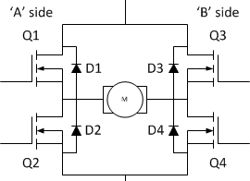
Circuit of H-bridge
The switching elements (Q1..Q4) are usually bi-polar or FET transistors, in some high-voltage applications IGBTs. Integrated solutions also exist but whether the switching elements are integrated with their control circuits or not is not relevant for the most part for this discussion. The diodes (D1..D4) are called catch diodes and are usually of a Schottky type.

Slide 14
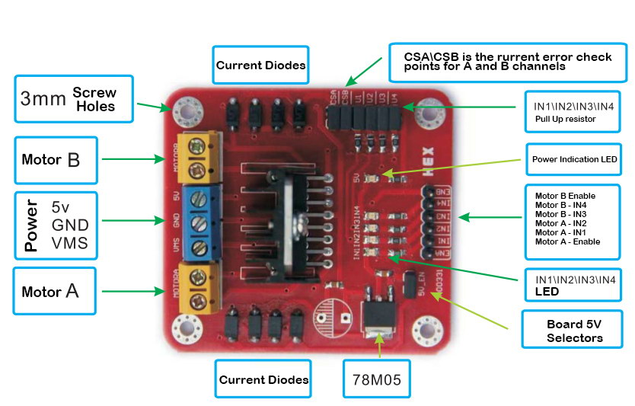
L298N H-bridge board
The LN298 is a high voltage, high current, dual full-bridge motor driver designed to accept standard TTL logic levels and drive inductive loads such as relays, solenoids, DC

Slide 15

Programming the board

Slide 16
Arduino ide
ESP8266 open community provides library to program board like node mcu using Arduino IDE
Arduino is a software company, project, and user community that designs and manufactures computer open-source hardware, open-source software, and microcontroller-based kits for building digital devices and interactive objects that can sense and control physical devices

Slide 17
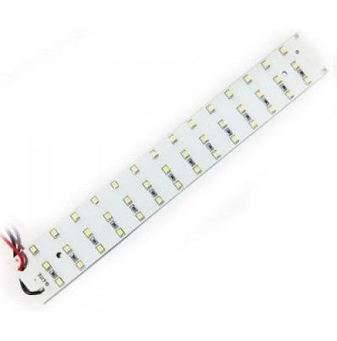
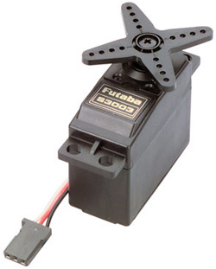
Components
42 LED SMD panel
Servo motor

Slide 18
Block diagram
WIFI Client
Node MCU web-server
Servo
220V AC/DC Converter
5 V
H-Bridge
LED light panel
12 V
Block Diagram of Project

Slide 19



Project UI

Slide 20

Thank You
Omni-LED

