Slide 1
Chapter 1: Introduction Operating System and System Programming
Presented by- Mst. Rashida Akhtar Assistant Professor Dept of CSE, VU

Slide 2
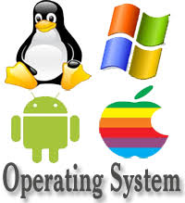

Slide 3
Objectives
To describe the basic organization of computer systems
To provide a grand tour of the major components of operating systems
To give an overview of the many types of computing environments
To explore several open-source operating systems

Slide 4
Chapter 1: Introduction
What Operating Systems Do
Computer-System Organization
Computer-System Architecture
Operating-System Structure
Operating-System Operations
Process Management
Memory Management
Storage Management
Protection and Security
Kernel Data Structures
Computing Environments
Open-Source Operating Systems

Slide 5
What is an Operating System?
A program that acts as an intermediary between a user of a computer and the computer hardware.
Operating System is a software that controls the operation of a computer and directs the processing of programs (as by assigning storage space in memory and controlling input and output functions)

Slide 6
Operating system goals:
Execute user programs and make solving user problems easier
Make the computer system convenient to use
Use the computer hardware in an efficient manner

Slide 7
Computer System Structure
Computer system can be divided into four components:
Hardware – provides basic computing resources
CPU, memory, I/O devices
Operating system
Controls and coordinates use of hardware among various applications and users
Application programs – define the ways in which the system resources are used to solve the computing problems of the users
Word processors, compilers, web browsers, database systems, video games
Users
People, machines, other computers

Slide 8
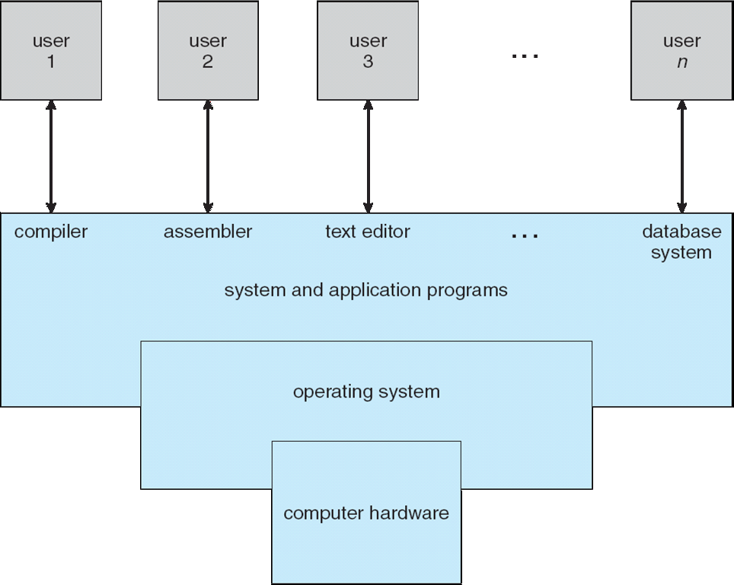
Four Components of a Computer System

Slide 9
What Operating Systems Do
Depends on the point of view
Users want convenience, ease of use and good performance
Don’t care about resource utilization
But shared computer such as mainframe or minicomputer must keep all users happy
Users of dedicate systems such as workstations have dedicated resources but frequently use shared resources from servers-designed to compromise between individual usability and resource utilization.
Handheld computers are resource poor, optimized for usability and battery life
Some computers have little or no user interface, such as embedded computers in devices and automobiles

Slide 10
Operating System Definition
OS is a resource allocator
Manages all resources
Decides between conflicting requests for efficient and fair resource use
OS is a control program
Controls execution of programs to prevent errors and improper use of the computer

Slide 11
Operating System Definition (Cont.)
“The one program running at all times on the computer” is the kernel.
Kernel: is the collection of all core software of operating system.
middleware—a set of software frameworks that provide additional services to application developers
(Apple’s iOS and Google’s Android-features
a core kernel along with middleware that supports databases, multimedia, and graphics)

Slide 12
Bootstrap program
bootstrap or bootloader program is loaded at power-up or reboot
Typically stored in ROM or EPROM, generally known as firmware
Initializes all aspects of system
Loads operating system kernel and starts execution

Slide 13
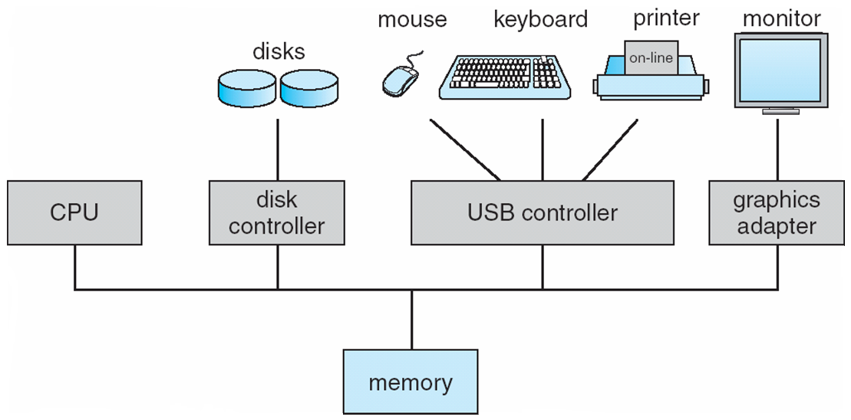
Computer System Organization
Computer-system operation
One or more CPUs, device controllers connect through common bus providing access to shared memory
Concurrent execution of CPUs and devices competing for memory cycles

Slide 14
Computer-System Operation(OLD)
I/O devices and the CPU can execute concurrently
Each device controller is in charge of a particular device type
Each device controller has a local buffer
CPU moves data from/to main memory to/from local buffers
I/O is from the device to local buffer of controller
Device controller informs CPU that it has finished its operation by causing an interrupt

Slide 15
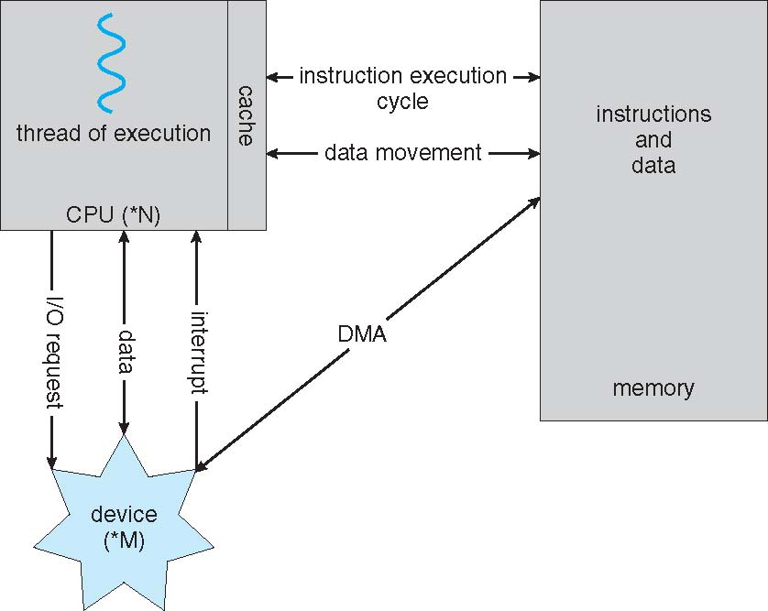
How a Modern Computer Works
A von Neumann architecture

Slide 16
Direct Memory Access Structure
Used for high-speed I/O devices able to transmit information at close to memory speeds
Device controller transfers blocks of data from buffer storage directly to main memory without CPU intervention
Only one interrupt is generated per block, rather than the one interrupt per byte

Slide 17
Common Functions of Interrupts
The occurrence of an event is usually signaled by an interrupt from either the hardware or the software.
Hardware interrupt :Hardware may trigger an interrupt at any time by sending a signal to the CPU, usually by way of the system bus.
Software interrupt: Software may trigger an interrupt by executing a special operation called a system call (also called a monitor call).
A trap or exception is a software-generated interrupt caused either by an error or a user request
An operating system is interrupt driven

Slide 18
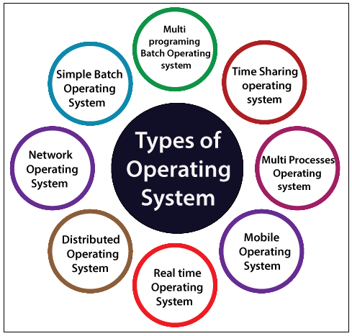

Slide 19
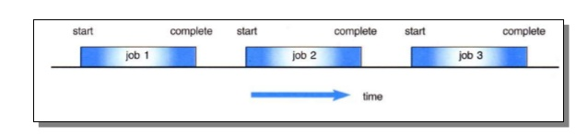
Batch operating systems
Batch Operating System: Batch processing is the execution of non-interactive processing tasks, meaning tasks with no user-interface. To speed up processing, jobs with similar needs are batched together and run as a group.
How it works: OS keeps the number of jobs in memory and executes them one by one. Jobs processed in first come first served order. Each set of a job considered as a batch. When a job completes its execution, its memory is released, and the output for the job gets copied into an output spool for later printing or processing.

Slide 20
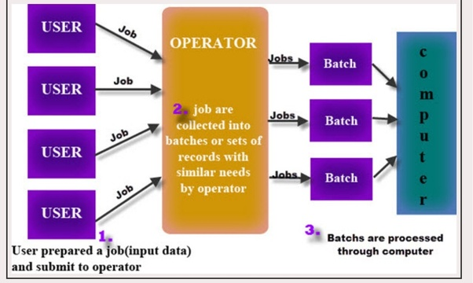
Batch operating systems

Slide 21
Batch operating systems
Example of Batch Operating System:
Billing:
A telecom company runs a monthly batch job to process call data records that include the details of millions of phone calls to calculate charges
Transactions
A bank that processes transactions such as international money transfers after-hours. After-hours batch processing was once extremely common in the banking industry.
Examples of Batch based Operating System: Payroll System, Bank Statements etc

Slide 22
Types of operating systems
Batch Operating System:
Advantages:
1) Same jobs in the batch are higher executed speed.
2) A process is complete its execution, next job from job spool get executed without any user interaction.
3) CPU utilization gets improved.
4) To speed up the processing speed, the batch process can partition into the number of processes.
Disadvantages:
1) Difficult to debug.
2) If a job gets to enter in an infinite loop, other jobs wait for unknown time.
3) Batch systems are costly

Slide 23
Time-Sharing operating systems
Time-Sharing Operating Systems :
Time-sharing is a technique which enables many people, located at various terminals, to use a particular computer system at the same time.
Each task is given equal time to execute which is known as time slice or quantum, so that all the tasks work smoothly. Each user gets time of CPU as they use single system. These systems are also known as Multitasking Systems.
Time-sharing or multitasking is a logical extension of multiprogramming.

Slide 24
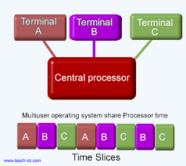
Examples of Time-Sharing OSs are: Multics, Unix etc.

Slide 25
Distributed operating systems
Distributed Operating System:
A distributed system is a system whose components are located on different networked computers, which communicate and coordinate their actions by passing messages to one another.
Various autonomous interconnected computers communicate each other using a shared communication network.
Independent systems possess their own memory unit and CPU. These are referred as loosely coupled systems or distributed systems.

Slide 26
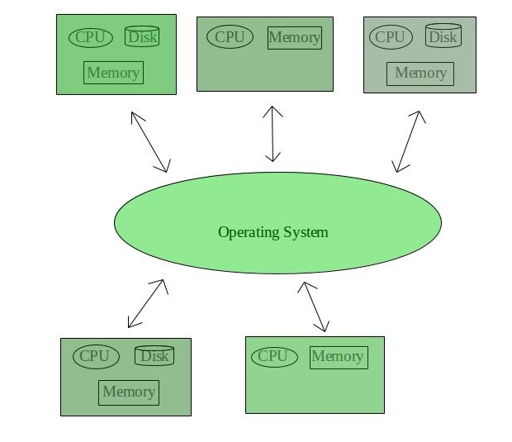
Distributed operating systems
Distributed Operating System:
Examples of Distributed Operating System are- LOCUS, AEGIS etc.

Slide 27
Network Operating System
Network Operating System :
an alternative explanation of an operating system entering the computer network that allows the sharing of content from one device to the other.
These type of operating systems allow shared access of files, printers, security, applications, and other networking functions over a small private network.
these computers are popularly known as tightly coupled systems

Slide 28
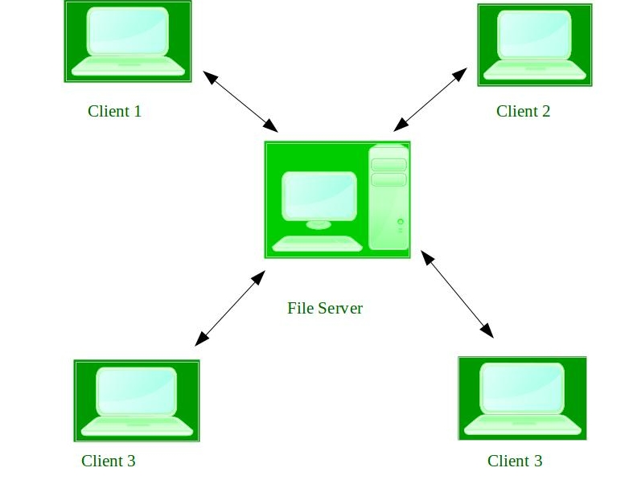
Types of operating systems
Network Operating System :
Examples of Network Operating System are: Microsoft Windows Server 2003, Microsoft Windows Server 2008, UNIX, Linux, Mac OS X, Novell NetWare, and BSD etc.

Slide 29
Mobile operating systems
Handheld smartphones, tablets, etc
What is the functional difference between them and a “traditional” laptop?
Extra feature – more OS features (GPS, gyroscope)
Allows new types of apps like augmented reality
Use IEEE 802.11 wireless, or cellular data networks for connectivity
Leaders are Apple iOS and Google Android

Slide 30
Embedded operating system
An embedded operating system is specialized for use in the computers built into larger systems, such as cars, traffic lights, digital televisions, ATMs, airplane controls, point of sale (POS) terminals, digital cameras, GPS navigation systems, elevators, digital media receivers and smart meters.

Slide 31
Types of operating systems
A real-time operating system (RTOS) is an operating system that guarantees a certain capability within a specified time constraint. For example, an operating system might be designed to ensure that a certain object was available for a robot on an assembly line.
Examples of Real-Time Operating Systems are:
Scientific experiments, medical imaging systems, industrial control systems, weapon systems, robots, air traffic control systems, etc.

Slide 32
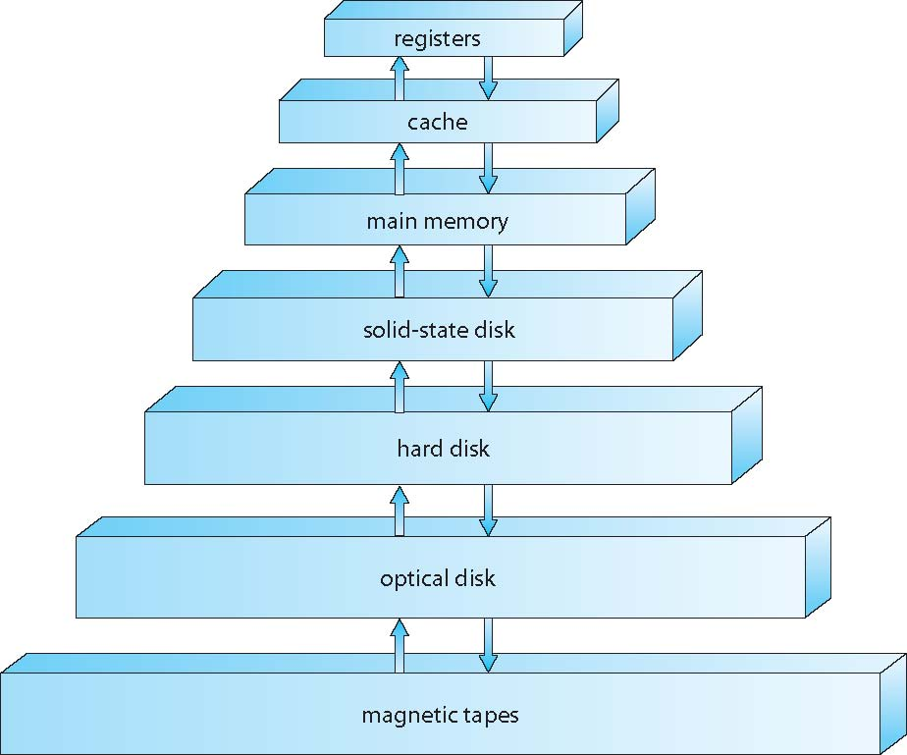
Storage-Device Hierarchy

Slide 33
Performance of Various Levels of Storage
Movement between levels of storage hierarchy can be explicit or implicit

Slide 34
Caching
Important principle, performed at many levels in a computer (in hardware, operating system, software)
Information in use copied from slower to faster storage temporarily
Faster storage (cache) checked first to determine if information is there
If it is, information used directly from the cache (fast)
If not, data copied to cache and used there

Slide 35
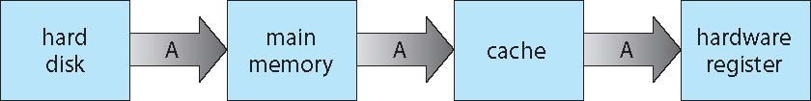
Migration of data “A” from Disk to Register
Multitasking environments must be careful to use most recent value, no matter where it is stored in the storage hierarchy
Multiprocessor environment must provide cache coherency in hardware such that all CPUs have the most recent value in their cache

Slide 36
Computer-System Architecture
Most systems use a single general-purpose processor
Most systems have special-purpose processors as well
Multiprocessors systems growing in use and importance
Also known as parallel systems, tightly-coupled systems
Advantages include:
Increased throughput
Economy of scale
Increased reliability – graceful degradation or fault tolerance
Two types:
Asymmetric Multiprocessing – each processor is assigned a specific task.
Symmetric Multiprocessing – each processor performs all tasks

Slide 37
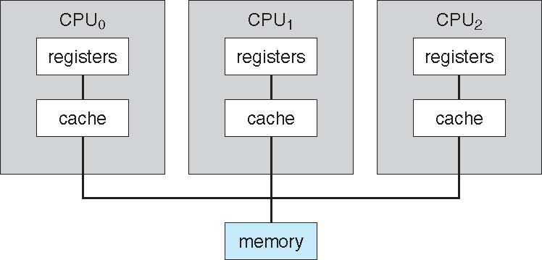
Symmetric Multiprocessing Architecture

Slide 38
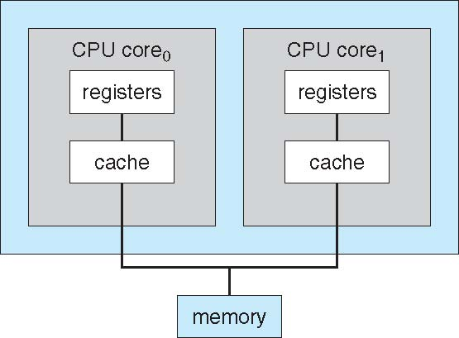
A Dual-Core Design
Multi-chip and multicore
Systems containing all chips
Chassis containing multiple separate systems

Slide 39
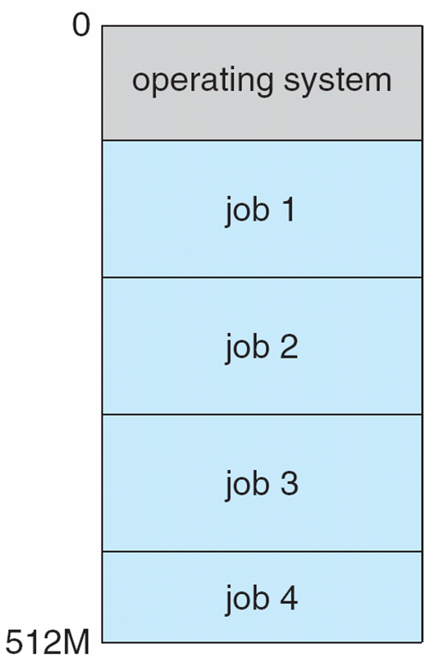
Memory Layout for Multiprogrammed System

Slide 40
Operating-System Operations
Dual-mode operation allows OS to protect itself and other system component
User mode and kernel mode
Mode bit provided by hardware
Provides ability to distinguish when system is running user code or kernel code
Some instructions designated as privileged, only executable in kernel mode
System call changes mode to kernel, return from call resets it to user

Slide 41
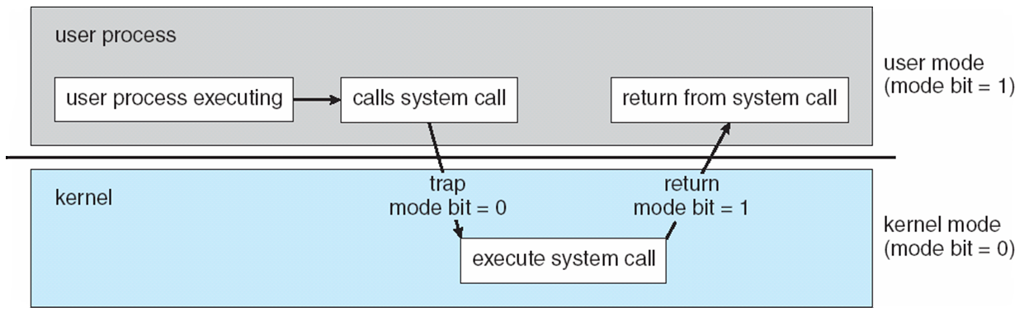
Transition from User to Kernel Mode
Figure: Dual mode operation

Slide 42
Open-Source Operating Systems
Operating systems made available in source-code format rather than just binary closed-source
Linux is the best-known and most-used open source operating system.
Started by Free Software Foundation (FSF), which has “copyleft” GNU Public License (GPL)
https://opensource.com/resources/linux

Slide 43
Open-Source Operating Systems
Ubuntu
Linux Lite
Fedora
Linux Mint
Solus. Source
Xubuntu
Chrome OS
React OS
(Source: https://blogs.systweak.com/8-best-open-source-operating-system/)

Slide 44

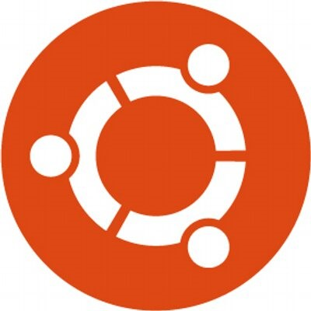





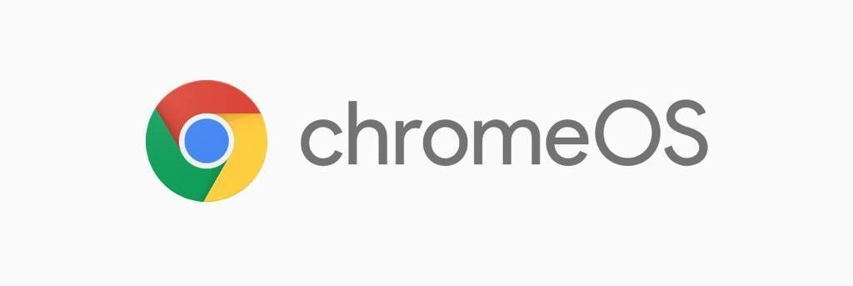

Slide 45
Computing Environments - Virtualization
Allows operating systems to run applications within other OSes
Vast and growing industry
Emulation used when source CPU type different from target type (i.e. PowerPC to Intel x86)
Generally slowest method
Virtualization – OS natively compiled for CPU, running guest OSes also natively compiled
Consider VMware running WinXP guests, each running applications, all on native WinXP host OS
VMM (virtual machine Manager) provides virtualization services

Slide 46
Computing Environments - Virtualization

