Slide 1
Cryptography and Network Security
Course Code: CSE 431
Lecture 1

Slide 2
Cryptography
Cryptography is the study of " Secret (crypto-) writing (-graphy)
Concerned with developing algorithms
Conceal the context of some message from all except
the sender and recipient (privacy or secrecy), and/or
Verify the correctness of a message to the recipient
(authentication)

Slide 3
Cryptography
The art or science encompassing the principles and
methods:
transforming an intelligible message into one that is unintelligible, and then
retransforming that message back to its original form

Slide 4
Key Terminologies:
Plaintext
The original intelligible message
Ciphertext
The transformed message
Cryptanalysis
The study of principles and methods of transforming an
unintelligible message back into an intelligible message
without knowledge of the key. Also called Codebreaking
Cryptology
Both cryptography and cryptanalysis
Code
An algorithm for transforming an intelligible message
into an unintelligible one using a code.

Slide 5
Key Terminologies:
Stream cipher
Encrypt a message a character at a time
Block cipher
Encrypt a message a chunk( large piece) at a time
Authentication
determine origin of message
Confidentiality
others cannot read contents of the message
Integrity
verify that message has not been modified
Nonrepudiation
sender should not be able to falsely deny that a message was sent

Slide 6
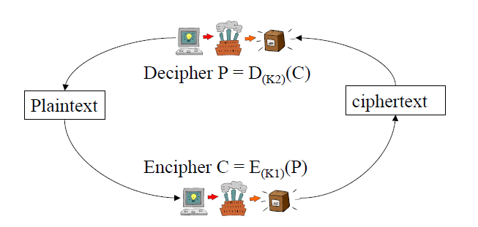
Plaintext Cipher text

Slide 7
Classical Cryptographic Techniques
Two basic components of classical ciphers:
Substitution: letters are replaced by other letters
Transposition: letters are arranged in a different order
These ciphers may be:
Monoalphabetic: only one substitution/ transposition is used, or
Polyalphabetic: where several substitutions/ transpositions are used
Product cipher:
several ciphers concatenated together

Slide 8
Symmetric Encryption
conventional / secrete-key / single-key
sender and recipient share a common key
all classical encryption algorithms are private-key

Slide 9
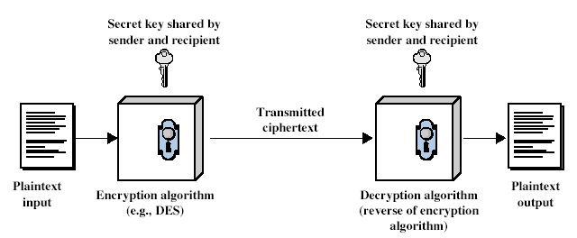
Symmetric Cipher Model

Slide 10
Symmetric Algorithm
Secret key
C = E_{K}(M )
M = D_{K}(C )

Slide 11
Public key algorithm
public key and private keys
C₁ = E_{public}(M )
M = D_{private}(C₁ )
also:
C₂ = E_{private}(M )
M = D_{public}(C₂ )

Slide 12
Cryptography
can be characterized by:
type of encryption operations used
substitution / transposition
number of keys used
single-key/two-key( private – public)
way in which plaintext is processed
block / stream

Slide 13
Caesar Cipher
earliest known substitution cipher by Julius Caesar
first attested use in military affairs
replaces each letter by 3rd letter on
Example:
meet me after the toga party
PHHW PH DIWHU WKH WRJD SDUWB

Slide 14
Cryptanalysis of Caesar Cipher
only have 26 possible ciphers
A maps to A,B,..Z
could simply try each in turn
a brute force search - given ciphertext, just try all shifts of letters

Slide 15
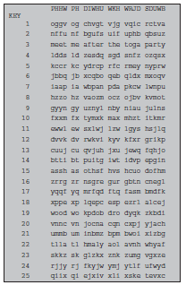
Brute-Force Cryptanalysis of Caesar Cipher

Slide 16
Caesar cipher
A
B
C
D
E
F
G
H
I
J
K
L
M
N
O
P
Q
R
S
T
U
V
W
X
Y
Z
U
V
W
X
Y
Z
A
B
C
D
E
F
G
H
I
J
K
L
M
N
O
P
Q
R
S
T
shift alphabet by n (6)

Slide 17
Caesar cipher
MY CAT HAS FLEAS
A
B
C
D
E
F
G
H
I
J
K
L
M
N
O
P
Q
R
S
T
U
V
W
X
Y
Z
U
V
W
X
Y
Z
A
B
C
D
E
F
G
H
I
J
K
L
M
N
O
P
Q
R
S
T

Slide 18
Caesar cipher
MY CAT HAS FLEAS
A
B
C
D
E
F
G
H
I
J
K
L
M
N
O
P
Q
R
S
T
U
V
W
X
Y
Z
U
V
W
X
Y
Z
A
B
C
D
E
F
G
H
I
J
K
L
M
N
O
P
Q
R
S
T
G

Slide 19
Caesar cipher
MY CAT HAS FLEAS
A
B
C
D
E
F
G
H
I
J
K
L
M
N
O
P
Q
R
S
T
U
V
W
X
Y
Z
U
V
W
X
Y
Z
A
B
C
D
E
F
G
H
I
J
K
L
M
N
O
P
Q
R
S
T
GS

Slide 20
Caesar cipher
MY CAT HAS FLEAS
A
B
C
D
E
F
G
H
I
J
K
L
M
N
O
P
Q
R
S
T
U
V
W
X
Y
Z
U
V
W
X
Y
Z
A
B
C
D
E
F
G
H
I
J
K
L
M
N
O
P
Q
R
S
T
GSW

Slide 21
Caesar cipher
MY CAT HAS FLEAS
A
B
C
D
E
F
G
H
I
J
K
L
M
N
O
P
Q
R
S
T
U
V
W
X
Y
Z
U
V
W
X
Y
Z
A
B
C
D
E
F
G
H
I
J
K
L
M
N
O
P
Q
R
S
T
GSWU

Slide 22
Caesar cipher
MY CAT HAS FLEAS
A
B
C
D
E
F
G
H
I
J
K
L
M
N
O
P
Q
R
S
T
U
V
W
X
Y
Z
U
V
W
X
Y
Z
A
B
C
D
E
F
G
H
I
J
K
L
M
N
O
P
Q
R
S
T
GSWUN

Slide 23
Caesar cipher
MY CAT HAS FLEAS
A
B
C
D
E
F
G
H
I
J
K
L
M
N
O
P
Q
R
S
T
U
V
W
X
Y
Z
U
V
W
X
Y
Z
A
B
C
D
E
F
G
H
I
J
K
L
M
N
O
P
Q
R
S
T
GSWUNB

Slide 24
Caesar cipher
MY CAT HAS FLEAS
A
B
C
D
E
F
G
H
I
J
K
L
M
N
O
P
Q
R
S
T
U
V
W
X
Y
Z
U
V
W
X
Y
Z
A
B
C
D
E
F
G
H
I
J
K
L
M
N
O
P
Q
R
S
T
GSWUNBU

Slide 25
Caesar cipher
MY CAT HAS FLEAS
A
B
C
D
E
F
G
H
I
J
K
L
M
N
O
P
Q
R
S
T
U
V
W
X
Y
Z
U
V
W
X
Y
Z
A
B
C
D
E
F
G
H
I
J
K
L
M
N
O
P
Q
R
S
T
GSWUNBUM

Slide 26
Caesar cipher
MY CAT HAS FLEAS
A
B
C
D
E
F
G
H
I
J
K
L
M
N
O
P
Q
R
S
T
U
V
W
X
Y
Z
U
V
W
X
Y
Z
A
B
C
D
E
F
G
H
I
J
K
L
M
N
O
P
Q
R
S
T
GSWUNBUMZ

Slide 27
Caesar cipher
MY CAT HAS FLEAS
A
B
C
D
E
F
G
H
I
J
K
L
M
N
O
P
Q
R
S
T
U
V
W
X
Y
Z
U
V
W
X
Y
Z
A
B
C
D
E
F
G
H
I
J
K
L
M
N
O
P
Q
R
S
T
GSWUNBUMZF

Slide 28
Caesar cipher
MY CAT HAS FLEAS
A
B
C
D
E
F
G
H
I
J
K
L
M
N
O
P
Q
R
S
T
U
V
W
X
Y
Z
U
V
W
X
Y
Z
A
B
C
D
E
F
G
H
I
J
K
L
M
N
O
P
Q
R
S
T
GSWUNBUMZFY

Slide 29
Caesar cipher
MY CAT HAS FLEAS
A
B
C
D
E
F
G
H
I
J
K
L
M
N
O
P
Q
R
S
T
U
V
W
X
Y
Z
U
V
W
X
Y
Z
A
B
C
D
E
F
G
H
I
J
K
L
M
N
O
P
Q
R
S
T
GSWUNBUMZFYU

Slide 30
Caesar cipher
MY CAT HAS FLEAS
A
B
C
D
E
F
G
H
I
J
K
L
M
N
O
P
Q
R
S
T
U
V
W
X
Y
Z
U
V
W
X
Y
Z
A
B
C
D
E
F
G
H
I
J
K
L
M
N
O
P
Q
R
S
T
GSWUNBMUFZYUM

