Slide 1
Lecture 6 Stored procedures

Slide 2
Stored Procedure
Stored procedure is a named collection of SQL statements and procedural logic.
Or
A stored procedure is group of T-SQL (Transact SQL) statements. If you have a situation, where you write the same query over and over again, you can save that specific query as a stored procedure and call it just by it's name.
There are mainly two types of stored procedure
System stored procedure
System stored procedure starts with sp_
Like sp_helptext
User defined stored procedure
N.B. Its prohibited to use sp_ as prefix in user defined stored procedure
Notes:
1

Slide 3
Procedural Extensions and Stored Procedures
SQL provides a module language
Permits definition of procedures in SQL, with if-then-else statements, for and while loops, etc.
Stored Procedures
Can store procedures in the database
then execute them using the call statement
permit external applications to operate on the database without knowing about internal details.

Slide 4
Advantage of Stored Procedure
Its pre-compiled that reduce the execution time.
Reduce network traffic.
Better security and avoid sql injection attack.

Slide 5
Store Procedure Syntax
To create store procedure the syntax is
Create Proc procName
As
Begin
( body part )
End
N.B. We can use proc or procedure as a keyword
And to execute the procedure
Exec procName
N.B. or we can simply write the procedure name

Slide 6
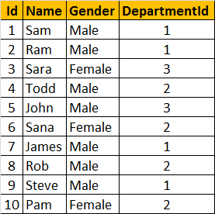
Store Procedure Example
Suppose we want to write a stored procedure that will return name and gender from tblemployee table
Create Proc spGetEmployee
As
Begin
select name, gender from tblemployee
End
Now to run the stored procedure we will write
Exec spGetEmployee
Table: tblemployee

Slide 7
To execute the stored procedure
To run this procedure use EXEC or EXECUTE keywords followed by the procedure name as shown below.
spGetEmployees
EXEC spGetEmployees
EXECUTE spGetEmployees
Note: When naming user defined stored procedures, Microsoft recommends not to use "sp_" as a prefix.
All system stored procedures, are prefixed with "sp_".
This avoids any ambiguity between user defined and system stored procedures and any conflicts, with some future system procedure.

Slide 8
Stored Procedure with Parameters
Now we want to create a store procedure that will have two parameter Gender and DeptId
Create Proc getEmployeeByGenderAndDepartmentId
@Gender varchar(10),
@DepartmentId int
As
Begin
select name, gender, departmentId from tblemployee
where gender= @Gender and departmentId= @DepartmentId
End

Slide 9
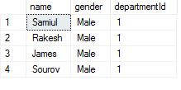
Stored Procedure with Parameters Cntd….
Now to execute this procedure we need to write as follow
Exec getEmployeeByGenderAndDepartmentId 'Male',1
But the following statement is wrong
Exec getEmployeeByGenderAndDepartmentId 1, 'Male‘
Another way to do the task
Exec getEmployeeByGenderAndDepartmentId @DepartmentId=1,@gender='male'

Slide 10
View Stored Procedure
To view the stored procedure we need to write
Sp_helptext procName
For the tblEmployee table
Sp_helptext getEmployeeByGenderAndDepartmentId

Slide 11
Alter & Drop Procedure
Suppose we want to see the name of the employee in ascending order
Now to do the change we need to alter the procedure
Alter Proc spGetEmployee
As
Begin
select name, gender from tblemployee order by name
End
To drop any procedure the syntax is
Drop proc procName
For our example
Drop proc spGetEmployee

Slide 12
Encrypt Stored Procedure
For security issue encryption is required .The format of encryption is
Alter Proc getEmployeeByGenderAndDepartmentId
@Gender varchar(10),
@DepartmentId int
with Encryption
As
Begin
select name,gender,departmentId from tblemployee where gender= @Gender and departmentId= @DepartmentId
End
N.B:If we use this Encryption we cannot modify or newly show create procedure.

Slide 13
Characteristics of Encrypted Stored Procedure
When a procedure is encrypted we can only use it.
It is not possible to view the text of the procedure
because it is encrypted or locked.
But encrypted procedure can be deleted in a formal way.

Slide 14
Stored Procedure with output parameter
We use the keywords OUT or OUTPUT.
@EmployeeCount is an OUTPUT parameter. Notice, it is specified with OUTPUT keyword.
Create Procedure spGetEmployeeCountByGender
@Gender nvarchar(20),
@EmployeeCount int Output
as
Begin
Select @EmployeeCount = COUNT(Id) from tblEmployee where Gender = @Gender
End

Slide 15
Execute stored procedure with OUTPUT parameter
First initialize a variable of the same data type as that of the output parameter.
We have declared @EmployeeTotal integer variable.
Then pass the @EmployeeTotal variable to the stored procedure .
To specify the OUTPUT keyword.
If don't specify the OUTPUT keyword, the variable will be NULL.
Execute
Declare @EmployeeTotal int
Execute spGetEmployeeCountByGender 'Female', @EmployeeTotal output
Print @EmployeeTotal

Slide 16
Check Validation in OUTPUT parameter
If you don't specify the OUTPUT keyword, when executing the stored procedure, the @EmployeeTotal variable will be NULL.
Here, we have not specified OUTPUT keyword. When you execute, you will see '@EmployeeTotal is null' printed.
Declare @EmployeeTotal int
Exec spGetTeacherCountByDept 'CSE', @EmployeeTotal
if (@EmployeeTotal is null)
print '@EmployeeTotal is null'
else
print '@EmployeeTotal is not null'
print @EmployeeTotal
Output is:
@EmployeeTotal is null

Slide 17
Check Validation in OUTPUT parameter
Here, we have specified OUTPUT keyword. When you execute, you will see '@EmployeeTotal is not null' printed.
Declare @EmployeeTotal int
Exec spGetTeacherCountByDept 'CSE', @EmployeeTotal output
if (@EmployeeTotal is null)
print '@EmployeeTotal is null'
else
print '@EmployeeTotal is not null'
print @EmployeeTotal
Output is:
@EmployeeTotal is null

Slide 18
The following procedure returns total number of employees in the Employees table, using output parameter - @TotalCount.
Create Procedure spGetTotalCountOfEmployees1
@TotalCount int output
as
Begin
Select @TotalCount = COUNT(ID) from tblEmployee
End
Executing spGetTotalCountOfEmployees1 returns 3.
Declare @TotalEmployees int
Execute spGetTotalCountOfEmployees @TotalEmployees Output
Select @TotalEmployees

Slide 19
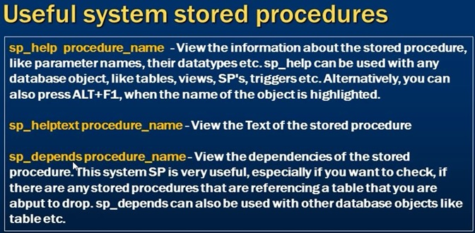

Slide 20
Re-written stored procedure using return variables
Create Procedure SpGetTotalCountOfEmployees2
as
Begin
return (Select COUNT(ID) from Employees)
End
Executing spGetTotalCountOfEmployees2 returns 3.
Declare @TotalEmployees int
Execute @TotalEmployees = spGetTotalCountOfEmployees2
Select @TotalEmployees

Slide 21
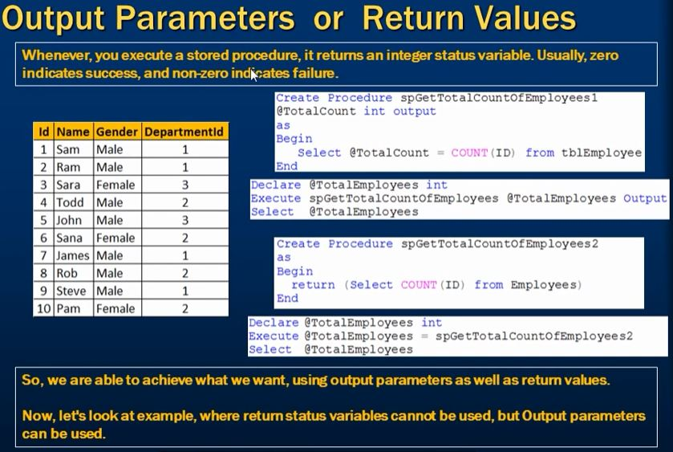

Slide 22

Difference between Return value & output parameters

Slide 23
END

