Slide 1
Database Management System

Slide 2
What is DBMS?
collection of related data
easier to retrieve,
manipulate
produce information.

Slide 3
Database Applications:
Banking: transactions
Airlines: reservations, schedules
Universities: registration, grades
Sales: customers, products, purchases

Slide 4
Database Applications:
Online retailers: order tracking, customized recommendations
Manufacturing: production, inventory, orders, supply chain
Human resources: employee records, salaries, tax deductions

Slide 5
Characteristics of Modern DBMS
Real-world entity
Relation-based tables
Isolation of data and application
Less redundancy
Consistency

Slide 6
Query Language
ACID (Atomicity, consistency, isolation, durability) Properties
Multiuser and Concurrent Access
Multiple views
Security

Slide 7
Levels of Abstraction
Physical level
Logical level
View level

Slide 8
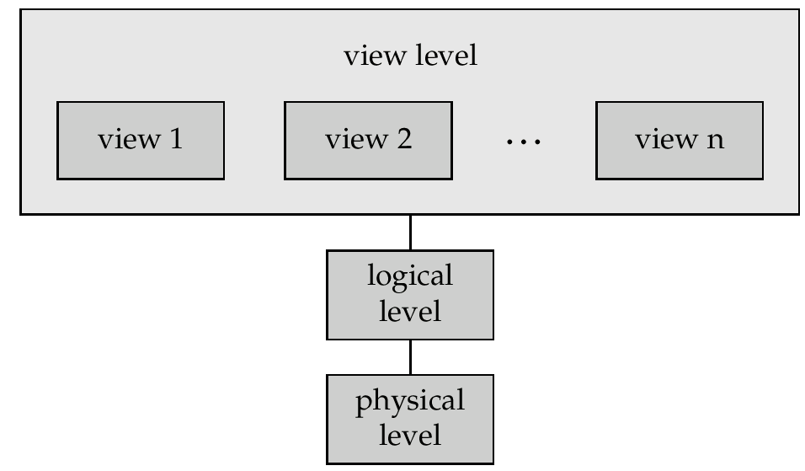
View of Data:

Slide 9
Schemas and Instances
Schema
Physical schema
Logical schema
Instance

Slide 10
Data Models
Entity-Relationship model
Relational model
object-oriented model
semi-structured data model

Slide 11
Entity Relationship Model
Entities (objects)
E.g. customers, accounts, bank branch
Relationships between entities
E.g. Account A-101 is held by customer Johnson

Slide 12
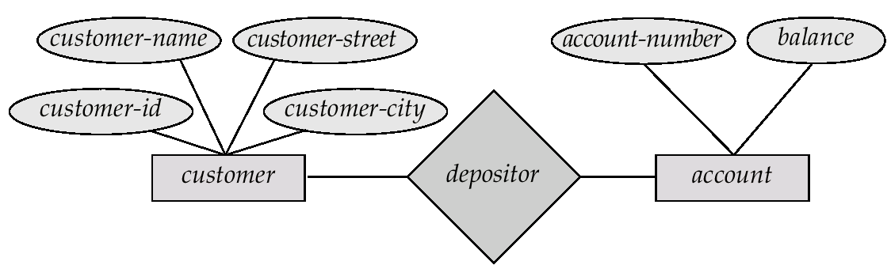

Slide 13
SQL LANGUAGE TYPES
DDL
DML
DQL
TCL
DCL

Slide 14
Data Definition Language (DDL)
DDL changes the structure of the table like creating a table, deleting a table, altering a table, etc.
CREATE
ALTER
DROP
TRUNCATE
All the command of DDL are auto-committed that means it permanently save all the changes in the database.

Slide 15
Data Definition Language (DDL)
CREATE TABLE EMPLOYEE(Name VARCHAR2(20), Email VARCHAR2(100), DOB DATE);
DROP TABLE EMPLOYEE;
ALTER TABLE STU_DETAILS ADD(ADDRESS VARCHAR2(20));
ALTER TABLE STU_DETAILS MODIFY (NAME VARCHAR2(20));
TRUNCATE TABLE EMPLOYEE;

Slide 16
Data Manipulation Language
DML commands are used to modify the database. It is responsible for all form of changes in the database.
INSERT
UPDATE
DELETE
The command of DML is not auto-committed that means it can't permanently save all the changes in the database. They can be rollback.

Slide 17
Data Manipulation Language
INSERT INTO LIBRARY (Author, Subject) VALUES (“MC. LOREN", "DBMS");
UPDATE students SET User_Name = 'Sonoo' WHERE Student_Id = '3'
DELETE FROM LIBRARY WHERE Author=" MC. LOREN";

Slide 18
Data Query Language
DQL is used to fetch the data from the database.
SELECT
EXAMPLE
SELECT emp_name
FROM employee
WHERE age > 20;

Slide 19
Transaction Control Language
TCL commands can only use with DML commands like INSERT, DELETE and UPDATE only.
COMMIT - to save all the transactions to the database
ROLLBACK - to undo transactions that have not already been saved to the database
These operations are automatically committed in the database that's why they cannot be used while creating tables or dropping them.

Slide 20
Transaction Control Language
Commit command is used to save all the transactions to the database.
DELETE FROM CUSTOMERS
WHERE AGE = 25;
COMMIT;
Rollback command is used to undo transactions that have not already been saved to the database.
DELETE FROM CUSTOMERS
WHERE AGE = 25;
ROLLBACK;

Slide 21
HAVE A LOOK
https://stackoverflow.com/questions/139630/whats-the-difference-between-truncate-and-delete-in-sql

Slide 22
Data Control Language
DCL commands are used to grant and take back authority from any database user
Grant
Revoke
GRANT SELECT, UPDATE ON MY_TABLE TO USER1, USER2;
REVOKE SELECT, UPDATE ON MY_TABLE FROM USER1, USER2;

