Slide 1
CV RESEARCH-REPRODUCTION PROJECT · FINAL REVIEW
Reproducing Transfer-Learning Diabetic Retinopathy Grading on APTOS 2019
Ordinal regression, imbalance-aware losses and a strict-protocol gap analysis
Base paper: Chilukoti et al., BMC Medical Informatics and Decision Making 24:37 (2024)
Shivansh · Divyanshi · Vivek · Shubham
github.com/sshivanshg/dr-grading-reproduction
Notes:
Final review. One sentence: the paper's 0.954 does not reproduce on a clean split; our best strict model is 0.918, and ordinal regression is the one change that consistently helped.

Slide 2
All six phases are complete
ROADMAP
1
2
3
4
5
6
Literature survey
Pick base paper
Reproduce
Hypothesis
Implement & ablate
Analyse & write
10+ papers, 5 gaps
Reproducibility checklist
0.82 → 0.90, gap explained
Ordinal regression, 8 predictions
4 arms × 3 seeds + focal, CB-ordinal
IEEE paper + defence
Research question (Phase 1)
How we worked
Can class-balanced, ordinal-aware learning improve Severe NPDR and PDR recognition while reducing clinically large grading errors?
Predictions written down before every stage's runs
Test set (550 images) never used for a decision
Every prediction reported as it fell, including failures
No clinical claims

Slide 3
A strong claim with no code and unstated details
STAGE 2 · BASE PAPER
Fundus image
→
CLAHE + blur
→
EfficientNet-B3
→
3-layer head
→
Snapshot vote
0.954
Not stated in the paper
Red flags we noted first
APTOS split and test size
Batch size and epochs
Loss function
CLAHE parameters
Final or best checkpoint
Precision = recall = QWK = 0.867 exactly (Table 3)
Constant predictors with macro AUC 0.196 (should be 0.5)
EyePACS confusion matrices do not give the printed QWKs
Reported QWK on APTOS 2019 (ImageNet init, single model)

Slide 4
Paper recipe: 0.82. Lower lr + augmentation: 0.90
STAGE 3 · RESULTS
What we learned
At lr 1e-3 validation QWK keeps collapsing; Severe NPDR is never predicted
The snapshot vote hurts when training is unstable
Weighted CE: Severe recall 0.28 → 0.48, QWK unchanged
Ranks well (AUC 0.94), decides poorly (macro-F1 0.65)
123 duplicate groups, 30 with conflicting grades; leakage ≤ 0.007 QWK

Slide 5
Treat the grade as a number, not five unrelated classes
STAGE 4 · HYPOTHESIS
Cross-entropy (baseline)
Ablation: one model, four decision rules
Calling a Severe eye “No DR” costs the same as calling it “PDR”. QWK, and the clinic, see these very differently.
 | Default rule | Tuned cut-offs
Cross-entropy | A (vote, baseline) | B
MSE (ordinal) | C (rounding) | D (hypothesis)
Ordinal regression (hypothesis)
3 seeds + one de-duplicated pair
8 predictions written before any run
Paired bootstrap on the same 550 test images
One output, mean-squared error against the grade: an error of d grades costs d², like QWK. Four cut-offs tuned on validation turn the score into a grade.

Slide 6
Ordinal + tuned cut-offs is the best Stage 4 arm
STAGE 4 · RESULTS
Arm (ensemble) | QWK | Severe | PDR | Errors ≥ 2 | Ref. sens / spec
A: CE, vote | 0.897 ± .004 | 0.28 | 0.61 | 21.7 | .946 / .904
B: CE, tuned | 0.907 ± .007 | 0.44 | 0.57 | 15.7 | .982 / .879
C: MSE, rounding | 0.896 ± .001 | 0.47 | 0.17 | 17.0 | .900 / .948
D: MSE, tuned | 0.914 ± .004 | 0.40 | 0.58 | 16.0 | .963 / .909
+0.016
QWK, D over A (mean of 3 seeds)
−26%
Mean ± std over seeds 42–44, 10-snapshot ensemble, 550 test images
Errors of ≥ 2 grades (21.7 → 16.0)
The trade-off
+12.6
D makes fewer far errors and more one-grade errors: accuracy falls 0.828 → 0.804 while QWK rises. For screening that means more referrals: sensitivity 0.946 → 0.963 at the same specificity.
points of Severe recall (0.28 → 0.40)

Slide 7
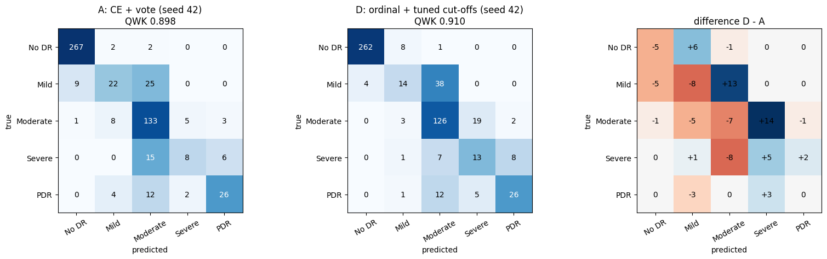
Neither the loss nor the cut-offs work alone
STAGE 4 · ABLATION
Ordinal + rounding ties the baseline
C − A = −0.001. Outputs shrink to the mean grade, so PDR recall drops to 0.17.
Tuned cut-offs undo the shrinkage
D − C = +0.018 [+0.007, +0.029]; the top cut-off moves down by about 0.6 grades.
Seed 42: A vs D and their difference (blue = more images in D)
The loss matters, not the vote
Soft-vote control: A_soft ties A; D − A_soft = +0.015 [+0.002, +0.030].
Why rounding fails
Squared error on imbalanced, noisy labels pulls predictions towards the mean grade (about 1.1). Tuned cut-offs [0.3, 1.3, 2.3, 2.9] vs rounding [0.5, 1.5, 2.5, 3.5].
Only in the ensemble
As single models all arms tie at about 0.90.

Slide 8
5 of 8 predictions held; the main one did not
STAGE 4 · PREDICTION CHECK
# | Prediction (written before the runs) | Observed | Held?
P1 | QWK +0.01 to +0.03, CI excludes 0 in ≥ 2 of 3 seeds | +0.016; 1 of 3 seeds | No
P2 | Errors ≥ 2 grades fall by ≥ 25% | 21.7 → 16.0 (−26%) | Yes
P3 | Severe recall +10 points or more | +12.6 | Yes
P4 | Risk: PDR recall falls | 0.61 → 0.58 | Yes
P5 | Referable AUC changes ≤ 0.01 | 0.979 → 0.984 | Yes
P6 | Decision rule alone < half the gain | +0.009 vs +0.016 | No
P7 | Ordinal beats baseline even with rounding | −0.001 | No
P8 | Same sign on de-duplicated data | +0.010 | Yes
Why P1 failed
Right size and direction in every seed, but the test set (29 Severe images) is too small for a +0.016 effect to clear our own significance bar.

Slide 9
With tuned cut-offs, every loss lands at 0.907–0.914
STAGE 4E · FOCAL LOSS AND CLASS-BALANCED ORDINAL
Arm (ensemble, post-test) | QWK | Severe | PDR | Errors ≥ 2
A: CE, vote | 0.897 | 0.28 | 0.61 | 21.7
B: CE, tuned | 0.907 | 0.44 | 0.57 | 15.7
E: focal, vote | 0.901 | 0.24 | 0.58 | 21.0
E: focal, tuned | 0.911 | 0.54 | 0.53 | 10.0
C: MSE, rounding | 0.896 | 0.47 | 0.17 | 17.0
D: MSE, tuned | 0.914 | 0.40 | 0.58 | 16.0
F: CB-MSE, rounding | 0.888 | 0.45 | 0.22 | 18.0
F: CB-MSE, tuned | 0.908 | 0.46 | 0.55 | 16.0
Focal loss
−(1 − pₜ)^γ · log pₜ, γ = 2, no α. Confident, easy images (mostly No DR) contribute almost nothing.
Class-balanced ordinal
Squared error weighted by 1/√(class size): 0.69 for No DR up to 2.12 for Severe (the Stage 3 weighted-CE weights).
Same split, seeds, recipe and decision rules as Stage 4; only the loss changes. Run after the test set was opened, so these numbers drive no choice.

Slide 10
Focal adds nothing; class balancing helps in one seed only
STAGE 4E · PREDICTION CHECK
# | Prediction (fixed before the runs) | Observed | Held?
Q1 | Focal does not change QWK under the same rule | E vote − A +0.004; E tuned − B +0.004 | Yes
Q2 | Focal raises Severe recall under the vote by ≥ 0.05 | 0.276 → 0.241 | No
Q3 | Ordinal still beats focal (D > E tuned) | D − E tuned +0.003, CI includes 0 | Yes*
Q4 | Class balancing raises Severe recall on top of ordinal by ≥ 0.05 | 0.402 → 0.460 (by seed 0 / +0.17 / 0) | Yes*
Q5 | Class balancing costs no QWK (|F tuned − D| < 0.01) | F tuned − D −0.006 | Yes
Q6 | Errors ≥ 2 grades do not rise by more than 10% | 16.0 → 16.0 | Yes
Q7 | Class balancing lifts PDR recall under rounding by ≥ 0.15 | 0.167 → 0.220 | No
Q8 | Sanity: Kaggle controls within 0.015 of Colab (A, D) | A +0.011; D −0.002 | Yes
Answer to our Phase 1 question
By our pre-set rule (Q4 and Q5 hold), class-balanced ordinal helps Severe NPDR: recall 0.40 → 0.46 at −0.006 QWK.
But the gain is 5 images in 1 of 3 seeds, and referable sensitivity drops (0.963 → 0.943).
We keep D: ordinal + tuned cut-offs.
* weak: see the Observed column.

Slide 11
Every lever we could validate stops at 0.918
STAGES 4B–4D · STRICT PROTOCOL
Adopted on validation (5-fold CV)
lr 3e-4, strong augmentation, label cleaning
Ben Graham pre-processing
Noisy-Student B4, 380–512 px, 5-fold ensembles
Did not help
ConvNeXt-T, SE-ResNeXt50 (diversity)
EyePACS pre-training, at any fine-tune lr (4d)
Best strict result: 0.918 [0.900, 0.935]

Slide 12
Test-set selection reaches 0.928, not 0.954
GAP ANALYSIS
0.928
0.83
0.93
Best we can reach by choosing members and cut-offs on the test set (not a result)
Highest accuracy of any model here, vs the paper's 0.942
Published ceiling for careful ImageNet-only APTOS results (Fang 2023, nnMobileNet, SSiT)
What is left
Duplicate leakage, snapshot choice, cut-offs on test and a lucky split together add at most about 0.02–0.03, and none moves accuracy
Every remaining strict lever is estimated at ≤ +0.004 OOF, below what 550 test images can detect (0.007–0.018)
Remaining explanations: a reporting error (the paper's own tables fail their arithmetic) or a test set overlapping training

Slide 13
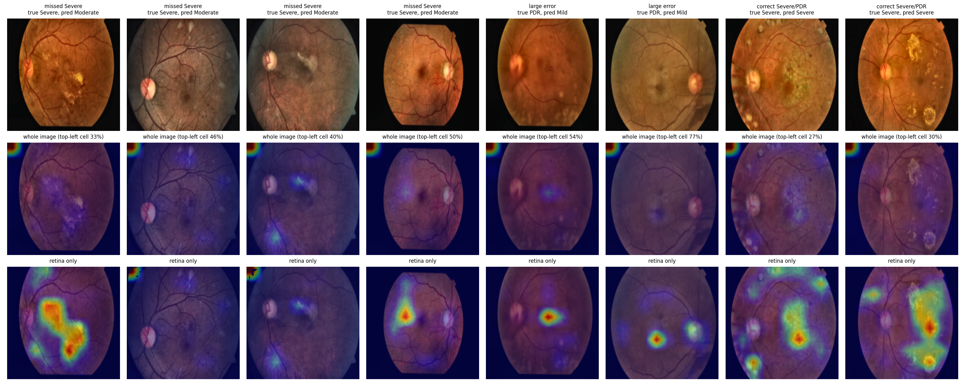
Errors follow label noise, blur and adjacent grades
FAILURE ANALYSIS · ARM D, SEED 42
Label noise sets a floor
6 of 7 test images with conflicting duplicate labels are wrong in both A and D (86% vs 16–19%).
Blurry and darker photos
Misgraded images: median sharpness 50.9 vs 62.8 (p = 0.0005); brightness 87.8 vs 92.9 (p = 0.046).
Saliency needs a sanity check
B3 pads only the top-left at 300 px; that cell holds 27–77% of each raw map. Masking to the retina removes it in 6 of 8.
Grad-CAM: whole image (middle) vs retina only (bottom)

Slide 14
What these results do not show
LIMITATIONS
One dataset, one split
Small rare classes
No external validation; 3 seeds; bootstrap covers test-set noise only
29 Severe and 44 PDR test images: one image = 3.4 points of Severe recall
Assumed details
Post-test stages
The paper's split, batch size, loss and CLAHE settings were our choices
Stages 4d and 4e ran after the test set was opened; reported, never used to choose
EyePACS out of scope
No clinical claims
Only 5 epochs of pre-training tried, so the paper's 0.967 is untested
Agreement with one grader on a curated competition set says nothing about screening

Slide 15
Summary
TAKE-AWAYS
1
The paper's recipe gives 0.82, not 0.954
Re-implemented from the text; lr 1e-4 + augmentation reach 0.90.
2
Ordinal regression helps, in the ensemble
+0.016 QWK, −26% far errors, +13 points Severe recall; P1 not significant.
3
Tuned cut-offs matter more than the loss
Focal ties CE; class-balanced ordinal adds Severe recall only in one seed. Every tuned arm: 0.907–0.914; every vote/rounding arm: 0.888–0.903.
4
Best strict model: 0.918 [0.900, 0.935]
At the published ceiling; the gap to 0.954, and 94% accuracy, is not explained by any protocol choice we could measure.
Code, plans, raw outputs, paper: github.com/sshivanshg/dr-grading-reproduction Questions?

