Slide 1
CRIME PREDICTION BASED ON CRIME TYPES AND USING SPATIAL AND TEMPORAL CRIMINAL HOTSPOTS
Group Number: 16
Domain: Crime
Team Members:
Devyani Deshmukh
Shivanvitha Konda
Sneha Alkuru
Vaishnavi Kankanala

Slide 2




Team Members
Devyani Deshmukh
Sneha Alkuru
Shivanvitha Konda
Vaishnavi Kankanala

Slide 3
Outline
Abstract
Introduction
Problem Statement (Outcomes)
Related work
Datasets
Methodologies
Data analysis
Project Outcomes
Model Building
References
Questions

Slide 4
Abstract
Analyzing dataset for two different real world crime datasets for Denver and Los Angeles.
Statistical analysis is used to compare two different datasets.
Authors conducted apriori algorithm approach to produce frequent patterns for criminal hotspots.
To find the factors that might affect the neighborhood safety the paper combines the demographic information with Denver crimes’ datasets.
The results are used to create awareness among the people to locate danger prone areas and predict future crimes in a future location at specific time.

Slide 5
Introduction
Keywords: Data mining, crime classification, crime frequent patterns, etc.
Crimes affect social quality of life.
Crimes affect the economic growth of society.
Crime is an important aspect in lives of people to determine to move to crime prone areas or not.
With the increase of crimes law enforcement agencies are demanding advanced geographic studies and data mining to improve results to protect communities.

Slide 6
Introduction Contd..
Although crimes can occur anywhere it is common that criminals work on opportunities they face in most familiar areas for them
By using data mining approach to determine the crime type and crime prone areas people’s awareness is increased in particular zone and at particular time.
People can stay away from that zone at that time according to the proposed analyzation of data.
Also police force can use this solution to increase the level of crime prediction and prevention.
Help even distribution of police force.

Slide 7
Problem Statement
The authors aim to find spatial and temporal criminal hotspots using the real world datasets.
They are trying to locate the most likely crime locations and their frequent occurrence time.
Also, they will predict what type of crime might occur next in a specific location within a particular time.
Finally, the authors aim to provide an analysis study by combining findings of a particular crimes dataset with its demographic information.

Slide 8
Related Work
There are several maps applications that show the exact crime location along with the crime type for any given city
Even though crime locations have been identified none of previous work consider the three elements location, time, crime type together
There is no information available that includes the crime occurrence date and time
There is very little research that can accurately predict where crimes will happen in the future
Provide a data-mining model for crime prediction based on crime types and using spatial and temporal criminal hotspots

Slide 9
Datasets
Denver Crimes Dataset
Offense_Category_id
First_occurrence_date
Neighbourhood_id
Is_crime
Los Angeles Crimes Dataset
Crm cd desc
Date occ
Time occ
Area Name

Slide 10
Datasets
Denver Neighborhood Demographics Dataset
Gender
Race
Age
Family size
Housing units
Number of occupied and vacant units and
Number of rental and owned units

Slide 11
Methodology
Finding relationships between crime elements is highly important in order to predict the crime probability.
Our proposed approach concentrates on three elements
what are the types of crime
The occurrence time
Crime location
Notes:
1.Realtionship between the crime elements is very important in order to predict hotspot of crime in future.
2.In this paper we concentrate more on 3 elements like Which are the type of crime, crime date and crime location
3.Applying some classification methods we extracted some interesting patterns based on variables and also predict potential crime type in specific location at particular time.

Slide 12
Data Preprocessing
We performed the following pre-processing steps on two data sets.
Data cleaning:
No key attributes missing
No noisy and inconsistent values
Data reduction:
Selection of attributes
removing instances that are not relevant
Notes:
Data cleaning: There are some missing values in some attributes such as last_occurance_date and incident_address in Denver dataset. But all of them are not key attributes so no data cleaning is necessary. Also there is no noisy and inconsistent values in dataset.
Data reduction: For both crime datasets, we needed to apply data reduction. For example, among the available 19 attributes in Denver crimes dataset, we just selected four of them. On the other hand, we performed data reduction in terms of number of instances. We observed that Denver crimes dataset contained a set of traffic accident instances. The attribute “Is_Crime” indicates whether the instance belongs to a crime or accident. While we concern with crime information, we used the attribute “Is_Crime” to filter the instances and remove all the irrelevant ones.

Slide 13
Data Preprocessing
Data integration:
Avoid different attribute naming
Our mining study requires analyzing the date and time info on different granularities.
we initiated Crime_Type_Id attribute to give an id for each of the 14 crime categories
Data transformation and Data Discretization:
Our goal was to get more frequent patterns and to increase the model accuracy.
Notes:
Data integration: We performed several steps of data integration for our datasets. First, to avoid different attributenaming, we unified the key attribute names for both crime datasets as follow: Crime_Type,Crime_Date, and Crime_Location. Therefore, we used the Crime_Date attribute, which contains date and time crime info, to generate three more attributes: Crime_Month, Crime_Day, and Crime_Time. we initiated Crime_Type_Id attribute to give an id for each of the 14 crime categories for both datasets to get integrated crime types.
Data transformation and data discretization: we applied data transformation to both attributes by mapping their values to fall within smaller groups.

Slide 14
Data Analysis
To analyze and to get the big view of our data we conducted statistical analysis.
For each city, we started with generating a python script to calculate frequencies of distinct values for every attribute.

Slide 15
Crime rate over the 12 months in Denver and Los Angeles in 2014
Fig 1 : Percentage of Crime over 12 months (Year : 2014)
Retrieved from https://arxiv.org/ftp/arxiv/papers/1508/1508.02050.pdf

Slide 16
Percentage of crimes over the days of the week in Denver based on the different crime types
Fig 2 : Percentage of Crime over 12 months (Year : 2014)
Retrieved from
https://arxiv.org/ftp/arxiv/papers/1508/1508.02050.pdf

Slide 17
Percentage of crimes over the 24 hours in LA based on the different crime type
Fig 3 : Percentage of Crime over 12 months (Year : 2014)
Retrieved from
https://arxiv.org/ftp/arxiv/papers/1508/1508.02050.pdf

Slide 18
Evaluation
Used Apriori algorithm to find spatial and temporal criminal hotspots.
Found that Denver has 62 frequent patterns while Los Angeles has 59 patterns.
for predicting the crime type that might occur at specific location at a particular time they used Bayesian classifier and Decision tree classifier.
But Bayesian classifier model is more accurate compared to decision tree classifier.
Notes:
Frequent patterns based on location, day of the week and time. Five-Point, Capitol Hill, CBD, Montebello, Union Station, Stapleton, and
Westwood are the hotspots that have most crimes frequent patterns in Denver. In addition, we can find that Wednesday is the peak day of crimes occurred in CBD.
Naïve Bayesian classifier, it achieves an accuracy of 51% in Denver crime prediction while it reaches 54% for Los Angeles crime prediction. On the other hand, decision tree classifier reports less prediction accuracy with 42 % for Denver and 43% for Los Angeles.

Slide 19
Evaluation Contd..
For finding relationship between crime rate and demographic information they did demographic analysis.
Observed: large population, more vacant houses are more dangerous locations.
Dangerous neighborhoods has more male and with bigger number of people of age 20 – 29 years.
No relationship between crime hotspots and peoples race distribution.

Slide 20
Conclusion Contd..
51% of prediction accuracy in Denver and 54% of prediction accuracy in Los Angeles was achieved.
As a future work, implement more classification models for higher prediction accuracy and improved performance.
Finding relationship between income level and their crime rate.

Slide 21
Project Outcomes
There are various crimes taking place in the city so we want to analysis the crime type that occurred most in 2001 to present year and find if it is increased or decreased, and during which hour of the day it is very high.
We will classify the five most crime zones in the city.
Analyzing which type of criminal is arrested, if he was arrested when was it updated.

Slide 22
Model Building
Analyzing most crime type – Apriori algorithm
Classifying five most crime zones – Classification
Analyzing the type of criminal arrested – Decision tree classifier model.
20 attributes and 1048576 instances.
Data pre-processing: Data reduction – to remove unwanted attributes and instances.
Data transformation and discretization – for grouping crime type features to minimize the type list.

Slide 23
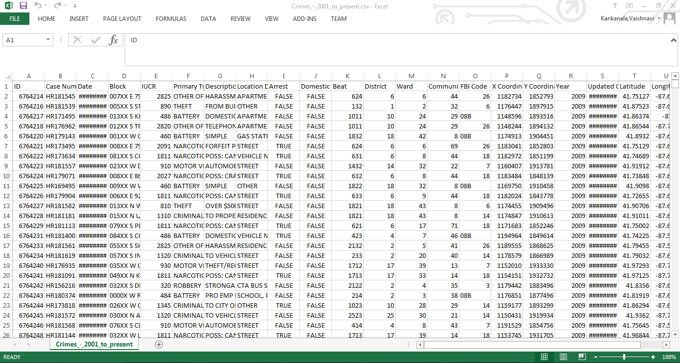
Data:

Slide 24
References
Almanie, T., Mirza, R., & Lor, E. (2015). Crime prediction based on crime types and using spatial and temporal criminal hotspots. International Journal of Data Mining & Knowledge Management Process, Vol.15, No.4
https://arxiv.org/ftp/arxiv/papers/1508/1508.02050.pdf
https://catalog.data.gov/dataset/crimes-2001-to-present-398a4
http://www.cs.waikato.ac.nz/ml/weka/downloading.html
http://www.pentaho.com/download

Slide 25


Slide 26
Thank you

