Slide 1
Crime Analysis in Chicago
Group Number: 16
Presented By:
Vaishnavi Kankanala
Devyani Deshmukh
Sneha Alkuru
Shivanvitha Konda

Slide 2
Outline
Introduction
Outcomes
Algorithms
Results
Conclusion
References

Slide 3
Introduction
There are various crimes taking place in the country. So we have selected Chicago city, analyzed crime type that occurred most from 2007 to 2016 year.
We took the data from https://catalog.data.gov/dataset/crimes-2001-to-present

Slide 4
Outcomes
Analysis of the crime type that occurred most from 2007 to 2016 year and find if it is increased or decreased, and in which particular month it is increased.
Visualizing five most crime zones in city of Chicago.
Trend analysis of crime types in different months.

Slide 5
Analysis of Crime types
Algorithms used:
MultiClassClassifier
Multilayer Perceptron (ANN)
J48 Decision Tree
Observed: Crimes happened more in 2016 and in the month of March. And the most occurred crime type is Theft/Robbery/Burglary.

Slide 6
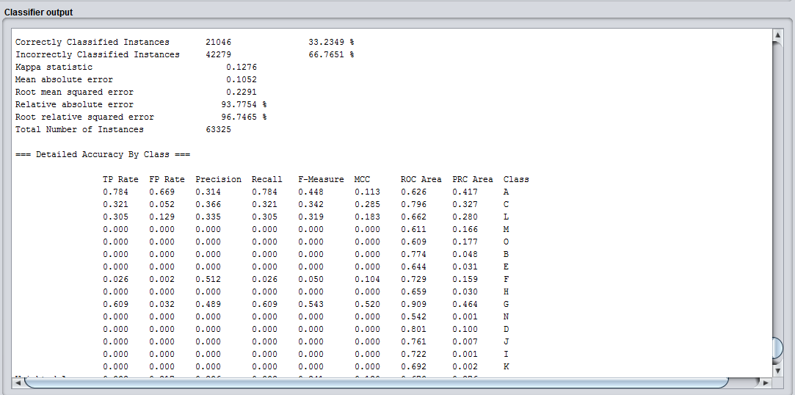

Multiclass Classifier

Slide 7
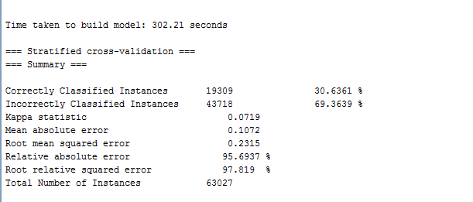

Multilayer Perceptron

Slide 8
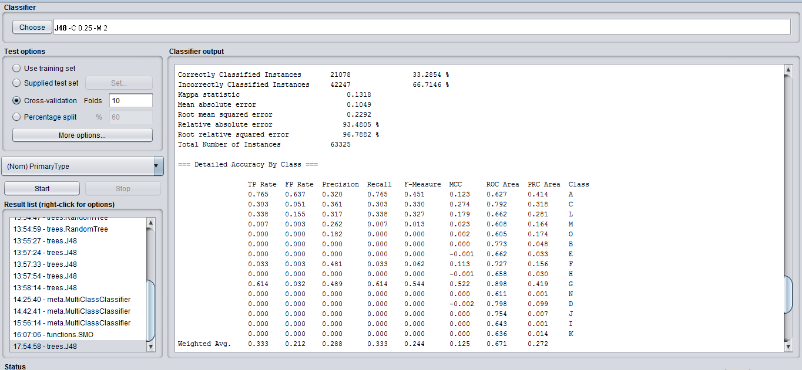

J48 Decision Tree

Slide 9
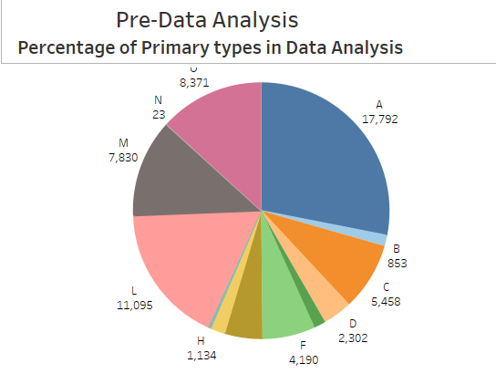
Pie Chart
Letter | Crime Type
A | theft,burglary,robbery
B | kidnapping
C | deceptive practice
D | motor vehicle
E | sexual
F | drugs
G | homicide
H | rules violation
I | gambling
J | interference with public
K | intimidation
L | battery
M | criminal damage
N | non-criminal
O | others

Slide 10
Five most crime zones
Visualized 5 most crime zones based on count of crimes happened in the area. Areas where the count of crimes is more than 40 are considered as most crime zones.
Out of 5 crime zones in 4 of the places Theft is the primary crime type occurred.
Other one is Drugs.

Slide 11
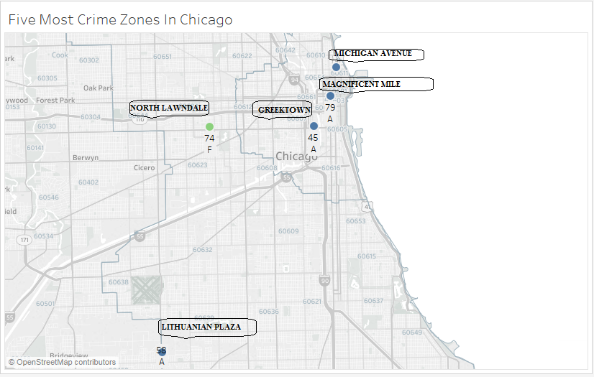
Crime Zones

Slide 12
Trend Analysis
Considered all the months from 2007 to 2016 years and observed that most of the crimes happened in the month of February, March and April.
In Chicago most of the crimes happened in the month of March.

Slide 13
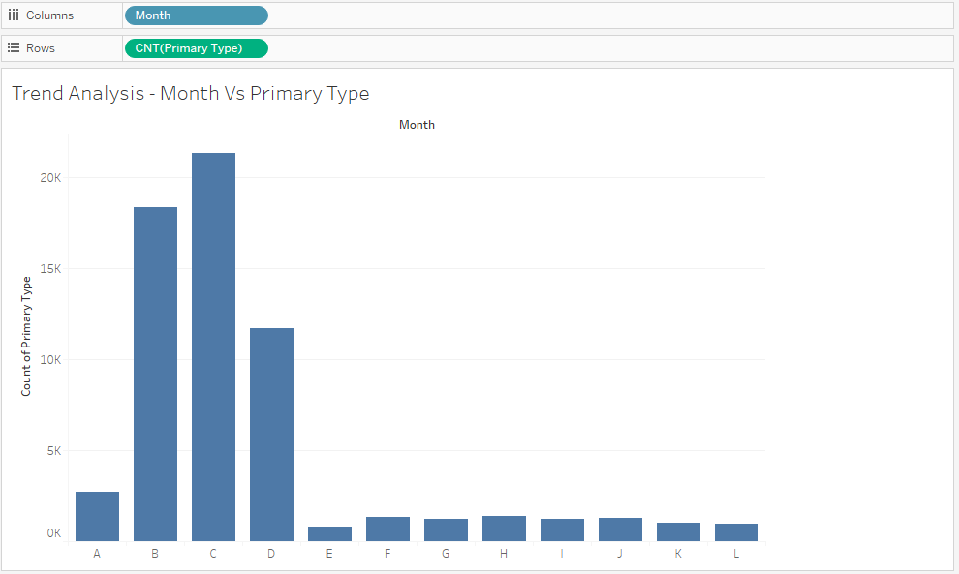
Trend Analysis

Slide 14
Conclusion
Theft is the most happened crime in Chicago so Police Department should focus more on Theft/Robbery/Burglary and people in the surrounding areas of Crime zones must be made aware of this.

Slide 15
References
Almanie, T., Mirza, R., & Lor, E. (2015). Crime prediction based on crime types and using spatial and temporal criminal hotspots. International Journal of Data Mining & Knowledge Management Process, Vol.15, No.4
https://arxiv.org/ftp/arxiv/papers/1508/1508.02050.pdf
https://catalog.data.gov/dataset/crimes-2001-to-present-398a4
http://www.cs.waikato.ac.nz/ml/weka/downloading.html
http://www.pentaho.com/download

Slide 16
Thank you

