Slide 1
Salon & Spa Appointment Management System
REVIEW 1 · WEEK 7
Problem identification, requirements and conceptual (ER) design
Devyani Pawar · 25WU0102069 · AIML Rhinos
Database Management Systems (DBMS) · Project-Based Learning
School of Technology, Woxsen University
Notes:
Introduce yourself and the project. Review 1 covers the problem, scope, users, functional requirements, the ER diagram and the first relational schema.

Slide 2
Why manual appointment books fail
1
Double-booked staff
2
Wrong person for the job
Two clients written into the same stylist's slot; one waits or walks out.
A barber booked for a facial because the book does not know staff skills.
3
Lost package sessions
4
Stock and money leakage
Prepaid packages tracked on cards; sessions over-used or disputed.
Products used without record; part-payments forgotten at the counter.
Goal: one database that knows customers, services, staff skills, schedules, packages, stock and money — and refuses invalid entries.
Notes:
Explain the real problem: the paper book cannot see conflicts, skills, package balances or dues. Every one of these becomes a business rule in the database.

Slide 3
Objectives
1
Design a normalised (3NF) relational database covering all 12 required entity areas
2
Enforce 5 core business rules inside MySQL: no staff overlap, skill match, package limits, valid times, payment limits
3
Populate realistic sample data (600+ appointments, 40 customers, 10 staff) and 20+ report queries
4
Develop a Python (Streamlit) application for booking, packages, products, billing, payments and reports
5
Validate the system with positive and negative test cases and a recorded demonstration
Notes:
Five measurable objectives; each maps to a review deliverable.

Slide 4
Scope, assumptions and users
Scope
Receptionist
registers customers, books, bills, takes payments
In: customers, services & categories, staff, skills, weekly schedules, appointments, packages, memberships, product usage, bills, payments, reports
Out: online booking portal, payroll, supplier purchase orders, SMS reminders
Assumptions: single branch; open 09:00–21:00; 18% GST; prices in INR; one bill per visit
Salon manager
staff, skills, schedules, packages, stock, reports
Stylist / therapist
performs services, issues products
Customer
indirect user — receives services, buys packages
Notes:
In scope vs out of scope, and the four user roles.

Slide 5
Functional requirements
ID | Requirement | Priority
FR-01 | Register, search, update and delete customers with validation | High
FR-02 | Maintain service categories, services, durations and prices | High
FR-03 | Maintain staff, skills (with proficiency) and weekly schedules | High
FR-04 | Book an appointment with one or more services and time slots | High
FR-05 | Assign only skilled, on-shift, free staff to each service | High
FR-06 | Reschedule, cancel, complete or mark no-show | High
FR-07 | Sell packages; redeem sessions within limits and validity | High
FR-08 | Enrol memberships; apply plan discount on bills | Medium
FR-09 | Issue products against services; reduce stock; reorder alert | Medium
FR-10 | Generate bill (subtotal, discount, GST) for completed visits | High
FR-11 | Record full / partial payments without exceeding the bill | High
FR-12 | Reports: appointments, utilisation, popularity, packages, products, revenue | High
Notes:
Walk through the 12 FRs; priorities show the core path first.

Slide 6
Five business rules the database must enforce
1
No overlapping staff appointments
2
Skill match
3
Package-session limit
A staff member cannot have two services whose time ranges overlap on the same day.
The assigned staff member must hold the skill the service requires.
Redemptions ≤ sessions included, before expiry, by the package owner.
4
Valid appointment times
5
Payment limit
6
Supporting rules
Inside 09:00–21:00 and the staff shift; slot length = service duration.
Total paid on a bill can never exceed the bill total.
Bill only completed visits; stock never negative; unique phone and email.
Notes:
These rules drive the trigger design in Review 2.

Slide 7
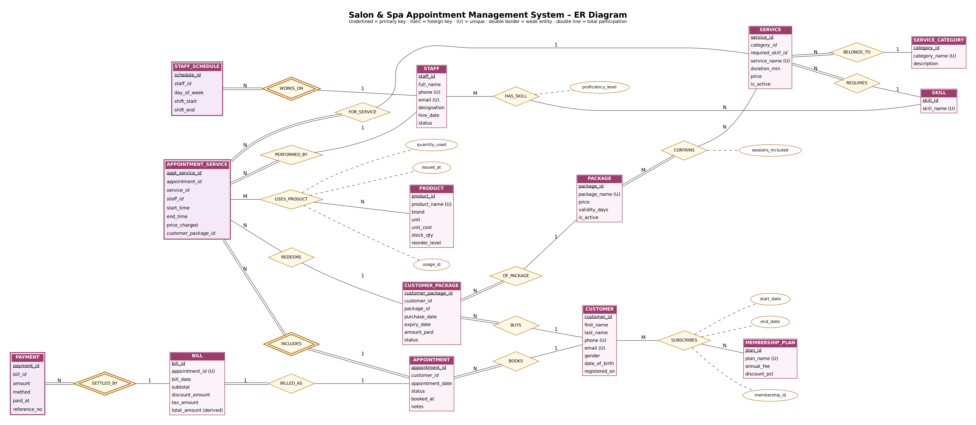
Conceptual design: ER diagram
Notes:
14 entities and 16 relationships. Weak entities have a double border; double lines are total participation.

Slide 8
Entities and key relationships
Relationship | Entities | Cardinality | Note
BOOKS | Customer – Appointment | 1 : N | a visit belongs to one customer
INCLUDES | Appointment – Appointment_Service | 1 : N | one visit, many services (weak)
PERFORMED_BY | Appointment_Service – Staff | N : 1 | one staff per service slot
HAS_SKILL | Staff – Skill | M : N | attribute proficiency_level
REQUIRES | Service – Skill | N : 1 | basis of skill-match rule
WORKS_ON | Staff – Staff_Schedule | 1 : N | weekly shifts (weak)
CONTAINS | Package – Service | M : N | attribute sessions_included
BUYS / REDEEMS | Customer – Customer_Package – Appt_Service | 1 : N / 1 : N | package balance
SUBSCRIBES | Customer – Membership_Plan | M : N | start / end dates
USES_PRODUCT | Appointment_Service – Product | M : N | quantity_used
BILLED_AS / SETTLED_BY | Appointment – Bill – Payment | 1 : 1 / 1 : N | partial payments allowed
Notes:
Explain the main cardinalities.

Slide 9
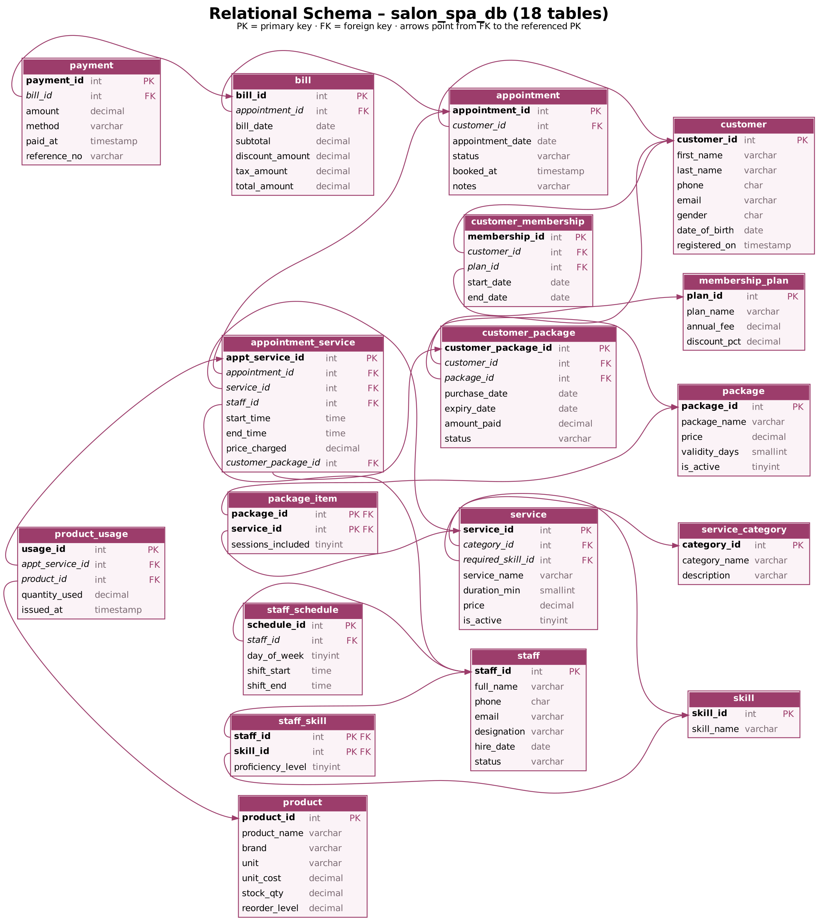
Initial relational schema: 18 tables
Masters
customer, staff, skill, service_category, service, package, membership_plan, product
M:N / associative
staff_skill, package_item, customer_membership, customer_package, product_usage
Transactions
staff_schedule, appointment, appointment_service, bill, payment
Every table has a surrogate INT primary key (composite for the two pure link tables); 20 foreign keys connect them.
Notes:
M:N relationships become their own tables: staff_skill, package_item, customer_membership, product_usage.

Slide 10
Plan to Review 2 and Review 3
Week 7
Review 1
Problem, FRs, ER diagram, initial schema
Weeks 8–10
Build DB
3NF, DDL + constraints, triggers, sample data, views
Week 11
Review 2
Normalisation, data dictionary, queries & prototype
Weeks 12–15
Build app
Python front-end, validation, testing
Week 16
Review 3
Final demo, report, video, GitHub
Notes:
Timeline of remaining deliverables.

Slide 11
Thank you — questions?
Problem: manual books cause staff clashes, skill errors, lost sessions and dues
Design: 14 entities, 16 relationships → 18 tables
Next: 3NF, constraints and triggers for the five business rules

