Slide 1
Salon & Spa Appointment Management System
REVIEW 2 · WEEK 11
Normalised design (3NF), integrity constraints, SQL queries and prototype
Devyani Pawar · 25WU0102069 · AIML Rhinos
Database Management Systems (DBMS) · Project-Based Learning
School of Technology, Woxsen University
Notes:
Review 2 shows the normalised design, data dictionary, DDL with business-rule enforcement, sample data, queries/views and the working prototype.

Slide 2
Where the design stands
18
85
5
7
tables in 3NF
constraints (PK, FK, UNIQUE, CHECK)
triggers for business rules
views for reports
603
892
674
427
appointments, Aug–Oct 2026
booked service lines
product issues
bills · 419 payments
DBMS: MySQL 8.0 (scripts also run unchanged on MariaDB 10.11). All sample data loads through the triggers, so every row obeys the rules.
Notes:
Headline numbers of the implemented database.

Slide 3
Key functional dependencies
customer_id -> first_name, last_name, phone, email, gender, date_of_birth
phone -> customer_id (candidate key)
service_id -> category_id, required_skill_id, service_name, duration_min, price
staff_id -> full_name, phone, email, designation, hire_date, status
{staff_id, skill_id} -> proficiency_level
{staff_id, day_of_week} -> shift_start, shift_end (candidate key)
{package_id, service_id} -> sessions_included
appointment_id -> customer_id, appointment_date, status, booked_at
appt_service_id -> appointment_id, service_id, staff_id, start_time,
end_time, price_charged, customer_package_id
customer_package_id -> customer_id, package_id, purchase_date, expiry_date
bill_id -> appointment_id, bill_date, subtotal, discount, tax
appointment_id -> bill_id (1:1, UNIQUE)
payment_id -> bill_id, amount, method, paid_at, reference_no
Notes:
Each determinant is a candidate key of its table, which is why every table is in BCNF.

Slide 4
Normalisation: from the paper booking slip to 3NF
Booking slip
customer, phone, date, {service, staff, staff skills, time, price}, package, bill, payments — repeating groups
UNF
Atomic values
One row per service per visit; staff skills moved to staff_skill; payments to their own rows
1NF
No partial deps
service_name/price depend only on service_id; customer data only on customer_id → separate tables
2NF
No transitive deps
category_name via category_id, skill_name via skill_id, plan discount via plan_id → split out
3NF
Notes:
Show the unnormalised slip and how each normal form removed a problem.

Slide 5
Normalisation status of all 18 relations
Relation(s) | 1NF | 2NF | 3NF | BCNF | Remark
customer, staff, skill, service_category | ✓ | ✓ | ✓ | ✓ | single-attribute PK; phone/email are alternate keys
service, package, membership_plan, product | ✓ | ✓ | ✓ | ✓ | category/skill names moved out (3NF)
staff_skill, package_item | ✓ | ✓ | ✓ | ✓ | composite PK; non-key depends on the whole key
staff_schedule, customer_membership | ✓ | ✓ | ✓ | ✓ | UNIQUE(staff_id, day_of_week) is a candidate key
appointment, appointment_service | ✓ | ✓ | ✓ | ✓ | price & end_time frozen at booking (history)
customer_package | ✓ | ✓ | ✓ | ✓ | expiry frozen at purchase (validity may change)
product_usage | ✓ | ✓ | ✓ | ✓ | stock kept in product, updated by trigger
bill, payment | ✓ | ✓ | ✓ | ✓ | total is a generated column; paid/balance computed in a view
Notes:
All relations reach 3NF; the stored snapshots are justified on the right.

Slide 6
Data dictionary extract: appointment_service
Attribute | Type | Key / constraint | Description
appt_service_id | INT | PK, AUTO_INCREMENT | one booked service inside a visit
appointment_id | INT | FK → appointment, NOT NULL, CASCADE | the visit
service_id | INT | FK → service, NOT NULL | service performed
staff_id | INT | FK → staff, NOT NULL | staff member assigned
start_time / end_time | TIME | CHECK end > start; 09:00–21:00 | slot; length = service duration (trigger)
price_charged | DECIMAL(8,2) | CHECK ≥ 0 | price at booking; 0 when from package
customer_package_id | INT | FK → customer_package, NULL, SET NULL | package redeemed, if any
Notes:
Full dictionary for all tables is in the report (Table 8).

Slide 7
Integrity constraints in the DDL
18
20
12
CONSTRAINT chk_customer_phone
CHECK (phone REGEXP '^[6-9][0-9]{9}$'),
CONSTRAINT chk_as_hours CHECK
(start_time >= '09:00:00'
AND end_time <= '21:00:00'),
CONSTRAINT chk_bill_discount CHECK
(discount_amount <= subtotal),
total_amount DECIMAL(10,2) AS
(subtotal - discount_amount
+ tax_amount) STORED,
CONSTRAINT uq_sched_staff_day
UNIQUE (staff_id, day_of_week)
PRIMARY KEY
FOREIGN KEY (RESTRICT / CASCADE / SET NULL)
UNIQUE
35
17
88
CHECK
DEFAULT
NOT NULL columns
Notes:
Declarative constraints first; triggers only where a rule needs other rows.

Slide 8
Business rules enforced inside MySQL
Rule | Mechanism | Error raised on violation
No overlapping staff appointments | trigger: startA < endB AND startB < endA on same staff/date | Staff conflict: … overlapping appointment
Skill match | trigger: staff_skill must contain service.required_skill_id | Skill mismatch: …
Valid appointment times | CHECK 09:00–21:00 + trigger: slot = duration, inside shift | Invalid time slot / not on shift
Package-session limit | trigger: owner, ACTIVE, not expired, used < sessions_included | Package session limit reached
Payment limit | trigger: SUM(paid) + new ≤ bill.total_amount | Payment exceeds balance …
Stock never negative | trigger on product_usage + CHECK stock_qty ≥ 0 | Insufficient stock …
Bill only completed visits | trigger on bill | Bill can be generated only for …
Notes:
Triggers raise SQLSTATE 45000 with a readable message; the app shows it as is.

Slide 9
The overlap rule, in SQL
-- inside sp_validate_appt_service (called by BEFORE INSERT / UPDATE triggers)
SELECT COUNT(*) INTO v_cnt
FROM appointment_service s
JOIN appointment a ON a.appointment_id = s.appointment_id
WHERE s.staff_id = p_staff_id
AND a.appointment_date = v_date
AND a.status NOT IN ('CANCELLED','NO_SHOW')
AND s.appt_service_id <> p_self_id -- ignore the row being updated
AND s.start_time < p_end AND p_start < s.end_time; -- interval overlap
IF v_cnt > 0 THEN
SIGNAL SQLSTATE '45000' SET MESSAGE_TEXT =
'Staff conflict: staff member already has an overlapping appointment';
END IF;
Back-to-back slots (10:00–11:00 then 11:00–12:00) are allowed; cancelled visits free their slots automatically.
Notes:
Same check runs on INSERT and UPDATE via one stored procedure.

Slide 10
Sample data: a realistic salon, Aug–Oct 2026
40 customers, 10 staff (1 on leave), 22 services in 6 categories, 10 skills
6 packages, 3 membership plans, 15 products with stock
603 visits: 427 completed, 125 upcoming, 41 cancelled, 10 no-show
10 bills deliberately left part-paid to test balances
Notes:
Generated by a seeded Python script, loaded through the triggers.

Slide 11
Queries and views
Report area | View | SQL concepts demonstrated
Appointments | v_appointment_details | 5-table JOIN, LEFT JOIN … IS NULL, correlated subquery
Staff utilisation | v_staff_utilization | derived tables, CROSS JOIN, SUM/COUNT, HAVING, EXISTS / NOT EXISTS
Service popularity | v_service_popularity | LEFT JOIN, IN subquery, GROUP BY, revenue share via scalar subquery
Package balances | v_package_balance | correlated subquery for sessions used, date filter
Product use | v_product_usage | aggregation, CASE for re-order flag, cost per service
Revenue | v_monthly_revenue, v_bill_summary | GROUP BY month, billed vs collected, above-average spenders
Notes:
20 queries in 05_queries.sql cover every SQL concept asked for.

Slide 12
What the reports show
Notes:
Two of the six reports, plotted from the views.

Slide 13
Testing the rules: 18 cases, all behave as expected
Test | Action | Result
TC-01 / 03 | Valid booking; back-to-back booking | Inserted ✓
TC-02 | Same staff, overlapping 13:30–14:30 | Rejected: Staff conflict ✓
TC-04 | Bridal makeup given to the barber | Rejected: Skill mismatch ✓
TC-05 / 06 / 07 | 45 min for a 30 min service; before shift; 08:00 | Rejected: invalid time ✓
TC-08 / 10 | Someone else's package; 5th of 4 sessions | Rejected ✓
TC-11 / 12 | Bill a booked visit; pay more than balance | Rejected ✓
TC-14 – 18 | Over-issue stock, bad phone, duplicate phone, delete referenced customer, discount > subtotal | Rejected ✓
Notes:
Script 06 runs in one transaction and rolls back.

Slide 14
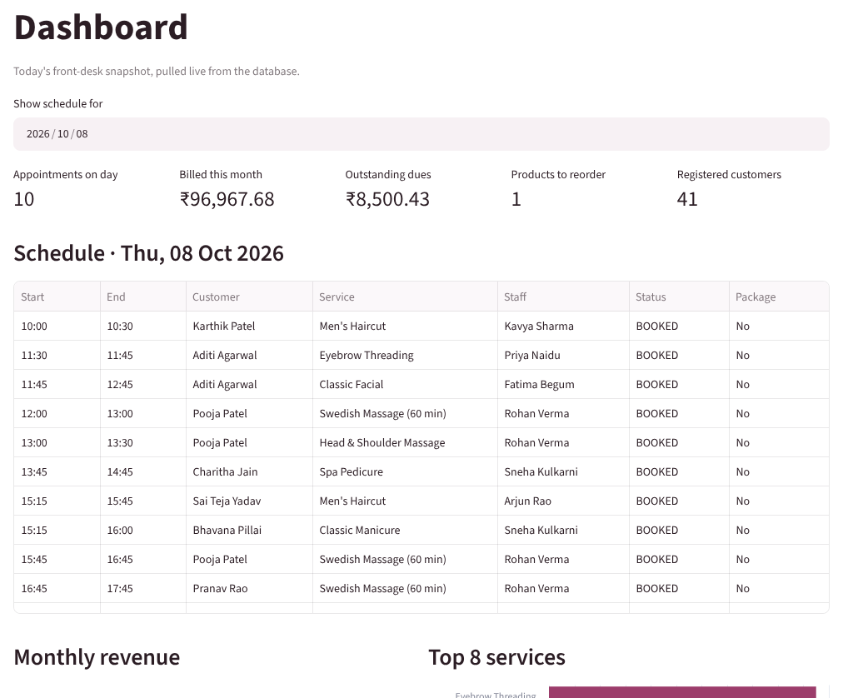
Prototype: database connected to the Python app
Already working
Dashboard, booking with skilled-staff filter, billing and reports on the live database
Next (Review 3)
Full CRUD, validation messages, test log, report and video
Notes:
Show the live dashboard; the app is the Review 3 deliverable.

Slide 15
Thank you — questions?
18 tables in 3NF/BCNF with 85 declarative constraints
5 triggers enforce overlap, skill, time, package and payment rules
7 views and 20 queries cover the six required reports
Next: complete the application, testing and documentation

