Slide 1
Salon & Spa Appointment Management System
REVIEW 3 · WEEK 16 · FINAL
Python application on the designed database: demonstration, testing and results
Devyani Pawar · 25WU0102069 · AIML Rhinos
Database Management Systems (DBMS) · Project-Based Learning
School of Technology, Woxsen University
Notes:
Final review: the working application, how it uses the database, validation, reports, tests and conclusions.

Slide 2
Architecture: the rules live in the database
Presentation
Streamlit (Python) — 9 screens: dashboard, customers, booking, appointments, packages, products, billing, staff, reports
Data access
db.py — mysql-connector-python, parameterised queries, transaction() with COMMIT / ROLLBACK, friendly error mapping
Database
MySQL 8 — 18 tables, 85 constraints, 5 triggers + 1 procedure, 7 views, 7 secondary indexes
Notes:
Even a bad client cannot break the rules: triggers sit below the app.

Slide 3
Development environment
Item | Details
Language | Python 3.11+
DBMS | MySQL 8.0 (also verified on MariaDB 10.11)
GUI framework | Streamlit (browser-based UI written in pure Python)
Driver | mysql-connector-python (official Oracle connector)
Tools | VS Code, MySQL Workbench / mysql CLI, Git & GitHub
Run | mysql -u root -p < database/salon_spa_full.sql → streamlit run app/streamlit_app.py
Notes:
Everything is open source and runs on a laptop.

Slide 4
Modules mapped to tables
Module | Main tables | Operations
Customers | customer, customer_membership | Create, search, update, delete (FK-guarded)
Book Appointment | appointment, appointment_service, staff_skill, staff_schedule, customer_package | Insert in one transaction; skilled-free staff list
Manage Appointments | appointment, appointment_service | Complete / cancel / no-show, reschedule (trigger re-check)
Packages & Memberships | package, package_item, customer_package, membership_plan | Sell, enrol, balances (view)
Products & Stock | product, product_usage | Issue (stock trigger), restock, add
Billing & Payments | bill, payment, v_bill_summary | Generate bill with discount + GST; part payments
Reports | 7 views | 6 reports, charts, CSV export
Notes:
Every screen reads and writes the designed tables; no static data.

Slide 5
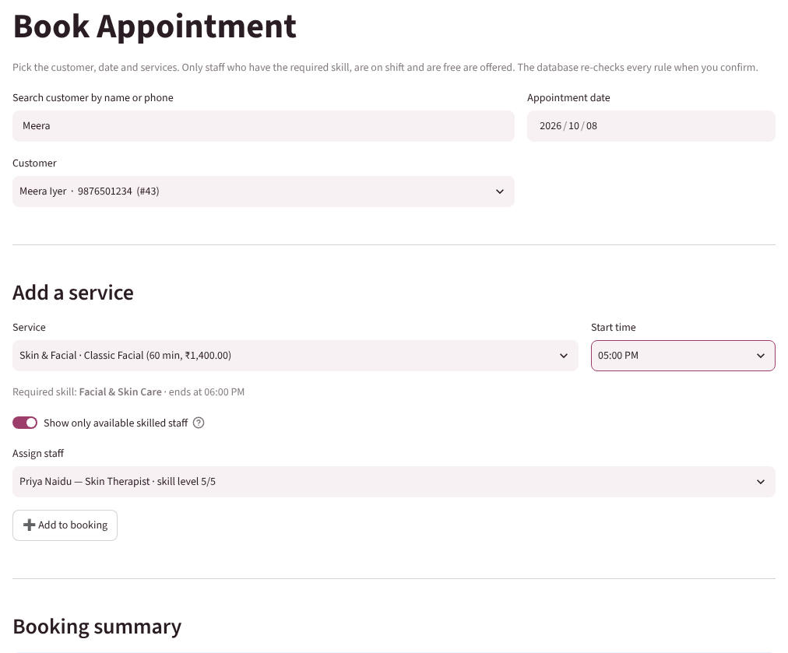
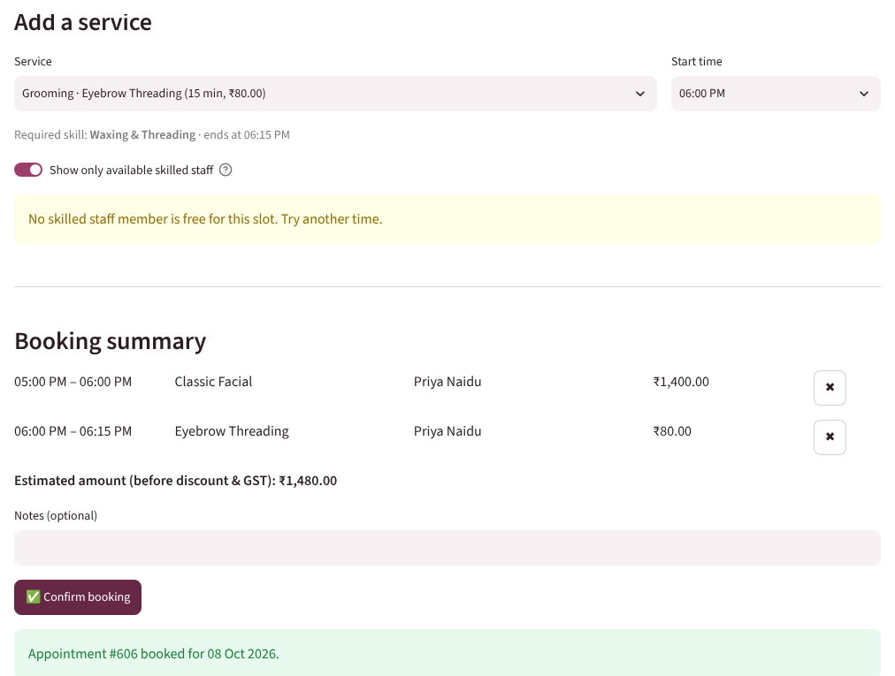
Booking: only skilled, free staff are offered
Header + all service lines are inserted in one transaction: all or nothing.
Notes:
Demo: pick customer, service, time; the staff list is filtered by skill, shift and clashes.

Slide 6
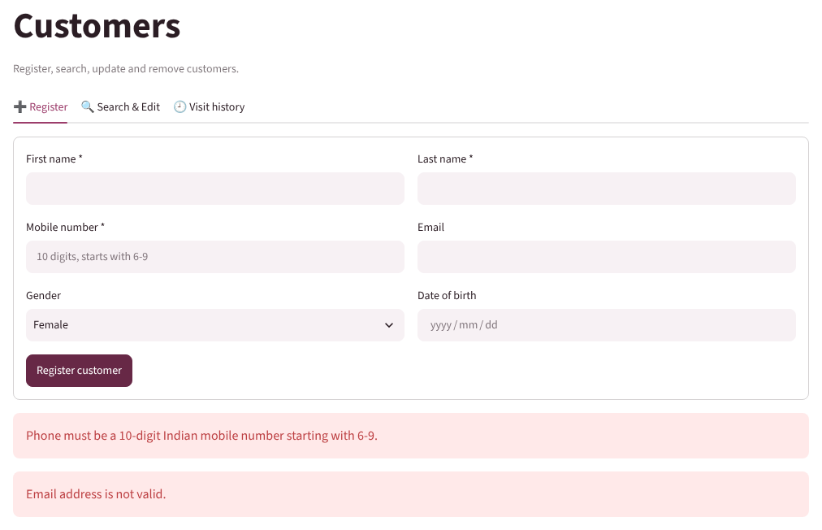
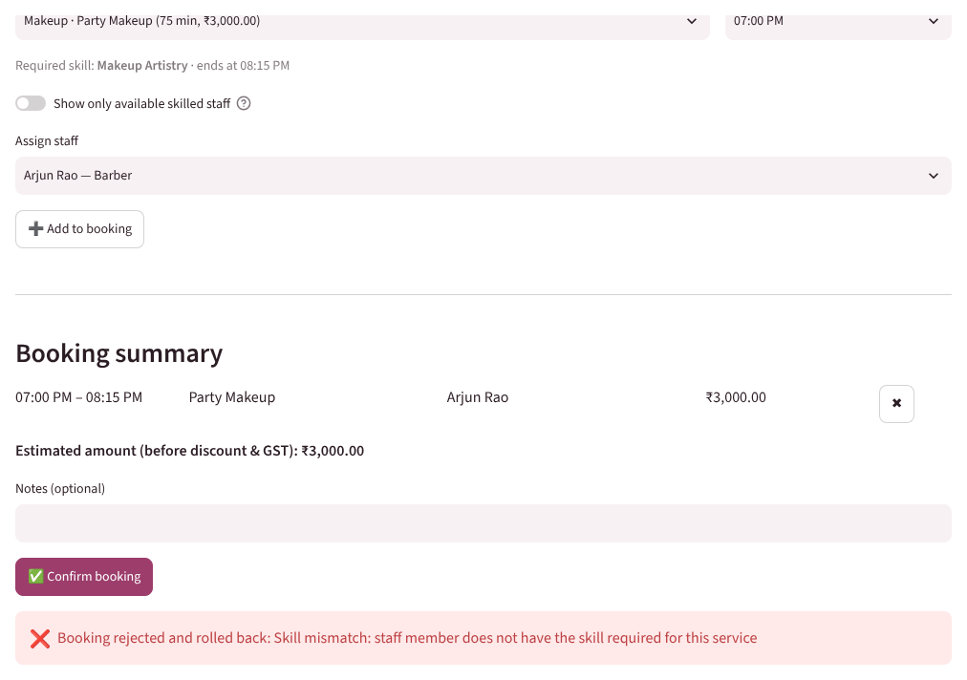
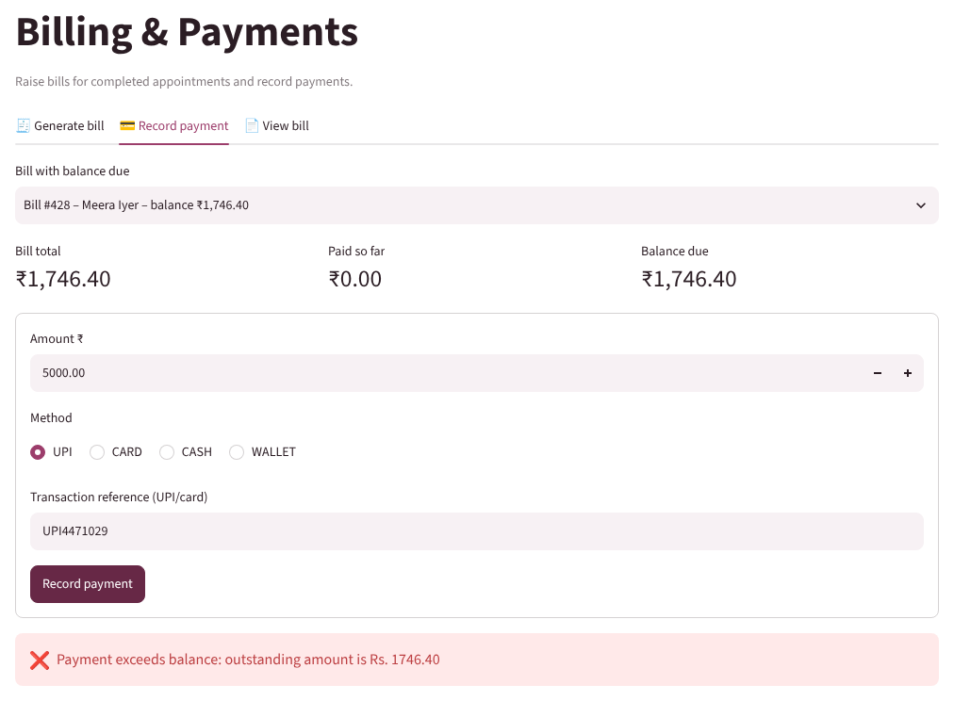
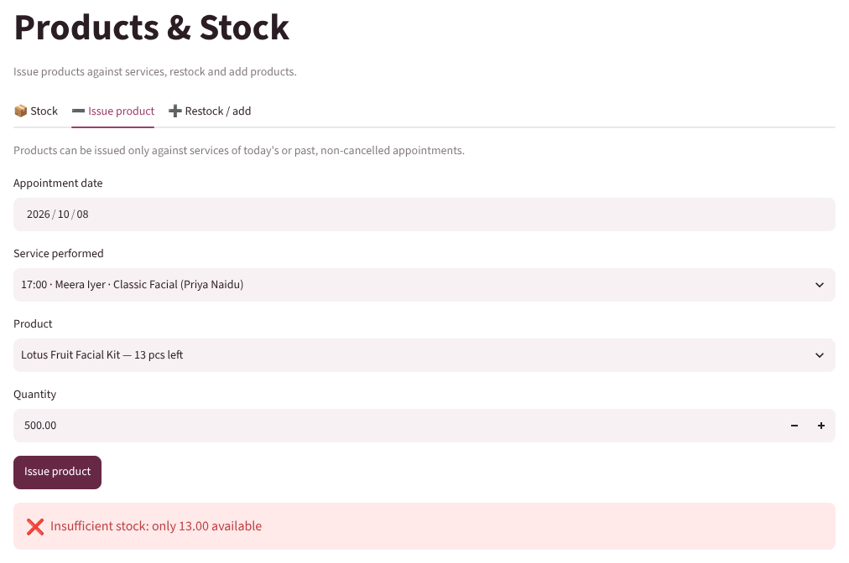
Validation and error handling
Input validation (Python)
Skill mismatch (trigger)
Over-payment (trigger)
Insufficient stock (trigger)
Notes:
Two layers: Python checks input format; MySQL enforces business rules.

Slide 7
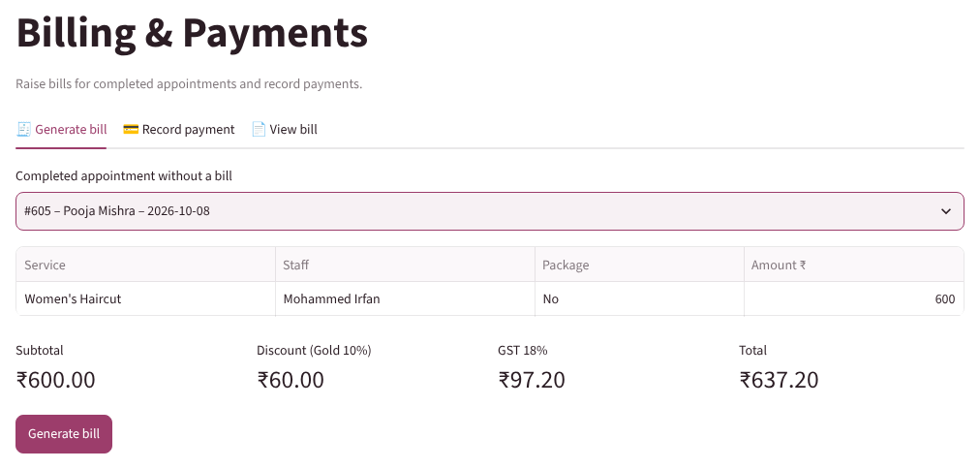
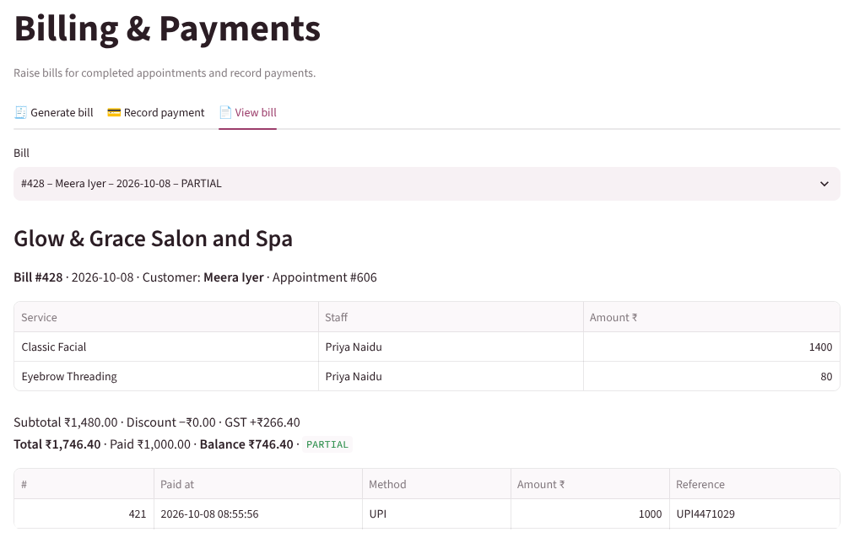
Billing and payments
Gold member: 10% off, then 18% GST · only COMPLETED visits can be billed (trigger) · total is a generated column · balance and status come from v_bill_summary
Notes:
Bill = subtotal − membership discount + 18% GST; payments may be split.

Slide 8
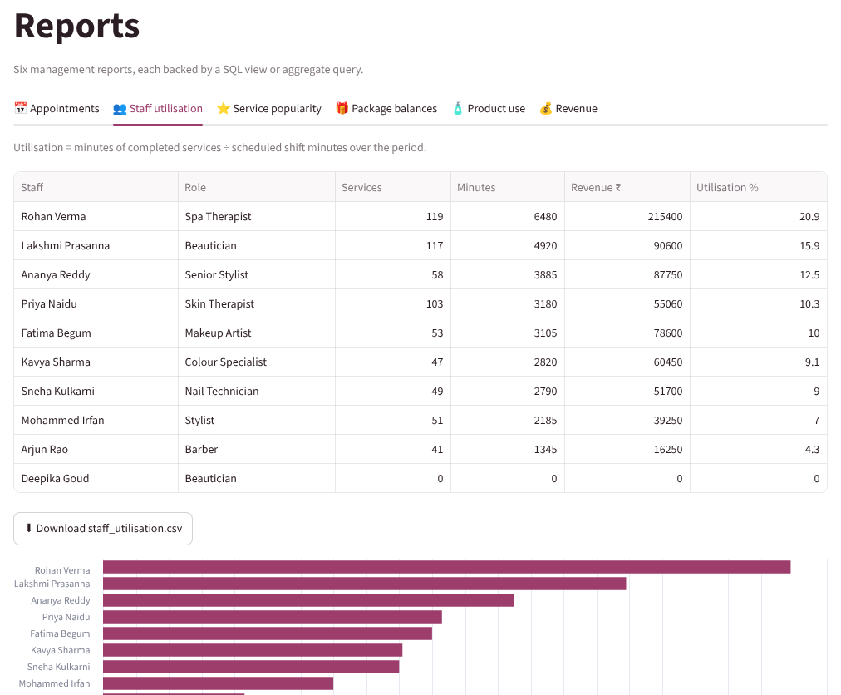
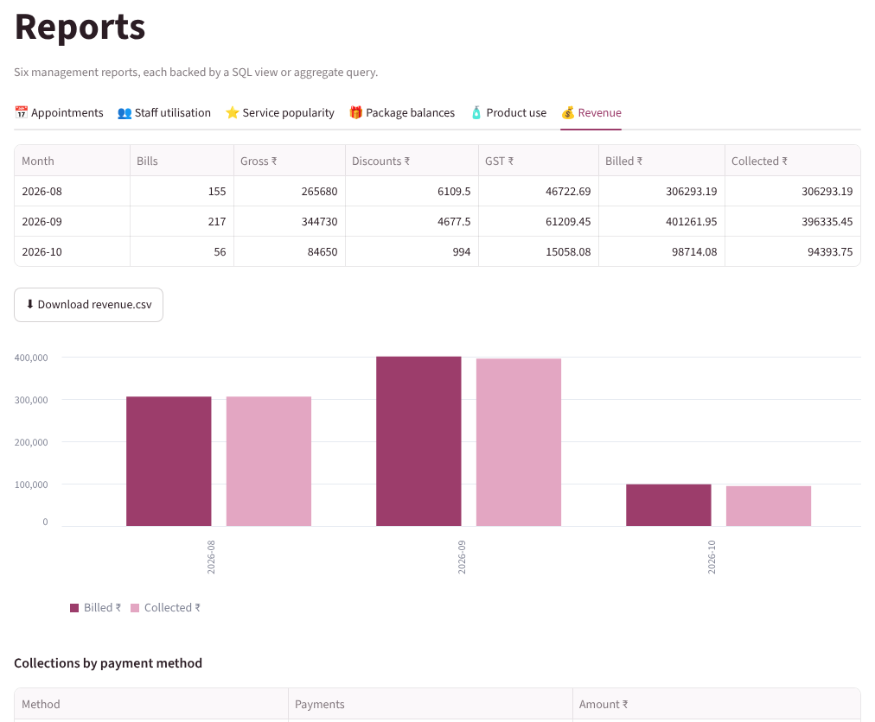
Reports
Appointments · Staff utilisation · Service popularity · Package balances · Product use · Revenue
Notes:
Six reports, each from a view, with CSV export.

Slide 9
CRUD, transactions and indexing
1
CRUD
2
Transactions
Create customer / booking / bill / payment; read via search and views; update profile, status, schedule, price, stock; controlled delete with FK RESTRICT.
Booking writes header + lines in START TRANSACTION … COMMIT; any trigger error rolls back everything. SELECT … FOR UPDATE in stock and payment triggers.
3
Indexing
4
Security
7 secondary indexes on searched columns: customer name, appointment date+status, staff+start time, bill date, payment time, package status.
All SQL uses %s parameters (no string building), so user input cannot inject SQL. DB user with least privilege.
Notes:
How the app satisfies the 'transaction awareness' and 'indexing' requirements.

Slide 10
Test results
ID | Feature | Input / action | Expected | Status
TC-01 | Register customer | Phone 12345, email 'x@gmail' | Two validation errors | Pass
TC-02 | Register customer | Valid details | Saved, new ID shown | Pass
TC-03 | Booking | Facial 17:00 + threading 18:00 | Only skilled free staff; booked | Pass
TC-04 | Booking | Party makeup → barber (filter off) | Rejected, rolled back | Pass
TC-05 | Reschedule | Threading moved onto a facial slot | Staff conflict message | Pass
TC-06 | Package | Manicure, 3 of 4 sessions used | Redeemed at ₹0 | Pass
TC-07 | Billing | ₹600 haircut, Gold member | ₹60 off + GST = ₹637.20 | Pass
TC-08 | Payment | ₹5,000 on ₹1,746.40 bill | Exceeds balance error | Pass
TC-09 | Product issue | 500 facial kits | Insufficient stock error | Pass
TC-10 | Delete customer | Customer with history | FK blocks deletion | Pass
Notes:
Application-level tests, positive and negative.

Slide 11
Conclusion, limitations and next steps
Delivered
3NF database where the five salon rules cannot be broken by any client
Python app covering booking to payment, plus six reports
Repeatable test script and realistic data
Limitations → future
No login/roles yet → add role-based access
Single branch → branch_id on staff and appointments
No reminders → SMS / WhatsApp before appointment
Customer self-booking portal
Notes:
Wrap up.

Slide 12
Thank you
GitHub repository: github.com/devyanipawar9003-max/DBMS_PBL
5-minute demo video: link in video/VIDEO_LINK.md in the repository
Repository contains: 3 review decks, SQL scripts, app source, test data, screenshots, report
Notes:
Point to the repository structure; the video link is in video/VIDEO_LINK.md.

