Slide 1

WOXSEN UNIVERSITY · SCHOOL OF TECHNOLOGY · AIML RHINOS
Design and Implementation of a Database
Management System for Salon & Spa
Appointment Management
Review 1 — Requirements, Scope & Conceptual Design
Devyani Pawar | Roll No. 25WU0102069
Week 7 · September 2026
Notes:
Good morning/afternoon. My name is Devyani Pawar, roll number 25WU0102069, and this is my Review 1 presentation for the project titled "Design and Implementation of a Database Management System for Salon and Spa Appointment Management." Over the next few minutes, I'll walk you through the problem we're solving, the scope and objectives of the system, the users it serves, and the conceptual design we've arrived at — including the ER diagram and an initial relational schema.

Slide 2

REVIEW 1 OVERVIEW
What We'll Cover
01
Problem Identification
Why manual salon scheduling breaks down
02
Scope & Objectives
Boundaries and goals of the system
03
Users & Functional Requirements
Who uses the system and what it must do
04
Conceptual Design
Key entities and the ER diagram
05
Initial Relational Schema
Proposed tables, keys and relationships
SALON & SPA APPOINTMENT MANAGEMENT SYSTEM | REVIEW 1
2
Notes:
Here's a quick roadmap of what I'll cover today. I'll start with the problem we identified and why a database-backed system is needed. Then I'll define the scope and objectives of the project. After that, I'll talk about the users of the system and the functional requirements we've gathered. Finally, I'll present the conceptual design — the key entities and the ER diagram — followed by the initial relational schema showing our proposed tables and relationships.

Slide 3





THE CHALLENGE
Problem Identification
Salons and spas juggle multiple staff, skills, service menus, packages and payments — but most still rely on manual registers or generic calendar apps to manage appointments.
Double-Booked Staff
No Skill Matching
Untracked Packages & Stock
Manual, Error-Prone Billing
No automatic check prevents two customers being booked with the same staff member at overlapping times.
Customers can be assigned to staff who aren't trained for the requested service.
Package session balances and product usage during services are not reliably recorded.
Bills, discounts and part-payments are calculated by hand with no audit trail.
These gaps in coordination and data integrity motivate a dedicated, database-backed appointment management system.
SALON & SPA APPOINTMENT MANAGEMENT SYSTEM | REVIEW 1
3
Notes:
Salons and spas today manage a lot of moving parts — multiple staff members with different skill sets, a wide service menu, customer packages, product inventory, and billing — but most still rely on manual registers or generic calendar apps to handle appointments. This creates real, recurring problems. First, staff can get double-booked because there's no automatic check for overlapping appointment times. Second, customers can end up assigned to staff who aren't actually trained for the requested service, since there's no skill-matching. Third, package session balances and the products used during a service often go untracked. And fourth, billing — including discounts and partial payments — is done manually, which is slow and error-prone. These gaps in coordination and data integrity are exactly what motivate building a dedicated, database-backed appointment management system.

Slide 4

PROJECT BOUNDARIES
Scope of the Project
IN SCOPE
OUT OF SCOPE (Review 1)
Customer registration & profile management
Service catalogue organised by category
Staff, skills and weekly work schedules
Appointment booking with skill-matched staff
Packages, memberships and session tracking
Product usage recorded per appointment
Billing, discounts, taxes and payments
Reports: utilisation, popularity, revenue
Multi-branch / franchise management
Online payment gateway integration
Mobile app front-end (web/desktop only)
SMS / email marketing automation
HR & payroll processing for staff
Third-party POS or accounting integration
SALON & SPA APPOINTMENT MANAGEMENT SYSTEM | REVIEW 1
4
Notes:
To keep the project focused, we clearly defined what's in scope and what isn't for this system. In scope: customer registration, a service catalogue organized by category, staff profiles with skills and weekly schedules, appointment booking with skill-matched staff, packages and memberships with session tracking, product usage recorded per appointment, and full billing with discounts, taxes, and payments — along with operational reports like utilization, service popularity, and revenue. Out of scope for Review 1: multi-branch or franchise management, online payment gateway integration, a mobile app front-end (web/desktop only), marketing automation, HR and payroll, and integration with third-party POS or accounting systems. This keeps our first version tight and achievable.

Slide 5

GOALS OF THE SYSTEM
Objectives
1
Model the domain accurately
2
Eliminate scheduling conflicts
Capture customers, services, staff, skills, schedules, appointments, packages, memberships, products and billing as a normalized relational schema.
Enforce no overlapping staff appointments, valid appointment times and skill-based staff assignment through DB constraints.
3
Guarantee data integrity
4
Track packages, stock & revenue
Apply keys, UNIQUE, NOT NULL, CHECK and DEFAULT constraints; normalize up to 3NF to remove redundancy and anomalies.
Maintain accurate package-session balances, product usage and payment limits for reliable financial reporting.
5
Enable actionable reporting
6
Deliver a usable front-end
Support joins, aggregates, nested queries and views for appointments, staff utilisation, popularity and revenue.
Provide a Java/Python application for booking, billing and reporting with input validation and testing.
SALON & SPA APPOINTMENT MANAGEMENT SYSTEM | REVIEW 1
5
Notes:
We have six core objectives. One, model the domain accurately — capturing customers, services, staff, skills, schedules, appointments, packages, memberships, products, and billing as a normalized relational schema. Two, eliminate scheduling conflicts by enforcing no overlapping staff appointments, valid appointment times, and skill-based staff assignment through database constraints. Three, guarantee data integrity using keys, UNIQUE, NOT NULL, CHECK, and DEFAULT constraints, and normalizing up to Third Normal Form. Four, track packages, stock, and revenue accurately. Five, enable actionable reporting through joins, aggregates, nested queries, and views. Six, deliver a usable front-end application in Java or Python for booking, billing, and reporting, with input validation and testing.

Slide 6





WHO USES THE SYSTEM
Users & Stakeholders
Customer
Salon Staff / Stylist
Receptionist
Salon Manager / Admin
Owner
Registers, browses services & packages, books appointments and views bills/payment history.
Views assigned schedule and appointments; records service completion and product usage.
Handles walk-ins, books & reassigns appointments, manages billing and payment collection.
Manages staff, skills, schedules, service catalogue, packages and views operational reports.
Reviews revenue, staff utilisation and service popularity reports for business decisions.
SALON & SPA APPOINTMENT MANAGEMENT SYSTEM | REVIEW 1
6
Notes:
The system serves five main types of users. Customers register, browse services and packages, book appointments, and view their bills and payment history. Salon staff or stylists view their assigned schedule and appointments, and record service completion and product usage. Receptionists handle walk-ins, book and reassign appointments, and manage billing and payment collection. The salon manager or admin manages staff, skills, schedules, the service catalogue, and packages, and reviews operational reports. And the owner reviews revenue, staff utilization, and service popularity reports to make business decisions.

Slide 7

SYSTEM CAPABILITIES
Functional Requirements
Customer & Catalogue
Scheduling & Appointments
Register / update customer profiles
Maintain service categories & service menu with pricing
Maintain staff profiles and skill sets
Maintain weekly staff schedules
Book appointments with skill-matched, available staff
Reject overlapping bookings & invalid appointment times
Packages & Products
Billing & Reporting
Sell packages / memberships and track remaining sessions
Record product usage per appointment against stock
Generate bills with discounts, taxes and payment limits
Record full/partial payments per bill
Produce appointment, utilisation, popularity, package-balance, product-use and revenue reports
SALON & SPA APPOINTMENT MANAGEMENT SYSTEM | REVIEW 1
7
Notes:
Our functional requirements fall into four groups. Customer and catalogue: register/update customer profiles, maintain service categories and the service menu with pricing, and maintain staff profiles and skill sets. Scheduling and appointments: maintain weekly staff schedules, book appointments only with skill-matched, available staff, and reject overlapping bookings or invalid appointment times. Packages and products: sell packages/memberships while tracking remaining sessions, and record product usage per appointment against stock. Billing and reporting: generate bills with discounts, taxes, and payment limits, record full or partial payments, and produce reports covering appointments, staff utilization, service popularity, package balances, product use, and revenue.

Slide 8

CONCEPTUAL DESIGN
Key Entities Identified
Customer
Category
Service
Staff
Individuals who book services
Groups services (e.g. Hair, Skin, Spa)
Individual offerings with price & duration
Employees who perform services
Skill
Schedule
Appointment
Package
Competencies required to perform a service
Staff availability by day & time
A booked service slot (central transaction entity)
Bundled sessions sold at a fixed price
Membership
Product
Product Usage
Bill
A customer's purchase of a package
Consumables used during services
Products consumed in an appointment
Charges generated for an appointment
Payment
Amount(s) paid against a bill
SALON & SPA APPOINTMENT MANAGEMENT SYSTEM | REVIEW 1
8
Notes:
We identified thirteen core entities. Customer represents the people booking services. Category groups services — hair, skin, spa. Service is the individual offering with price and duration. Staff are the employees, and Skill represents the competencies required for a service. Schedule captures staff availability. Appointment is the central transaction entity. Package is a bundle of sessions sold at a fixed price, and Membership represents a customer's purchase of a package. Product covers consumables, and Product Usage tracks what was consumed in an appointment. Bill captures charges for an appointment, and Payment records amounts paid against that bill.

Slide 9
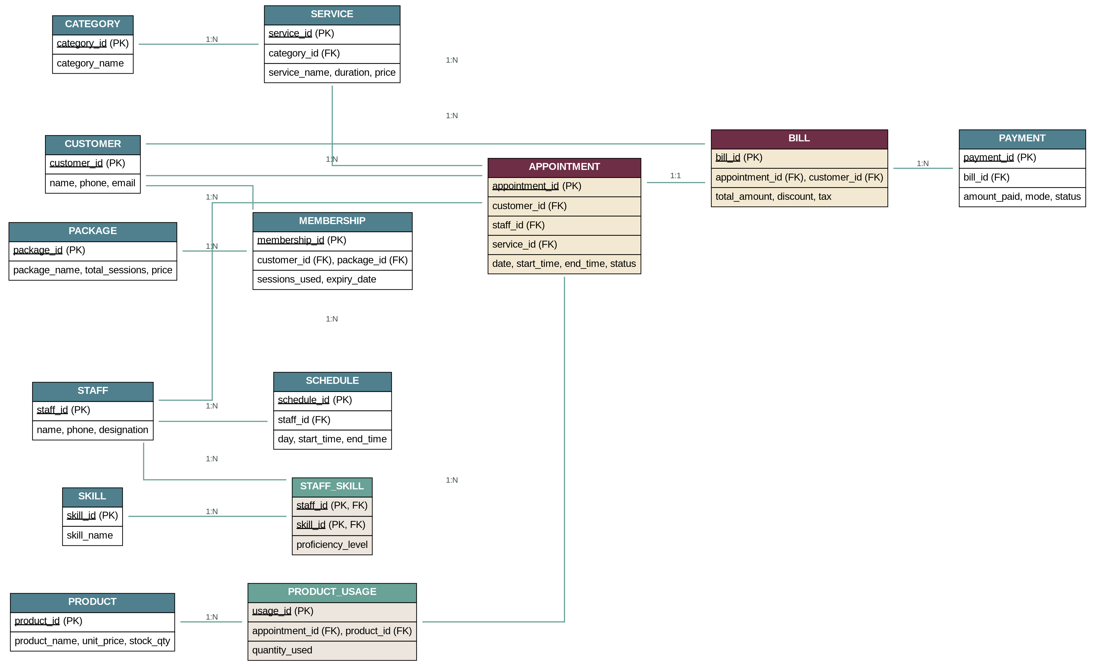
CONCEPTUAL DESIGN
Entity-Relationship Diagram
SALON & SPA APPOINTMENT MANAGEMENT SYSTEM | REVIEW 1
9
Notes:
This is our conceptual ER diagram, bringing all thirteen entities together along with the Staff_Skill bridge table that resolves the many-to-many relationship between staff and skills. Category feeds into Service; Staff connects to Schedule and, through Staff_Skill, to Skill. Customer, Staff, and Service all connect into Appointment, which sits at the center of the model since it's referenced by both Product Usage and Bill. Bill connects to Payment. This lets us trace every booking and every payment back to a customer, staff member, and service.

Slide 10

CONCEPTUAL DESIGN
Relationship Summary
Entity A | Entity B | Cardinality | Business Meaning
Category | Service | 1 : N | A category groups many services
Staff | Skill (via Staff_Skill) | M : N | A staff member can hold many skills
Staff | Schedule | 1 : N | A staff member has many schedule slots
Customer | Appointment | 1 : N | A customer can book many appointments
Staff | Appointment | 1 : N | A staff member fulfils many appointments
Service | Appointment | 1 : N | A service is booked in many appointments
Customer | Membership | 1 : N | A customer can hold many memberships
Package | Membership | 1 : N | A package can be purchased by many customers
Appointment | Product Usage | 1 : N | Multiple products may be used per appointment
Appointment | Bill | 1 : 1 | Each completed appointment generates one bill
Bill | Payment | 1 : N | A bill may be settled via one or more payments
SALON & SPA APPOINTMENT MANAGEMENT SYSTEM | REVIEW 1
10
Notes:
Here's a summary table of every relationship's cardinality. Most are one-to-many — one category has many services, one customer has many appointments, one bill can have many payments to support partial payments. The exception is Staff to Skill, which is many-to-many, resolved by the Staff_Skill junction table. Appointment to Bill is one-to-one, since each completed appointment generates exactly one bill. Getting these cardinalities right lets us correctly enforce rules like skill-matching and no-overlap later.

Slide 11

LOGICAL DESIGN
Initial Relational Schema — Part 1
CUSTOMER
CATEGORY
Column | Key
customer_id | PK
name
phone | UNIQUE
email
gender
registration_date | DEFAULT
Column | Key
category_id | PK
category_name | UNIQUE
description
STAFF
Column | Key
staff_id | PK
name
phone | UNIQUE
designation
hire_date
SERVICE
Column | Key
service_id | PK
category_id | FK
service_name
duration_mins
price | CHECK>0
SKILL
Column | Key
skill_id | PK
skill_name | UNIQUE
SALON & SPA APPOINTMENT MANAGEMENT SYSTEM | REVIEW 1
11
Notes:
This slide shows the first six tables. Customer holds core customer details, with phone marked UNIQUE. Category and Service represent our service catalogue, with Service carrying a foreign key to Category and a CHECK constraint ensuring price is greater than zero. Staff holds employee details with a UNIQUE phone number. Skill, along with the Staff_Skill bridge table, implements the many-to-many relationship between staff and skills — Staff_Skill uses a composite primary key of staff_id and skill_id together.

Slide 12
LOGICAL DESIGN
Initial Relational Schema — Part 2
APPOINTMENT
STAFF_SKILL
Column | Key
appointment_id | PK
customer_id | FK
staff_id | FK
service_id | FK
appt_date
start/end_time | CHECK
status | DEFAULT
Column | Key
staff_id | PK, FK
skill_id | PK, FK
proficiency_level
PACKAGE
Column | Key
package_id | PK
package_name
total_sessions | CHECK>0
price | CHECK>0
validity_days
SCHEDULE
Column | Key
schedule_id | PK
staff_id | FK
day_of_week
start_time
end_time | CHECK
MEMBERSHIP
Column | Key
membership_id | PK
customer_id | FK
package_id | FK
sessions_used | DEFAULT 0
expiry_date
SALON & SPA APPOINTMENT MANAGEMENT SYSTEM | REVIEW 1
12
Notes:
These tables center around scheduling and transactions. Appointment is our central table, pulling in foreign keys from Customer, Staff, and Service, with CHECK constraints on start/end times and a DEFAULT status. Schedule records staff availability. Package defines bundled sessions with CHECK constraints on total sessions and price. Membership links a customer to a purchased package, tracking sessions used against the total, starting at DEFAULT zero.

Slide 13
LOGICAL DESIGN
Initial Relational Schema — Part 3
BILL
PAYMENT
Column | Key
bill_id | PK
appointment_id | FK
customer_id | FK
bill_date | DEFAULT
total_amount | CHECK>0
discount, tax
Column | Key
payment_id | PK
bill_id | FK
payment_date | DEFAULT
amount_paid | CHECK>0
mode, status
PRODUCT_USAGE
PRODUCT
Column | Key
usage_id | PK
appointment_id | FK
product_id | FK
quantity_used | CHECK>0
Column | Key
product_id | PK
product_name
unit_price | CHECK>0
stock_qty | CHECK>=0
SALON & SPA APPOINTMENT MANAGEMENT SYSTEM | REVIEW 1
13
Notes:
The final tables handle billing and inventory. Bill captures charges for an appointment, referencing the appointment and customer, with a CHECK constraint on total amount. Payment references the bill and records each amount paid, supporting multiple partial payments per bill. Product holds inventory items with checks on price and stock quantity, and Product Usage logs which products, and how much, were consumed during a specific appointment. Together these fourteen tables form the complete initial schema.

Slide 14

DATA INTEGRITY
Key Business Rules to Enforce
No Overlapping Appointments
A staff member cannot be booked for two appointments with intersecting time ranges.
1
Skill Match
Staff assigned to an appointment must possess the skill required by the booked service.
2
Package-Session Limits
sessions_used on a membership can never exceed the package's total_sessions.
3
Valid Appointment Times
Appointments must fall within staff schedule hours, with end_time after start_time.
4
Payment Limits
Sum of payments against a bill cannot exceed the bill's total_amount.
5
SALON & SPA APPOINTMENT MANAGEMENT SYSTEM | REVIEW 1
14
Notes:
Beyond table structure, five critical business rules need enforcing. No staff member should be booked for two appointments with overlapping time ranges. Staff assigned to an appointment must possess the skill the service requires. Sessions used on a membership can never exceed the package's total sessions. Appointments must fall within staff schedule hours, with end time after start time. And the total of all payments against a bill can never exceed that bill's total amount. These rules guide our constraint design in the next phase.

Slide 15

WRAPPING UP
Review 1 Recap & What's Next
DELIVERED IN REVIEW 1
COMING IN REVIEW 2 · WEEK 11
Problem identification, scope & objectives
Identified users and functional requirements
Conceptual design with full ER diagram
Initial relational schema — 14 proposed tables with primary & foreign keys
Normalization to 3NF with functional dependencies & data dictionary
DDL scripts enforcing all business-rule constraints
Sample data + queries: joins, subqueries, aggregation, views
Working database prototype demonstration
SALON & SPA APPOINTMENT MANAGEMENT SYSTEM | REVIEW 1
15
Notes:
To summarize, in this review we've delivered problem identification, scope and objectives, identified users and functional requirements, completed the conceptual design with a full ER diagram, and produced an initial relational schema covering fourteen proposed tables with primary and foreign keys. Looking ahead to Review 2 in Week 11: normalize to 3NF with functional dependencies and a data dictionary, write DDL scripts enforcing all five business rules, populate sample data and demonstrate joins/subqueries/aggregation/views, and show a working database prototype.

Slide 16

Thank You
Questions & Feedback Welcome
Devyani Pawar · 25WU0102069 · Woxsen University · AIML Rhinos
Notes:
Thank you for your time. That concludes my Review 1 presentation. I'd be happy to take any questions or feedback you may have.

