Slide 1

Load Balancing In Fog Network
VI Sem Minor Project Review - 2
Course Code:15ECSW302
Team Number: N11
Manisha Belagal | 01FE19BCS207
Mehar Anjum Soudagar | 01FE19BCS208
Devyansh Agrawal | 01FE19BCS245
Chetan N Shet | 01FE19BCS255
Under the guidance of
Dr. Vijeth Kotagi
2021 – 2022 Even semester
SoCSE, KLE TECHNOLOGICAL UNIVERSITY-HUBLI

Slide 2
Problem Statement
To design and implement an effective distributed load balancing algorithm in a fog network.

Slide 3
Suggestions Given In Review 1
Approach to solve the problem has to be decided.
Methodology has to be designed.

Slide 4
Objectives
To minimize overload probability.
To make an effective dynamic offloading decisions.
To determine the number of tasks to be offloaded.
To minimize request processing time and hence its latency.

Slide 5
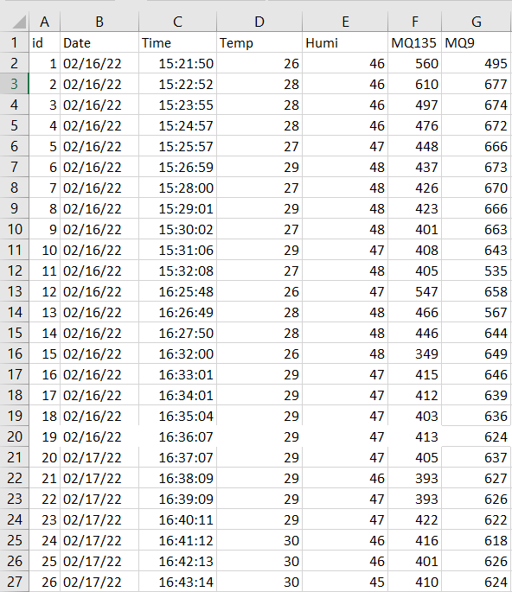
Dataset Collected From Campus
Sensors used:
Temperature sensor
Humidity sensor
MQ135: Air quality sensor
MQ9: Carbon monoxide sensor

Slide 6
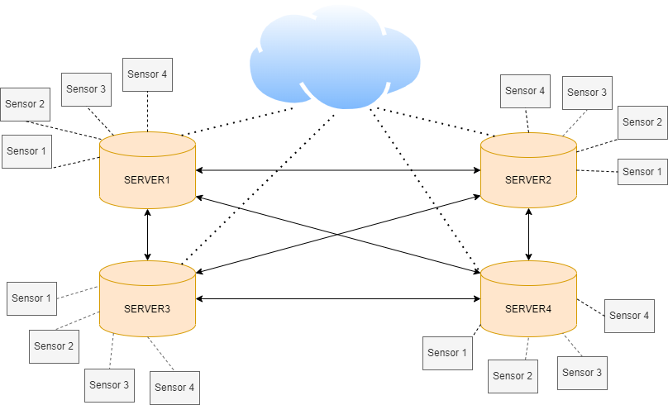
Architectural Design
Client and server architecture

Slide 7
System Design
The proposed load balancing uses Q learning which consists the following tuples:
F : set of fog nodes
M : set of IoT devices
dₘ : maximum allowed delay for m^{th} IoT device ∀ m ∈ M
tₘ : actual processing time for m^{th} IoT device ∀ m ∈ M
S : set of states.
s1 : 0 – 0.6 ( low load state )
s2 : 0.6 – 0.8 ( medium load state )
s3 : > 0.8 ( high load state )
The states represent the load value of fog node f ∈ F
A : set of actions defined as A = {(P(B) – Ø) ∪ ac } , where B = { bᵢ : i = 1 to | F | }and ac is action representing offloading to cloud.
R(s , a) : Reward function is calculated as,
R(s , a) = tanh(D) , where D = dₘ - tₘ

Slide 8
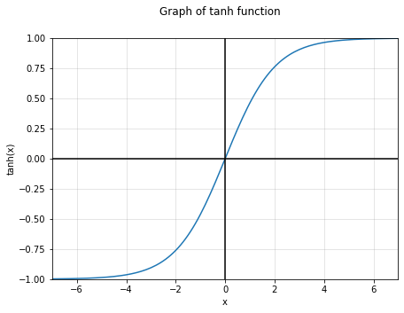
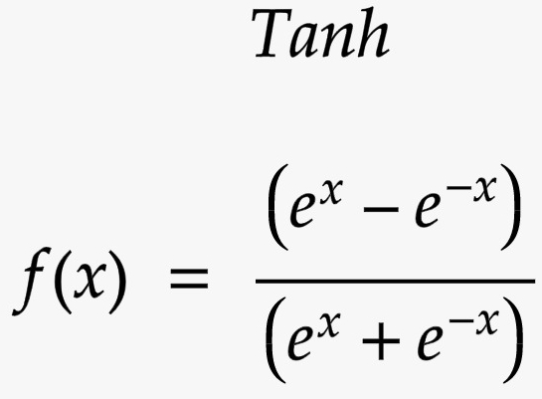
Reward Function

Slide 9
Proposed Algorithm
Input :
λf (Arrival rate of the packets in the fog node f ∈ F following Poisson distribution)
∝ (Learning rate )
ε (Exploration policy)
𝚪 (discount factor)
μ (Processing rate of the server following exponential distribution)
dₘ (Allowed latency constraint of a sensor)
Output :
Fog nodes selected for offloading and the percentage of packets served within latency constraint.

Slide 10
Proposed Algorithm
Q learning algorithm
Steps :
Q(s , a)←0, ∀ s ∈ S, ∀ a ∈ A //initialize Q values states and actions.
Repeat
| choose action a ∈ A based on epsilon greedy algorithm
| offload packets to neighbours based on chosen action a.
| Receive D from neighbours
| Calculate reward R(s,a) = tanh(D)
| Update Q table using Q(s , a) = ∝ [R(s , a)+𝚪 ⨉ max Q(s`,*)]+(1- ∝)Q(s , a)
| move to next state s ← s`

Slide 11
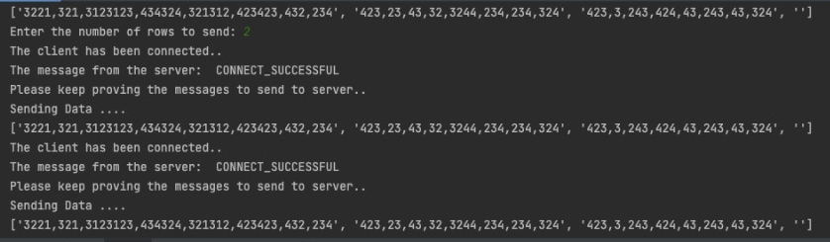
Implementation
Client and server architecture is implemented and data from .csv file is successfully sent from client to server.
The packets are also offloaded from one server to another.
The number of packets to be offloaded is determined using Poisson distribution.
Sending data from client node

Slide 12
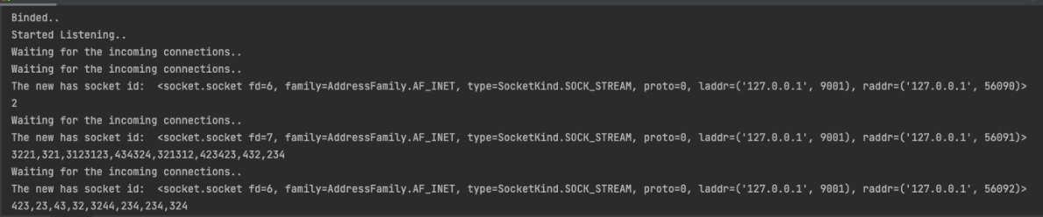
Implementation
Server receiving the data from client node

Slide 13
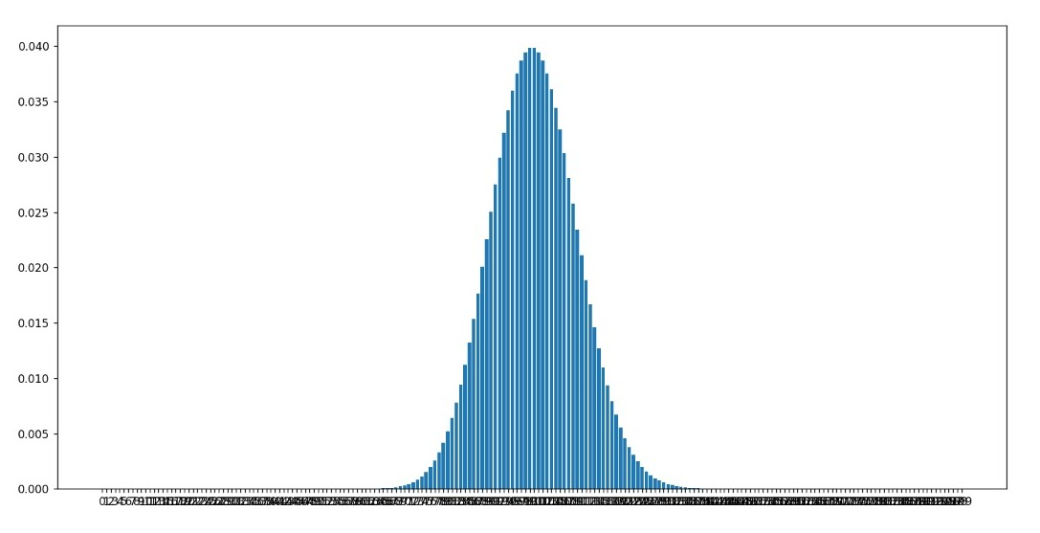
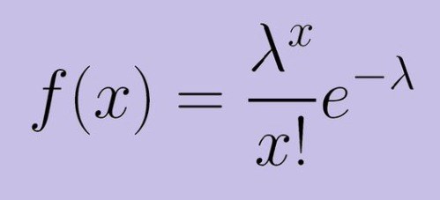
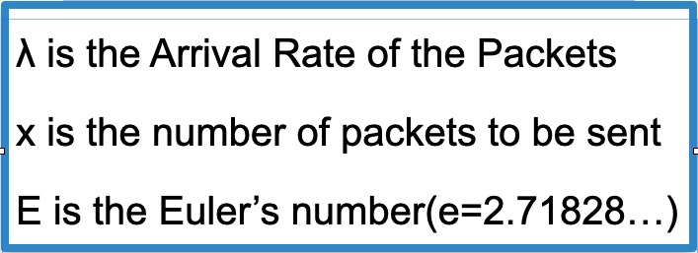
Implementation
Graph of Probability mass distribution
Probability mass (f(x))
Number of packets

Slide 14
Pending Work
Implementing Q learning algorithm
Analysing results

Slide 15
References
M. Mukherjee, L. Shu and D. Wang, "Survey of Fog Computing: Fundamental, Network Applications, and Research Challenges," in IEEE Communications Surveys & Tutorials, vol. 20, no. 3, pp. 1826-1857, thirdquarter 2018.
J. -y. Baek, G. Kaddoum, S. Garg, K. Kaur and V. Gravel, "Managing Fog Networks using Reinforcement Learning Based Load Balancing Algorithm," IEEE Wireless Communications and Networking Conference (WCNC), 2019, pp. 1-7
V. Divya and R. L. Sri, "ReTra: Reinforcement based Traffic Load Balancer in Fog based Network," 2019 10th International Conference on Computing, Communication and Networking Technologies (ICCCNT), 2019, pp. 1-6
W. Bai and C. Qian, "Deep Reinforcement Learning for Joint Offloading and Resource Allocation in Fog Computing," 2021 IEEE 12th International Conference on Software Engineering and Service Science (ICSESS), 2021, pp. 131-134

Slide 16
Thank You

