Slide 1

Minor project review-3
Load Balancing In Fog Network
Team Number: N11
Manisha Belagal | 01FE19BCS207
Mehar Anjum Soudagar | 01FE19BCS208
Devyansh Agrawal | 01FE19BCS245
Chetan N Shet | 01FE19BCS255
Under the guidance of
Dr. Vijeth Kotagi
2021 – 2022 Even semester
SoCSE, KLE TECHNOLOGICAL UNIVERSITY-HUBLI

Slide 2
Problem Statement
To design and implement an effective distributed load balancing algorithm in a fog network.

Slide 3
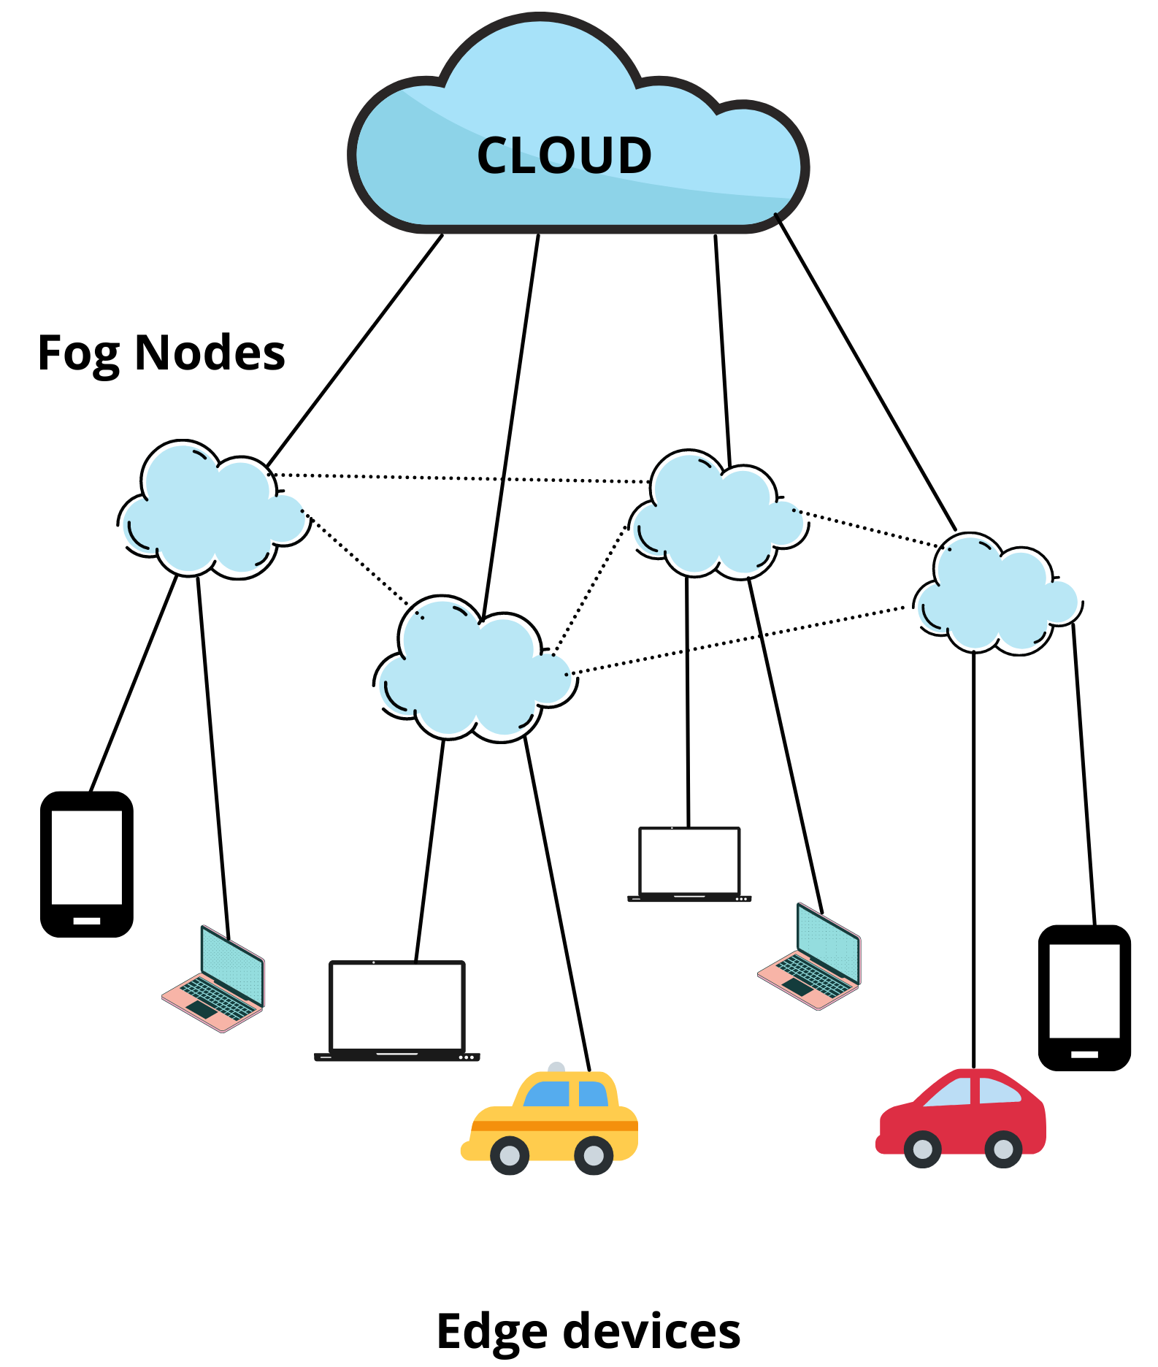
Problem Statement Description

Slide 4
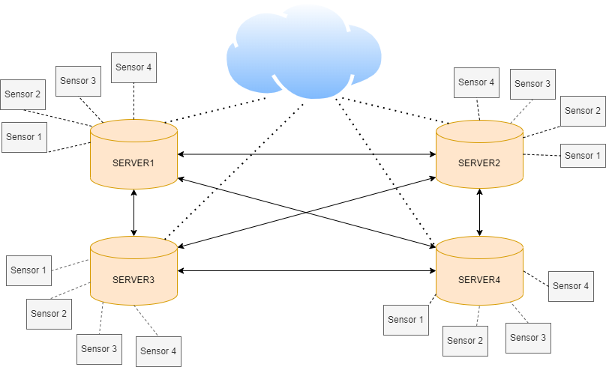
Architectural Design
Client and server architecture

Slide 5
System Design
The proposed load balancing uses Q learning which consists the following tuples:
F : set of fog nodes
M : set of IoT devices
dₘ : maximum allowed delay for m^{th} IoT device ∀ m ∈ M
tₘ : actual processing time for m^{th} IoT device ∀ m ∈ M
S : set of states.
s1 : 0 – 0.6 ( low load state )
s2 : 0.6 – 0.8 ( medium load state )
s3 : > 0.8 ( high load state )
The states represent the load value of fog node f ∈ F
A : set of actions defined as A = {(P(B) – Ø) ∪ ac } , where B = { bᵢ : i = 1 to | F | }and ac is action representing offloading to cloud.
R(s , a) : Reward function is calculated as,
R(s , a) = tanh(D) , where D = dₘ - tₘ

Slide 6
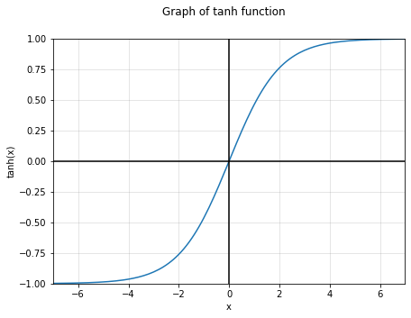
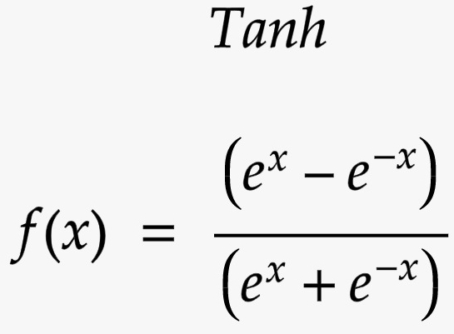
Reward Function

Slide 7
Proposed Algorithm
Input :
λf (Arrival rate of the packets in the fog node f ∈ F following Poisson distribution)
∝ (Learning rate )
ε (Exploration policy)
𝚪 (discount factor)
μ (Processing rate of the server following exponential distribution)
dₘ (Allowed latency constraint of a sensor)
Output :
Fog nodes selected for offloading and the percentage of packets served within latency constraint.

Slide 8
Proposed Algorithm
Q learning algorithm
Steps :
Q(s , a)←0, ∀ s ∈ S, ∀ a ∈ A //initialize Q values states and actions.
Repeat
| choose action a ∈ A based on epsilon greedy algorithm
| offload packets to neighbours based on chosen action a.
| Receive D from neighbours
| Calculate reward R(s,a) = tanh(D)
| Update Q table using Q(s , a) = ∝ [R(s , a)+𝚪 ⨉ max Q(s`,*)]+(1- ∝)Q(s , a)
| move to next state s ← s`

Slide 9
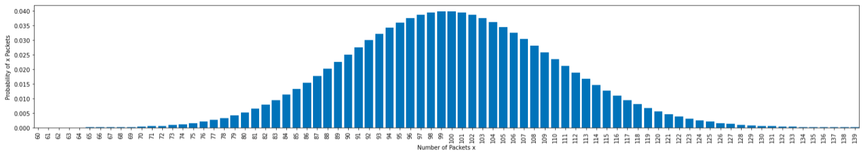
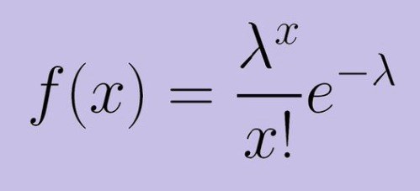
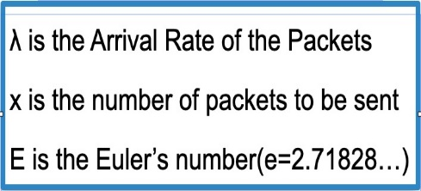
Implementation
Graph of Probability mass distribution

Slide 10
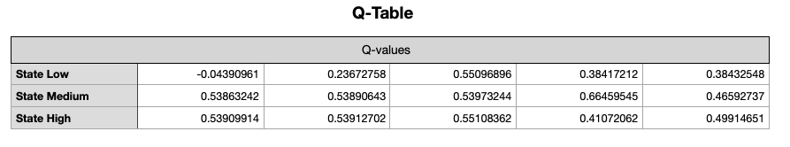
Implementation

Slide 11
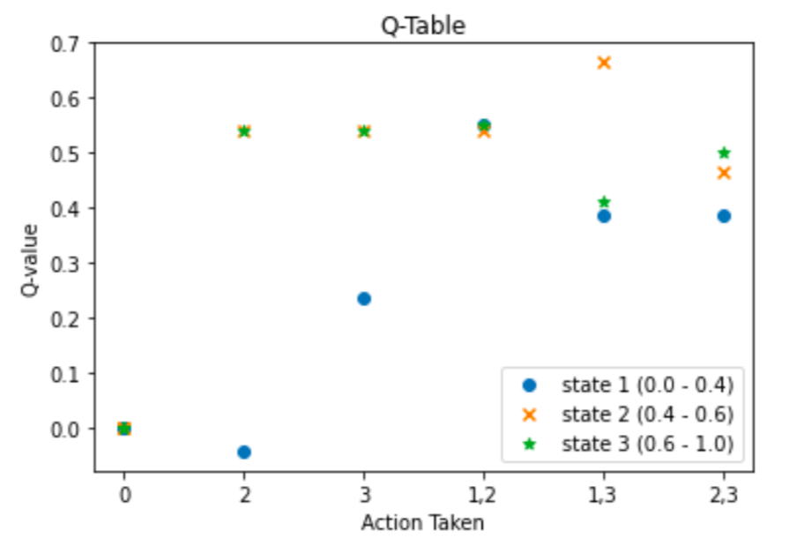
Implementation

Slide 12
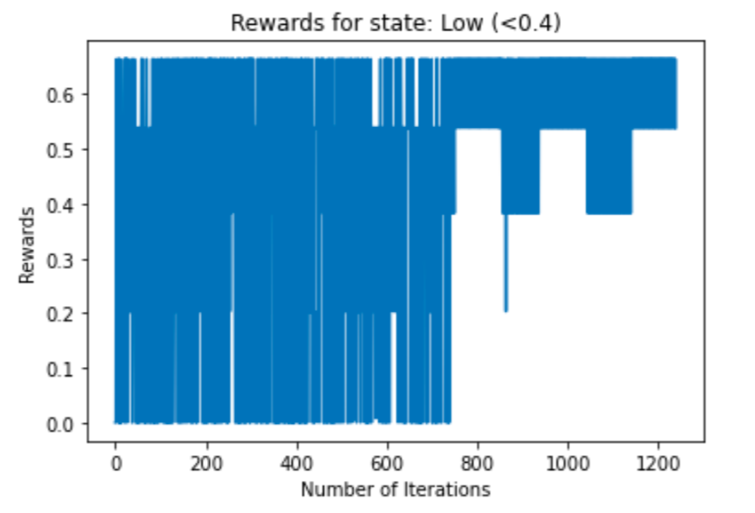
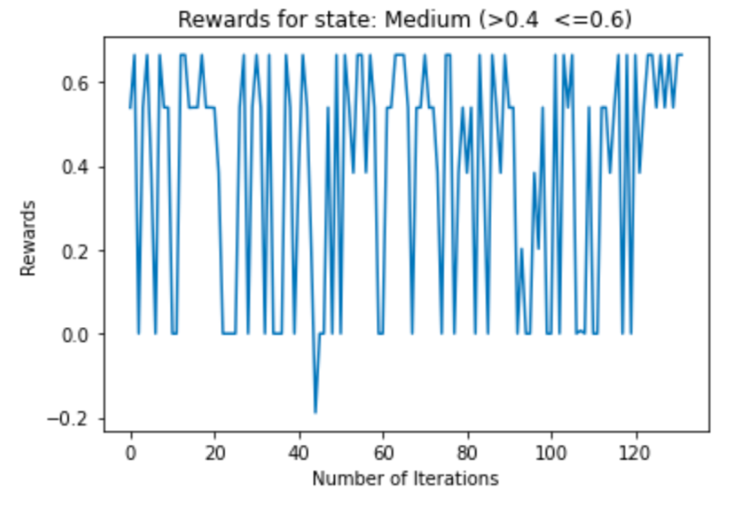
Implementation

Slide 13
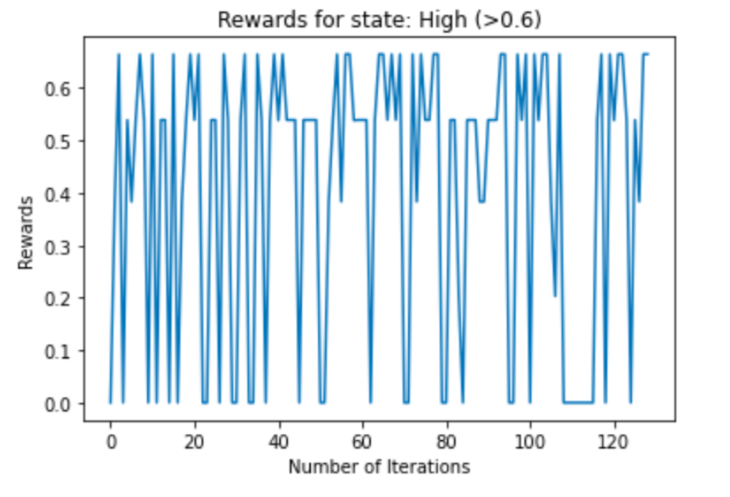
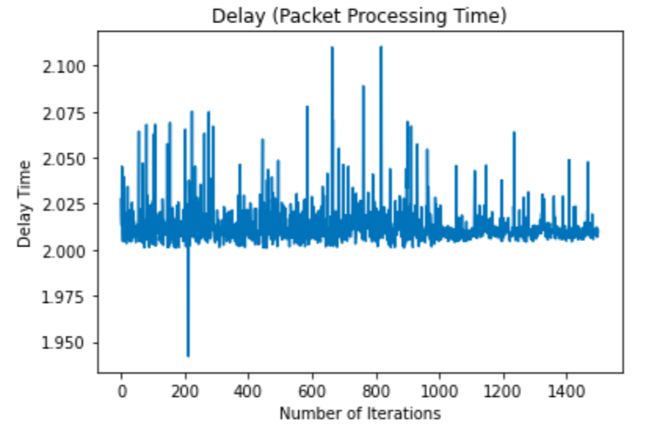
Implementation

Slide 14
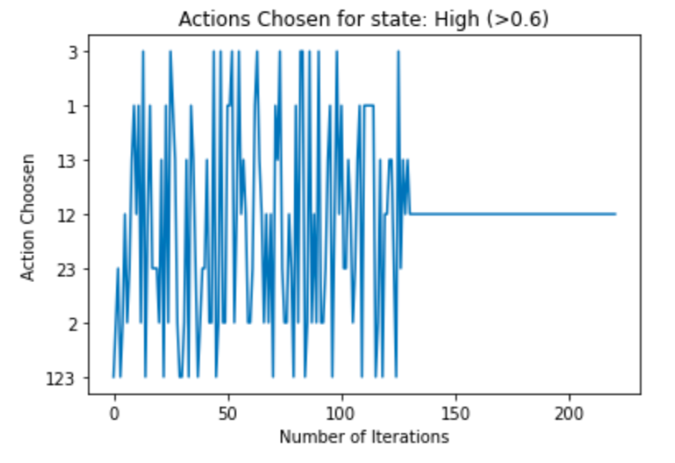
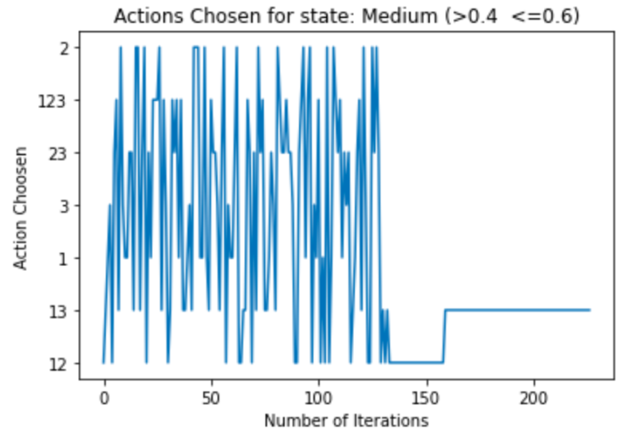
Implementation

Slide 15
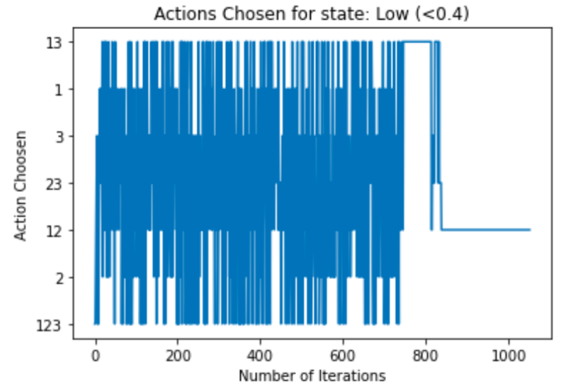
Implementation

Slide 16
Thank You

