Slide 1
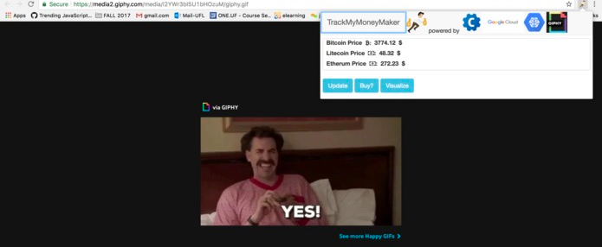
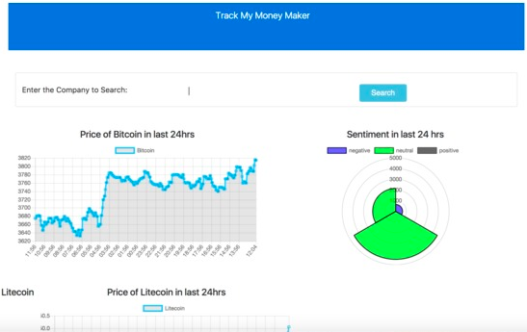




Track My Money Maker
Purpose: Track My Money Maker tracks the price of bitcoin and the sentiments about bitcoins on twitter and checks whether there is a correlation between them.
Inspiration: We were inspired by the decentralized nature of bitcoin and its potential to disrupt the global financial markets. We wanted to work with bitcoins and correlating bitcoin exchange rates with twitter sentiment seemed like a great program to work with.
Built With: Google App Engine, Google Cloud Natural Language API, Coinbase API, Giphy API, React.JS, Twitter API, Tweepy, Flask, javascript, python.
We get tweet data using the twitter API for each cryptocurrency and its related terms. We clean the data, put in placeholders for urls, images, users and then send it to Google Cloud’s Natural Language API. Natural Language API gives us sentiments for tweets in a certain interval. We weigh these sentiments by salience and produce a sentiment score for that interval and use it as a model to predict bitcoin price. We deploy this model on the server and allow access to it via a REST API.
Devyash Sanghai, Ruturaj Zadbuke

