Slide 1
Machine Learning Algorithms :
(whatever I learnt in past 3 weeks)
BY- DEVYASH PARIHAR
2016A7PS0066P

Slide 2
Regression: 1).Linear Regression 2).Polynomial Regression Classification: 1).Logistic Regression 2).K-Nearest Neighbors(K-NN) 3).Support Vector Machine

Slide 3
Linear Regression:
Simple linear regression is useful for finding relationship between two continuous variables. One is predictor or independent variable and other is response or dependent variable.
Examples:
a).Years of Experience vs Salary
b). Nos of hours studied vs Marks obtained.

Slide 4
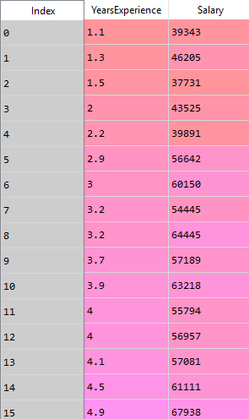
Sample dataset:

Slide 5
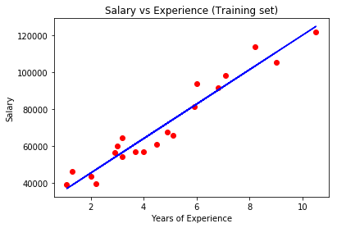
Plotting the training set, we obtain a straight line in case of simple linear regression as shown below.

Slide 6
Polynomial Regression:
Polynomial regression is a form of regression analysis in which the relationship between the independent variable x and the dependent variable y is modelled as an nth degree polynomial in x.
The kth order polynomial model in one variable is given by
y=a0 + a1*x + a2*x*x + a3*x*x*x + ……… (ak)*(x^k)

Slide 7
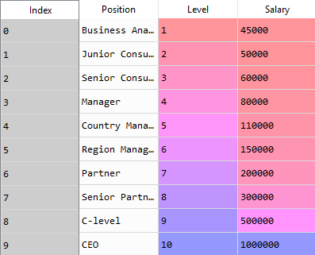
Sample dataset:

Slide 8
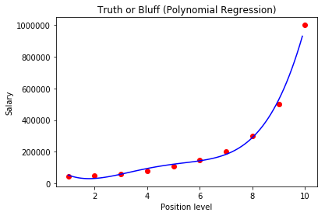
Curve fits the dataset very precisely here in the case of polynomial regression.

Slide 9
Logistic Regression:
It is the go-to method for binary classification problems (problems with two class values).
The two possible dependent variable values are often labelled as "0" and "1", which represent outcomes such as pass/fail, win/lose, alive/dead or healthy/sick.

Slide 10
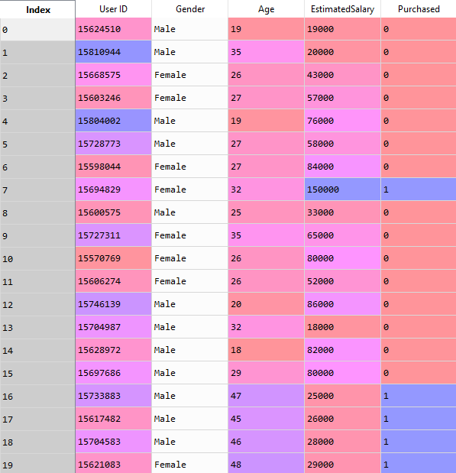
Sample dataset:

Slide 11
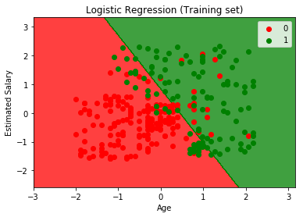
Two separate regions got formed.

