Slide 1
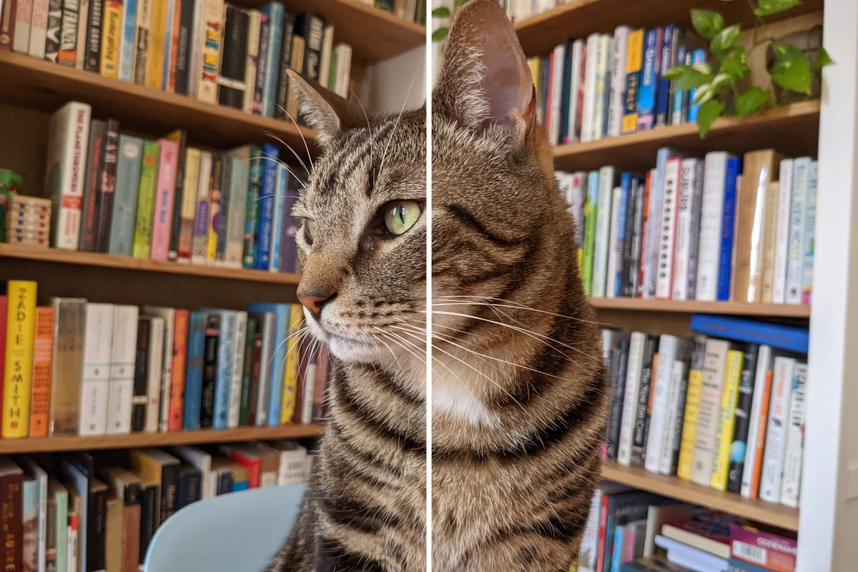

JPEG
PNG
JPEG Vs PNG

Slide 2
Group-7
IMAGE COMPRESSION
JPEG Vs PNG

Slide 3
INTRODUCTION
In order to cope up with the increase in data, new storage devices must be installed and themodems and multiplexers must be improved continuously to permit large scale data transfer.
A solution to these problems is “COMPRESSION” which helps avoiding storage of repetitive data and reduces the storage size.
Image compression is mainly done by two methods: Lossy and Lossless image compression. Here we have done lossy and lossless compression on uncompressed gray scale image to JPEG and PNG formats.
A lot of space is consumed by uncompressed data, which is not effective for limited storage devices, hardwares and internet download speeds.
A commonly used lossy image compression DCT(Discrete Cosine Transform), a Fourier related transform and LZW(Lempel-Ziv-Welch), a dictionary based lossless compression method used for lossless compression is discussed and performed.
In Lossy Compression some data will be lose during image compression and it is used to store data . While Lossless compression is used to transfer data because in lossless compression information will not lose.

Slide 4
PROBLEM STATEMENT
For a given grayscale image in uncompressed format e.g. (TIFF , BMP) apply LZW algorithm and DCT transmission to the image and compress it.

Slide 5
DEMONSTRATION-LZW
Our LZW compression algorithm implemented uses a compression table with 4096 number of table entries used. Single bytes of the input file are assigned 0-255 codes in the table. The encoding starts with entries up to 255 and rest till 4095 are empty initially. As the encoding continues, the algorithm identifies the repeated sequence and if that sequence is not in the table, then it gets added to the table. As repetitive sequences are stored, the efficiency of this algorithm increases with the amount of data and the amount of long or repetitive data in the input.
https://www.geeksforgeeks.org/lzw-lempel-ziv-welch-compression-technique/

Slide 6
LZW–SAMPLE IMAGE
INPUT IMAGE SIZE = 18.2MB (tiff)

Slide 7
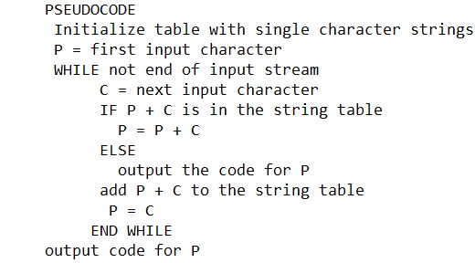
LZW–ENCODING
https://www.geeksforgeeks.org/lzw-lempel-ziv-welch-compression-technique/

Slide 8
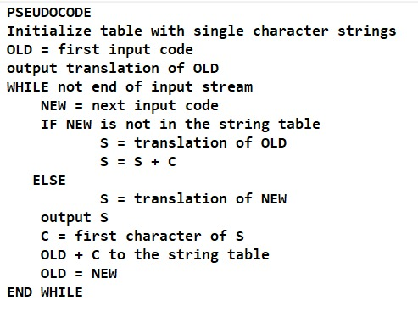
LZW - DECODING
https://www.geeksforgeeks.org/lzw-lempel-ziv-welch-compression-technique/

Slide 9
LZW–OUTPUT IMAGE
OUTPUT SIZE = 2.4MB (PNG)

Slide 10
DEMONSTRATION-JPEG
https://www.youtube.com/watch?v=Q2aEzeMDHMA&t=463s
The way that DCT works, is we take some data, in this case our image data and we try and represent it as the sum of lots of cosine waves.
Each wave represents a small constituent of the output.
The aim to get rid of some of the high frequency signals and the general gist of the image would still be there.
https://www.youtube.com/watch?v=Q2aEzeMDHMA&t=463s

Slide 11
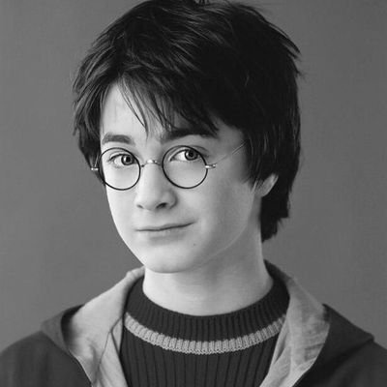
JPEG-SAMPLE IMAGE
INOUT
INPUT IMAGE SIZE = 29.7KB

Slide 12
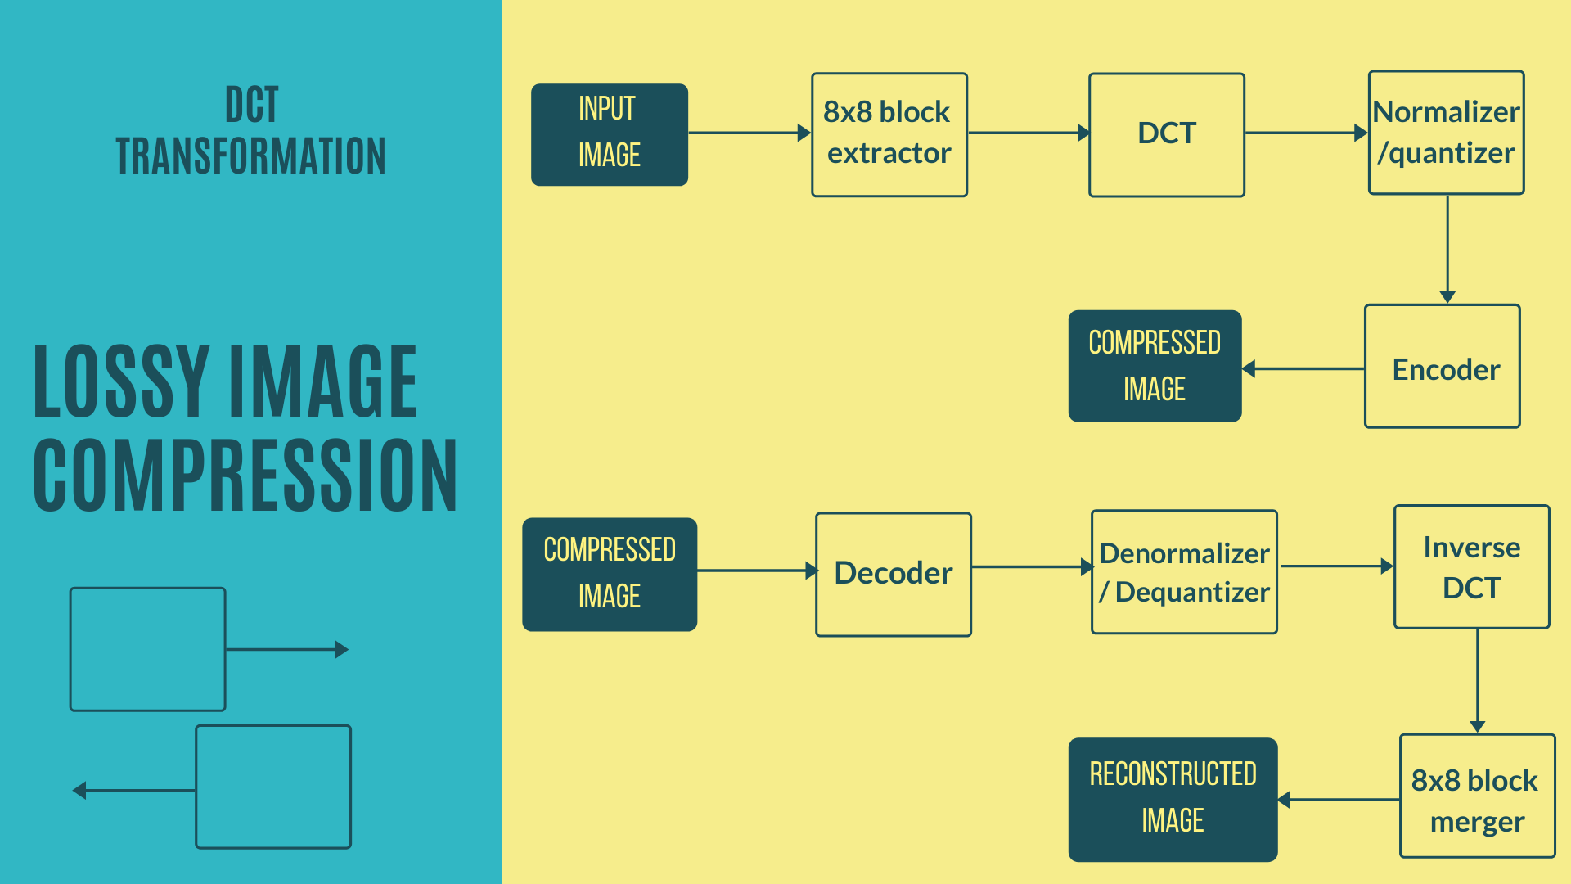
JPEG-PROCESS

Slide 13
JPEG-DCT
62 | 55 | 55 | 54 | 49 | 48 | 47 | 55
62 | 57 | 54 | 52 | 48 | 47 | 48 | 53
61 | 60 | 52 | 49 | 48 | 47 | 49 | 54
63 | 61 | 60 | 60 | 63 | 65 | 68 | 65
67 | 67 | 70 | 74 | 79 | 85 | 91 | 92
82 | 95 | 101 | 106 | 114 | 115 | 112 | 117
96 | 111 | 115 | 119 | 128 | 128 | 130 | 127
109 | 121 | 127 | 133 | 139 | 141 | 140 | 133
-66 | -73 | -73 | -74 | -79 | -80 | -81 | -73
-66 | -71 | -74 | -76 | -80 | -81 | -80 | -75
-67 | -68 | -76 | -79 | -80 | -81 | -79 | -74
-65 | -67 | -68 | -68 | -65 | -63 | -60 | -63
-61 | -61 | -58 | -54 | -49 | -43 | -37 | -36
-46 | -33 | -27 | -22 | -14 | -13 | -16 | -11
-32 | -17 | -13 | -9 | 0 | 0 | 2 | -1
-19 | -7 | -1 | 5 | 11 | 13 | 12 | 5
An 8x8 Sample Matrix of pixels.
Values of pixels rounded to 128

Slide 14
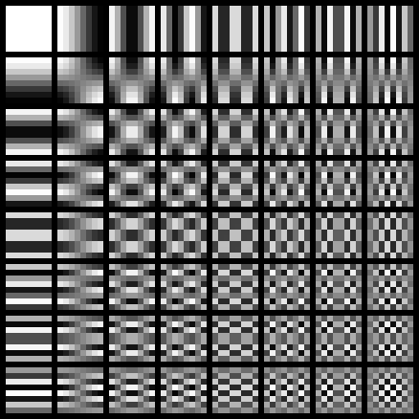
JPEG-DCT
-370 | -29.7 | -2.6 | -2.5 | -1.1 | -3.7 | -1.5 | -0.08
-231 | 44.9 | 24.5 | -0.3 | 9.3 | 3.9 | 4.3 | -1.4
62.8 | 8.5 | -7.6 | -2.7 | 0.3 | -0.4 | 0.5 | -0.8
12.5 | -14.6 | -3.5 | -3.4 | 2.4 | -1.3 | 2.7 | -0.4
-4.9 | -3.9 | 0.9 | 3.6 | 0.1 | 5.1 | 1.1 | 0.5
-0.5 | 3.1 | -1.4 | 0.2 | -1.1 | -1.5 | -1.1 | 0.9
4.4 | 2.3 | -1.7 | -1.6 | 1.1 | -2.7 | 1.1 | -1.4
-10.2 | -1.8 | 5.9 | -0.4 | 0.3 | 0.4 | -1 | 0
Coefficient Matrix after performing DCT
Cosine waves of different frequencies

Slide 15
JPEG-QUANTIZATION
Quantization is a process performed on transformed matrix to round off each element in the 8x8 matrix so that we can remove values with higher frequency and who’s contribution is significantly low in our data
Process of quantization is achieved by dividing 8x8 DCT transformed matrix element by element and rounding off them so that the low contributing data rounds off to zero as described in the figure above.
https://cs.stanford.edu/people/eroberts/courses/soco/projects/data-compression/lossy/jpeg/coeff.htm

Slide 16
JPEG-QUANTIZATION
In this demonstration for performing quantization process we have used the default JPEG 8x8 quantization table called Luminance Quantization Table shown below
16 | 11 | 10 | 16 | 24 | 40 | 51 | 61
12 | 12 | 14 | 19 | 26 | 58 | 60 | 55
14 | 13 | 16 | 24 | 40 | 57 | 69 | 56
14 | 17 | 22 | 29 | 51 | 87 | 80 | 62
18 | 22 | 37 | 56 | 68 | 109 | 103 | 77
24 | 35 | 55 | 64 | 81 | 104 | 113 | 92
49 | 64 | 78 | 87 | 103 | 121 | 120 | 101
72 | 92 | 95 | 98 | 112 | 100 | 103 | 99

Slide 17
JPEG-QUANTIZATION
-23 | -2 | 0 | 0 | 0 | 0 | 0 | 0
-21 | 4 | 2 | 0 | 0 | 0 | 0 | 0
6 | 1 | 0 | 0 | 0 | 0 | 0 | 0
1 | -1 | 0 | 0 | 0 | 0 | 0 | 0
0 | 0 | 0 | 0 | 0 | 0 | 0 | 0
0 | 0 | 0 | 0 | 0 | 0 | 0 | 0
0 | 0 | 0 | 0 | 0 | 0 | 0 | 0
0 | 0 | 0 | 0 | 0 | 0 | 0 | 0
-23 | -2 | 0 | 0 | 0 | 0 | 0 | 0
-21 | 4 | 2 | 0 | 0 | 0 | 0 | 0
6 | 1 | 0 | 0 | 0 | 0 | 0 | 0
1 | -1 | 0 | 0 | 0 | 0 | 0 | 0
0 | 0 | 0 | 0 | 0 | 0 | 0 | 0
0 | 0 | 0 | 0 | 0 | 0 | 0 | 0
0 | 0 | 0 | 0 | 0 | 0 | 0 | 0
0 | 0 | 0 | 0 | 0 | 0 | 0 | 0
Sample matrix obtained after quantization
Sample matrix obtained after quantization

Slide 18
JPEG-ENCODING
Zigzag Scan:
Converts 8x8 matrix to 1x64 vector.
Arranges the values with increasing order of frequency.
Run Length Encoding (RLE):
There will be lots of zeros in 1x64 vector.
RLE will encode them as (skip, value) where, skip is the number of zeros and value is the next non-zero value.

Slide 19
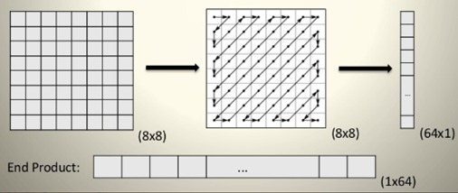
JPEG-ENCODING
https://www.javatpoint.com/jpeg-compression

Slide 20

JPEG-OUTPUT IMAGE
OUTPUT IMAGE SIZE = 15.7KB

Slide 21
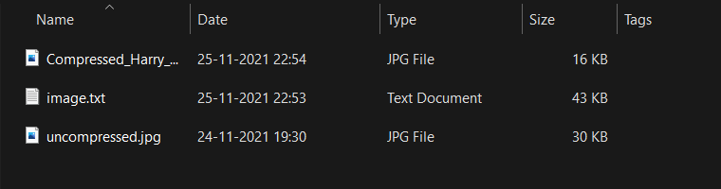
TOTAL-OUTPUT FILES

Slide 22
CONCLUSIONS
Overall, we have implemented two image compression named JPEG and PNG (LZW) to show that how these individual processes affect the size of the image and how these processes are used in day-to-day life such as PNG is used when we don’t want to lose the data, but we want to transfer the data with less memory, and in case of JPEG, we want to reduce the size of the respective file so that we can store the file at low storage.

Slide 23
Role of each group member in the project
Kush – Zig-Zag scan code, DCT explanation, Report and PPT.
Kathan – Image to RLE Code, Quantization Explanation of DCT, and PPT
Devyash – LZW Code and Explantion, Research of LZW DCT, and Report
Meet – Introduction, LZW Code and explanation, Research of LZW, and PPT
Dev – RLE to Image Code and Encoding Explanation of DCT, and Report

Slide 24
REFERENCES
https://www.youtube.com/watch?v=Q2aEzeMDHMA&t=463s
https://www.geeksforgeeks.org/lzw-lempel-ziv-welch-compression-technique/
https://www.javatpoint.com/jpeg-compression
https://cs.stanford.edu/people/eroberts/courses/soco/projects/data-compression/lossy/jpeg/coeff.htm
https://aminoapps.com/c/potter-amino-em-portugues/page/item/harry-james-potter/0vmx_65TZIYKRP3gqaG2pwo74QWWpm4GEk

