Slide 1
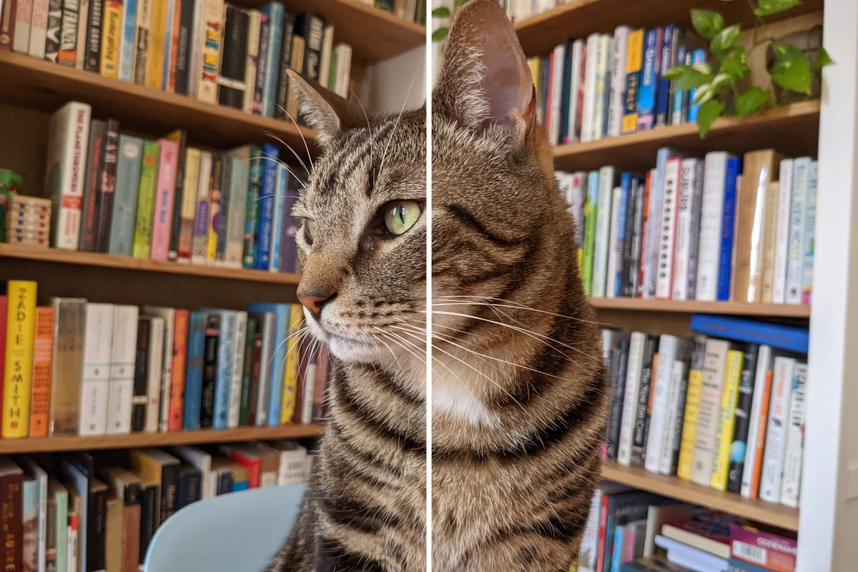

JPEG
PNG
JPEG Vs PNG

Slide 2
Group-7
IMAGE COMPRESSION
JPEG Vs PNG

Slide 3
BACKGROUND
Image compression is mainly done by two methods: Lossy and Lossless image compression.
In this project we have tried to perform lossy and lossless compression on a gray scale uncompressed image to JPEG and PNG formats respectively.
A commonly used lossy image compression DCT(Discrete Cosine Transform), a Fourier related transform and LZW(Lempel-Ziv-Welch), a dictionary based lossless compression method used for lossless compression is discussed and performed.

Slide 4
MOTIVATION
In recent years, transferring of large-scale information by remote computing has shown a tremendous growth.
In order to cope up with the increase in data, new storage devices must be installed and themodems and multiplexers must be improved continuously to permit large scale data transfer.
A solution to these problems is “COMPRESSION” which helps avoiding storage of repetitive data and reduces the storage size.
A lot of space is consumed by uncompressed data, which is not effective for limited storage devices, hardwares and internet download speeds.
Example: One minute of uncompressed HD video can be over 1 GB.How can we fit a two-hour film on a 25 GB Blu-ray disc?

Slide 5
PROBLEM STATEMENT
For a given grayscale image in uncompressed format e.g. (TIFF , BMP) apply LZW algorithm and DCT transmission to the image and compress it.

Slide 6
LITERATURE SURVEY
As there is a vast flow of images on the internet, and an uncompressed image demands more space and transmission bandwidth, image compression is an essential subject of research. It's also crucial to create a system that compresses the image while keeping the key information in mind. Researchers discovered that the quality of an image created using lossless compression is superior than that created using lossy compression when comparing the two ways of image compression: lossy and lossless.
Reading a sequence of symbols, arranging the symbols into strings, and translating the strings into codes is how LZW compression works. We achieve compression because the codes take up less space than the strings they replace. When using LZW compression to compress an image, the type of image and amount of colours must be taken into account, and LZW compression will be utilised in some circumstances. For coloured and grayscale photos, the constraint will be reduced by using bit plan slicing. The proposed method outperforms the typical LZW method by doubling the compression ratio for grayscaled images.

Slide 7
LITERATURE SURVEY
The discrete cosine transform (DCT) represents an image as a sum of sinusoids of varying magnitudes and frequencies. The dct2 function computes the two-dimensional discrete cosine transform (DCT) of an image. The DCT has the property that, for a typical image, most of the visually significant information about the image is concentrated in just a few coefficients of the DCT. For this reason, the DCT is often used in image compression applications. For example, the DCT is at the heart of the international standard lossy image compression algorithm known as JPEG.

Slide 8
LITERATURE SURVEY
The image is transformed using Discrete Cosine Transform. The DCCoefficient is then extracted from the Discrete Cosine Transformed Matrix and individually saved or communicated. With a threshold value, the Discrete Cosine Transformed matrix is truncated without the DC-coefficient. Singular Value Decomposition is done to this truncated matrix. The Singular Value Decomposition matrices are shortened again with a suitable cutoff value. These matrices are then multiplied back together. The resulting matrix is trimmed once more with the threshold value. The matrix is then quantized. The quantized matrix is then transformed into a sparse matrix. The sparse matrix elements are then converted to data types. The sparse matrix's column elements are run length encoded, and the compressed image may then be obtained. This compressed version can be saved or sent.

Slide 9
REPRODUCED WORK
We have used LZW algorithms on a word file containing random lines and texts. Following are the results in which we have compared the raw data and the encoded data using our algorithm (4096 bits). We have also presented the same result graphically.
Encoded Data (in bytes)

Slide 10
REPRODUCED WORK
4786 | 2288
4810 | 3630
8585 | 5474
5321 | 3812
5840 | 4136
4268 | 3294
4276 | 3088
6067 | 4442
Raw Data (in bytes)
Encoded Data (in bytes)

Slide 11
REPRODUCED WORK

Slide 12
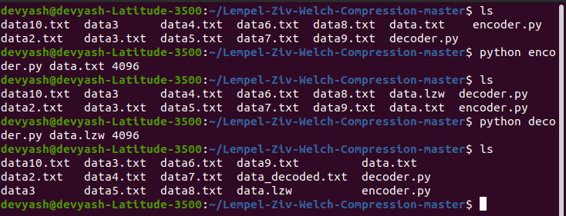
REPRODUCED WORK
Raw Data (in bytes)
Encoded Data (in bytes)

Slide 13
CONTRIBUTIONS
Kush - Literature Survey, Plan of Action.
Kathan - Introduction, PPT Designing and Plan of Action.
Devyash - Reproduced work, Latex, Problem Statement.
Meet - Motivation, Reproduced work, Research.
Dev - Background and Reproduced work.

Slide 14
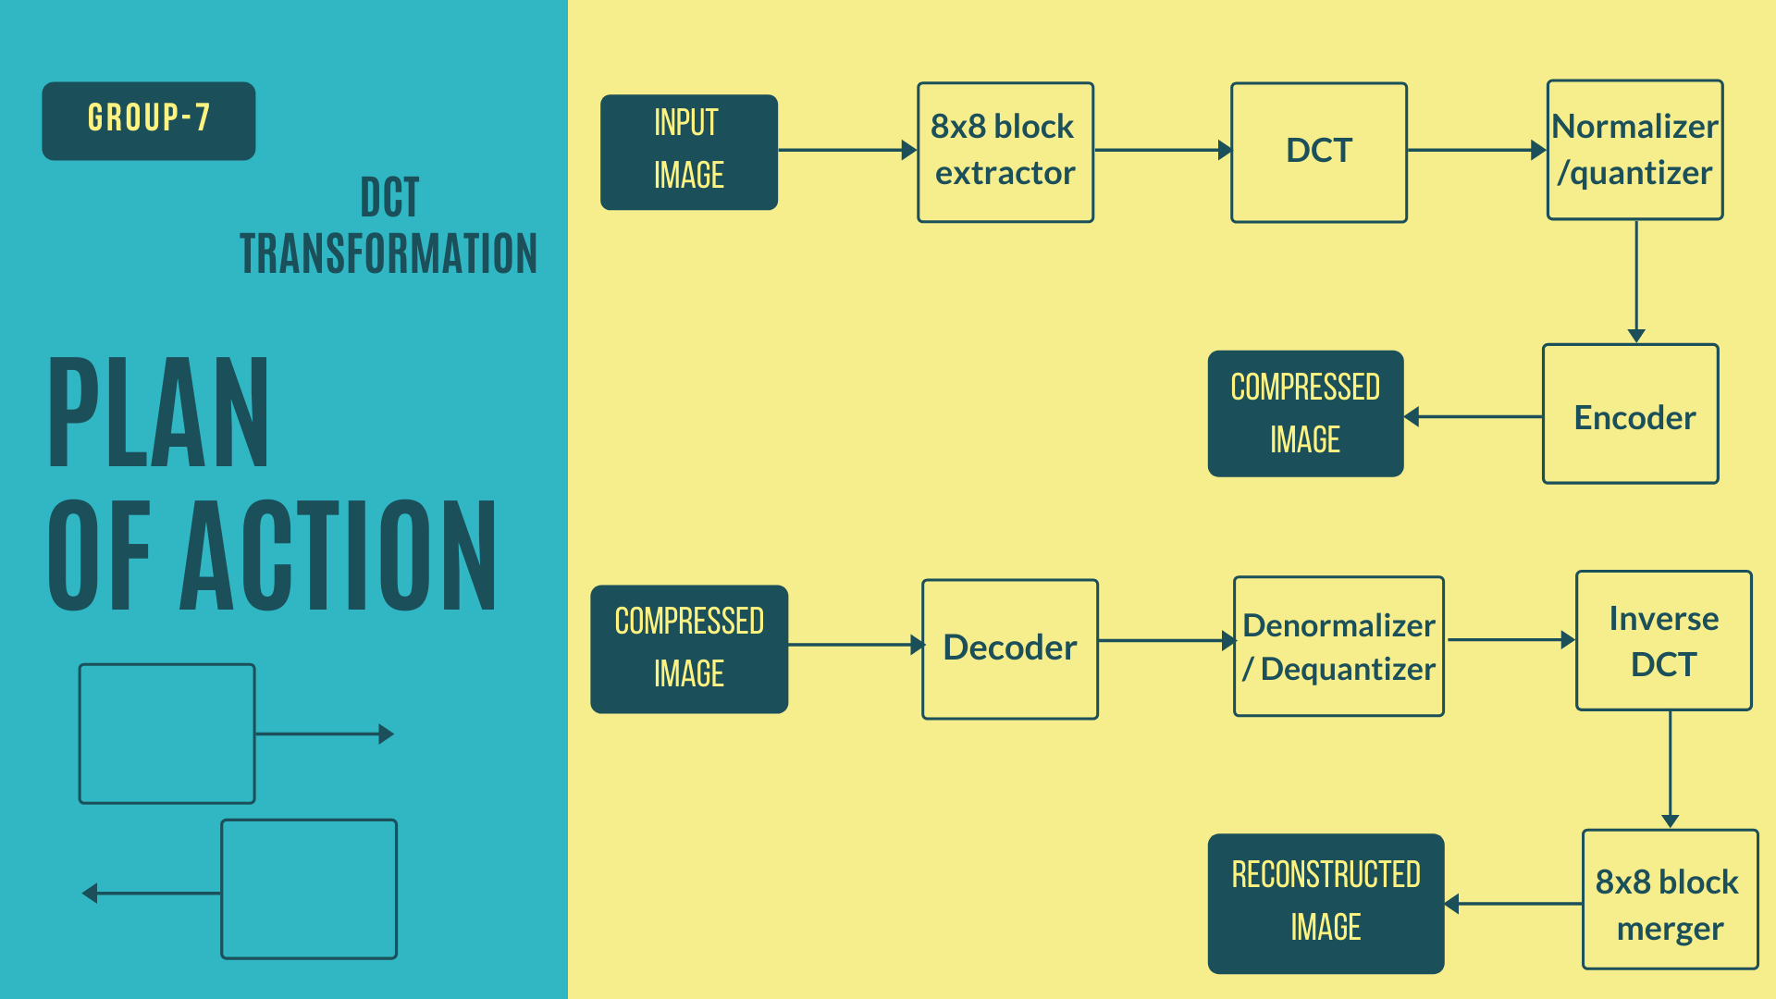
PLAN OF ACTION

