Slide 1

React

Slide 2

Developed by Facebook
Declarative
Web Components
Performant

Slide 3
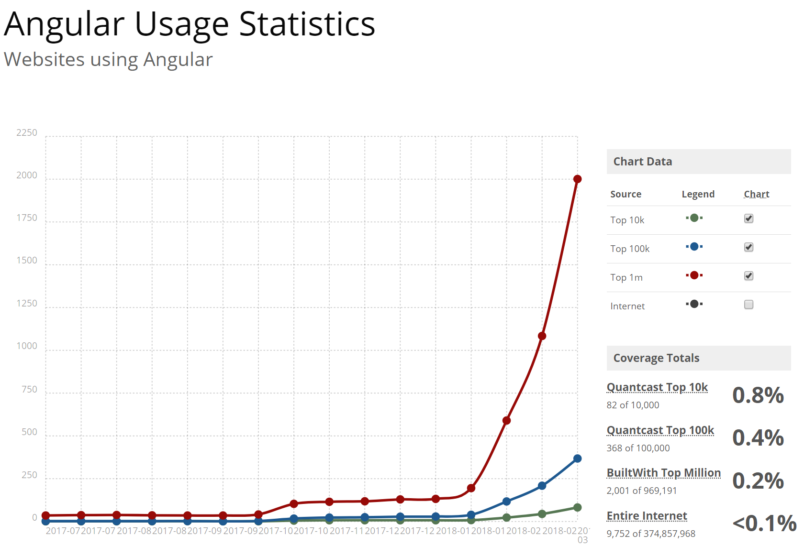
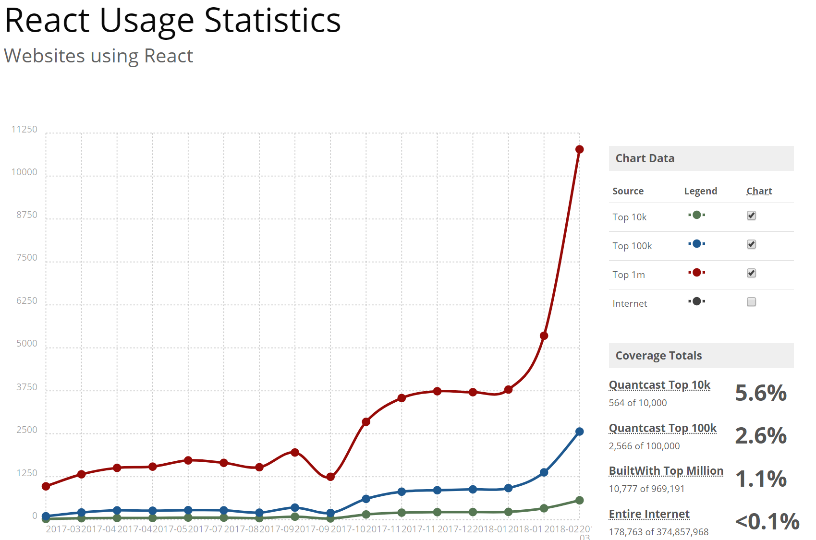
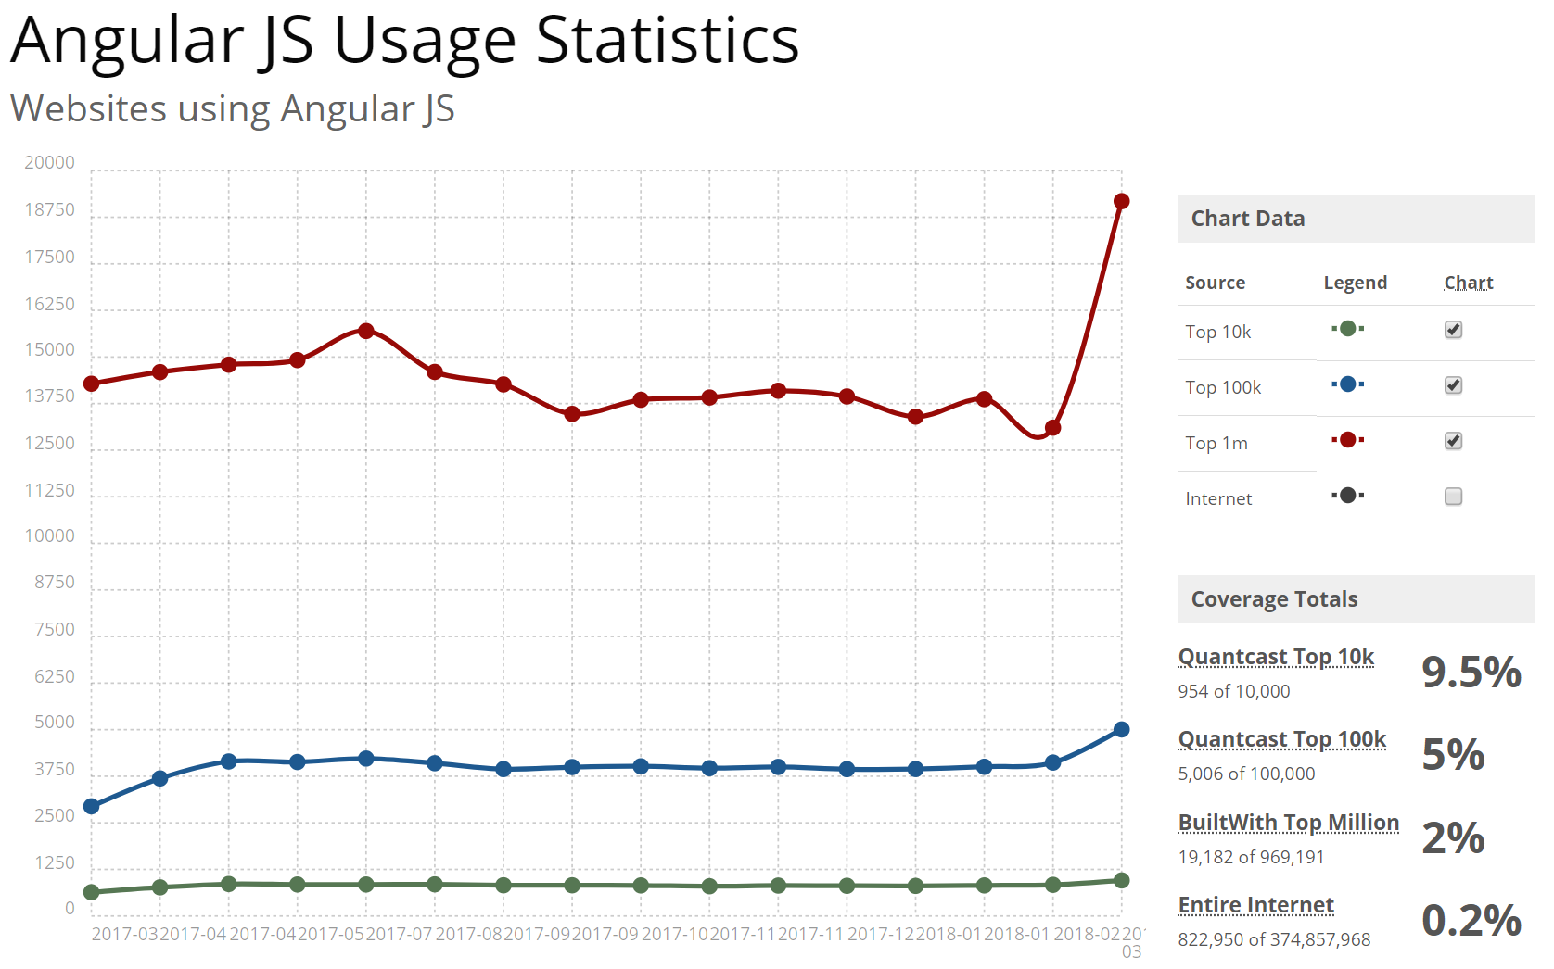
Source: https://builtwith.com

Slide 4
