Slide 1


Slide 2


Slide 3

HTML , CSS ,Javascript , php and Mysql
Theory & hands-on code
Practice code
Lesson recordings
Students Q&A
Real world project design
Real world project development

Slide 4


Slide 5


Slide 6
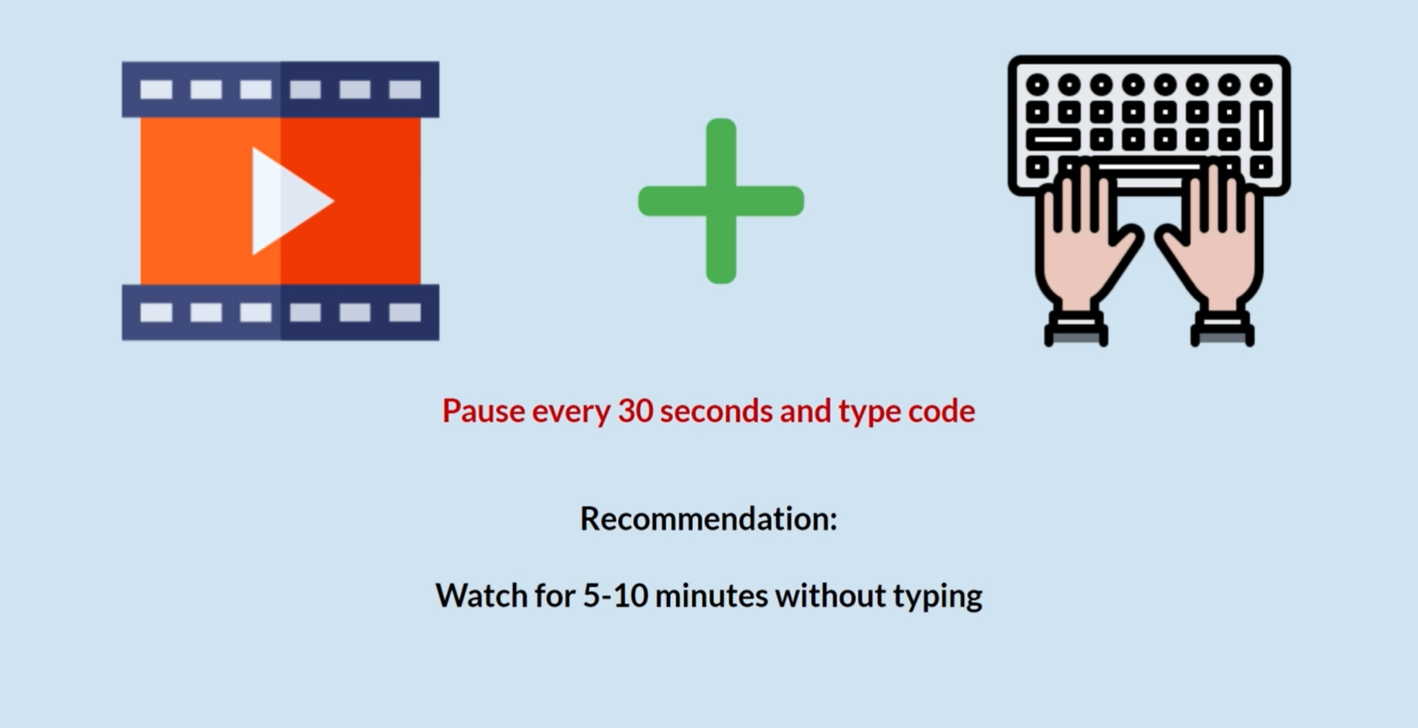

Slide 7


Slide 8



Slide 9


Slide 10
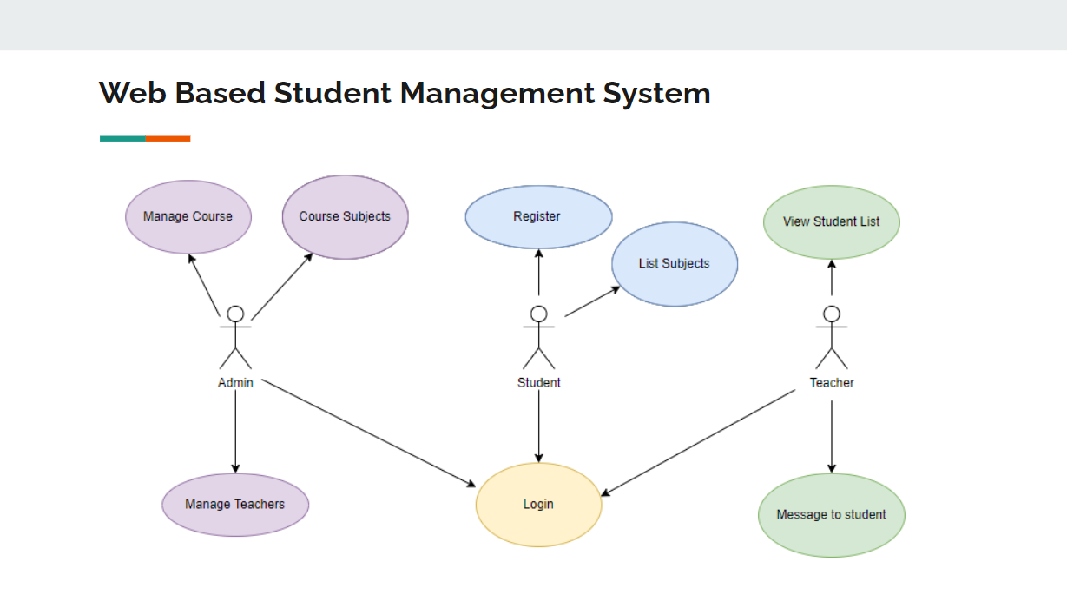

Slide 11
Lets Get Started
Introduction to HTML
Php environment setup

