Slide 1

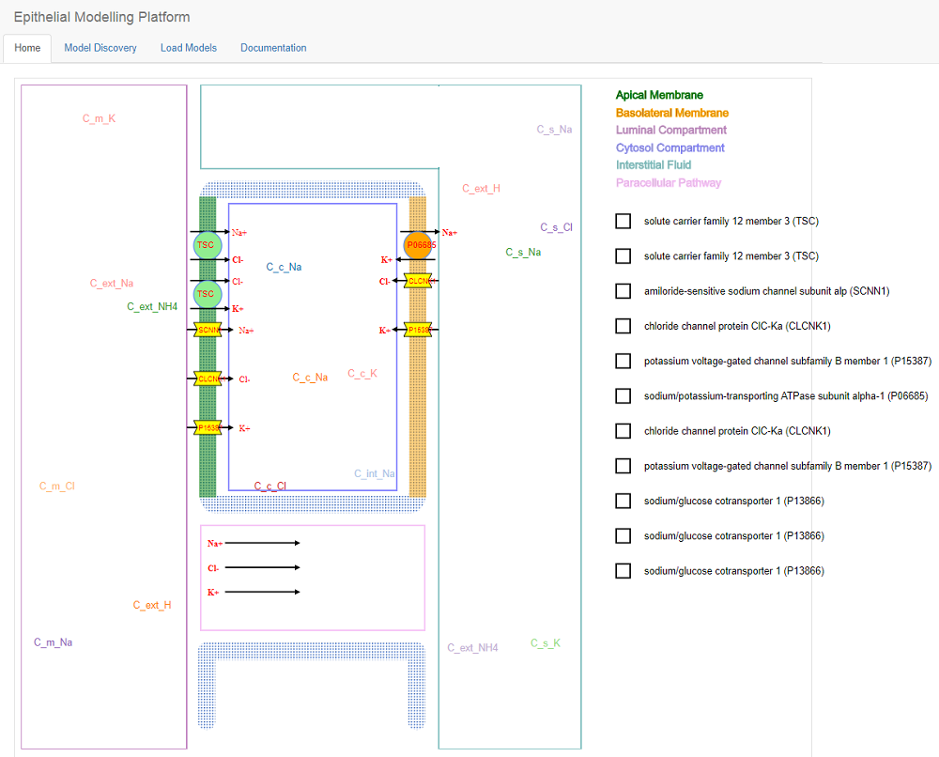
MODEL DISCOVERY LOAD MODELS DOCUMENTATION
An epithelial transport discovery, exploration and assembly tool for novice modelers' to make a new epithelial model from scratch
Discover CellML Models
Models Overlapping
Modelling Platform
Recommender System
Epithelial modelling platform is a web-based epithelial transport discovery, exploration and assembly tool. User can use this tool to learn how to develop a new epithelial model from the very begining. Hello this is dewan mahabub sarwar from Read More
Epithelial modelling platform is a web-based epithelial transport discovery, exploration and assembly tool. User can use this tool to learn how to develop a new epithelial model from the very begining. Hello this is dewan mahabub sarwar from Read More
Epithelial modelling platform is a web-based epithelial transport discovery, exploration and assembly tool. User can use this tool to learn how to develop a new epithelial model from the very begining. Hello this is dewan mahabub sarwar from Read More
Epithelial modelling platform is a web-based epithelial transport discovery, exploration and assembly tool. User can use this tool to learn how to develop a new epithelial model from the very begining. Hello this is dewan mahabub sarwar from Read More
CellML PMR CONTACT @ 2017 – Epithelial Modelling Platform

