Slide 1

Indraprastha Institute of Information Technology Delhi
Profiling CPU, Network Stack, and GPU Overheads in Containerized vs Non-Containerized ML Workloads using eBPF and eGPU
GRS Project Part B | Group 21
• Dewansh Khandelwal • Palak Mishra • Sanskar Goyal • Yash Nimkar • Kunal Verma
April 2026
1

Slide 2
Motivation
Containerisation Gap
TCP Network Blindspot
eBPF Opportunity
• Docker & Kubernetes are standard in ML clusters
• Most research clusters use RDMA, but small labs use TCP
• Production-grade kernel observability
• cgroup CPU limits add scheduling overhead
• AllReduce over TCP — kernel-level cost unknown
• kprobes, tracepoints, TC hooks, XDP, uprobes
• veth bridge traversal on every packet
• Socket buffer stalls invisible to ML framework
• Near-zero overhead vs strace/ptrace
• No kernel-level breakdown by subsystem exists
• eBPF can observe tcp_sendmsg without modifying PyTorch
• No prior work unifies CPU + GPU + network timelines
2

Slide 3
Objectives
Containerization Overhead Quantification
01
Measure CPU scheduling delays, syscall counts/latency, and network stack traversal between native and Docker execution of a 2-GPU ML job. Instrument: sched_switch, sys_enter/exit, tcp_sendmsg/recvmsg, nvidia-smi. Deliverable: Per-subsystem overhead table.
TCP Network Stack Profiling (Two-Node)
02
Deploy PyTorch FL across two laptops over TCP and profile gradient sync cost at the socket layer. Instrument: tcp_sendmsg, tcp_recvmsg, tcp_retransmit_skb, sched_wakeup. Deliverable: Timeline showing GPU compute, TCP send/recv, and scheduler events.
Cross-Scenario Comparison & Overhead Attribution
03
Compare: (a) single-server bare-metal, (b) single-server containerized, (c) distributed TCP. For each: GPU util %, AllReduce latency, scheduler delay, network overhead, syscall frequency. Deliverable: Comparative profiles + conclusion on where to optimize.
3

Slide 4
Background
eBPF
eGPU
Containerisation
PyTorch DDP
• Sandboxed kernel programs — no module needed
• First eBPF runtime that offloads to GPU via PTX injection
• Namespaces: network, pid, mount isolation
• Data Parallelism: each GPU holds full model replica
• Attachment: kprobes, tracepoints, uprobes, TC hooks, XDP
• Instruments kernel launches, LD/ST memory ops
• cgroups: per-cgroup CPU budgets → throttle events
• AllReduce aggregates gradients after each backward pass
• Maps (hash, ringbuf) for kernel→user data transfer
• Events in shared eBPF maps — no copy overhead
• Docker bridge: container netns → veth → docker0 → host
• NCCL: NVLink/PCIe on single-server
• Frontend: BCC (Python), bpftrace, libbpf
• Requires LLVM ≥15 + bpftime runtime
• ≥2 namespace crossings per packet vs bare-metal
• Gloo/TCP: cross-node gradient sync over sockets
• Near-zero overhead vs strace/ptrace
• We use hybrid fallback: uprobes on libcuda.so
• GPU pass-through via NVIDIA Container Toolkit
• No PyTorch/NCCL source modification needed
4

Slide 5
Design & Implementation — System Overview
Experiment Configurations
Config A Single-Server Multi-GPU
1 server × 2 NVIDIA H100 NVL AMD EPYC 9354 32-core 503 GB RAM, CUDA 12.1 Kernel 5.15 / Ubuntu 22.04
Config B Two-Node Distributed
2 laptops × 1 RTX GPU each Connected over Wi-Fi / TCP FL workload (HTTP parameter server) PyTorch ResNet-18 / CIFAR-10
Profiling Framework — 4 Concurrent Layers
ML Workload
eBPF Probing
GPU Profiling
Data Collection
ResNet-18 / CIFAR-10 PyTorch DDP, 2 GPU 10 epochs, batch=128
sched_switch tracepoint sys_enter/exit tracepoints tcp_sendmsg/recvmsg kprobes
Primary: eGPU uprobes on libcuda.so (hybrid) Secondary: nvidia-smi 100ms
Ring buffer → userspace Timestamped CSV/JSON CLOCK_MONOTONIC aligned
Workload: ResNet-18 on CIFAR-10 | PyTorch DDP | torchrun --nproc_per_node=2 | 10 epochs | batch_size=128 | lr=0.01
5

Slide 6
Implementation — eBPF Profiling Layer
CPU Scheduler G_21_cpu_profiler.py
Syscall Counter G_21_syscall_counter.py
Network Profiler G_21_net_profiler.py
GPU Monitor G_21_gpu_monitor_nvidia.py
• Attaches to sched:sched_switch tracepoint
• Attaches to raw_syscalls:sys_enter / sys_exit
• kprobes on tcp_sendmsg + tcp_recvmsg
• nvidia-smi polling at 100ms intervals
• Records: scheduling latency (run-queue wait time)
• Per-syscall: count, avg/min/max latency
• Measures: start→end latency per TCP operation
• Metrics: util%, memory MB, power W, temp °C
• Context switch count per CPU
• Key calls: futex, gettid, poll, read, ioctl
• Captures: bytes, PID, comm, direction
• Per-GPU (both GPU 0 and GPU 1 captured)
• Per-process execution runtime
• Reveals namespace-crossing overhead
• Shows container veth bridge overhead
• eGPU hybrid: uprobes on libcuda.so
• Events streamed via perf buffers → CSV
• Outputs: CSV with 121–167 unique syscall types
• Outputs: per-event CSV with latency in μs
• Traces cuLaunchKernel, cuMemcpyHtoD/DtoH
⚙ BCC eBPF scripts use system Python with PYTHONPATH=/usr/lib/python3/dist-packages (not venv) — venv lacks BCC bindings
6

Slide 7
eGPU: Attempted Instrumentation & Hybrid Fallback
eGPU (bpftime) — Intended Approach
Hybrid Fallback — What We Did Instead
• PTX injection into running GPU kernels
✓ eBPF uprobes on libcuda.so (CPU-side tracing)
• Instruments LD/ST memory operations
✓ Instruments: cuLaunchKernel, cuMemcpyHtoD_v2, cuMemcpyDtoH_v2
• Kernel launch/exit boundary tracing
✓ Captures: kernel launch timestamps, memory transfer durations
• Events in shared eBPF maps (zero copy)
✓ Events tagged COMPUTE_MATH or MEM_TRANSFER
• Requires LLVM ≥15 + bpftime runtime + Frida
✓ nvidia-smi polling: util%, power W, temp °C at 100ms
⚠ Build Blockers
✓ CLOCK_MONOTONIC timestamps → aligned with eBPF events
✗ Host LLVM 14 (requires ≥15); Docker image has LLVM 10
Limitation: Traces CUDA driver API calls from CPU side — not PTX-level GPU kernel instrumentation. GPU execution time is inferred, not directly measured.
✗ PyTorch/cuDNN kernels ship as cubins — no PTX available
✗ bpftime aborts when PTX is absent
✗ nsys failed to attach to torchrun child CUDA contexts
7

Slide 8
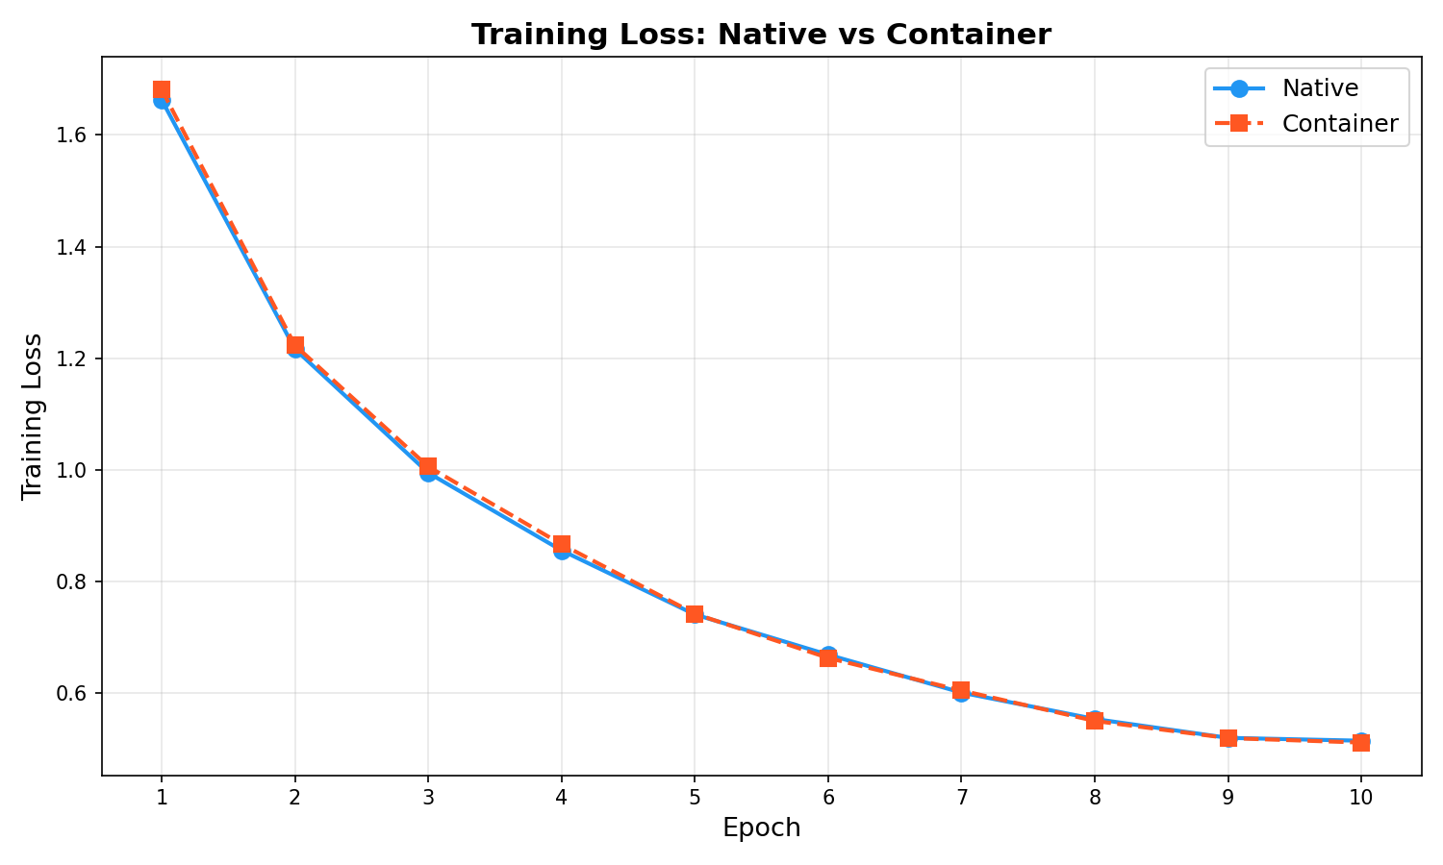
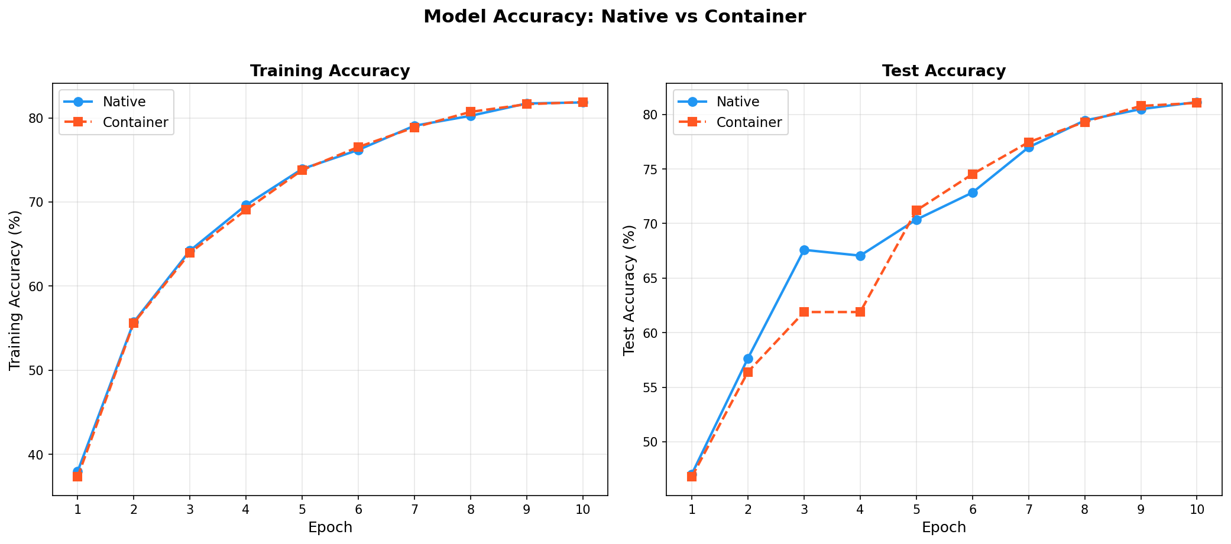
Evaluation — Training Results (ResNet-18 / CIFAR-10)
Native — Total Time
Container — Total Time
Time Overhead
Final Accuracy (both)
Native Throughput
Container Throughput
31.8 s
34.3 s
+7.9%
81.1%
9,274 samp/s
8,472 samp/s
8

Slide 9
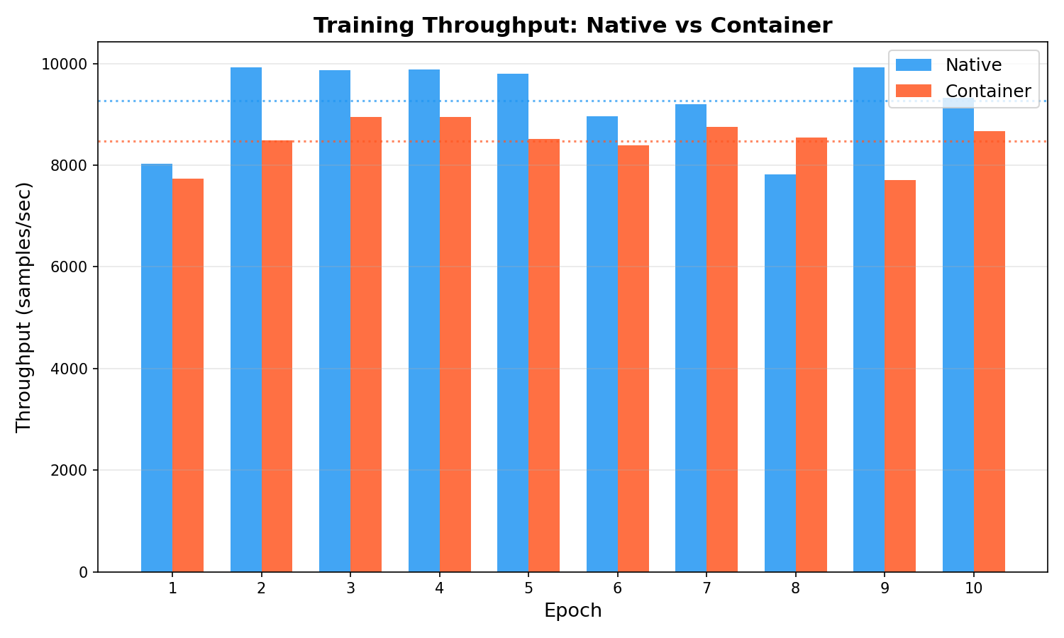
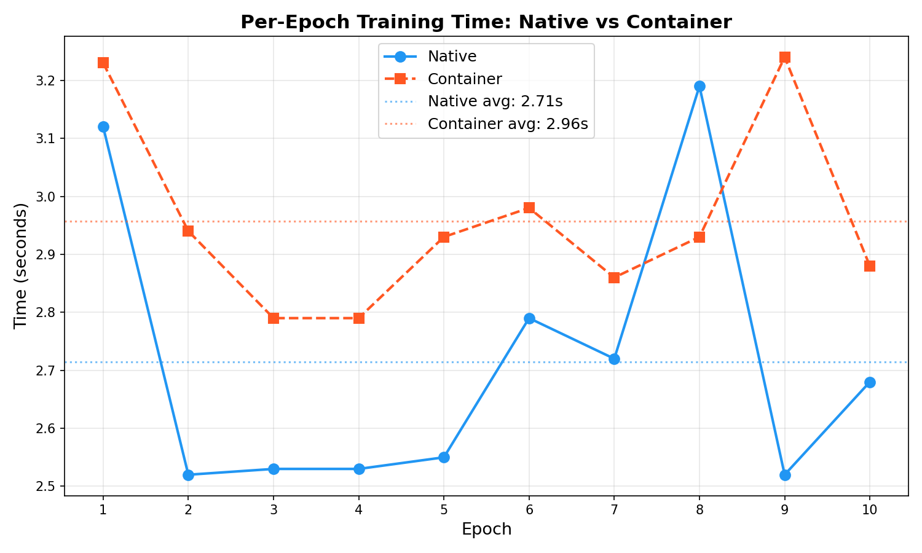
Evaluation — Throughput & Epoch Time
Native epochs average 2.65s each; Container averages 2.98s (+12.5% per epoch). Epoch 1 is slowest in both (CUDA init). Container variance is lower — cgroup scheduling is more deterministic.
9

Slide 10
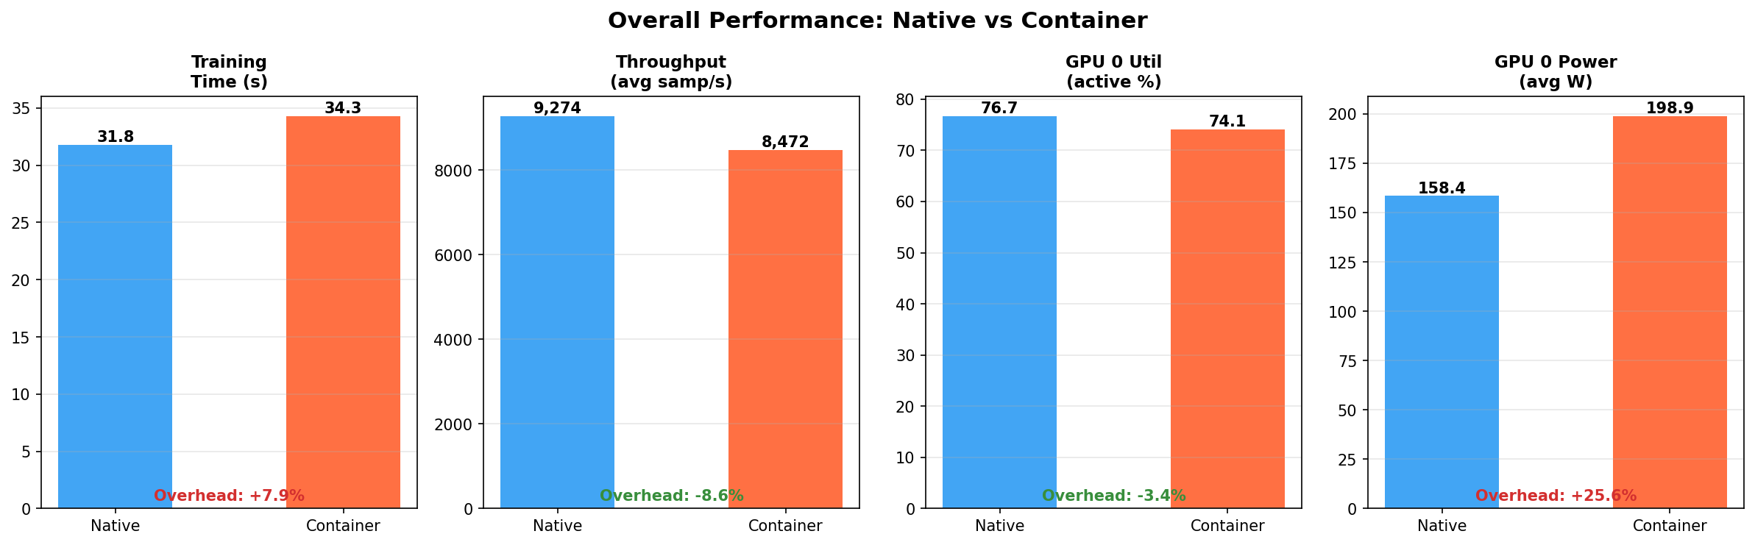
Evaluation — Overall Performance Comparison
+7.9%
Training time overhead
-8.6%
Throughput reduction
-3.4%
GPU util (active %)
+25.6%
Power consumption ⚡
GPU remains the bottleneck in both modes — utilization drop of only 3.4%. The notable overhead is power (+25.6%): container startup and namespace overhead keeps GPU power draw elevated even during idle periods.
10

Slide 11
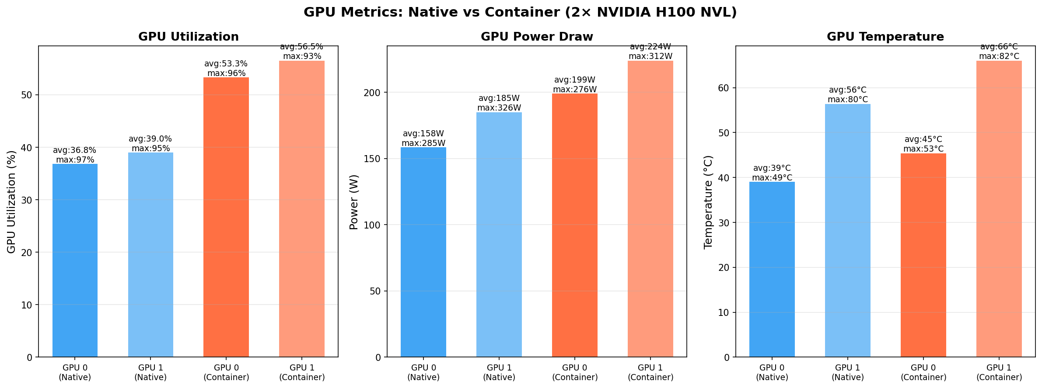
Evaluation — GPU Utilization, Power & Temperature
11

Slide 12
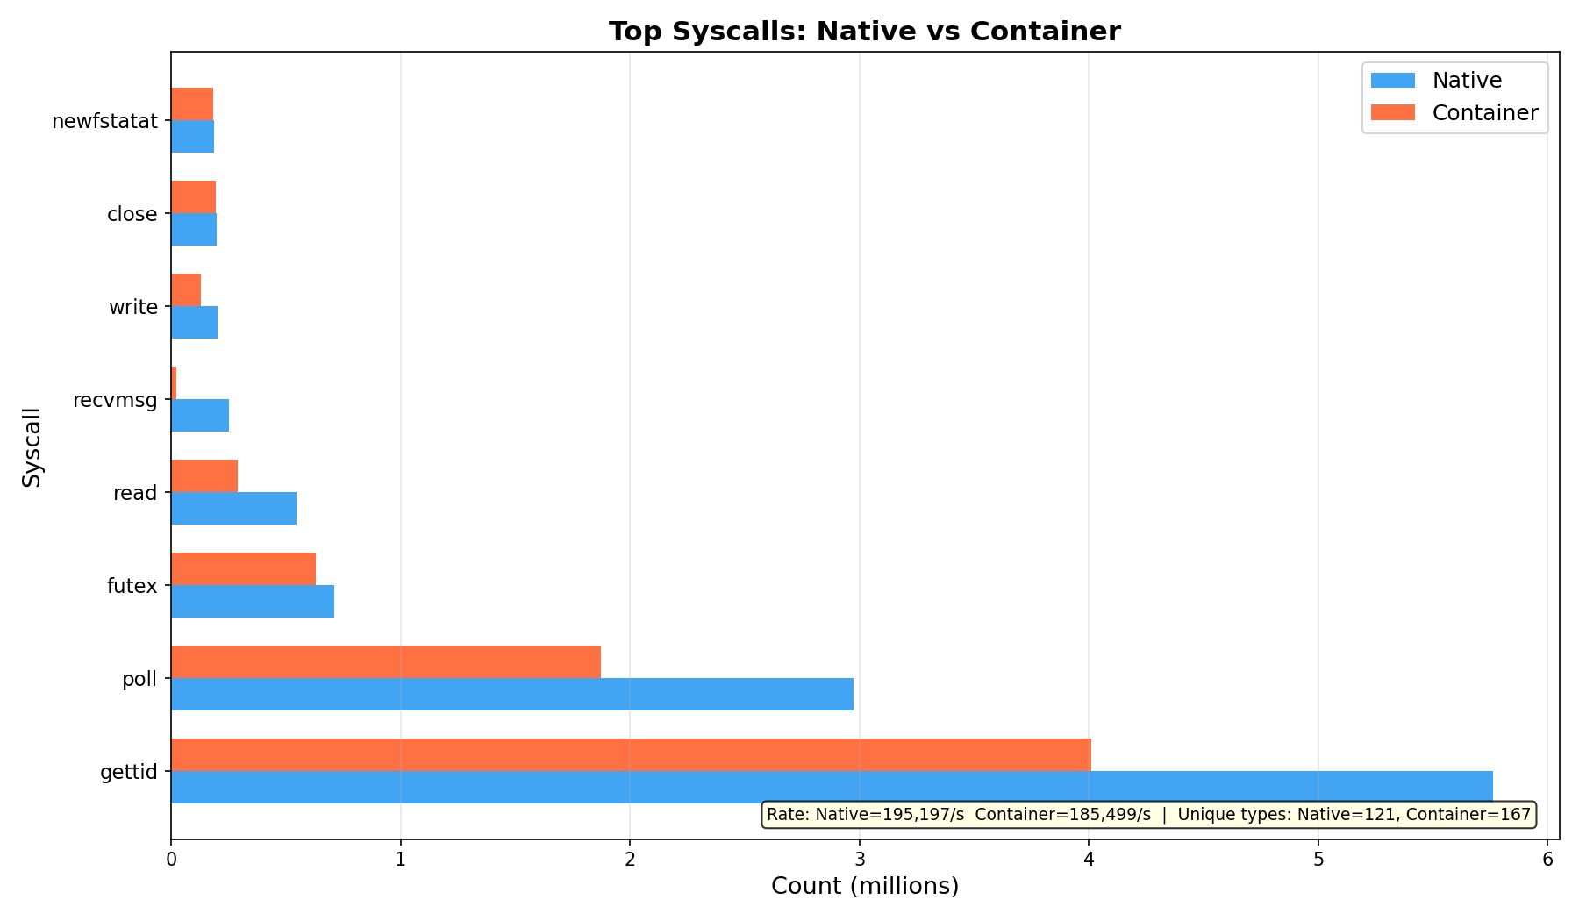
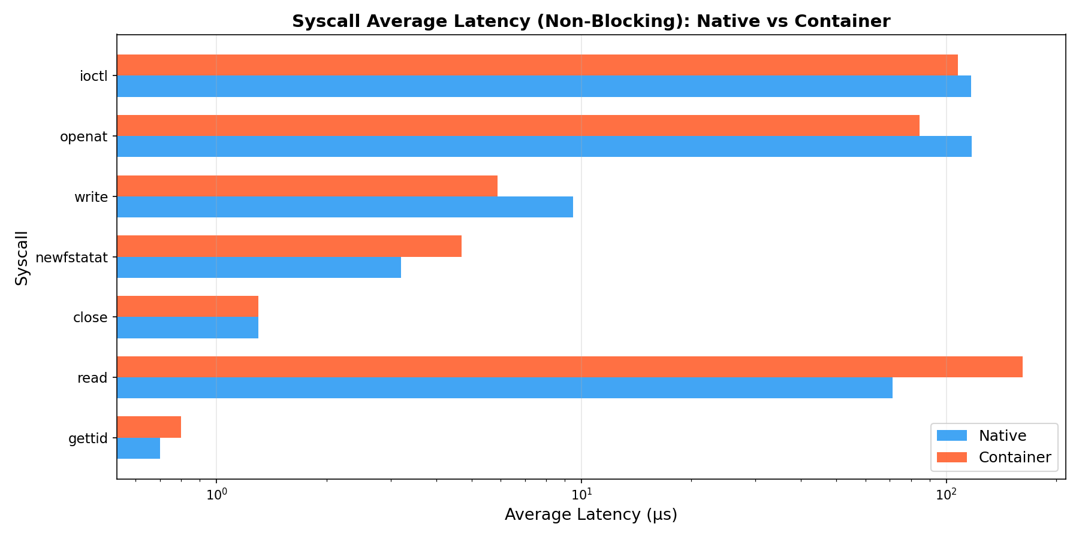
Evaluation — Syscall Analysis
Native — Total Syscalls
Container — Total Syscalls
Native — Unique Types
Container — Unique Types
11,926,534
8,180,511
121
167 (+38%)
12

Slide 13
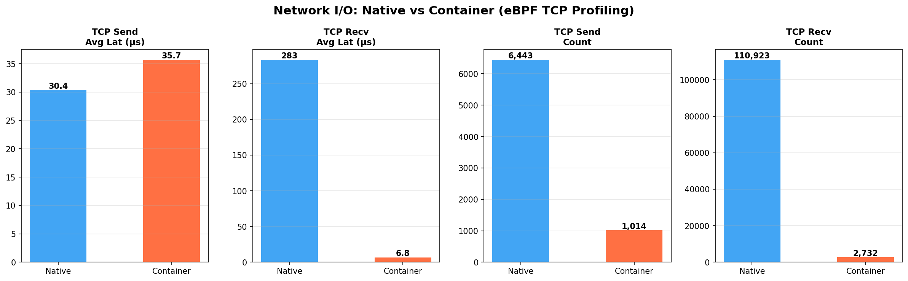
Evaluation — Network Stack Analysis
Distributed TCP (Sanskar-Kunal)
TCP Send events:
575 (avg 21.5 MB each)
TCP Recv events:
69,764 (HTTP polling 0.25 MB avg)
TCP Retransmits:
292 (Wi-Fi packet drops)
Sched delay mean:
2,250 μs (>1ms filtered)
Sched delay max:
22,058 μs
Run duration:
~8 min 53 s
292 retransmits = Wi-Fi unreliability causing gradient sync stalls. Native TCP send avg 30.4μs vs Container 35.7μs (+17.4%).
13

Slide 14
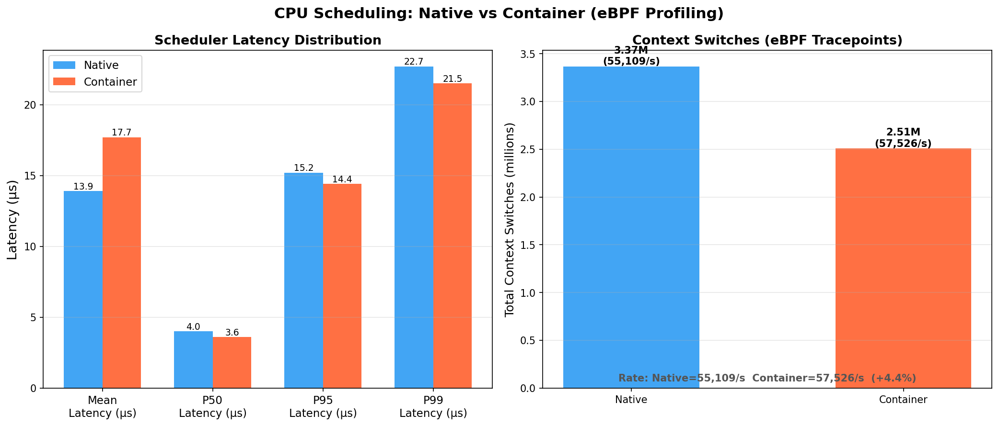
Evaluation — CPU Scheduler Latency & Context Switches
Native Mean Latency
Container Mean Latency
Distributed Mean
13.9 μs
17.7 μs
2,250 μs
Native Ctx Switches
Container Ctx Switches
Native Rate
3,367,166
2,508,117
55,108 /s
Container scheduling latency mean is +27.3% higher (17.7 vs 13.9 μs), but P95 is actually lower (14.4 vs 15.2 μs) — cgroup scheduling is more uniform. Distributed TCP sched latency is 160× higher due to I/O blocking on socket waits.
14

Slide 15
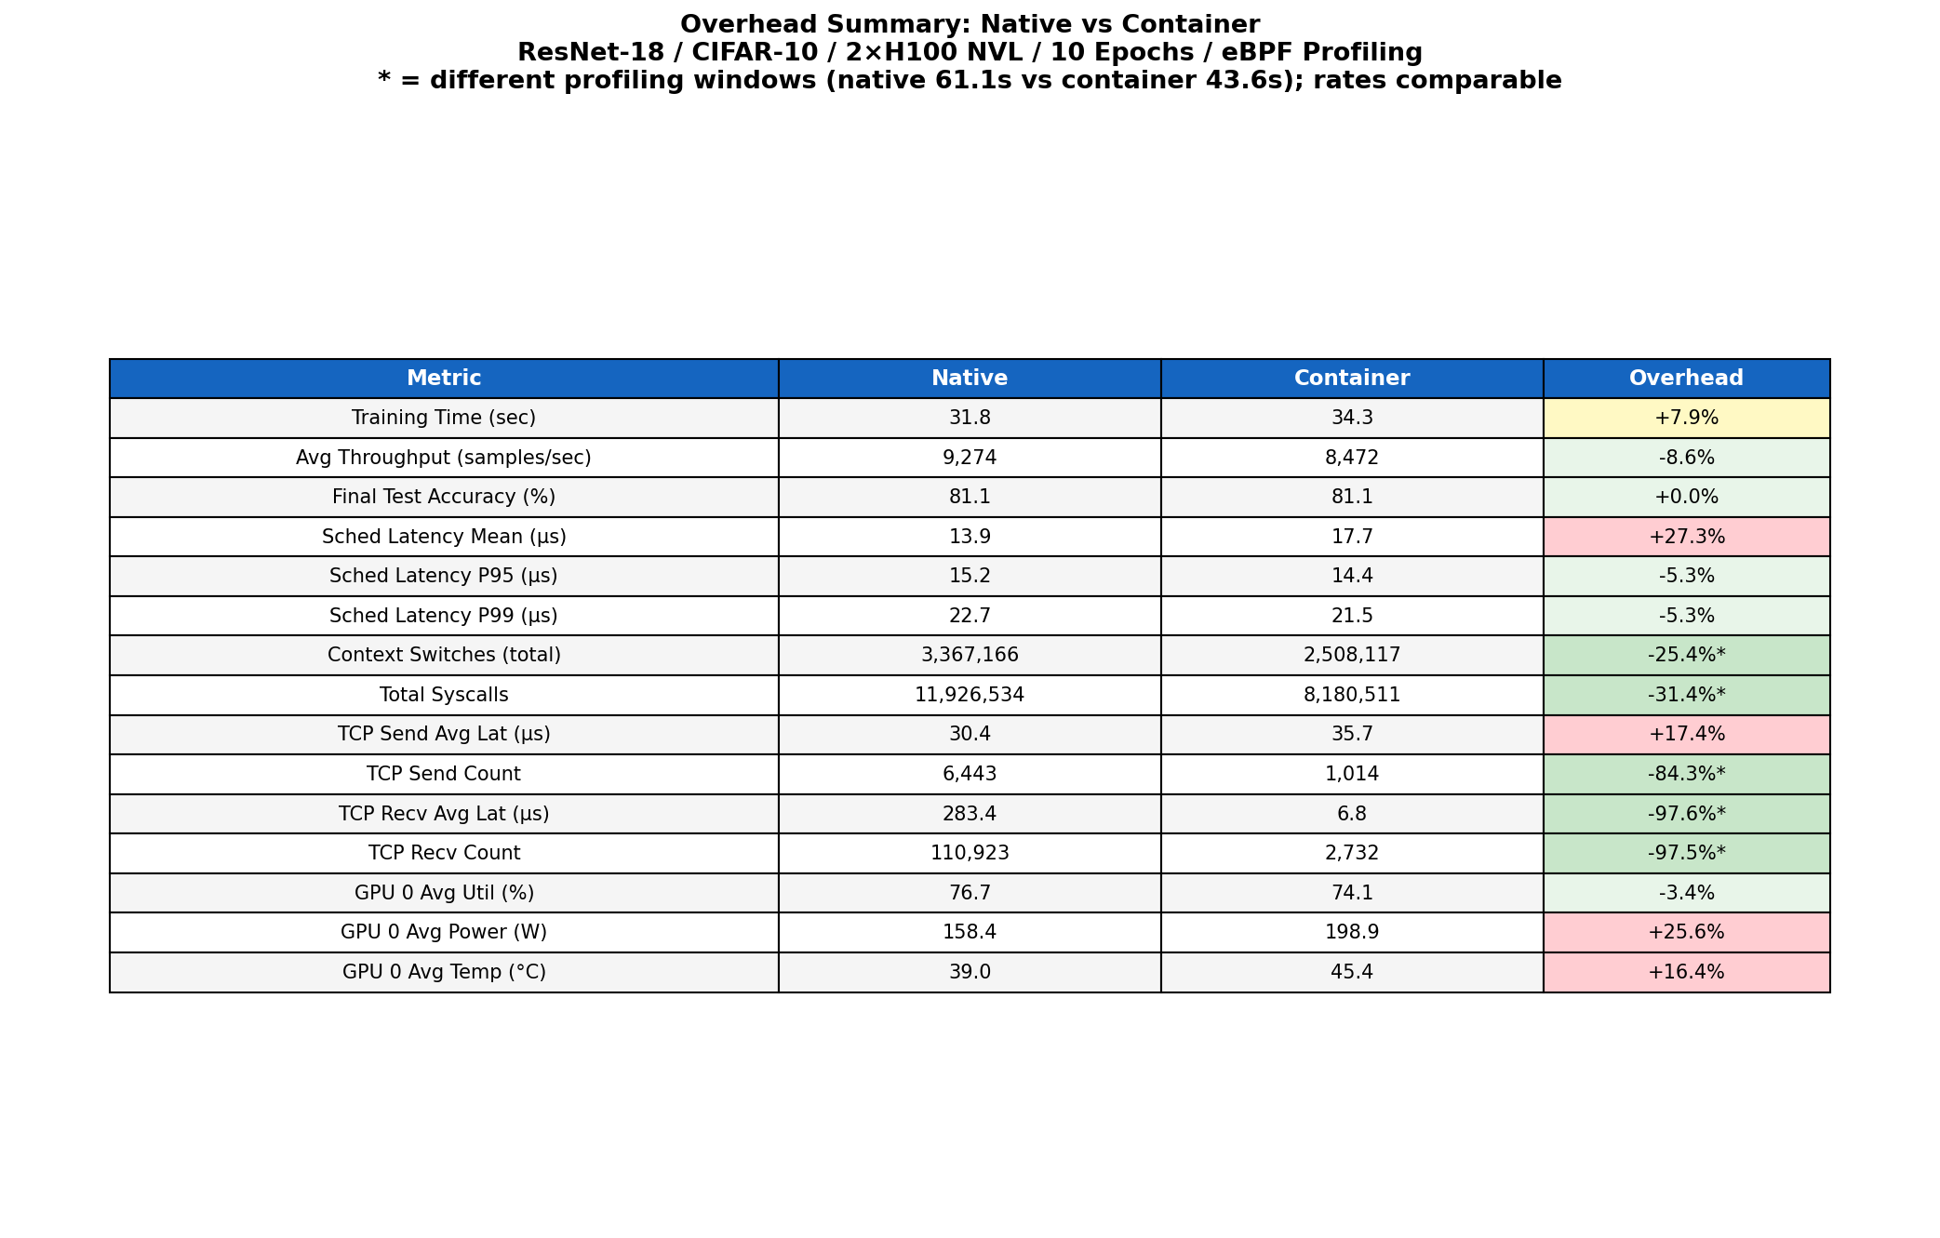
Overhead Summary — All Metrics
15

Slide 16
Insights & Key Findings
1
Container adds ~7.9% training time overhead
5
Scheduling latency mean +27.3% in container
On H100 NVL GPUs, Docker adds 2.5 extra seconds per 31.8s run. GPU is the bottleneck — not container overhead.
17.7 vs 13.9 μs mean. But P95 is slightly better in container (14.4 vs 15.2 μs) — cgroup scheduling is more uniform.
2
GPU utilization is near-identical (76.7% vs 74.1%)
6
Distributed TCP sched latency is 160× worse
Active-period GPU util drops only 3.4%. Both environments are GPU-bound. Containerization doesn't throttle the GPU.
2,250 μs mean in distributed FL setup (vs 13.9 μs native). Wi-Fi blocking I/O completely dominates CPU scheduling cost.
3
Power consumption spikes +25.6% in container
7
292 TCP retransmits in distributed setup
Container init (overlay FS, namespace setup) keeps GPU power elevated during idle phases (198.9W vs 158.4W avg).
Wi-Fi instability causes gradient sync stalls. RDMA/InfiniBand would eliminate this entirely.
4
Syscall diversity increases +38% in containers
8
eBPF is a viable unified profiling layer
167 unique syscall types in container vs 121 native. Overlay FS, veth, and cgroup management generate extra kernel calls.
Single framework captures CPU scheduling, syscalls, TCP stack, and GPU driver events with near-zero overhead.
16

Slide 17
Limitations & Future Work
Current Limitations
Future Work
⚠ eGPU Build Failed
→ Upgrade to LLVM ≥15 and build full eGPU (bpftime) for PTX-level GPU tracing
PTX-level GPU instrumentation required LLVM ≥15. We used a CPU-side uprobe fallback. True GPU kernel instrumentation remains unachieved.
⚠ Single Trial
→ Run 5+ trials and report mean ± std for all metrics
Only one run per configuration (native/container). Statistical variance not captured. 3+ trials with median selection would strengthen conclusions.
⚠ eBPF Requires Root
→ Add CUDA stream-level profiling via CUPTI for compute/communication overlap measurement
All eBPF profilers need sudo. Deployment in locked-down cloud environments (e.g., GKE) is not possible without privileged containers.
→ Extend to multi-node DDP on InfiniBand vs TCP and quantify RDMA benefit
⚠ nvidia-smi Resolution
100ms polling misses sub-millisecond GPU events. CUPTI or Nsight Compute would provide microsecond-level GPU kernel timing.
→ Add per-PID eBPF filtering to isolate training process from system noise
⚠ Single-Node Only
Config A experiments run on one server. Multi-node DDP overhead (NCCL ring AllReduce across nodes) not measured.
→ Test on smaller GPUs (RTX class) where container overhead may be relatively larger
⚠ System-Wide eBPF Probes
Our eBPF profilers capture all processes, not just the training job. This inflates syscall and context-switch counts.
17

Slide 18
Conclusions
1
Containerization overhead is real but modest on H100s
Docker adds 7.9% training time and -8.6% throughput. GPU utilization is almost identical — container overhead does not significantly throttle GPU-bound workloads.
2
Power is the hidden container cost
Container GPU power is +25.6% higher. Container initialisation keeps the GPU at elevated power even during idle phases between epochs.
3
Syscall diversity is a container fingerprint
+38% unique syscall types in containers reveal overlay FS, veth, and cgroup activity invisible at the application layer.
4
Distributed TCP over Wi-Fi is the dominant bottleneck
160× higher scheduling latency and 292 retransmits vs zero in native/container. Network infrastructure quality matters far more than containerization.
5
eBPF is a unified, zero-overhead profiling layer
A single eBPF framework successfully profiles CPU scheduling, syscalls, TCP stack, and GPU driver events concurrently — validating eBPF as the right tool for ML system observability.
18

Slide 19
References
[1] Yang et al., "eGPU: Extending eBPF Programmability and Observability to GPUs," HCDS '25. https://dl.acm.org/doi/pdf/10.1145/3723851.3726984
[2] eGPU (bpftime) GitHub: https://github.com/eunomia-bpf/eGPU
[3] BCC (BPF Compiler Collection): https://github.com/iovisor/bcc
[4] NVIDIA Nsight Systems: https://developer.nvidia.com/nsight-systems
[5] CUDA CUPTI: https://docs.nvidia.com/cupti/
[6] PyTorch ResNet: https://docs.pytorch.org/vision/main/models/resnet.html
[7] NVIDIA Container Toolkit: https://docs.nvidia.com/datacenter/cloud-native/container-toolkit/
[8] PyTorch Distributed Data Parallel: https://pytorch.org/tutorials/intermediate/ddp_tutorial.html
Thank You
Group 21 • GRS Part B • IIIT Delhi
19

