Slide 1
Indian Stock Market Analysis and Price Prediction Using Python
Prepared by: Dewanshi Purohit Internship Project – Data Analysis with Python Naviotech Solutions

Slide 2
INTRODUCTION
The stock market is a platform where shares of companies are bought and sold.
Stock market analysis helps investors understand market trends.
Data analysis and machine learning can be used to study historical stock prices and make predictions.
In this project, Reliance Industries stock data was analyzed using Python.

Slide 3
PROJECT OBJECTIVES
To collect historical stock market data of Reliance Industries.
To analyze stock price trends and patterns.
To visualize stock performance using graphs.
To apply machine learning techniques for prediction.
To predict future stock prices using Linear Regression.
To understand the role of data analysis in financial markets.

Slide 4
TECHNOLOGIES USED
Programming Language
Python
Libraries Used
Pandas
NumPy
Matplotlib
Scikit-Learn
yFinance
Development Environment
Jupyter Notebook

Slide 5
DATA COLLECTION
Data Source: Yahoo Finance
Stock Selected: Reliance Industries (RELIANCE.NS)
Data downloaded using yFinance library.
Period: January 2023 – May 2026
Data fields collected:
Open Price
High Price
Low Price
Close Price
Volume

Slide 6
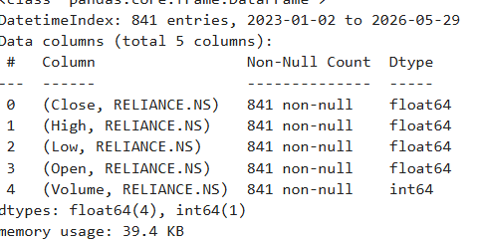
Data Collection & Dataset Information
Stock Selected: Reliance Industries (RELIANCE.NS)
Data Source: Yahoo Finance (yfinance)
Period: Jan 2023 – May 2026
Total Records: 841 trading days
Features Used: Open, High, Low, Close, Volume

Slide 7
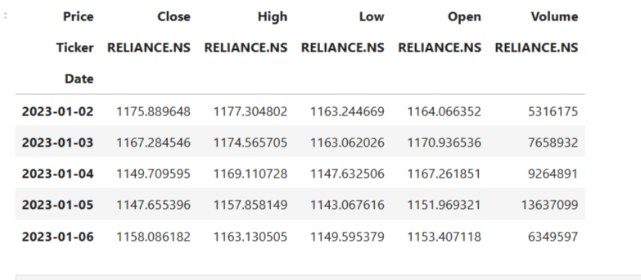
Dataset Preview
The data.head() function displays the first 5 rows of the dataset.
It provides a quick overview of the stock market data collected.
The dataset contains important features such as:
Open Price
High Price
Low Price
Close Price
Volume

Slide 8
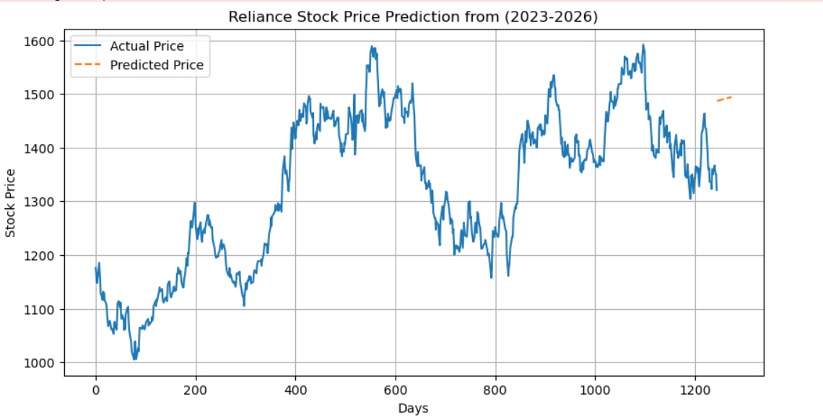
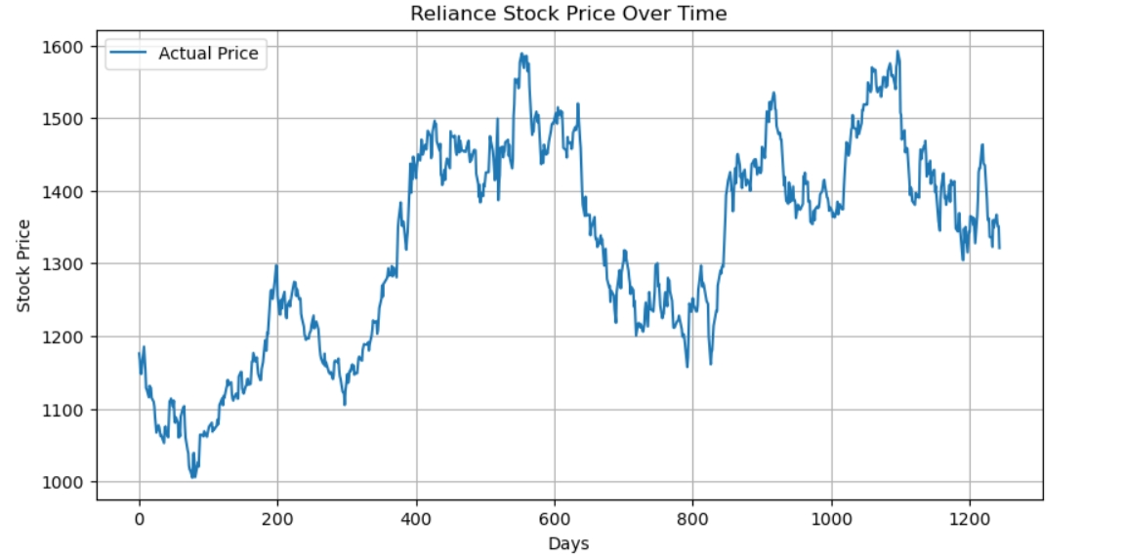
Stock Price Trend Analysis
The graph shows Reliance stock price movement from 2023–2026.
Stock prices fluctuated throughout the period.
Several upward and downward trends are visible.
Historical trends help understand market behavior.
The graph is useful for analysis before prediction.

Slide 9
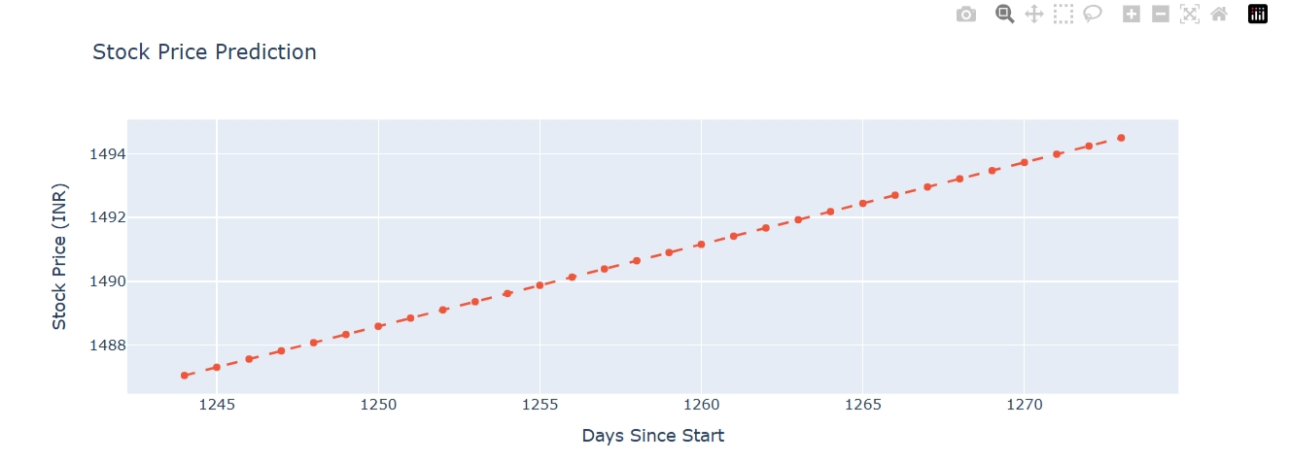
Stock Price Prediction using Linear Regression
Linear Regression was used to predict future stock prices.
Historical stock data was used to train the model.
The graph shows the predicted stock prices for upcoming days.
The predicted trend indicates a gradual increase in stock price.
Machine learning helps estimate future market behavior.

Slide 10
Conclusion
Reliance stock data was collected using Yahoo Finance.
Data was analyzed and visualized using Python.
Historical stock trends were studied successfully.
Linear Regression was applied for stock price prediction.
The project demonstrates the use of data analysis and machine learning in the stock market.

