Slide 1
Movie Recommendation System Using Machine Learning
Name : Dewanshi Purohit
Subtitle : Internship Project Report Presentation
Prepared By: Python , Machine Learning , Streamlit , TMDB API
Organization : Naviotech Solutions Internship Program
Date : May 2026

Slide 2
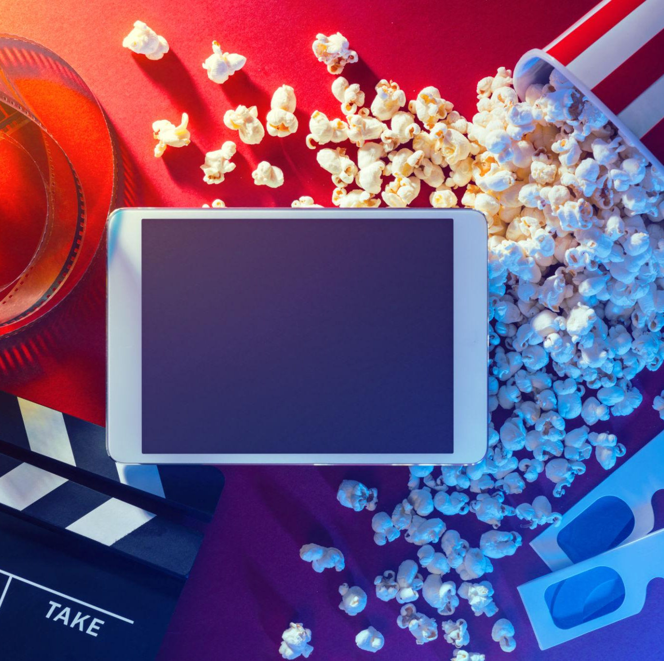
INTRODUCTION
Recommends movies based on similarity.
Helps users discover new movies easily.
Uses Machine Learning techniques.
Displays movie posters using TMDB API.
Built using Python and Streamlit.

Slide 3
Problem Statement & Objectives
Problem Statement
Users often find it difficult to choose movies from a large collection.
Searching manually for similar movies takes time.
There is a need for an intelligent system that can recommend movies automatically.
Objectives
Develop a movie recommendation system using Machine Learning.
Recommend top 5 similar movies based on selected movie.
Display movie posters using TMDB API.
Create an interactive web application using Streamlit.

Slide 4




Technologies Used
Key Features of Technologies
Python for application development.
Streamlit for interactive user interface.
TMDB API for displaying movie posters.
Pandas for handling movie datasets.
Pickle for storing recommendation data.

Slide 5
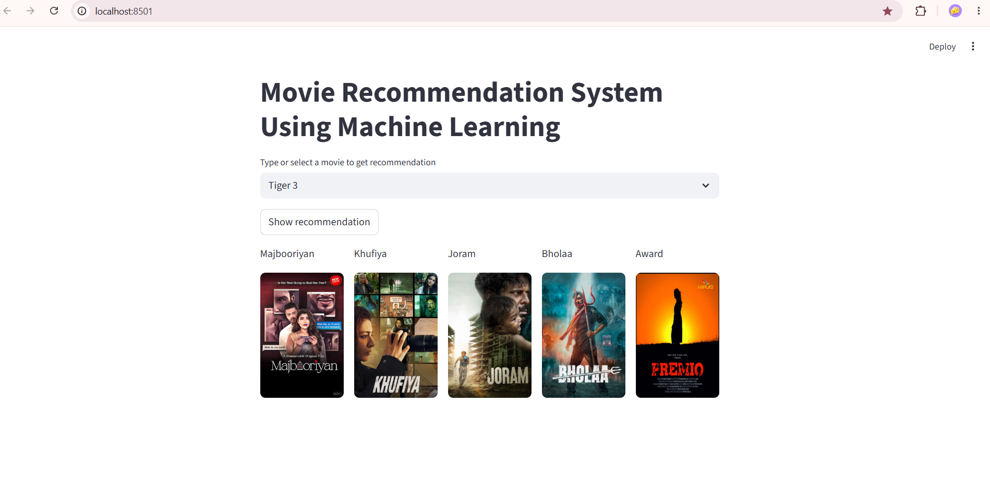
System Flow
Movie Recommendation System Displaying top 5 recommended movies for the selected movie
User selects a movie.
System finds the selected movie index.
Similarity matrix is used to calculate similar movies.
Top 5 most similar movies are selected.
Movie posters are fetched using TMDB API.
Recommendations are displayed in Streamlit

Slide 6
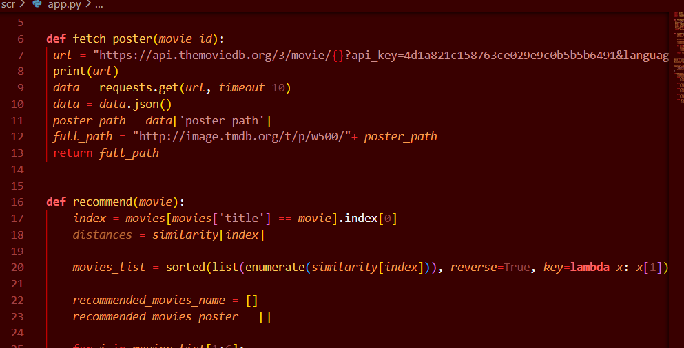
Implementation & Code Structure
Main Components:
movie_list.pkl – Stores movie information.
similarity.pkl – Stores similarity matrix.
recommend() – Finds top 5 similar movies.
fetch_poster() – Fetches movie posters using TMDB API.
Streamlit UI for user interaction.

Slide 7
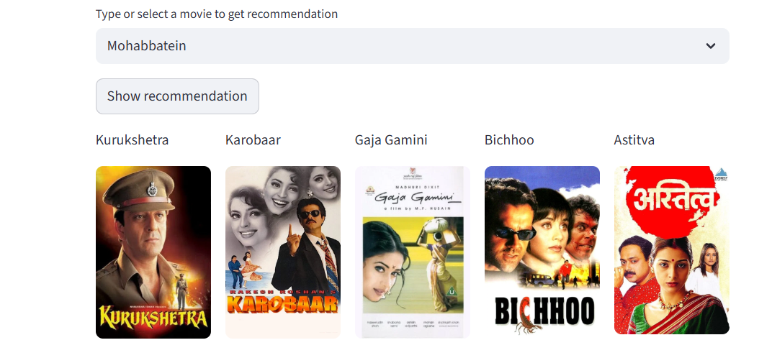
Results &Output
Project Output:
User selects a movie from the dropdown menu.
System analyzes similarity scores.
Top 5 similar movies are recommended.
Movie posters are displayed along with movie names.
Recommendations are generated instantly.

Slide 8
Advantages & Applications
Advantages
Easy to use and interactive interface
Provides quick movie recommendations
Reduces time spent searching for movies
Scalable for large movie datasets
Displays movie posters for better user experience
Applications
Movie Streaming Platforms (Netflix, Prime Video, Disney+)
Online Entertainment Portals
Mobile Movie Recommendation Apps
Personalized Content Recommendation Systems
Data Science and Machine Learning Projects

Slide 9
Future Scope
Improve recommendation accuracy using advanced Machine Learning algorithms.
Add user login and personalized recommendations.
Integrate user ratings and reviews.
Recommend movies based on genres, actors, and directors.
Deploy the application on cloud platforms for public access.
Expand the dataset to include thousands of movies and TV shows.

Slide 10
Conclusion
Successfully developed a Movie Recommendation System using Machine Learning.
Implemented a content-based recommendation approach using a similarity matrix.
Integrated TMDB API to fetch and display movie posters.
Created an interactive and user-friendly interface using Streamlit.
The system provides quick and relevant movie recommendations to users.

