Slide 1
WEEK 8 · 01211271 INDUSTRIAL AI AND IOT
From Sensor Data to a Dataset
Turning an accelerometer stream into a table a classifier will accept
Choosing the sampling rate from the fault, not the shaft
Windowing, labelling, and the learning table
Seven time-domain and five frequency-domain features
Splitting by run — and the accuracy you invent when you do not
When feature scaling matters, and when it is a ritual
Notebook: Week8_From_Sensor_Data_to_a_Dataset.ipynb
Varodom Toochinda · Electromechanical Manufacturing Engineering
Notes:
Set the frame for the whole second half. In weeks 1-7 every decision in their pipeline was a threshold they typed in by hand. From this week on, thresholds get learned - but a learning algorithm will not accept a stream of samples. It wants a table. Say plainly that building that table correctly is most of the work of industrial ML, and that the most common failure mode in this field is not a bad model but a dataset that was assembled or split wrongly, producing a number that looks excellent and does not survive contact with a real machine. Introduce the rig: motor, rotor disc, two bearings, accelerometer on the drive-end housing at 2000 Hz. Three states - normal, imbalance, outer-race bearing spall. Tell them the data is synthetic and why: we have no rig, and a synthetic rig gives us exact ground truth, which is what a teaching dataset needs. Point out the notebook filename and say the whole lecture is reproducible line by line; the five-hour session is lecture in the first half, this notebook plus the Wokwi lab in the second. Ask the room: who has recorded vibration from a real machine before? It calibrates how much mechanical background to assume.

Slide 2
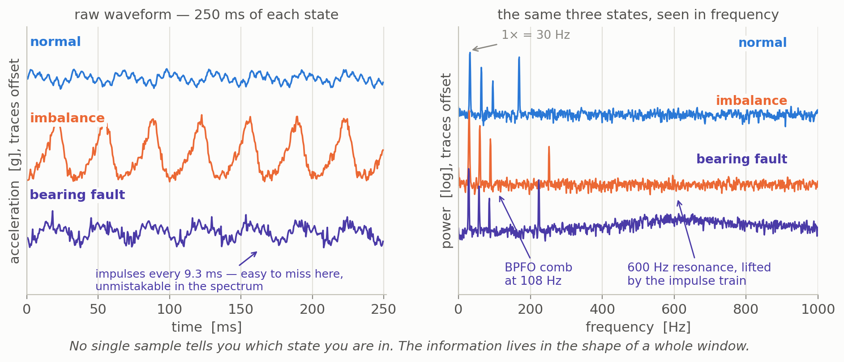
THE PROBLEM
One machine, three states, no obvious threshold
The three states differ, but no single sample tells you which one you are in — the information is in the shape of a whole window of samples.
Imbalance loads the 1× shaft line; the bearing spall puts its energy into a 600 Hz housing resonance struck 108 times a second. Two faults, two different places to look.
1
Notes:
Left panel first. Walk down the three traces. Normal: a modest 30 Hz wave in noise. Imbalance: obviously bigger, same shape - a student can see this one without any machine learning, and a plain RMS threshold would catch it. Bearing fault: this is the important one. Ask the room to point at the fault. They will struggle, which is the point - the impulses arrive every 9.3 ms and are buried under the 1x component and the noise floor. Now move to the right panel. The spectra are offset vertically so they do not cover each other; say so explicitly or someone will read the y-axis as absolute. Point at the 30 Hz line, common to all three. Then the bearing trace: the comb near 108 Hz, and the broad hump around 600 Hz where the housing rings. Connect it to the BPFO formula from the notebook - 3.6 times shaft rate, 108 Hz at 1800 rpm. The engineering message: two different faults announce themselves in two different frequency regions, so one threshold on one number cannot cover both. Expected objection: why not just look at the spectrum by eye? Answer: you can, for one machine; you cannot for two hundred machines reporting every minute.

Slide 3
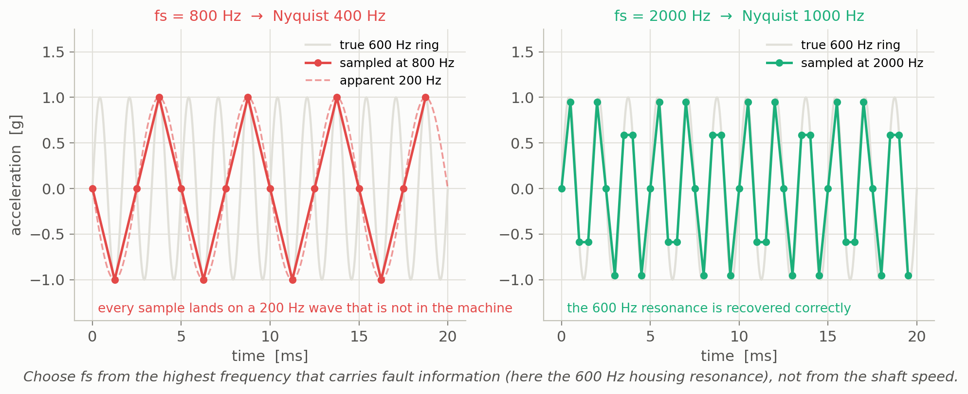
ACQUISITION
Choose the sampling rate from the fault
Anything above fs/2 does not vanish — it folds back and appears at a frequency that is not in the machine.
Sample for the highest frequency that carries diagnostic information — here the 600 Hz resonance, so fs = 2000 Hz — and put a real anti-alias filter in front of the ADC.
2
Notes:
This is Week 3 material returning with consequences. Left panel: the grey curve is the true 600 Hz ring from the bearing housing. The red dots are what you get sampling at 800 Hz. Trace the dots with your finger - they lie exactly on the dashed 200 Hz wave. Read the arithmetic aloud: 800 minus 600 is 200. That 200 Hz component is not in the machine and no amount of clever software will remove it afterwards, because the information was destroyed at the ADC. Right panel: at 2000 Hz the resonance is recovered honestly. Now the decision rule. A student who sizes fs from the shaft speed - 30 Hz, so a few hundred hertz should do - builds a system that sees imbalance perfectly and is structurally blind to bearing damage. So the question is never 'how fast does the shaft turn' but 'what is the highest frequency that carries the fault I care about'. Stress the analogue filter: aliasing must be stopped in hardware before the ADC, not in MicroPython afterwards. Ask: what would you have to change if the housing resonance were at 3 kHz? Exercise 1 in the notebook makes them work it out.

Slide 4
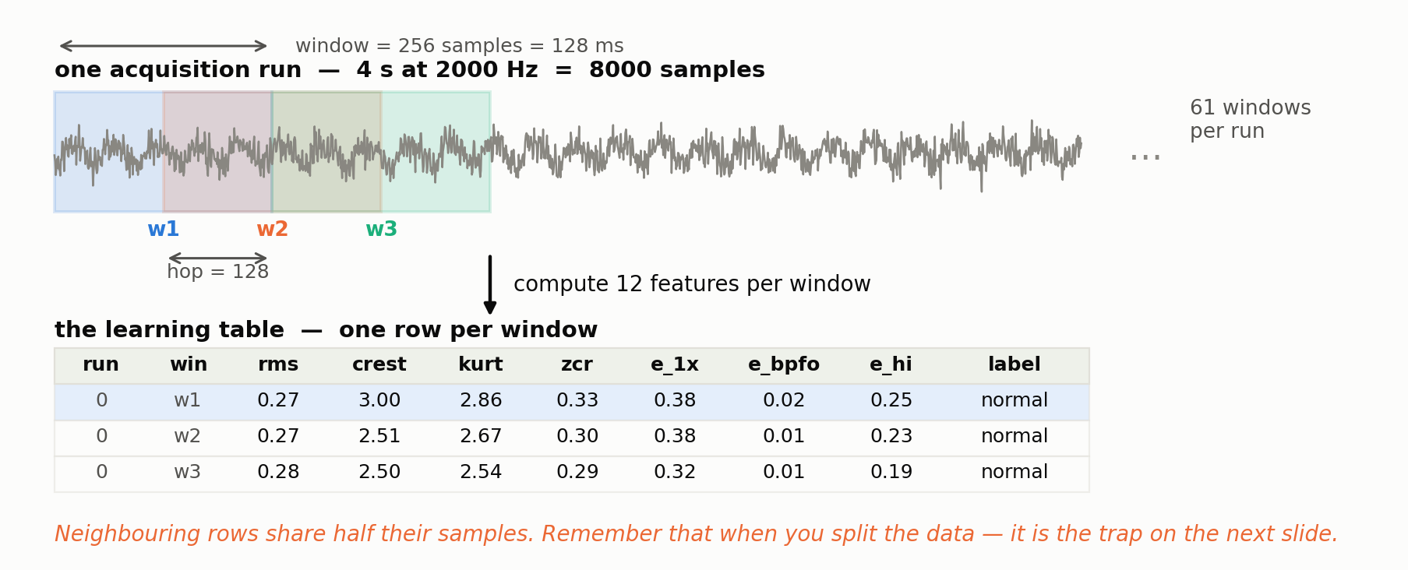
THE LEARNING TABLE
One window in, one row out
256 samples, 50 % overlap, 61 rows per 4-second run, 2928 rows in total from 48 runs — and neighbouring rows share half their samples.
3
Notes:
This slide is the mechanical heart of the week. A classifier needs a fixed-length input, so the continuous stream has to be cut up. Walk it top to bottom. One run is four seconds at 2000 Hz, eight thousand samples. The window is 256 samples, 128 milliseconds. The hop is 128, so each window starts halfway through the last one - that is the 50 percent overlap, and you can see the coloured boxes interleaving. Sixty-one windows come out of one run. For each window we compute twelve numbers and write one row. The table at the bottom is real output from the notebook, not a mock-up - these are the first three windows of run zero. Point at the run column and say it looks like bookkeeping but is the most important column in the table; slide 8 will explain why. Then deliver the warning in orange at the bottom: because of the overlap, row 1 and row 2 are not independent observations. They share 128 samples. Let that sit, because in three slides it becomes a twelve-point accuracy illusion. Someone will ask why overlap at all: it multiplies training rows and smooths the decision stream. It is not free.

Slide 5
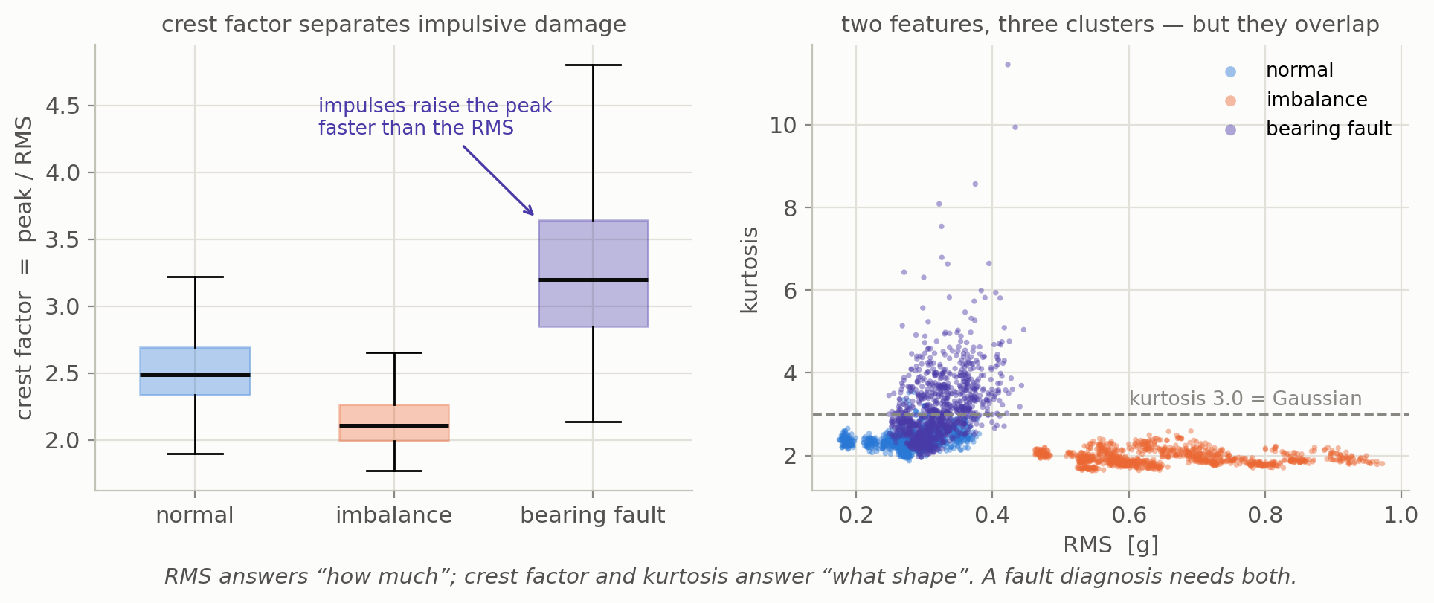
FEATURES 1–7
Time domain: how much, and what shape
mean · rms · std · ptp · crest · kurtosis · zero-crossing rate — all computed after removing the DC component.
RMS rises for imbalance (0.277 → 0.658 g) but barely moves for the bearing fault; crest factor does the opposite (2.537 → 3.294).
4
Notes:
Seven numbers, and the table in the notebook shows what each one buys. Start with the DC rule: an accelerometer bias drifts with temperature and mounting, so subtract the window mean before computing anything else. Leave it in and zero-crossing rate measures your bias instead of your machine. Now the two panels. Left: crest factor, peak over RMS, by class. Normal sits near 2.5, imbalance slightly lower - a bigger sine is still a sine - and the bearing fault jumps to 3.3 with a long upper whisker. Impulses raise the peak faster than they raise the RMS; that ratio is the whole idea. Right: RMS against kurtosis. The orange imbalance cluster separates on RMS alone. The blue and violet clusters sit on top of each other in RMS and separate vertically, on kurtosis. Read the headline numbers off the callout. The sentence to leave them with: RMS answers how much, crest and kurtosis answer what shape, and a diagnosis needs both. Note that neither panel gives clean separation - the clusters overlap - which is exactly why we will need a classifier rather than a pair of thresholds.

Slide 6
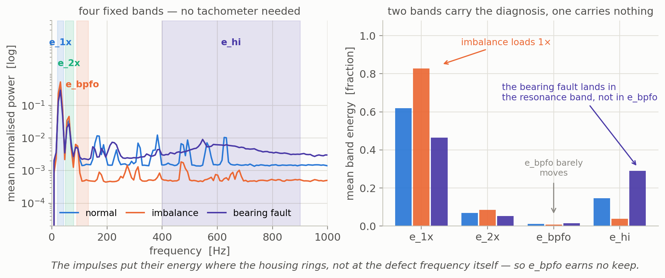
FEATURES 8–12
Frequency domain: four bands and a peak
Fixed bands in hertz, not shaft orders — our rig has no tachometer and the shaft wanders between 28 and 32 Hz.
e_bpfo was designed to catch the defect frequency and carries nothing (0.012 vs 0.014). A feature you invented is a hypothesis, not a fact.
5
Notes:
Five more features: the dominant frequency, and four band energies expressed as a fraction of the window's total power. Justify both design choices out loud. Fixed hertz bands rather than shaft orders, because order tracking needs a tachometer we do not have. Fractions rather than absolute power, because a loose accelerometer halves every absolute number and barely touches a ratio - the feature becomes gain-invariant for free. Left panel: the four shaded bands over the mean spectrum of each class. Right panel: the same information as bars. Imbalance loads e_1x to 0.83. The bearing fault loads e_hi from 0.146 to 0.289. Now spend real time on the third bar group. We designed e_bpfo specifically to catch the outer-race defect, and it does nothing - 0.012 healthy against 0.014 damaged. This is not a coding error, it is mechanics: an impulse excites whatever likes to ring nearby, so the energy lands in the 600 Hz resonance and not at the 108 Hz repetition rate. Two lessons. First, check your features against data instead of trusting the whiteboard. Second, the technique that does recover that periodicity is envelope analysis - name it, say it is outside our scope, and point anyone interested at the Randall and Antoni tutorial in the notebook references.

Slide 7
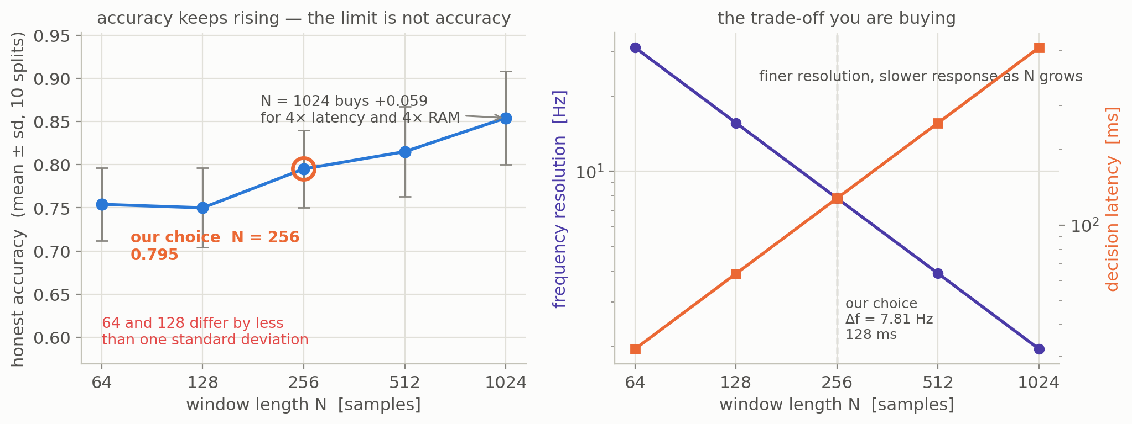
THE FIRST REAL TRADE-OFF
How long should the window be?
Accuracy keeps climbing with window length, so accuracy alone cannot choose it for you.
N = 256: 7.81 Hz resolution, 128 ms decision latency, 1024 bytes of buffer. N = 1024 buys +0.059 accuracy for 4× the latency and 4× the RAM.
6
Notes:
Left panel: honest accuracy against window length, with error bars over ten splits. Before reading the trend, make them look at the error bars - about 0.045. The apparent dip from 64 to 128 is smaller than one standard deviation, so it is noise, not a finding, and saying so out loud teaches more scepticism than any lecture on statistics. The rise from 256 to 1024 is about 0.06, just over one standard deviation: a weak but real trend. Now the key point. Accuracy never stops improving over this range, so it cannot be the thing that decides N. Right panel shows what actually decides it: frequency resolution falls as fs over N while decision latency rises as N over fs. They cross at 256. At N = 64 the bins are 31 Hz wide and the 1x and 2x lines land in neighbouring bins - the spectral features have nothing left to work with. At N = 1024 the accuracy is best but every decision lags the machine by half a second and the buffer alone is 4 KB of ESP32 RAM before any FFT workspace. We take 256. Ask the room: what if this were a protective trip rather than a maintenance alert? Then 128 ms may already be too slow and you would trade accuracy for speed. That is an engineering decision, not a machine-learning one.

Slide 8
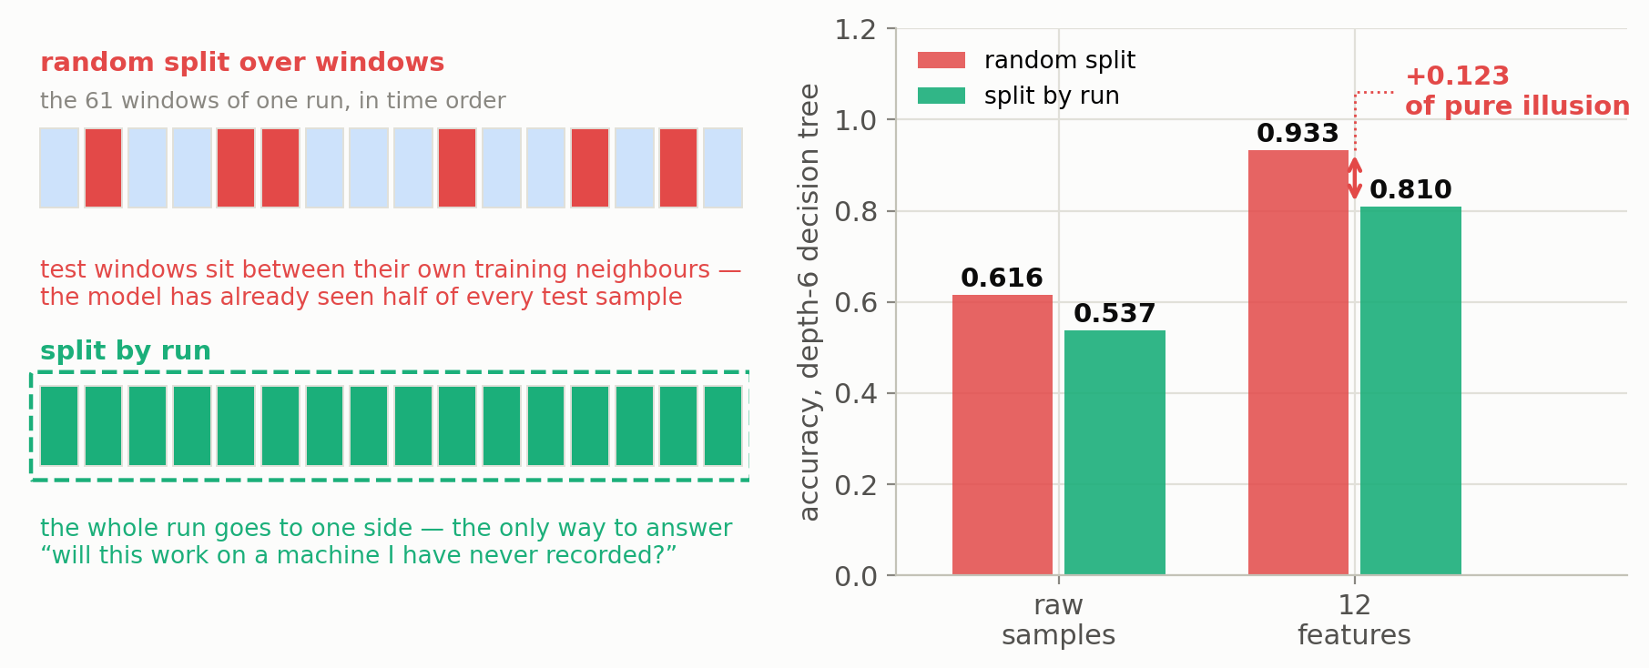
EVALUATION
The split that invents accuracy
train_test_split shuffles rows. Our rows are not independent: neighbours share samples, and every row of a run carries that run's speed, gain and noise floor.
Random split says 0.933. Split by run says 0.810. The difference, +0.123, is entirely fictional — and only the second number answers "will this work on a machine I have never recorded?"
7
Notes:
The most important slide of the week. Start by writing the wrong line on the board: X_train, X_test = train_test_split(X, y). Everyone has typed it. It is correct when rows are independent draws, and ours are not, for two separate reasons. One, overlap: window k and k+1 share half their samples, so a test row sits between two of its own training neighbours. Two, run identity: every run has its own shaft speed, gain, noise floor and frame resonance, and every row of that run carries the same label - so a model that learns 'this is run 23' can read the answer off it. Left schematic shows both schemes. Right bars show the damage: with twelve features, 0.933 under a random split against 0.810 when whole runs are held out. Say the two questions aloud, because the numbers are answers to different questions, not a good and a bad estimate of one thing. Also point at the left pair: on raw samples the honest number is 0.537, barely above the 0.333 of guessing, because sample 40 of a window means nothing at a random phase. Twelve features buy +0.273. Generalise the rule: if rows share a source - same run, machine, shift, patient - split on that source. Someone will ask whether overlap alone causes this; exercise 5 has them measure it.

Slide 9
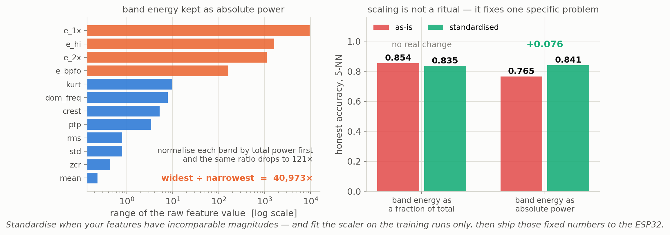
PREPROCESSING
Scaling is not a ritual
Standardising matters for models that measure distance or regularise coefficients. It does nothing for a decision tree, which only asks “is feature j above t?”.
Normalised bands: ranges differ by 121×, scaling changes nothing. Absolute band power: 40,973×, and scaling hands back +0.076. Good feature design removes the problem first.
8
Notes:
Push back gently on the textbook advice 'always standardise'. It is a fine default and a poor explanation, and students who follow rules without conditions cannot debug anything. Standardising matters when a model measures distance, as k-NN and SVM do, or when it regularises coefficients. A decision tree only ever asks whether one feature exceeds a threshold, so scaling is literally irrelevant to it - and the tree is what we will deploy in Week 11. Now the experiment. With band energy as a fraction of total power, our twelve features already share a scale within a factor of 121, and standardising changes k-NN by minus 0.019, which is noise. Rebuild the same features with absolute band power and the ratio explodes to about forty-one thousand, e_1x dominates every distance, k-NN drops to 0.765, and standardising hands 0.076 straight back. So the condition is incomparable magnitudes, not superstition. Two takeaways. First, good feature design can remove the problem before scaling has to fix it. Second, fit the scaler on training rows only - use a pipeline so you cannot get it wrong by hand. Flag forward: whatever you choose becomes twelve constants that must be copied into the ESP32 firmware.

Slide 10
EDGE PREVIEW
The same numbers have to come out of the ESP32
Everything up to the classifier runs on the device in MicroPython. No NumPy, no SciPy — a few dozen lines of plain Python over a 256-sample buffer.
# features.py — on the ESP32, MicroPython
def rms_crest_zcr(buf):
n = len(buf)
m = sum(buf) / n # remove DC first
s = 0.0; pk = 0.0; zc = 0; prev = buf[0] - m
for v in buf:
d = v - m
s += d * d
if abs(d) > pk: pk = abs(d)
if (d < 0) != (prev < 0): zc += 1
prev = d
r = (s / n) ** 0.5
return r, pk / r, zc / (n - 1)
Full FFT is expensive
A 256-point FFT in pure MicroPython costs 2048 butterflies. We only need four bands — the Goertzel algorithm gets one bin with two state variables.
Identical, not similar
Same window length, same feature order, same scaler constants. If the device computes anything differently, the model sees a world it was never trained on.
Lab 8: stream the stored waveform from flash, window it, print one CSV row per window over the serial port — and check those rows against the notebook to three decimals.
9
Notes:
Bridge from laptop to device, so the week lands in the hardware they actually use. Everything on the left of the workflow - window, features - has to run on the ESP32 in MicroPython, with no NumPy and no SciPy. Walk the code slowly. Note the mean subtraction on line four; note that we accumulate sum of squares, running peak and zero crossings in a single pass over the buffer, because a second pass costs another 256 iterations of interpreted Python. Right-hand boxes. The FFT one: a 256-point radix-2 FFT is about 2048 butterfly operations in interpreted Python, which is slow and memory-hungry; since we only need four band energies, the Goertzel algorithm computes a single bin with two state variables and a short loop. Mention it now and they will not be surprised in Lab 8. The second box is the one that bites people: the device must compute identically, not similarly. Same window length, same feature order, same scaler constants. A transposed feature order produces a model that is confidently wrong and very hard to debug. Then set up the lab: the acceptance test is that the device's CSV rows match the notebook to three decimal places - the fourth digit differs because the ESP32 computes in single precision, and saying so up front pre-empts an hour of false bug-hunting. If they match, the week's work is verified end to end.

Slide 11
IN THE SECOND HALF OF TODAY
Lab 8 — build the dataset your course will use
On the laptop, in the notebook
Generate the three-state signal set, verify the feature code against NumPy, and export week8_dataset.csv.
On the ESP32, in Wokwi
Upload one 2-second waveform to the device file system, stream it as if it came from the accelerometer, window it, print the seven time-domain features per window — and time the computation against the 128 ms window.
Acceptance test
The device rows and the notebook rows agree to three decimal places — the fourth digit differs because the ESP32 computes in single precision.
# device: wave_normal, 4000 samples
win,mean,rms,std,ptp,...
0,-0.0656,0.3007,0.3007,1.5001,...
1,-0.0489,0.2774,0.2774,1.4418,...
2,-0.0313,0.2937,0.2937,1.6930,...
...
# 30 windows
# feature time: ? us per window
# window duration: 128000 us
Deliverables
Pace for the lab half
features.py and main.py running in Wokwi · a screenshot of the serial output · week8_dataset.csv · a one-paragraph note on which two features you expect to matter most, and why.
Notebook walk-through 60 min · Wokwi build 90 min · device-versus-notebook comparison and write-up 30 min.
Keep week8_dataset.csv. Week 9 trains on this exact file, and Week 11 deploys the model back onto the device that produced it.
10
Notes:
Hand over to the lab half of the five-hour session. Read the three blocks in order. The laptop half is mostly running the notebook and reading it, but insist they actually verify the feature code against NumPy rather than assuming - that habit is what makes the device comparison meaningful later. The Wokwi half is the new work: Wokwi cannot produce realistic vibration, so we store a generated waveform on the device file system and stream it as if it were the accelerometer. Say clearly that this is a deliberate simulation choice, not a fudge - it gives every student identical data and exact ground truth. The acceptance test is the part to emphasise: three decimal places between device and notebook. Say out loud that the fourth digit will differ, because MicroPython on the ESP32 uses single-precision floats, or the room will lose an hour to false bug-hunting. A disagreement in the second decimal is a real bug, almost always the DC removal or the order of operations, and finding it today is far cheaper than finding it in Week 11 with a trained model on top. Remind them the CSV is not a throwaway - Week 9 trains on this exact file and Week 11 puts the resulting model back on the device. Anyone who loses it repeats today. Finally, the one-paragraph note: it costs them five minutes and gives you a reading on whether the feature discussion landed.

Slide 12
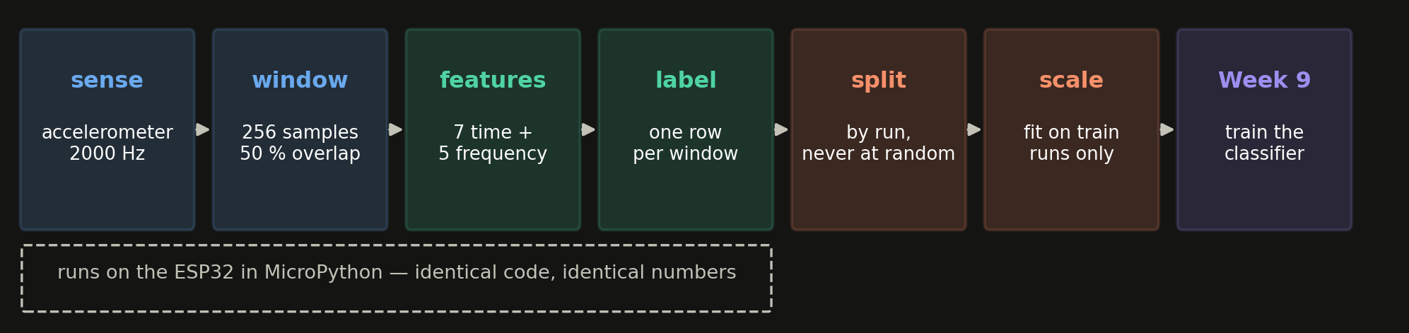
WEEK 8 IN ONE LINE
A dataset is a decision, not a download
1. Sample for the fault, not the shaft — everything above fs/2 folds back and lies to you.
2. One window, one row. N = 256 costs 128 ms of latency and 1024 bytes; accuracy alone will not choose it.
3. RMS says how much; crest factor and kurtosis say what shape. You need both.
4. A feature you invented is a hypothesis — e_bpfo looked essential and carried nothing.
5. Split by run, never at random. Here the random split invents +0.123 of accuracy.
6. Scale when magnitudes are incomparable, fit the scaler on training rows only — and ship those same constants to the ESP32.
Week8_From_Sensor_Data_to_a_Dataset.ipynb — 8 exercises and references at the end
Next week: training the classifier on week8_dataset.csv
Notes:
Close by walking the strip left to right and naming each stage: sense, window, features, label, split, scale, and then Week 9 trains the classifier. Point at the dashed box under the first four stages - that whole front end runs on the ESP32 in MicroPython, and it is what Lab 8 builds today. Then read the six rules. Spend the most time on rules four and five, because they are the two that separate a student who can run scikit-learn from an engineer who can be trusted with a maintenance decision. Rule four: e_bpfo was a reasonable, physics-motivated guess and it carried nothing, so check rather than assume. Rule five: the 0.123 inflation was not a subtle statistical effect, it was the difference between answering a question nobody asked and answering the one the maintenance engineer actually has. Remind them the notebook has eight exercises and real references, and that exercise 8 - a pure-Python feature function with no NumPy - is literally the first cell of next week's device code. Finish by naming next week: training classifiers on week8_dataset.csv, comparing decision trees, logistic regression and k-NN, and asking which of them could possibly fit in 200 KB of RAM.

