Slide 1
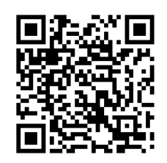

DEV101
By Will
https://github.com/dewhurstwill/learn-r

Slide 2
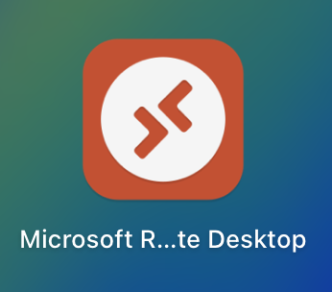
Virtual Machine
Download Remote Desktop from the app store
20.117.125.210
vmadmin
Sheffield1!

Slide 3
The terms

Slide 4
Data Types
Data types define the kind of data a variable can hold. Common data types include:
Integer: Whole numbers (e.g., 1, 2, 3)
Double: Floating-point numbers (e.g., 1.5, 2.8)
Character: Text strings (e.g., "Hello")
Logical: Boolean values (TRUE or FALSE)

Slide 5
Variables
A variable is a symbolic name associated with a value and can be used to store and manipulate data. For example, in R:
x <- 5
Here, 'x' is a variable that holds the value 5.

Slide 6
Function
A function is a reusable block of code that performs a specific task. Functions can take inputs (arguments) and return outputs. For example:
sum(x, y) # The 'sum' function adds x and y.

Slide 7
Argument
An argument is a value that you pass into a function. For example, in the function mean(c(1, 2, 3)), c(1, 2, 3) is the argument.

Slide 8
Library/Package
A library or package is a collection of functions and datasets that extend the capabilities of the programming language. In R, you use the library() function to load a package, like ggplot2.

Slide 9
Loop
A loop is a programming structure that repeats a block of code multiple times. Common types of loops include:
For Loop: Executes a block of code a specific number of times.
While Loop: Repeats a block of code as long as a condition is true.

Slide 10
Conditional Statement
A conditional statement executes different code blocks based on whether a condition is true or false. For example, in R:
if (x > 10) {
print("x is greater than 10")
} else {
print("x is 10 or less")
}

Slide 11
Array
An array is a collection of elements (of the same data type) organized in a multi-dimensional structure. Vectors in R are one-dimensional arrays.

Slide 12
Data Frame
A data frame is a two-dimensional, table-like structure used to store data in rows and columns. Each column can contain different types of data (e.g., numbers, text).

Slide 13
Comment
A comment is a piece of text in the code that is ignored by the interpreter and is used to explain what the code does. In R, comments start with the # symbol:
# This is a comment

Slide 14
Syntax
Syntax refers to the rules that define the structure of the code in a programming language. Each language has its own syntax rules.

Slide 15
Debugging
Debugging is the process of identifying and fixing errors or bugs in your code.

Slide 16
Compile/Interpret
Compile: The process of translating code from a high-level programming language into machine code before it is run.
Interpret: The process of executing the code directly, line by line, without a separate compilation step.

Slide 17
IDE (Integrated Development Environment)
An IDE is a software application that provides comprehensive facilities for coding, such as a code editor, debugger, and tools for managing files.
RStudio is an example of an IDE for R programming.

Slide 18
Algorithm
An algorithm is a step-by-step procedure or formula for solving a problem. In programming, it refers to the logic you implement to achieve a task.

Slide 19


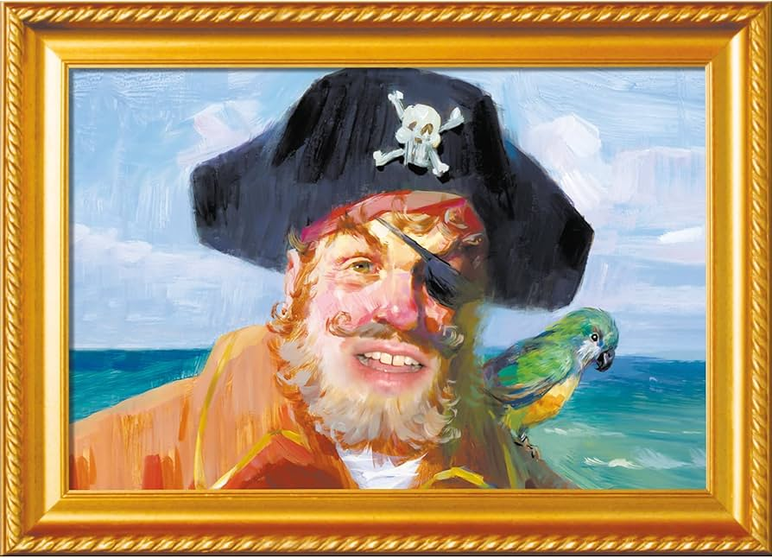
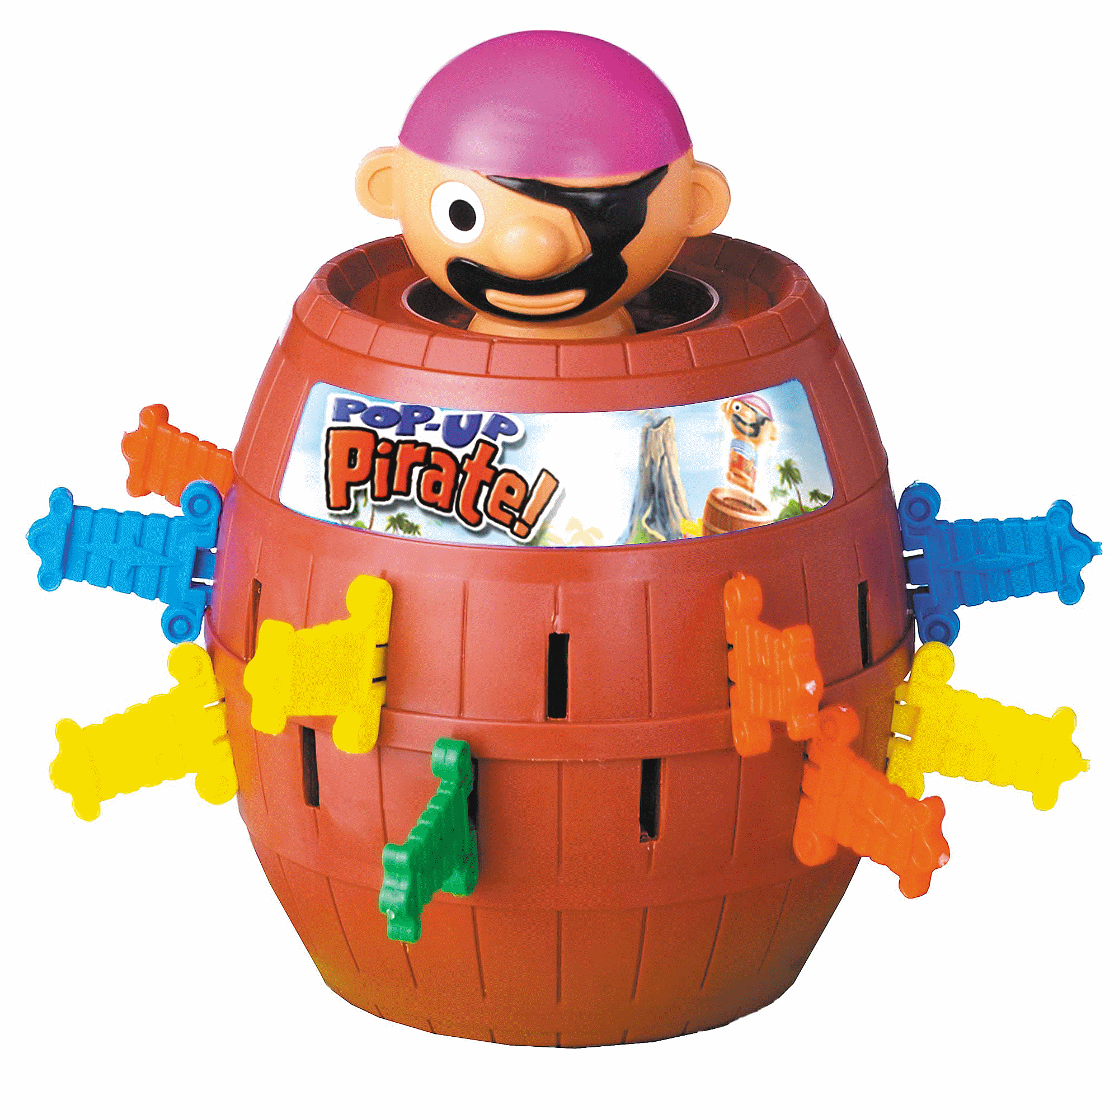
R

Slide 20
What is R
R is a popular programming language used for statistical computing and graphical presentation.

Slide 21
Why Use R?
It is a great resource for data analysis, data visualization, data science and machine learning
It provides many statistical techniques (such as statistical tests, classification, clustering and data reduction)
It is easy to draw graphs in R, like pie charts, histograms, box plot, scatter plot, etc++
It works on different platforms (Windows, Mac, Linux)
It is open-source and free
It has a large community support
It has many packages (libraries of functions) that can be used to solve different problems

Slide 22
Let’s try it
Open R Studio
Find the console window
Type 5 + 10
Press the enter key
Make sure you have a space after the number 5 and before the number 10
If you have additional spaces your command will error
You should see the output of the sum of 5+10

Slide 23
Now let's try this with variables
In R Studio find the console window
Type x <- 5 followed by pressing enter (make sure you have the correct spaces)
Do the same but for y <- 10
The type result <- x + y
If its easier to remember you can use = instead of <-
So it would become x = 5 and y = 10

Slide 24
Let’s try a vector
Vectors are one dimensional arrays
We can try this by finding the console and typing
vec <- c(1, 2, 3, 4, 5)
The c() is what tell R that this is a vector

Slide 25
Data frame
Let’s try a data frame
df <- data.frame( name = c("Alice", "Bob", "Charlie"), age = c(25, 30, 35) )

Slide 26
Functions
Let’s create a function
my_function <- function() { print(“Hello World!”) }
my_function()

Slide 27
More advanced function
my_function2 <- function(my_word) { print(my_word) }
my_function(“a word of your choice”)

