Slide 1


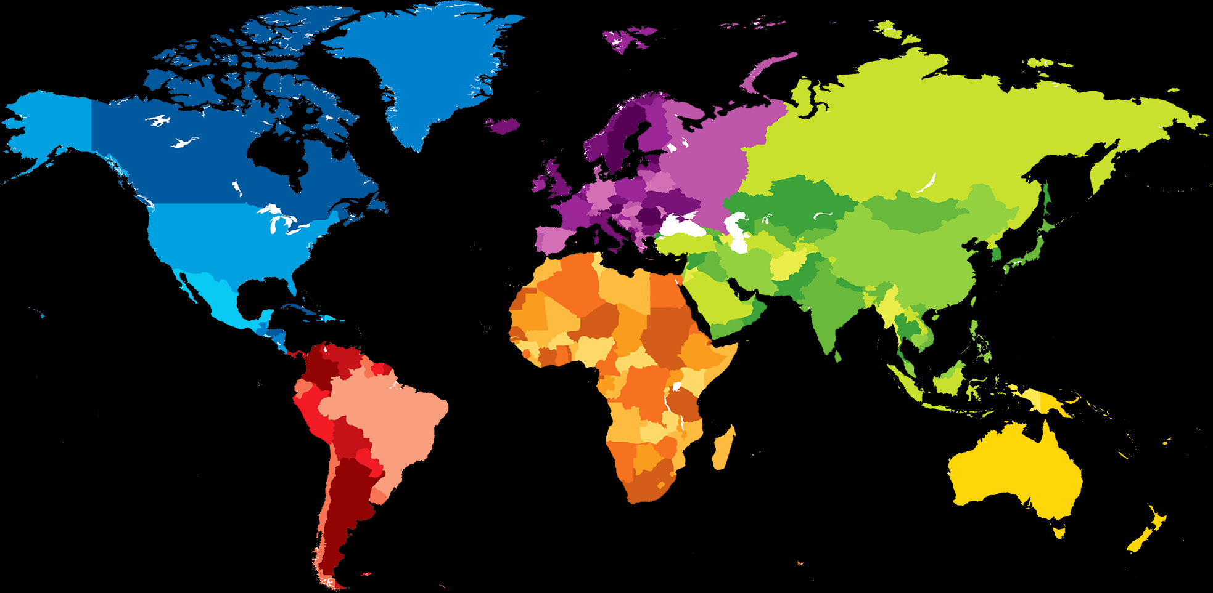
LANGITUDE
LATITUDE
Alamat
User

Slide 2





Google Maps API
API
User
Aplikasi Android
Electronic Nose
Database
Admin
Website

