Slide 1
Eric-MINIX
MD110 NIU-CF MINIX
File System Utility
Copyright © 2004 by IPTC Tech. Comm. AB
M.B.Kocic
Notes:
Classified as confidential and requires NDA (Non-Disclosure Agreement) to be accessed.

Slide 2
Eric-MINIX – Background
Started with trying to mount MINIX FS under the LINUX
Encountered problems:
  Instead of boot block, there is partition table
  Can be fixed by using loop-back device with offset on Linux
  MINIX FS block size mismatch (4kB instad of 1kB)
  MINIX FS superblock structure is different and skewed in few fields
  Date & Time begins on 1989-01-01 (not 1970-01-01)
  Not pure little- or big-endian, but mixture
Solutions:
  Write File System Device Driver
  Modify existing for LINUX. Create from scratch for Windows.
  Low-level programming. Overkill.
  Write User-Level File System Utility
  Works on any O.S.
  Basic functions: Drag to O.S. folder, and Drop from O.S. folder

Slide 3

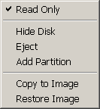
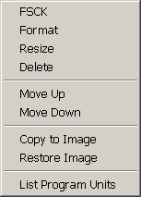
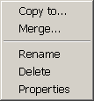
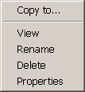
Eric-MINIX – MINIX File System: Objects
System
Disk
File System
0..n
0..n
partitions
root
Physical Device
Binary Image
0..n
1
Directory
File
subfolder
0..n

Slide 4
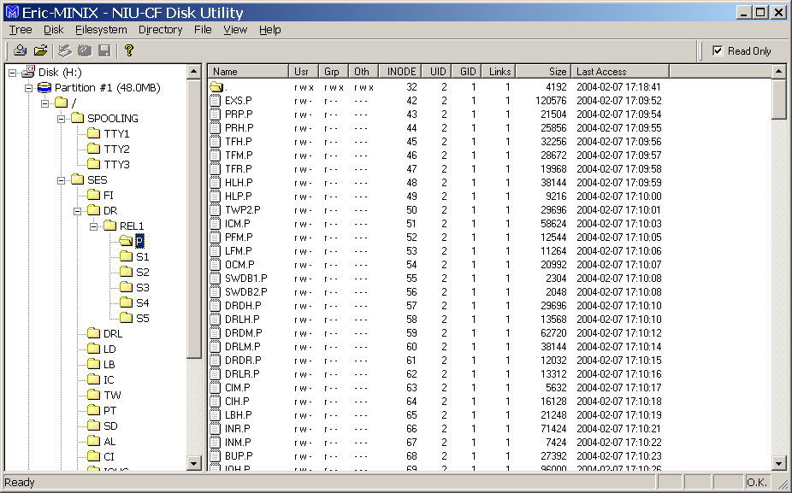
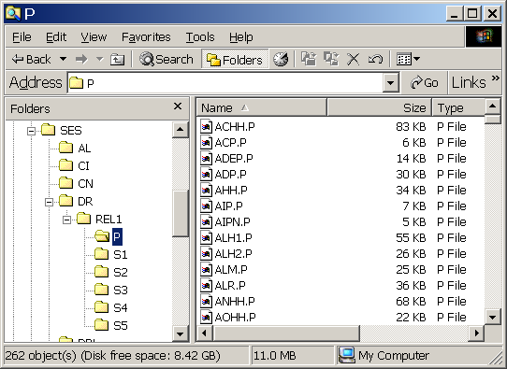
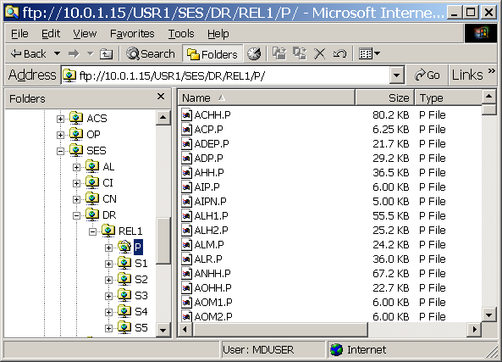
Eric-MINIX – Application & Methods
Standard Windows SDI Application
System
Disk
Menu and Toolbar
Drag & Drop
File System
Tree View
Status Bar
File List View
Directory
File

Slide 5
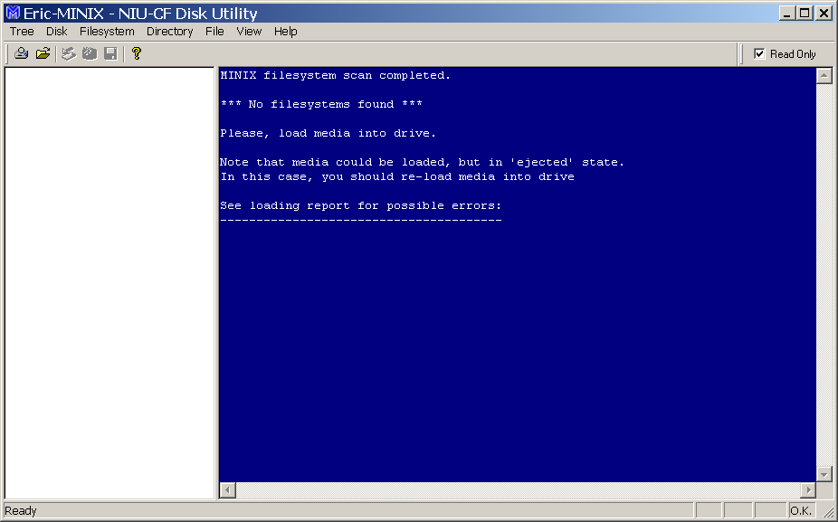

Eric-MINIX – Startup Screen (with no removable disks)

Slide 6
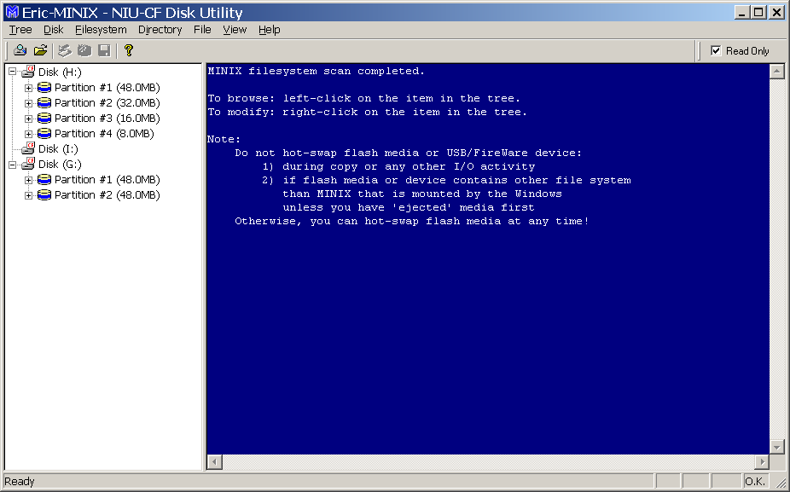
Eric-MINIX – Startup Screen (when found MINIX FS)

Slide 7
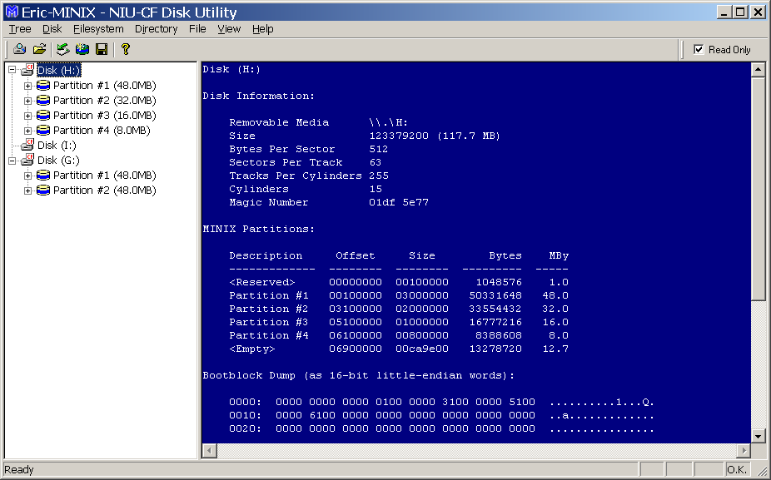
Eric-MINIX – Disk Info

Slide 8
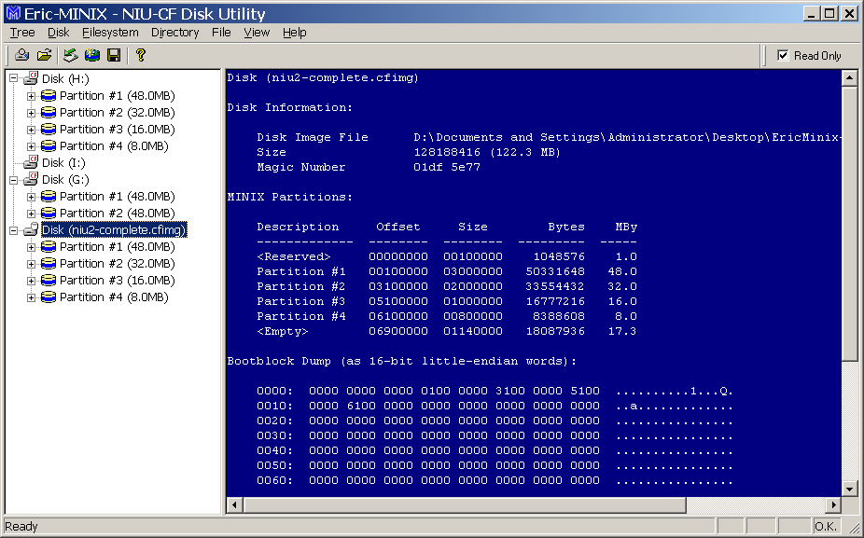
Eric-MINIX – Disk Image Info

Slide 9
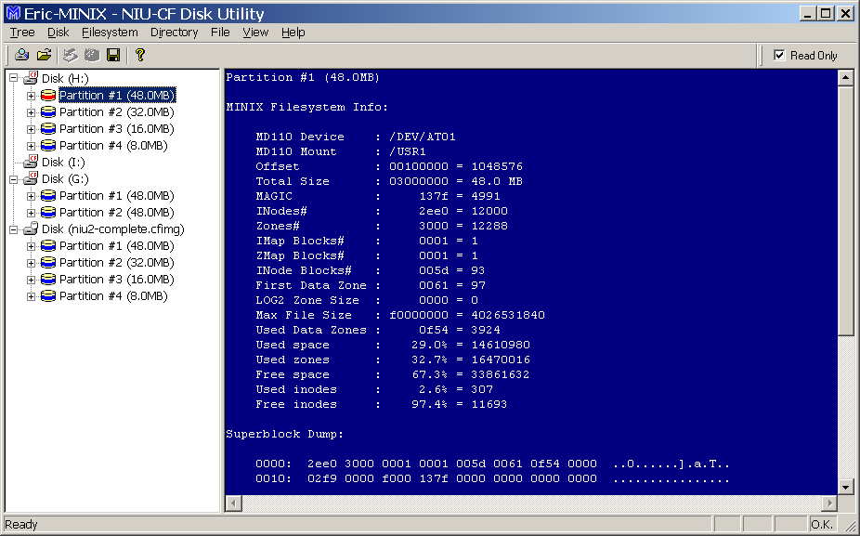
Eric-MINIX – MINIX FS / Disk Partition Info

Slide 10
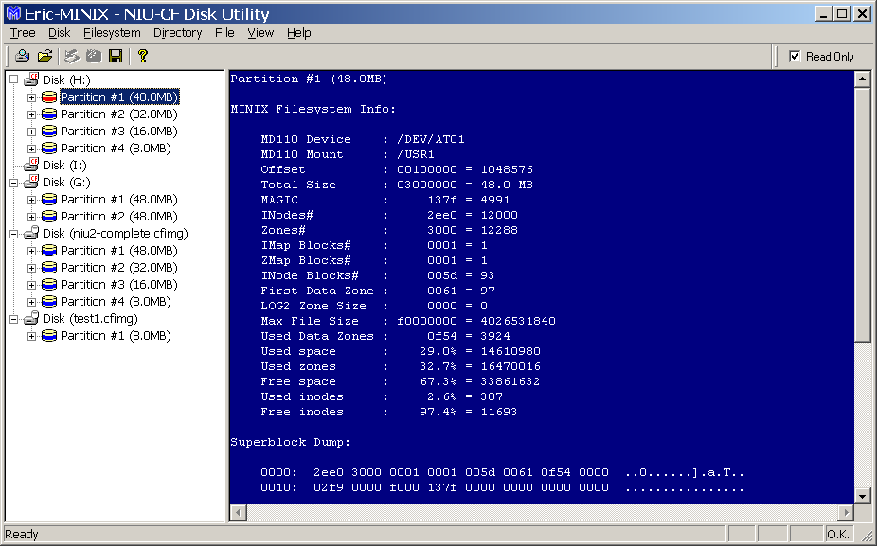
Eric-MINIX – File System Check

Slide 11
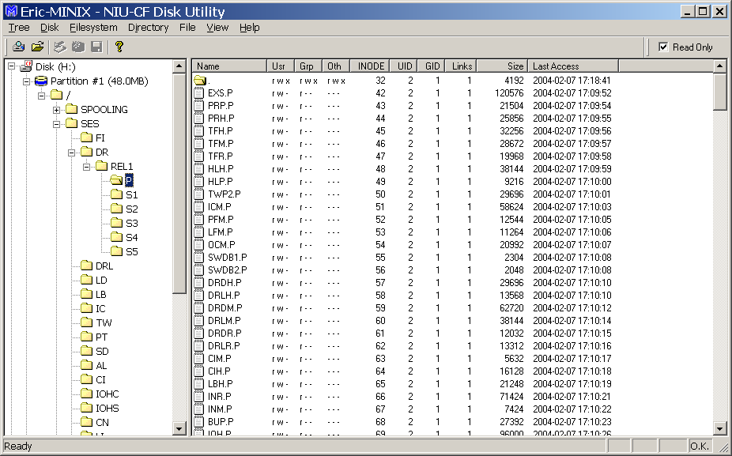
Eric-MINIX – Directory Tree

Slide 12
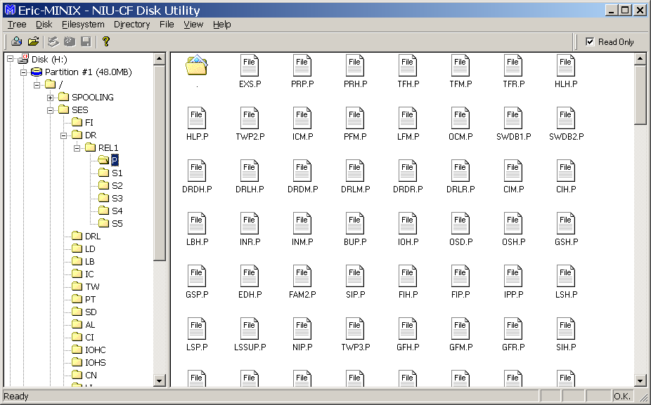
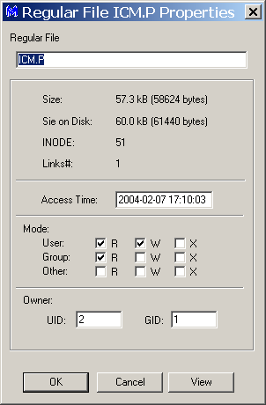
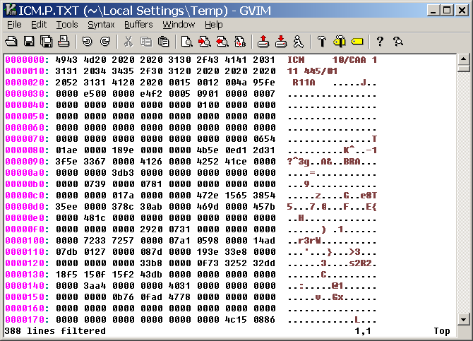
Eric-MINIX – File List

Slide 13
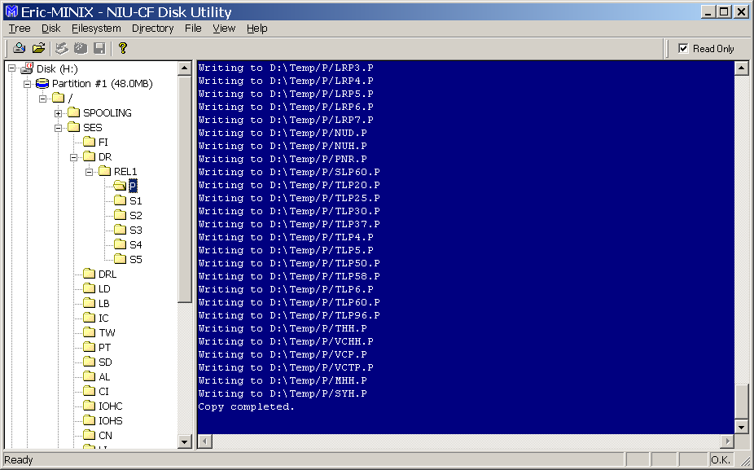
Eric-MINIX – Copying Directory Tree to Host Folder

Slide 14
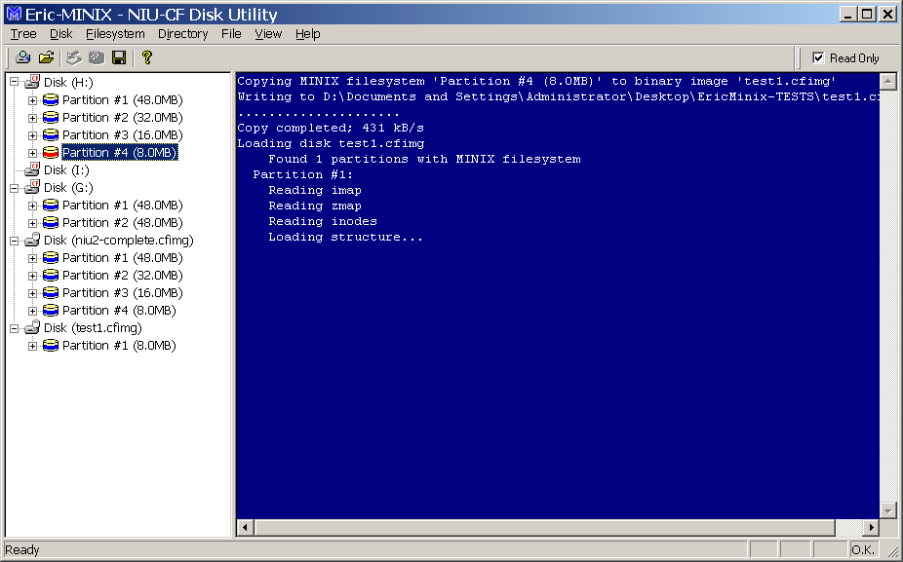
Eric-MINIX – Copying Partition to Binary Image File

Slide 15
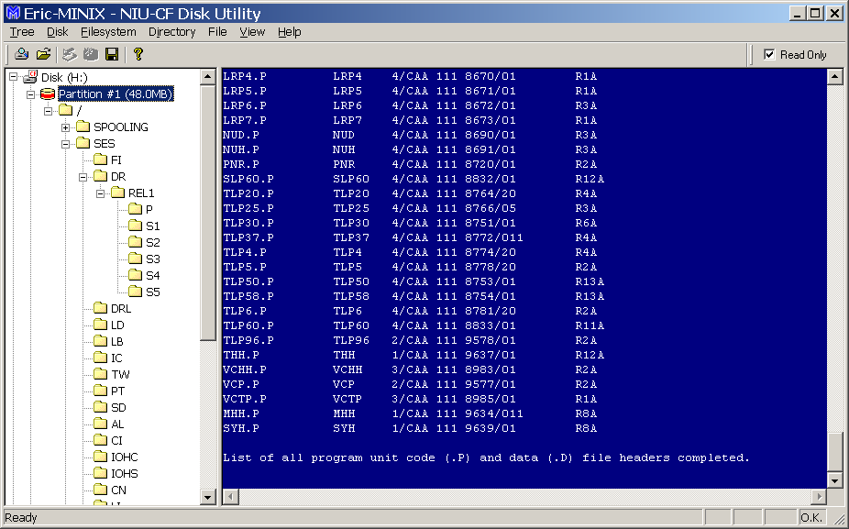
Eric-MINIX – Program Unit File Report

Slide 16

Eric-MINIX – Demonstration…
... and discussion ...

