Slide 1
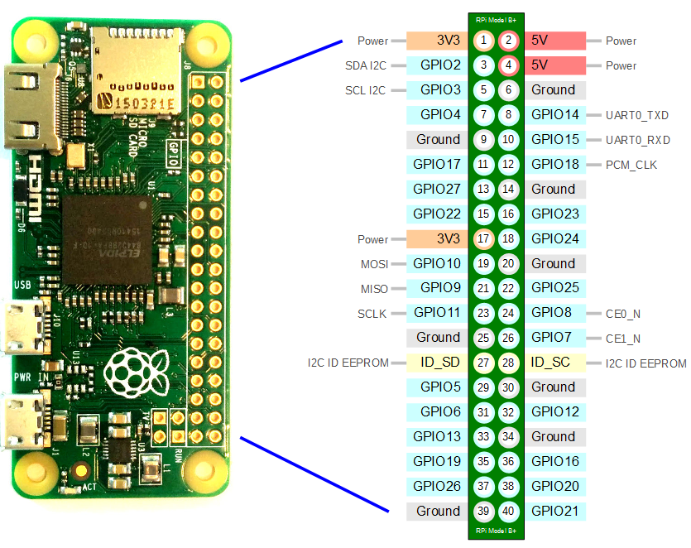
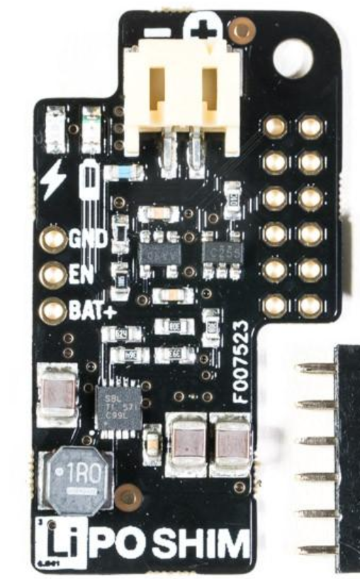

Lipo Shim
connected
to Rpi
pins 1-12
(Lipo Shim
mounted
onto pi)
Raspberry Pi Zero W
With Lipo Shim supply
And ADC for battery
voltage check
(For Omnipy rig)
(Dan Evans 29/4/19)
180k
To Lipo, joined to TP4056 charging module and RileyLink battery input
100k
Direct to pin33 (GPIO13)
Bend out, connect to resistors
Cut off (unused)
Direct to pin39 (GND)
Bend out, connect to pin17 (3V3), NOT GND
Direct to pin36 (GPIO16)
Direct to pin38 (GPIO20)
Direct to pin40 (GPIO21)
MCP3002 pinout
Resistor bridge calculation
V=IR
I = VBATT/280k
CH0 (MCP3003 pin2) voltage =
(VBATT/280k)*100k = VBATT*5/14
VBATT = CH0*14/5 = CH0*2.8
Details of MCP3002 ADC mounting onto Rpi pins
Based on http://raspi.tv/2013/controlled-shutdown-duration-test-of-pi-model-a-with-2-cell-lipo

