Slide 1
GridAI
Anti-Herding Compliance for Distributed Energy Resources
Four agents on Band · Regulated & High-Stakes Workflows
lablab.ai Band of Agents Hackathon · June 2026

Slide 2
THE PROBLEM
Australia has 15 GWh of home batteries reading the same price signal.
When they all respond at once, they synchronise.
same price signal
The fleet creates a new evening demand spike instead of smoothing the old one.
→
471 voltage breaches at the network edge.
This is the herding problem — and it gets worse as VPPs scale.
batteries
sync spike
Current DERMS/VPP platforms (EnergyHub, Kraken, AutoGrid) coordinate DERs — none expose anti-herding assurance.

Slide 3
WHY IT'S HARD
The problem is second-order: it appears precisely when VPP coordination succeeds.
Each aggregator's fleet looks fine in isolation. The failure is at the system level.
WHAT EXISTS
WHAT'S MISSING
DERMS platforms coordinate DERs well
Anti-herding assurance before dispatch
Voltage constraint management is table stakes
Cause-attributed breach compliance
Real-time dispatch of storage fleets
Regulator-ready audit trails
Commercial DERMS expose coordination. None expose anti-herding compliance as a primary artifact.

Slide 4
THE MECHANISM INSIGHT
Desynchronisation is not just a protocol problem.
It depends on fleet-level value heterogeneity. The market design matters as much as the protocol.
NAIVE
GRIDAI HOMOGENEOUS
GRIDAI HETEROGENEOUS
1.000
0.367
0.167
60/60 homes simultaneous
22/60 homes identical fleet
10/60 homes realistic fleet
Heterogeneous fleet synchrony is ~55% lower than homogeneous. Market incentives shape the outcome.

Slide 5
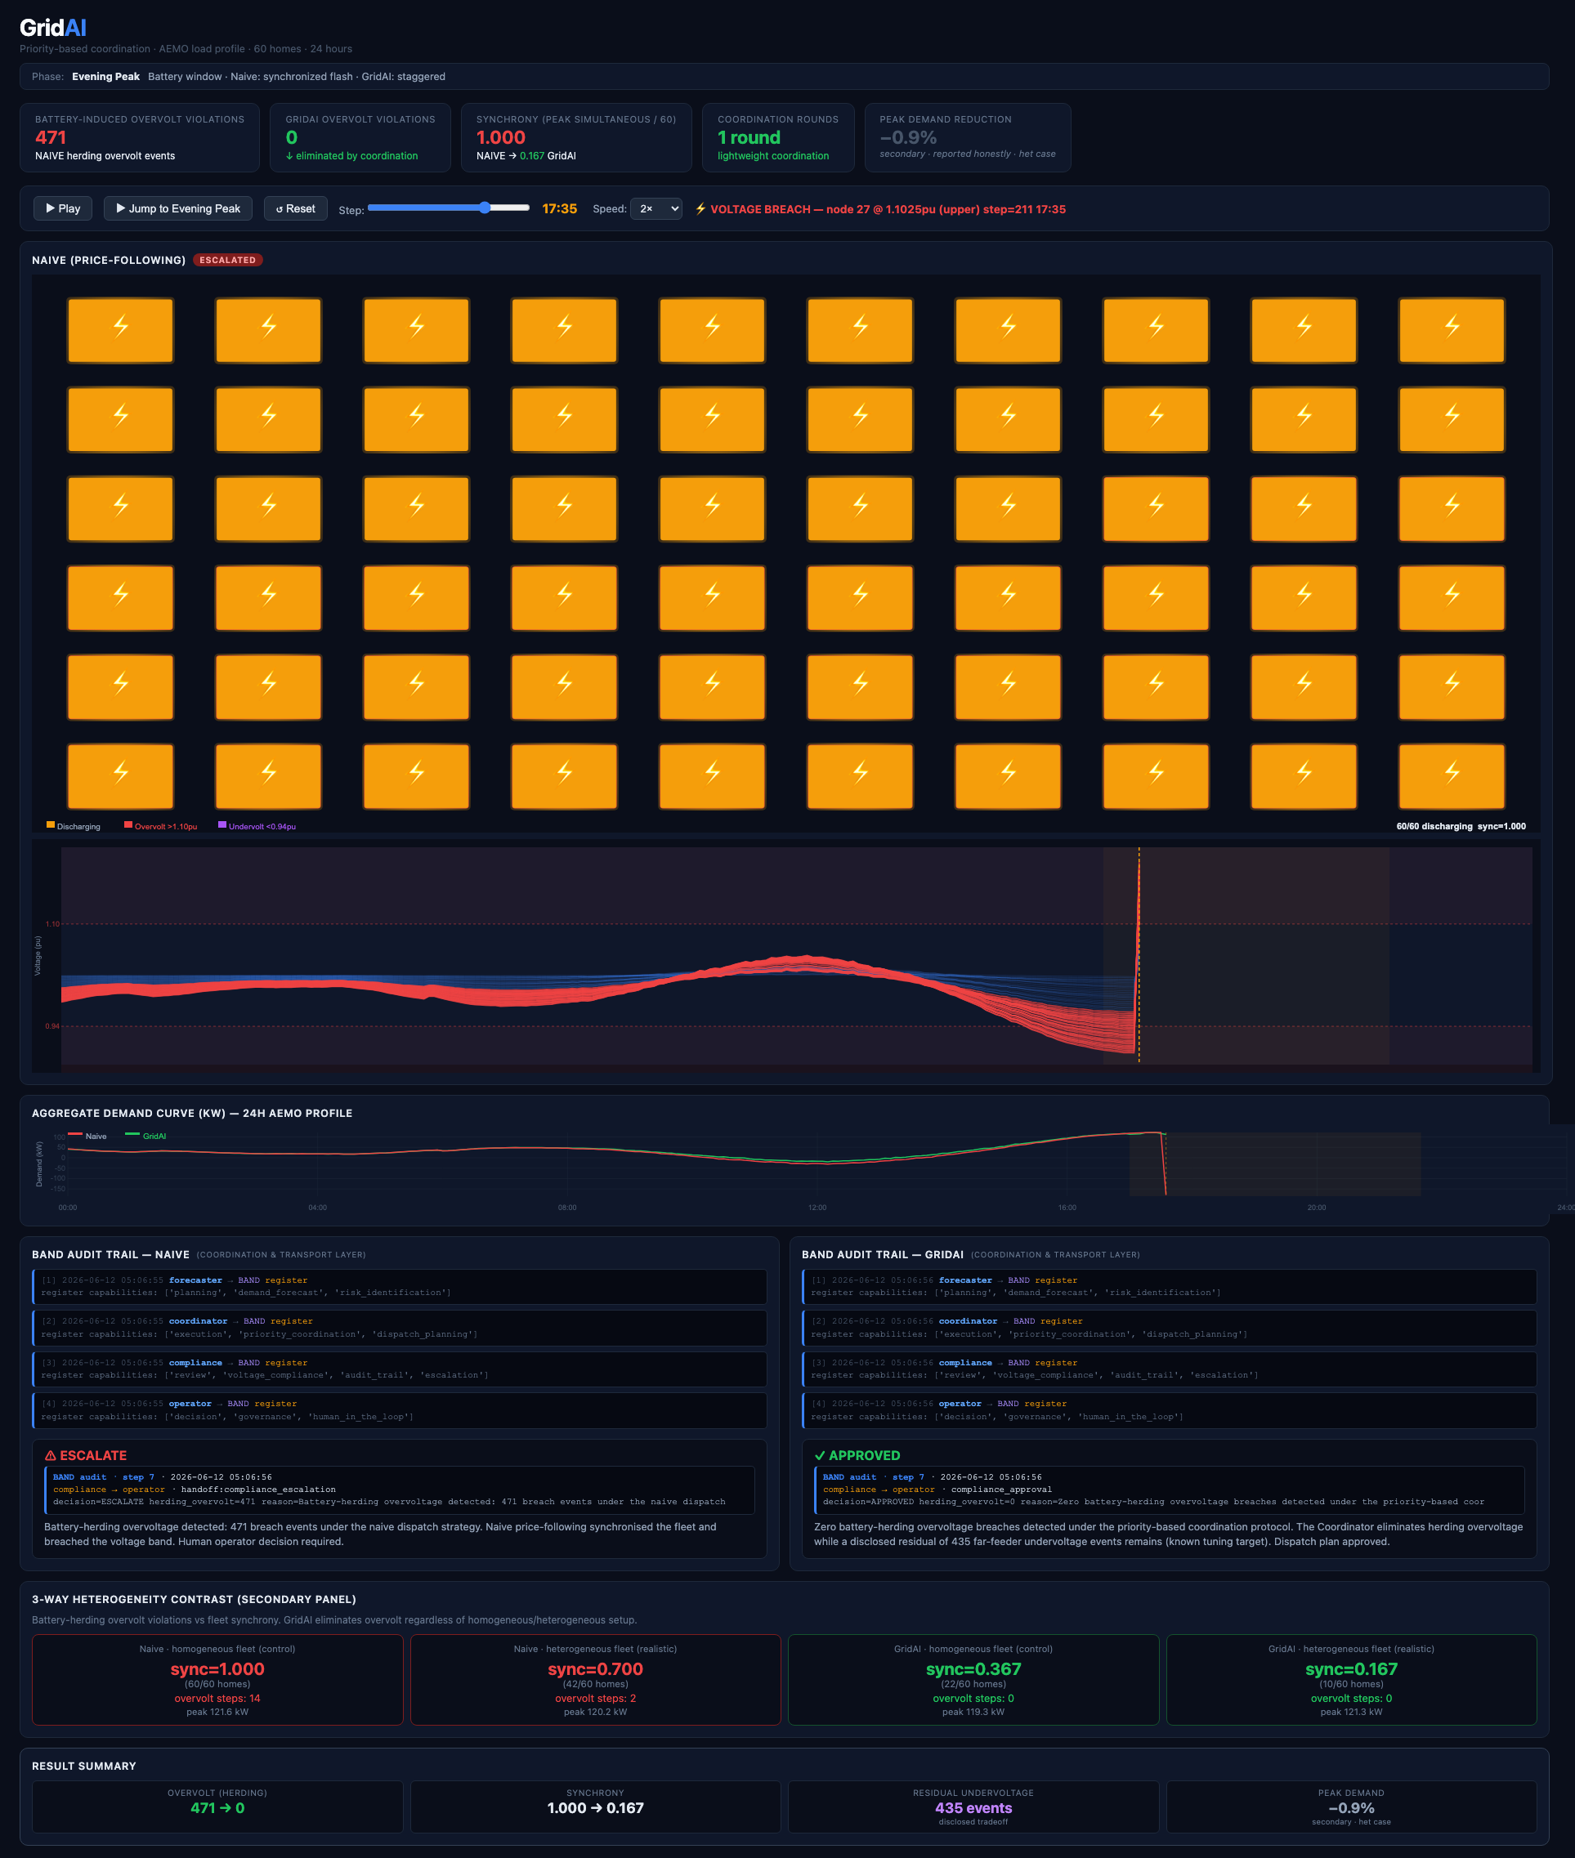
THE SOLUTION
GridAI: priority-based coordination protocol with a Band-native compliance layer.
• The Coordinator allocates each battery's dispatch slot from global fleet state, using SOC and owner preference.
• Centralised priority allocation, decentralised-ready. Converges in 1 to 2 rounds.
Battery-herding overvoltage:
471 → 0
Honest tradeoff: 435 far-feeder undervoltage events (distinct from herding, disclosed not hidden, next tuning target)

Slide 6
THE BAND ARCHITECTURE
Four agents coordinating through Band as the actual collaboration layer.
FORECASTER
COORDINATOR
COMPLIANCE
OPERATOR
Identifies risk windows, hands off to Coordinator
Runs priority-based dispatch, hands dispatch plan to Compliance
Checks AS IEC 60038:2022, attributes breach cause, escalates
Human-in-the-loop, receives escalation, records decision
→
→
→
BAND: shared room · @mention routing · append-only audit log · identity & handoff
Every handoff is traceable. Removing any agent breaks the chain (verified).
Band agents: @s4142972/gridai-forecaster · coordinator · compliance · operator

Slide 7
THE EVIDENCE
Metric
Naive
GridAI
Battery-herding overvoltage
471 steps
0 (eliminated)
Synchrony
1.000
0.167
Max simultaneous discharge
60/60
10/60
Convergence
—
1 to 2 rounds
Peak demand reduction
—
−0.9% (honest)
89 tests passing · including provenance coherence & agent interdependence
AEMO 2012 Victorian data, 17,568 rows. Representative day: 2012-01-24 (highest evening peak, 8,864 MW).

Slide 8
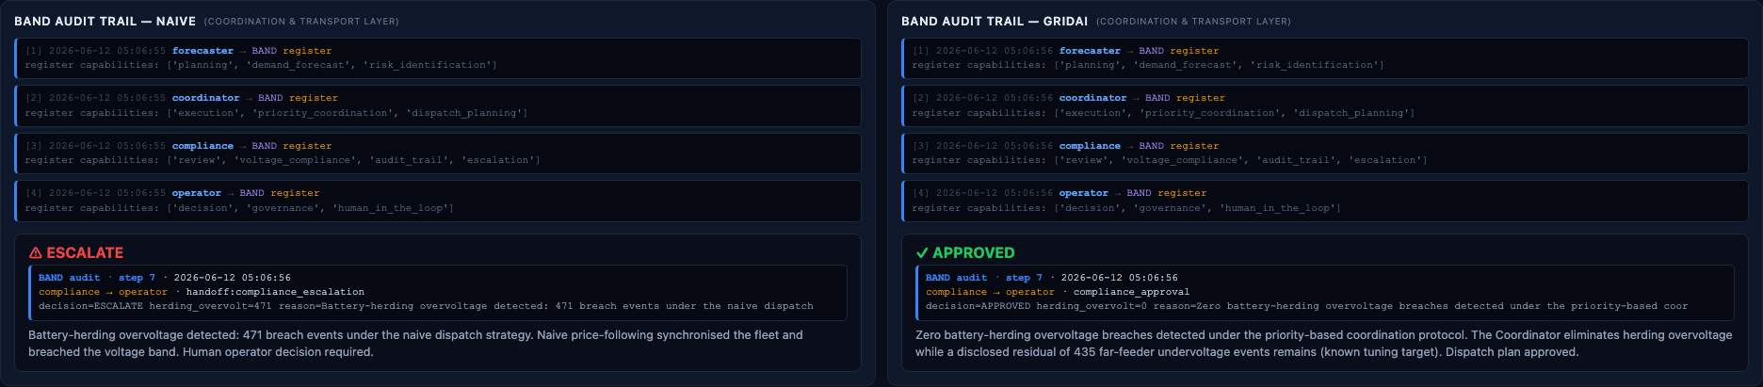
THE COMPLIANCE ARTIFACT
The Band audit trail is the regulated-workflows deliverable.
Every compliance decision is traceable to:
• The agent that made it
• The data it saw
• The moment it happened
• The cause category (pv_export vs battery_herding)
This is what a network operator or regulator can actually use.
AS IEC 60038:2022 · CSIP-AUS compliant · 8-step Band audit trail per scenario

Slide 9
WEDGE POSITIONING
GridAI is not a replacement for DERMS or VPP platforms.
It is an assurance and attribution layer that sits between fleets and the network.
VPP / DERMS PLATFORMS
EnergyHub · Kraken · AutoGrid · Tesla VPP
↓
GRIDAI ← assurance & attribution
Anti-herding + cause-attributed compliance
↓
DISTRIBUTION NETWORK / REGULATOR
AEMO · SA Power Networks · AER
NEXT STEPS
• OpenDSS validation
• Multi-aggregator scenarios
• CSIP-AUS live interface
• RAISE Summit Paris, July 2026

Slide 10
Links & Repository
PUBLIC DEMO
https://dexflex66.github.io/gridai/
GITHUB
https://github.com/dexflex66/gridai
BAND AGENTS
@s4142972/gridai-forecaster · coordinator · compliance · operator
89 tests · 82 original + 7 causal-link & regression additions Built with: Python · Band SDK · AEMO open data · AS IEC 60038:2022 GridAI heterogeneous 0.167 → GridAI homogeneous 0.367 → Naive 1.000 synchrony baseline
lablab.ai Band of Agents Hackathon · Track: Regulated & High-Stakes Workflows · June 2026

