Slide 1
Basic Android Dev. Tutorial
Class Demonstration – COMP3350
Taha R. Siddiqui
Sample Project available on GITHUB
https://github.com/trsiddiqui/StudentRecordKeeper

Slide 2
Sections
Setting up environment
Coding the app
Running/Debugging the app

Slide 3
Section 1
Setting up Environment
Google “Download Android Studio”
Download Android Studio
Install it
Keep pressing “Next” or “Ok” or “Retry”
Allow adding exception for firewall

Slide 5
Section 2
Open Android Studio
Create a new Project

Slide 6
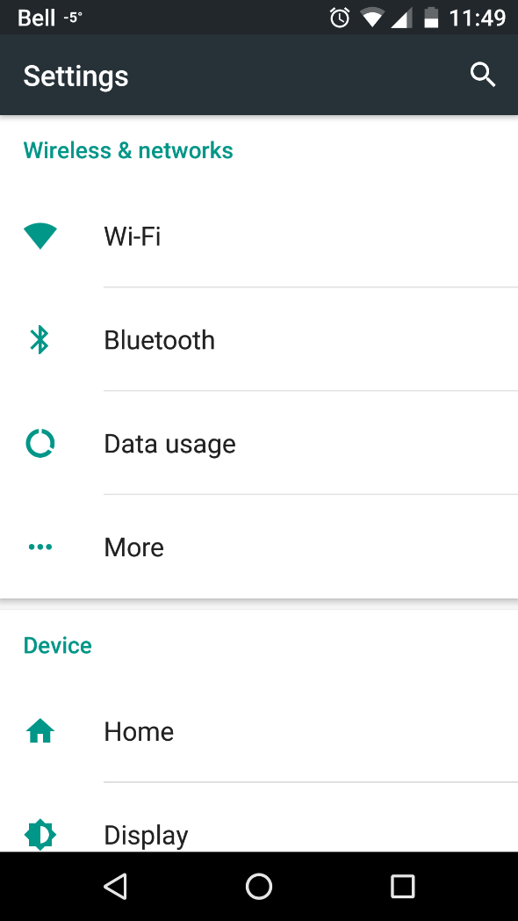
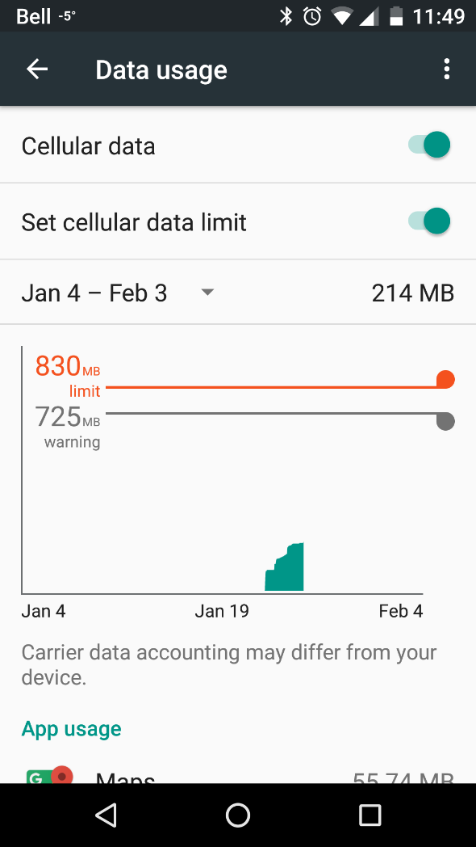
What is an Activity? Service? difference?
“Settings”

Slide 7
How Activity works?
Each activity has a layout associated with it, and it works as the server for that layout

Slide 8
How Activity works?
Each activity has a layout associated with it, and it works as the server for that layout
What is a layout?
It is an XML file, like HTML where you insert views (controls) for an activity.

Slide 9
How Activity works?
Each activity has a layout associated with it, and it works as the server for that layout
What is a layout?
It is an XML file, like HTML where you insert views (controls) for an activity.
An Activity is invoked by either another Activity or when application is launched (the one set as default activity)

Slide 10
How Activity works?
Each activity has a layout associated with it, and it works as the server for that layout
What is a layout?
It is an XML file, like HTML where you insert views (controls) for an activity.
An Activity is invoked by either another Activity or when application is launched (the one set as default activity)
As a developer you need to know when an activity starts or finishes or passes control to another activity etc, these are called events.

Slide 11
How Activity works?
Each activity has a layout associated with it, and it works as the server for that layout
What is a layout?
It is an XML file, like HTML where you insert views (controls) for an activity.
An Activity is invoked by either another Activity or when application is launched (the one set as default activity)
As a developer you need to know when an activity starts or finishes or passes control to another activity etc, these are called events.
Android has some default methods which you can override to do required actions when the above events occur.

Slide 12
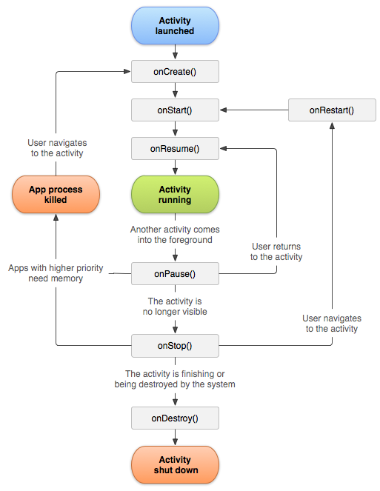
http://developer.android.com/reference/android/app/Activity.html

Slide 13
Activity Events Methods
Called when an activity changes states.
protected void onCreate(Bundle savedInstanceState);
Eg. Create DB If app needs one and can’t be found
protected void onStart();
Eg. Show some message that this started
protected void onPause();
protected void onStop();
Eg. You can save the visible state of the application to retrieve when onRestart or onResume is called
protected void onRestart();
protected void onResume();
protected void onDestroy();
Eg. Garbage disposal, delete temporary files etc

Slide 14
Calling another activity, How?
Intent
An object used to initiate activities.
You tell it
The activity you want to open now
Message (optional) you want to send to that activity
Important Note:
Activities are managed in stack
When you open a new Activity, it is stacked over the previous one, which is PAUSEd and STOPPEd, to be RESUMEd when you exit or press back on the other activity.

Slide 15
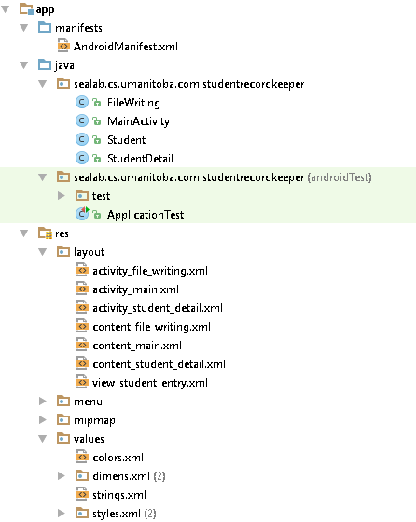

Slide 16
app → AndroidManifest
Configuration of your app containing definitions/declarations of
Permissions
Activities
Default Activity etc.
app → java → <namespace>
Java code of your application
app → res → layout
layout (associated with activities or independent to be included as sub-layout)
app → res → strings
colors, dimens, strings; key value pairs to save you if you need global changes.
Eg. Need to change color of all bars from blue to green(style), or change the language of the entire app(strings) etc.

Slide 17
Layout
Tree of XML elements, like HTML

Slide 18
Layout
Tree of XML elements, like HTML
XML elements are the views (eg. TextView, EditText, Button etc) with different attributes (layout, functionality etc.)

Slide 19
Layout
Tree of XML elements, like HTML
XML elements are the views (eg. TextView, EditText, Button etc) with different attributes (layout, functionality etc.)
Different Design Structures
Linear Layout – Either vertical or horizontal, like a list of views
Relative Layout – Views placed relative to each other (eg. left of textbox1)
Absolute Layout – Views placed absolutely with coordinates x,y (not recommended, may mess your design up for different screen resolution)
Grid Layout – Views placed in a grid of rows and columns.

Slide 20
Views
Controls. Eg. TextView, Button, EditText

Slide 21
Views
Controls. Eg. TextView, Button, EditText
Have several attributes, design or functionality. Eg. Make a Button stick to bottom right of the layout, or make an EditText multiline.

Slide 22
Views
Controls. Eg. TextView, Button, EditText
Have several attributes, design or functionality. Eg. Make a Button stick to bottom right of the layout, or make an EditText multiline.
Each control has some events that can be listened to. Eg. Button has OnClickListener, EditText has TextChangedListener.

Slide 23
Views
Controls. Eg. TextView, Button, EditText
Have several attributes, design or functionality. Eg. Make a Button stick to bottom right of the layout, or make an EditText multiline.
Each control has some events that can be listened to. Eg. Button has OnClickListener, EditText has TextChangedListener.
Some(different) methods are implemented in all the listener which are called when their corresponding events take place. Like afterTextChanged which is called as soon as text finishes changing in an EditText.

Slide 24
Section 3
Running / Debugging the App
Google “Download Genymotion”
Create an account, REMEMBER IT!
Account used when the application runs
Download Basic version
Add a virtual device
Run device OR Connect your own phone
Enable USB Debugging
Run/Debug App from Android Studio

