Slide 1
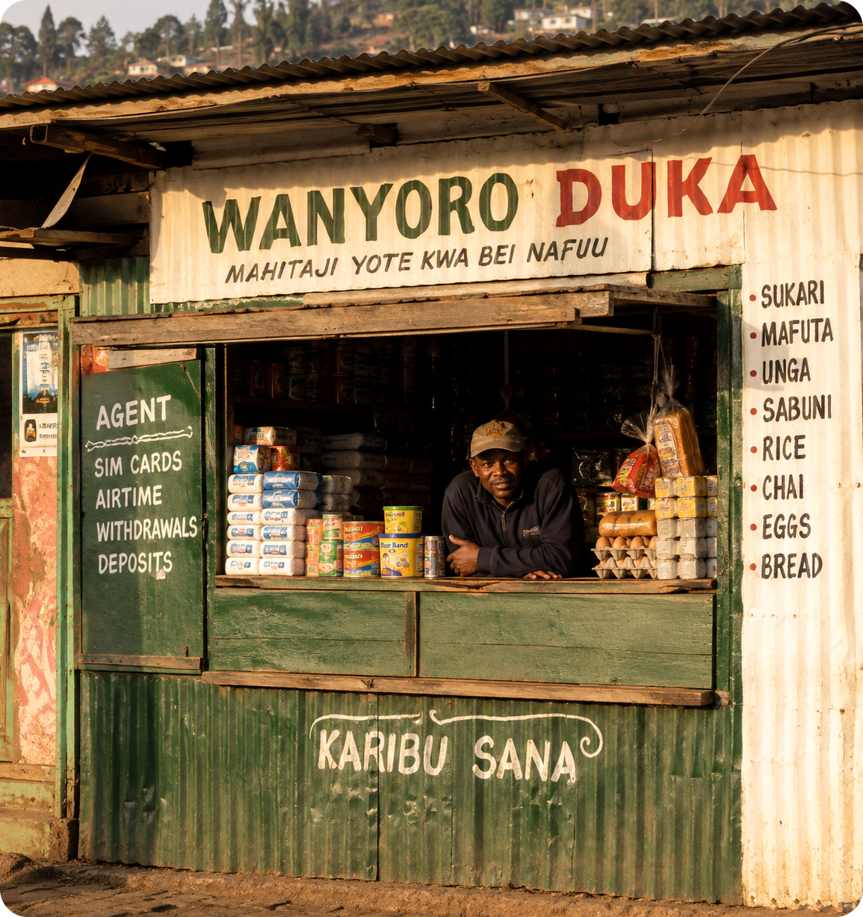
SAMPLE DECK
Mizani.
Bookkeeping that turns daily duka sales into bank-ready credit scores.
Amina Odhiambo, CEO · Nairobi · amina@mizani.example
Nyeri County, Kenya
A HackHouse Residency worked example: fictional company, illustrative figures.
HackHouse.
Notes:
HOOK (~15s): Jambo, I'm Amina Odhiambo, CEO of Mizani. We build bookkeeping that turns a duka's daily sales into a credit score banks actually recognise. Seven point four million shops run on paper; let me show you what that costs them, and the wedge it opens for us.

Slide 2



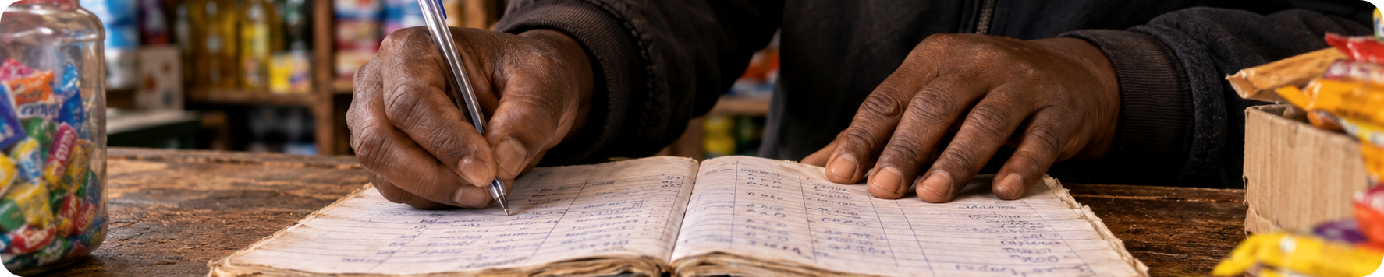
02 · PROBLEM
Duka owners lose KES 9,000 a month to paper records.
7.4M informal retailers
run the till on notebooks and memory.
THE COST OF PAPER
9,000
84% of loan applications rejected
there is no record a lender can read.
~12% of revenue lost
to stock leakage and stockouts.
KES lost per shop, every month
*Illustrative. Replace with your sourced figure.
MIZANI · SAMPLE DECK
ILLUSTRATIVE FIGURES · 02 / 12
Notes:
(~30s): Every duka runs on a notebook and memory. That costs the average owner around nine thousand shillings a month, illustrative here; source yours, in leakage and stockouts. Worse: when the owner needs stock financing, there is no record a lender can read, so eighty-four percent of applications are rejected. The tool they trust is the thing locking them out of credit.

Slide 3



03 · SOLUTION
Mizani: snap a sale, build a credit score.
→
→
TODAY
STEP 1
PAYOFF
Paper ledger
10-second capture
The Mizani Score
Free and familiar, but invisible to lenders.
Snap or voice-note every sale, on any phone.
A credit signal partner lenders recognise.
WHY NOW: 61% smartphone penetration in the segment, and open-banking rails live since 2025.
The rails finally exist. Mizani is the first ledger built for them.
MIZANI · SAMPLE DECK
ILLUSTRATIVE FIGURES · 03 / 12
Notes:
(~30s): Mizani is bookkeeping that pays for itself in credit. The owner snaps each sale, ten seconds, any phone, vernacular-first. Behind that, every entry feeds the Mizani Score, a credit signal our partner lenders recognise. Why now: smartphone penetration in this segment crossed sixty-one percent, and open-banking rails went live last year. The rails finally exist, we're the first ledger built for them.

Slide 4



04 · PRODUCT
Record. Reconcile. Get credit.
Mizani.
Sale captured
KES 1,240 · 10:42 am
Record · Snap or voice-note each sale in 10 seconds, on any phone.
Stock alert
Sugar: 2 days left
Reconcile · Auto P&L, stock alerts, clean monthly statements.
MIZANI SCORE
712
Get credit · The Mizani Score travels to partner lenders via API.
shared with 2 partner lenders
LIVE TODAY · CAPTURE · LEDGER · SCORE V1
NEXT · LENDER API
MIZANI · SAMPLE DECK
ILLUSTRATIVE FIGURES · 04 / 12
Notes:
(~40s): Three steps. Record: snap or voice-note the sale. Reconcile: we build the P&L and flag stock issues automatically. Get credit: the Score travels to lenders through our API. Capture, ledger and Score v1 are live today; the lender API ships next. If demoing live: this is Mary's shop in Kawangware, her Score unlocked a forty-thousand-shilling stock loan in March. Rehearse the demo path twice; never improvise it.

Slide 5
05 · MARKET
180,000 Nairobi-area shops: our first wedge.
$410M
THE WEDGE MATH · BOTTOM-UP
180,000 shops
× KES 250 / month
= KES 540M a year (~$4.2M)
$96M
$4.2M/yr
Loan referrals lift ARPU beyond the subscription.
*Top-down sizes illustrative. Cite your sources.
TAM
E. Africa SMB
money tools*
SAM
2.1M smartphone
retailers
SOM
180K shops ×
KES 250/mo
MIZANI · SAMPLE DECK
ILLUSTRATIVE FIGURES · 05 / 12
Notes:
(~25s): We size this bottom-up. The wedge is one hundred eighty thousand smartphone-owning shops around Nairobi at two hundred fifty shillings a month, about four point two million dollars a year before loan referrals. The reachable market is two point one million retailers, ninety-six million dollars. Top-down numbers here are illustrative; cite your own sources.

Slide 6



06 · BUSINESS MODEL
KES 250 a month, plus 2% of every loan we place.
CAC
PAYBACK
LTV
$18
~3 mo
$84
→
→
agent-led acquisition
on subscription alone
subs + loan referrals
4.7×
68% gross margin
Expansion: lender data licensing
LTV to CAC
payback inside three months
MIZANI · SAMPLE DECK
ILLUSTRATIVE FIGURES · 06 / 12
Notes:
(~25s): Two revenue lines: subscription at two hundred fifty shillings a month, plus two percent of every loan placed. A shop costs eighteen dollars to acquire through agents and returns eighty-four, four point seven to one, payback inside three months, sixty-eight percent gross margin. Data licensing to lenders is the expansion line.

Slide 7
07 · TRACTION
KES 540K MRR, growing 22% month-on-month.
Monthly recurring revenue, KES '000. Six months of paying customers
1,840
paying shops in 6 months
4%
monthly churn; loans lock them in
KES 18M
placed via 2 lender pilots
MIZANI · SAMPLE DECK
ILLUSTRATIVE FIGURES · 07 / 12
Notes:
(~30s): Six months of paying customers: one thousand eight hundred forty shops, five hundred forty thousand shillings of MRR, compounding twenty-two percent month-on-month with four percent churn. The proof of the model: two lender pilots have placed eighteen million shillings through Mizani Scores, and a shop that gets its first loan doesn't churn.

Slide 8

08 · COMPETITION
We win the shops POS systems can't afford to serve.
 | Notebooks | POS / ERP | Mizani
Price | Free | KES 30K+ hardware | KES 250 / month
Lender-visible | No | No | Yes, via the Mizani Score
Built for dukas | Familiar | English-first | Vernacular-first, zero hardware
Moat forming: repayment data on thin-file borrowers. Every cycle deepens it; a copycat starts at zero.
MIZANI · SAMPLE DECK
ILLUSTRATIVE FIGURES · 08 / 12
Notes:
(~25s): Our real competitor is the notebook, free and familiar, but invisible to lenders. POS systems need thirty-thousand-shilling hardware and English. We're zero-hardware, vernacular-first, and lender-integrated. The moat compounds: repayment data on thin-file borrowers that any copycat starts without.

Slide 9
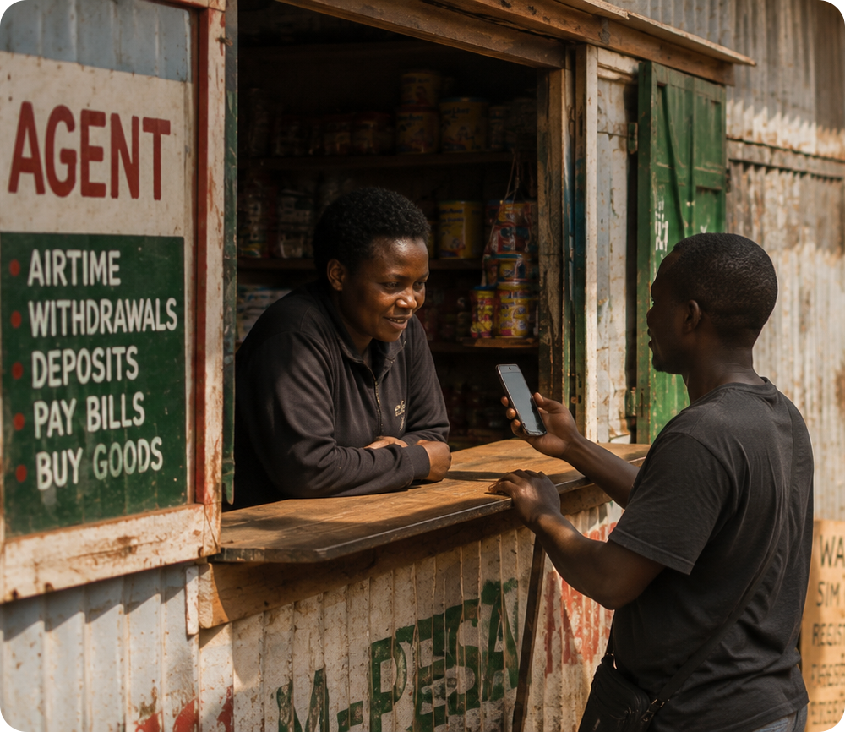



09 · GO-TO-MARKET
Twelve agents sign 40 shops each, every month.
NOW
Market agents
CAC $18
12 agents, 40 shops each per month; CAC steady across the whole team.
MOTION
Referral loop
33% referrals
Market-day demos, paid forward with airtime referral bonuses.
NEXT
SACCO partnerships
9 counties
Savings co-operatives as trusted distribution into new counties.
Agent onboarding at the hatch
MIZANI · SAMPLE DECK
ILLUSTRATIVE FIGURES · 09 / 12
Notes:
(~25s): The machine today: twelve market agents, forty shops each per month, at an eighteen-dollar CAC that has held across every agent, not just the first two. A third of new signups now come from airtime-bonus referrals, which pushes blended CAC down as we grow. Next channel: SACCO partnerships across nine counties.

Slide 10

10 · TEAM
We've kept the books and built the rails.
AO
BM
Amina Odhiambo
Brian Mutua
Credit-policy advisor
CO-FOUNDER · CEO
CO-FOUNDER · CTO
ADVISOR
Grew up in her family's duka; ex-telco SME product lead.
Eight years building lending infrastructure.
Former central-bank credit-policy lead.
“Every hard part of this company has an owner who's done it before.”
MIZANI · SAMPLE DECK
ILLUSTRATIVE FIGURES · 10 / 12
Notes:
(~20s): I grew up keeping the books in my family's duka, then ran SME products at a telco. Brian spent eight years building lending infrastructure. Our advisor wrote central-bank credit policy. Every hard part of this company has an owner who has done it before.

Slide 11
11 · FINANCIALS
Path to $1.2M ARR by 2029.
Projected ARR, $ '000, illustrative
THE ONE ASSUMPTION
22,000 shops across nine counties at KES 310 blended ARPU.
Everything else is arithmetic. Challenge this number.
Burn $9K / month
11 months runway
MIZANI · SAMPLE DECK
ILLUSTRATIVE FIGURES · 11 / 12
Notes:
(~20s): The illustrative path: ninety-two thousand ARR next year, four hundred ten, then one point two million by twenty twenty-nine, driven by a single assumption: twenty-two thousand shops across nine counties at three hundred ten shillings blended ARPU. We burn nine thousand a month; eleven months of runway.

Slide 12


12 · THE ASK
Raising $350K to reach 10,000 shops.
USE OF FUNDS
Growth · 45%
Product · 35%
Ops · 20%
agents & referrals
lender API & Score v2
compliance & finance
BY MONTH 18
10,000 shops
$45K MRR
3 lender integrations
These milestones price the next round.
amina@mizani.example · Demo Day, HackHouse Africa, Nairobi
MIZANI · SAMPLE DECK
ILLUSTRATIVE FIGURES · 12 / 12
Notes:
(~25s): We're raising three hundred fifty thousand dollars: forty-five percent growth, thirty-five product, twenty ops. By month eighteen: ten thousand shops, forty-five thousand dollars of MRR, and three lender integrations, the milestones that price the next round. I'm Amina, amina at mizani dot example. Asante. Leave this slide up for Q&A.

