Slide 1
dextermiller.com
Major: B.S. Computer Science
Minor: Mathematics
Indiana Tech

Slide 2

Project Summary
This project is a website, in and of itself, but rather how I implemented an AI for Tic-Tac-Toe and Connect 4 through a website via JavaScript.
Notes:
For my senior project this is what I did:
I built tic-tac-toe and connect 4 in JavaScript
I made an AI to play tic-tac-toe and connect 4
I built a website!
Normally, you would be able to see me when I present, so just in case you were wondering what I look like, here is an image.
// Why chosen It was build to show my skills, professionalism, and the
// fundamentals of an AI and algorithm development

Slide 3
Overview
Why did I decide dextermiller.com?
C++ -> JS
Artificial intelligence (AI)
I wanted to build a website
What did I do?
Ubuntu Server
Tic-tac-toe
Connect 4
Notes:
I’ve programmed Tic-tac-toe and Connect 4 before in C++ with an ASCII output Sophomore year of college. I wanted to build upon that and allow for an AI feature to play against. So I had to start over and build the game in JavaScript.
I’ve also came across a scrap computer that I wanted to play with, so I decided to turn it into an Ubuntu Server. This was the start of me building my website. Creating Tic-Tac-Toe and Connect 4 was simply learning JavaScript and how it works CSS and HTML.

Slide 4
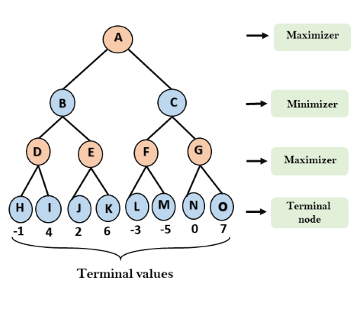
Analysis & Design
Algorithms
Minimax
Alpha-Beta
Terminal States
If win
Max: 10-depth
Min: -10+depth
Draw: 0
Notes:
I used two different but similar Algorithms, Minimax and Alpha-Beta pruning. Both of these algorithms are recursive with two players returning it’s best move. For example, in a game there are two players, where each is trying to better its position. Lets call the two players Min and Max, hence the name.
The Max player is always trying to pick the highest score, whereas the Min does the opposite. Naturally we would assume our opponent is going to make the best move for themselves, so that is what is simulated. In this recursive algorithm there are terminal states that we need to evaluate to return up the tree.
The depth is the distance from the root of the tree to the desired node. In Tic-Tac-Toe a terminal node is any node that contains a win. To score this terminal node, we take the depth and add it or subtract it to the winner’s score. This is because we want to score a move higher if it has a lesser depth. Later I’ll explain how I scored the Connect 4 terminal states.

Slide 5
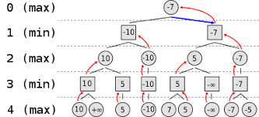
Minimax Algorithm
Notes:
This is another illustration on how the Minimax algorithm works, it shows how the terminal states are passed up from max to min. It is important to note that the min is always choosing the lesser of It’s leaf values, and max is choosing the greater.

Slide 6
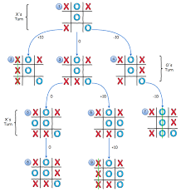
Minimax cont.
Notes:
Now that you know how the scoring works, This image shows how the branching out works. In this algorithm each available spot is tried until the board is full or there is a win.

Slide 7
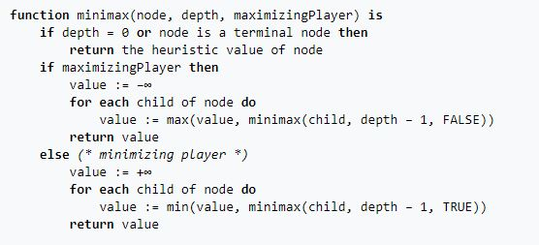
Minimax Pseudocode
Notes:
The implementation of the Minimax is described very well in this pseudocode. It checks for a terminal node. If there is no terminal node, then it is either the maximizer’s turn or the minimizers. On the player’s turn, we want to simulate a move and call the minimax function with the placed move.

Slide 8
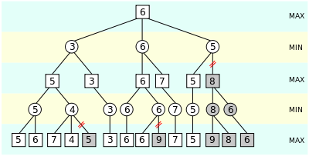
Alpha-Beta Pruning
Notes:
Now that you know how the minimax works, alpha-beta pruning is a way to improve upon the original minimax algorithm. Alpha is defined as the best (highest-value) choice we have found so fare at any point along the path of the maximizer. The initial value of alpha is –Infinity. Beta is the best (lowest-value) choice we have found so far at any point along the path of minimizer. The initial value of beta is Infinity.

Slide 9
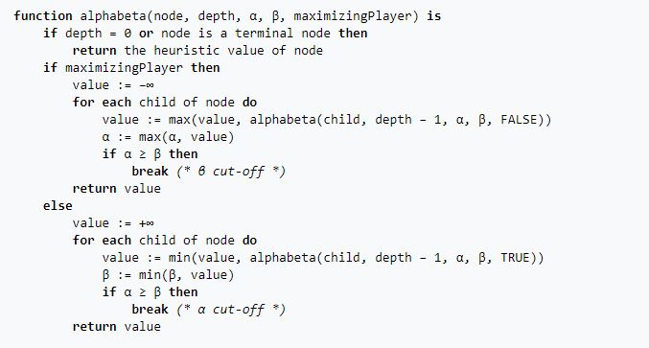
Alpha-Beta pseudocode
Notes:
As you can see, this is very similar to the Minimax pseudocode, but there is a break in the for loop, which iterates through each value. This skips over unnecessary searches.

Slide 10
Connect 4 Scoring
Win in all directions += 100
Horizontal
Vertical
Diagonals
3 in a row += 5
2 in a row += 2
Opponent 3 in a row -= 5
Center Column scoring += center count * 3
Notes:
The scoring function is a critical part of making the minimax/alpha-beta algorithm. So the first thing that needs to happen is for the AI to make a winning move.
In all directions: horizontal, vertical, and diagonals. I set the score for these positions to 100.
But, not every move is going to be a winning move, so we need to score 3 and 2 in a row. I set these to add 5 and 2 to the score.
I also need to score an opponent, because we need to block an opponent if they have 3 in a row. Therefore set this to add -5 to the score.
Lastly, I needed to score the center column, because it allows for the most options with diagonals, horizontals, and options to win. To do this I created a counter for the number of player pieces in the center column. Then I score that position by multiplying the center count by 3 and adding it to the score position.

Slide 11
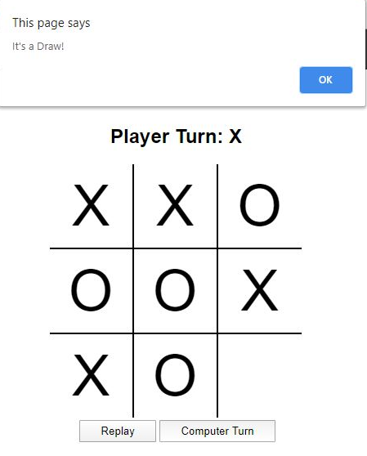
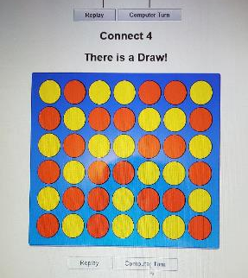
Testing
Playing the game!
Alert Function
Tic-Tac-Toe is essentially unbeatable
The connect 4 is hard
Notes:
I’ve had lot’s of friends and family play against my AI and interact with my website. The feed back I received was great! From spelling mistakes to the user interface of the games.
The image shown on the right is a good example of an issue others pointed out to me. When the last move was played, the script wouldn’t fill the HTML element before showing the alert. After fixing that issue, Tic-Tac-Toe seemed to work pretty well … and unbeatable.
However, the Connect 4 AI is difficult to beat, but it’s not impossible. I’ve played my AI against a connect 4 solver I found online, and it lost! The connect 4 AI is set to a depth of 6. So it’s not impossible to beat, but can be pretty hard against a human player. That being said, the picture shown to the left is the result of my dad forcing a draw against the computer.

Slide 12
Tic-Tac-Toe Data
Tic-Tac-Toe (Minimax)
Moves on board | Iterations | Average Time (ms)
1 | 549,946 | 211.77
2 | 59,705 | 22.58
3 | 7332 | 2.69
4 | 935 | 0.36
5 | 198 | 0.10
6 | 47 | 0.13
7 | 14 | 0.02
8 | 5 | 0.01
9 | 2 | 0.008
Notes:
I ran the computer turn function to play 9 moves on the board for Tic-Tac-Toe, with each turn the function returned the number of iterations along with the time, which is in milliseconds, to make the move. I did a set of 9 moves on the board 5 times; Then I took the average times seeing as they varied.
As the board starts to get filled it is clear to see that the number of iterations decrease exponentially as well as the time to run the minimax function. Because I didn’t set a depth limit nor did I implement alpha-beta pruning on Tic-Tac-Toe, we can expect the exponential decrease shown.

Slide 13
Connect 4 Data
Connect 4 (Minimax)
Moves | Iterations | Average Time (ms)
1 | 137257 | 981.15
2 | 137256 | 869.09
3 | 135743 | 853.90
4 | 137218 | 859.41
5 | 135669 | 896.13
6 | 134385 | 848.86
7 | 130637 | 851.21
8 | 131334 | 851.87
9 | 125387 | 840.05
Averages | 133876.20 | 872.41
Connect 4 (Alpha-Beta)
Moves | Iterations | Average Time (ms)
1 | 9007 | 150.18
2 | 12769 | 99.24
3 | 7628 | 57.44
4 | 9415 | 54.16
5 | 9065 | 75.85
6 | 7585 | 43.80
7 | 8542 | 48.43
8 | 8246 | 48.70
9 | 9214 | 54.55
Average | 9052.33 | 70.26
Notes:
Similar to the previous slide, I performed the same process to calculate the average iterations and time in milliseconds.
However; I did set the depth limit to 6 in this implementation of Connect 4. Because of this, we don’t see an exponential decrease, since the game isn’t over in 9 moves. Rather, we do see a significant difference between the minimax algorithm and alpha-beta pruning.
The difference I found in iterations from the Minimax algorithm to the alpha-beta pruning is a 93.24% decrease and the average time decreased 91.95%! It is clear to see that Alpha-beta pruning is much more efficient than minimax.

Slide 14
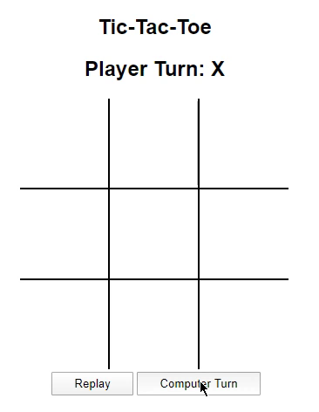
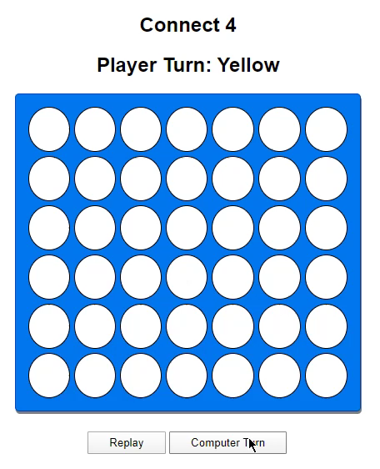
Demonstration
dextermiller.com

Slide 15
Citations

Slide 16
Questions

