Slide 1
dextermiller.com
Dexter Miller
Major: B.S. Computer Science
Minor: Mathematics

Slide 2
Overview
Summary
Creating a personal, professional website showing my projects and what I’ve done.
Why
I’ve programmed tic-tac-toe before in C++ but now I want to build upon it and share it with the world

Slide 3



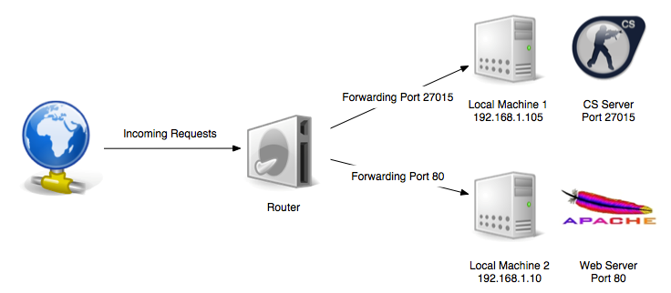
Resources

Slide 4
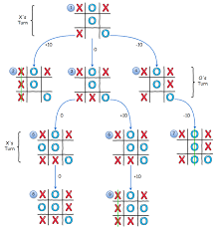
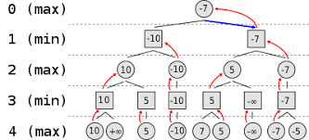
But How?
Minimax Algorithm

Slide 5
References
Geeksforgeeks.org
medium.com
towardsdatascience.com
101computing.net

