Slide 1

Twitter Airline Sentiment Analysis
Dexter Corley

Slide 2
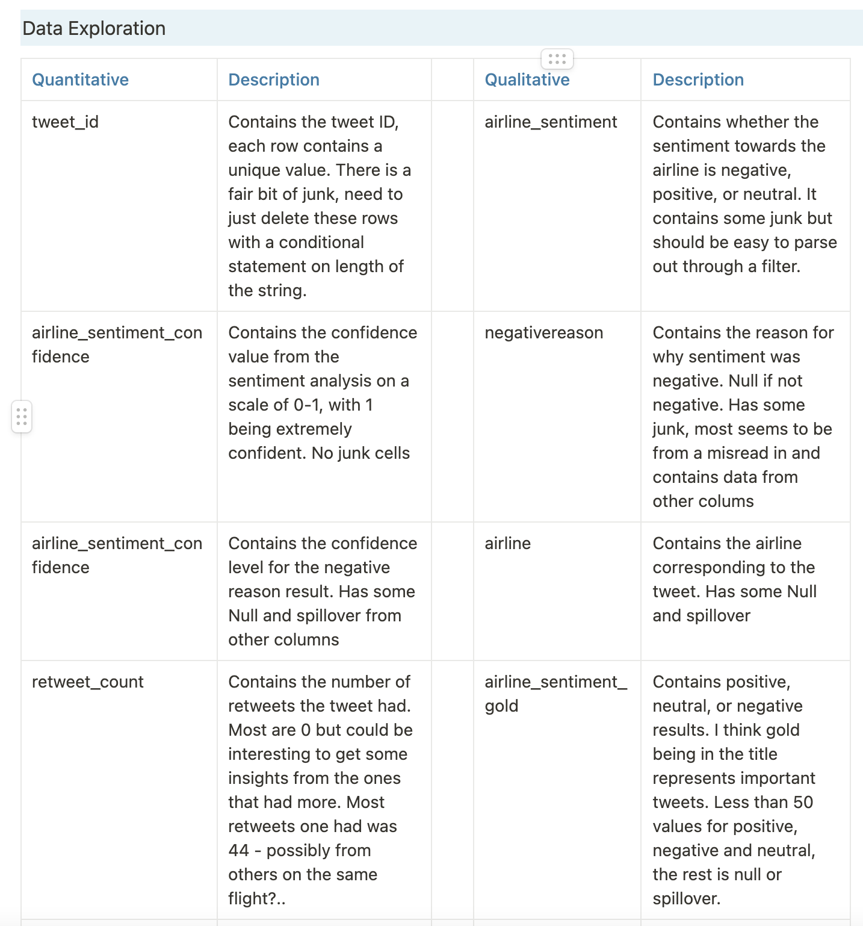
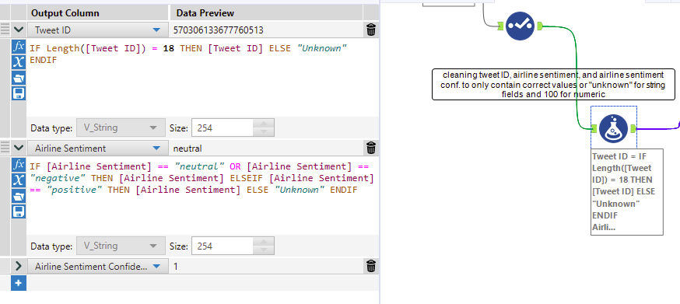
Initial Data Overview
I used Alteryx for the data engineering portion of this assignment and was eventually able to get this dataset into a working state. The first few slides will be about the steps I took to get there, and the rest will include my analysis.
During my first look at the data, I simultaneously was planning out the steps I needed to take. I like to make a table containing each of the variables as well as descriptions of each in my own words.
After my data once-over I started to skim through each of the fields, checking for things like null cells, cells containing data from other fields, and anything that shouldn’t be there. I used the browse tool in Alteryx for this process and was able to key for how I needed to manipulate each column. To give an example, the Tweet ID column had locational data, text data, etc. that needed to be removed.
After continuing this process for each field, I started sending the data through formulas that I wrote to cleanse it. The purpose of these formulas was pretty much the same for each field. I needed to, instead of deleting all the rows that had bad data, change these cells to ”Unknown” for string type data, and “100” for numeric. This is important in keeping the integrity of the data because you can still glean insights from a dataset without each column & row being filled.

Slide 3
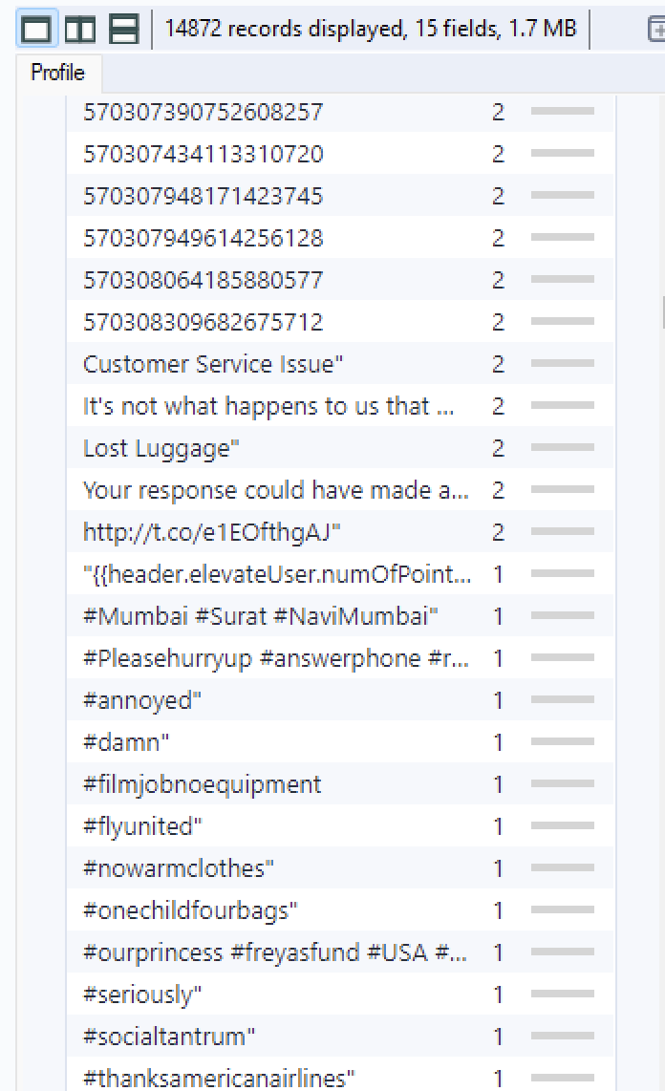
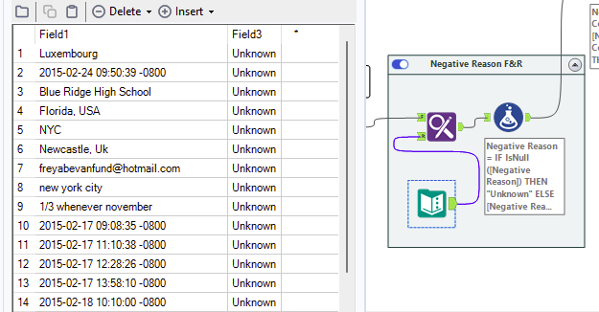
Digging Deeper
To continue, this is a screenshot from a portion of the tweet ID field. There are a few problems here that I addressed: duplicate ID’s, data from other columns, and null values. The null values and data from other columns were changed to being “Unknown” and the duplicate rows were deleted later in the workflow.
Essentially, for each of the columns I went through this process and widdled the data down to values that should be there and “Unknown” values to fill so in my analysis I would be able to categorize them out.
Though this process worked for most of the fields, I had to use a different approach for the columns Negative reason and Airline. Since these fields contain different words, a simple IF statement won’t suffice. In order to let the software know what belongs and what doesn’t, I used the Find & Replace tool. This corresponds to a lookup table in excel and was important in changing all the fluff in the fields with multiple categories to ”Unknown”.

Slide 4
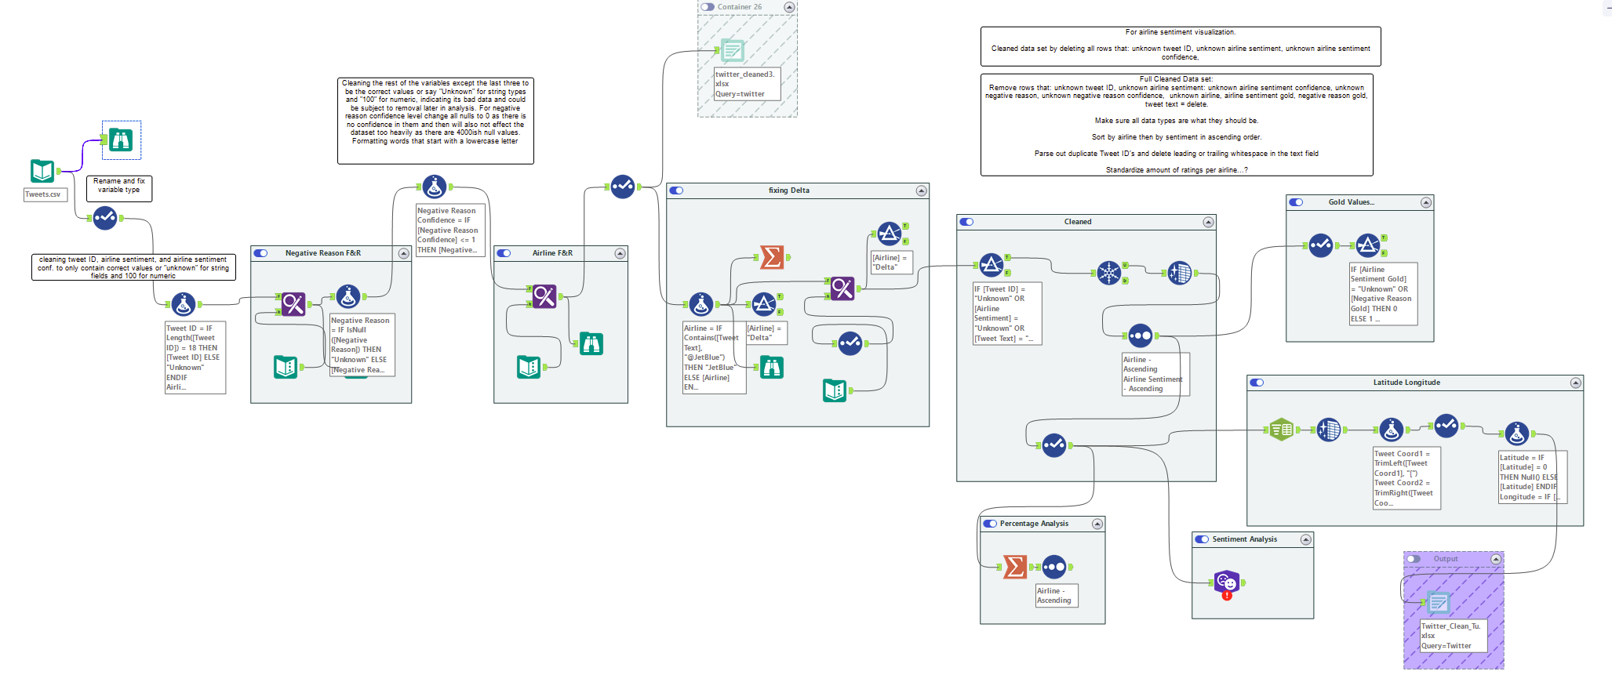
Final Workflow
Parsed out the ”gold fields” to see if there was anything that stood out. Deleted the fields in the final dataset as they’re unnecessary.
Changing the tweet coords field to two fields of latitude and longitude for tableau analysis
Table containing all the cells that need to be replaced with “Unknown”
Table containing all the cells that need to be replaced with “Unknown”
Conditional statement changing ”Delta” to ”JetBlue” when @JetBlue was mentioned in the body of the tweet. Find and replace to fix the leftover tweets mis tagged to delta.
I was going to do my own sentiment analysis but couldn't get the correct permissions in time

Slide 5
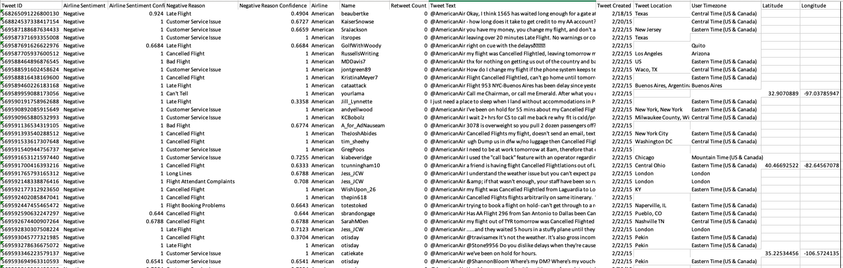
Last Steps
Final dataset contents:
100% unique, real Tweet ID’s. 100% values in airline sentiment are legit & are sorted in ascending order. For most of the negative sentiments there is a reason, if not the value is “Unknown. The Negative reason confidence is either a real value or 0 if unknown. Each row has a legit airline and sorted in ascending order, although after cleaning, Delta only has one tweet. The names are all there. Either a number for retweets or 0 if unknown. Each row has a tweet associated; the null rows got deleted as it would be pointless to keep them. Most of them have dates but I didn’t manipulate this field along with the location and time zone. The reason I kept them was to have extra detail in some of the tableau visualizations. The last two are latitude and longitude taken from the tweet coords field. These either have the correct value or are null so they don’t get in the way on the map visualization. I originally had the null values as 0.0, 0.0 but found it annoying that they all clumped up in the middle of the Atlantic.
After cleaning the dataset contains 14 fields with 14,464 rows of data.

Slide 6
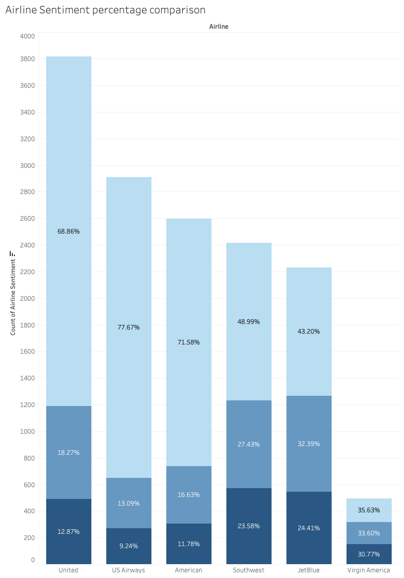
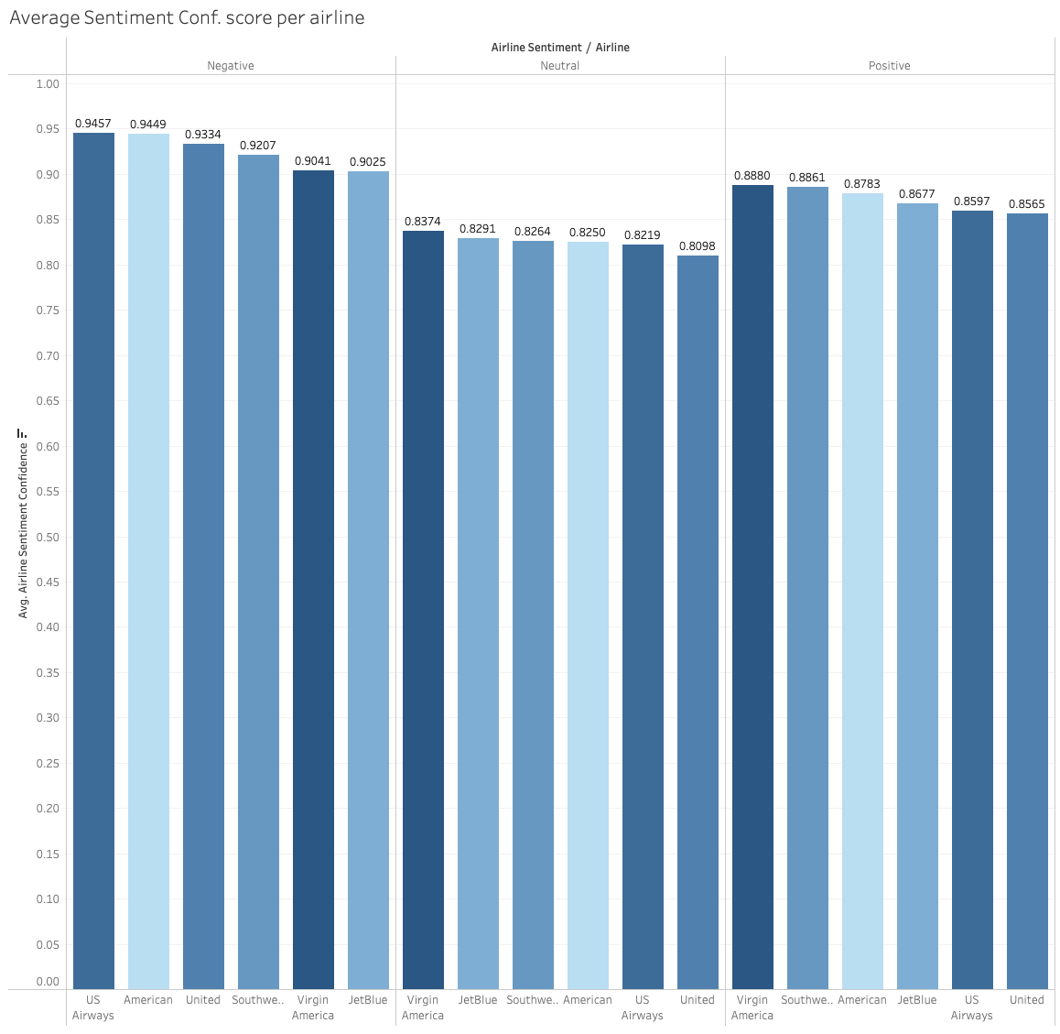
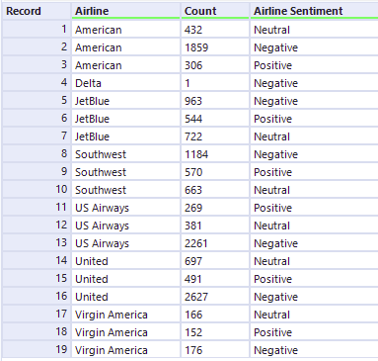
First Findings
Originally, I was thinking about standardizing the number of tweets for each airline by doing a random sample of like 600 or so but thought percentages are better to use for comparison. The far-right table shows the number of tweets each airline got in each sentiment category. The far-left bar graph essentially shows the same thing except with a percentage associated to each category. The middle bar graph shows the average sentiment confidence score for each airline for each category. A lower average score deems the results less reliable and is something to consider when making data driven decisions. A possible insight route from these visualizations is to look at US Airways, out of 2,911 tweets, 77.67% (2,627) of them were negative with a 94.57% confidence score.

Slide 7
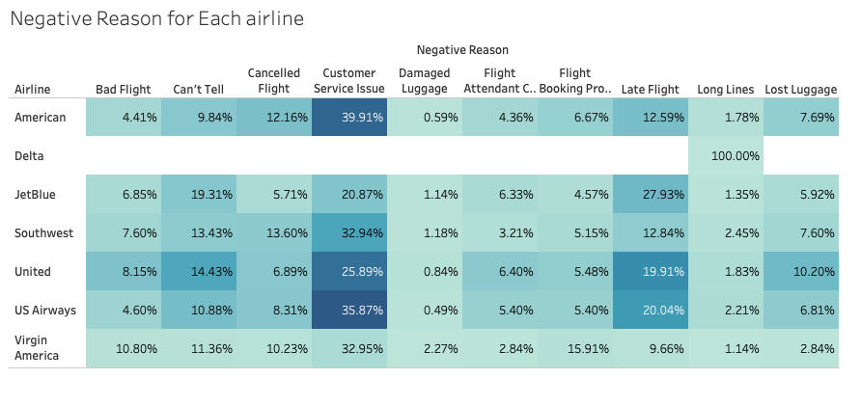
Deeper Understanding
Moving directly from the results of the last visualization, if US Airways were to look at their high number of negative sentiments, their next question would likely be aimed around what the feedback is. In this visualization, you can see the percentage of the number of tweets for each reason for each airline. The glaring issue for US Airways is a customer service problem as 35.87% of all negative sentiment scores that contain data on the reason were because of poor customer service. The second being due to late flights. Some of the takeaways for management is to 1. fix the customer service issues and 2. be timelier with flights.

Slide 8
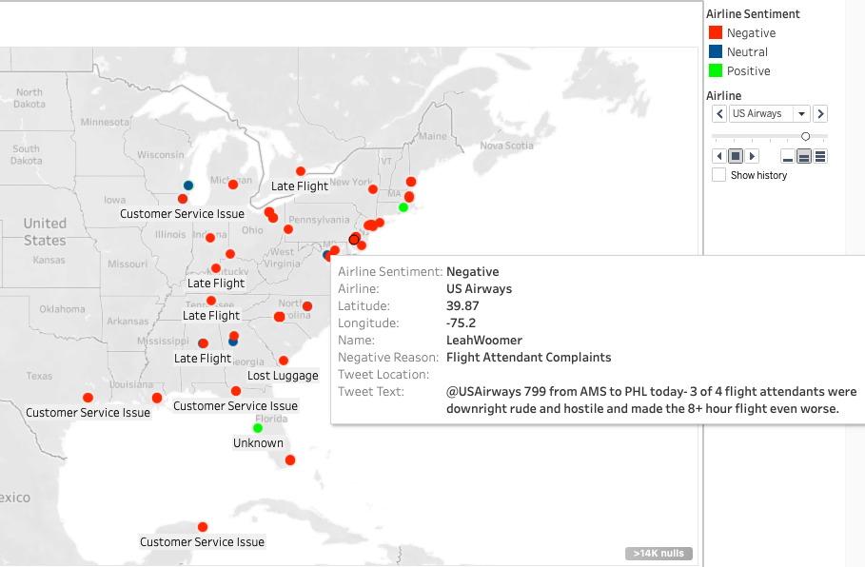
Map Visualization
This visualization is using the latitude and longitude coordinates to plot each of the rows there was data on for each airline. They are labeled by “Negative Sentiment Reason” and color coded to the sentiment. On the right side the analyst can click through to see the data on each airline.
Continuing with the US Airways story, looking at this map can give management a clear picture of the problem and where the it lies. The disclaimer for this visualization is that only 6% of the dataset is accounted for due to there not being many rows that had legitimate coordinates. Nonetheless, each point contains the location of the tweet, the sentiment, the tweet itself & tweeter, as well as the reason if negative. From the tweet selected, the tweet contents include the flight where the incident occurred and what happened to cause the poor experience. This is feedback that can be directly applied to those flight attendants as well as their managers at that location.

Slide 9
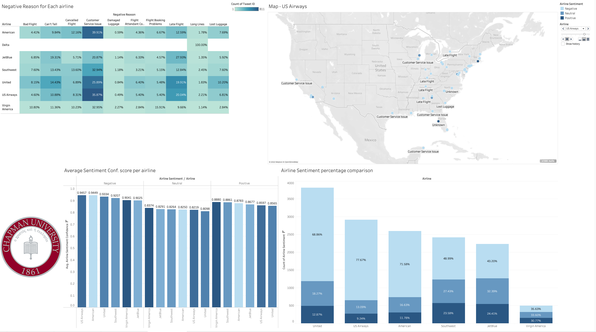
Interactive Visualization Dashboard to Present https://10az.online.tableau.com/t/dextercorley/views/TwitterVis/PresentationDashboard?:origin=card_share_link&:embed=n

Slide 10
Appendix
I enjoyed the analytics process for this assignment and felt satisfied with the result. To give a brief overview, the steps taken were setting up a plan for data engineering, cleaning the data with the intention of maintaining it’s integrity by not fully removing but fixing, and setting up visualizations to guide feedback and improvement strategies for each airline. The results can guide each airline to look at specifically at their areas of improvement when it comes to negative feedback at tweet locations.
Further things to investigate with this dataset; tweets with higher numbers of retweets and doing my own sentiment analysis.

