Slide 1
Welcome to DexTools

Slide 2
About
DexTools is a collection of tools used primarily for developing new Excel, Word and Access plug-ins (extended functionality).
It accomplishes this by using a sheet table serialization of forms, ribbon interface, shapes, range formatting;
It works by enabling custom events that are read and executed dynamically, thus bypassing some inherent VBA limitations;
It enables a very fine level of details and customization of afore mentioned components;
It also contains modules for unit and functional testing of VBA code and automatic formatting of function headers, error handling and logging;
It contains many prebuild functions and several extra-tools like a file parser, a color picker;
Due to the dynamic MCV-like approach it also enables multilanguage support for your plug-ins.
Please note that DexTools is still in beta-testing stage and will be constantly updated until we reach a stable and fully tested version. It is an open-source project and it’s subject to GPL 2 terms of use.

Slide 3
Getting started
Make sure DexTools.xlam file is saved in a safe run location by adding the save folder path to File/Options/Trust Center/Trust Center Options/Trusted Locations
Enable the trust access to the VBA project object model in File/Options/Trust Center/Trust Center Options/Macro Settings menu
Install JavaScript testing excel library prior to running the macro from https://github.com/florentbr/SeleniumBasic/releases/tag/v2.0.9.0. This library is used in testing JavaScript functions by executing shell commands against several known web browsers that also need to be installed on the testing machine. The Java Script testing is still buggy and will be fully enabled at a later stage.

Slide 4
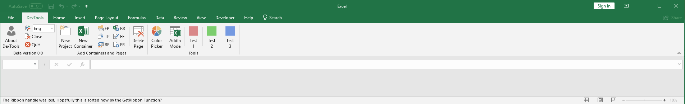
About Section
Contains information related to version number and other contact info about the developer. You can also change the language and close active workbooks and unload the plugin from excel until next run. It also checks for the latest version and resets the Ribbon interface.
It is the default Section for any new projects.

Slide 5
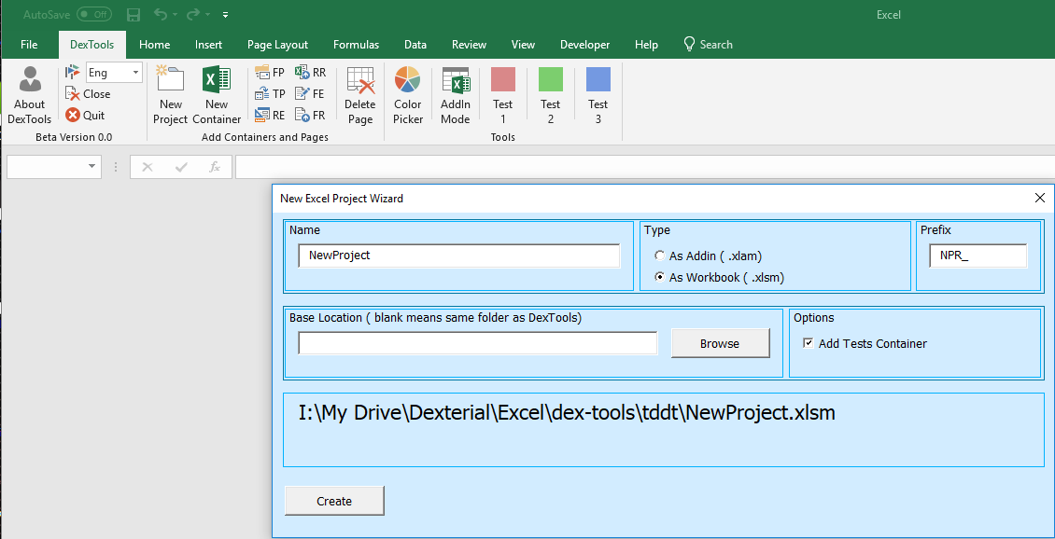
Add Containers and Pages Section
Contains buttons for adding new Projects (via wizard) of type add-in or macro enabled, and adding new Pages container with no macro code that just holds the information. The latest can be used for holding the data for tests, parsers, etc. It also allows to export and import page structure and data in json format.
The add new project Wizard allows you to create a new project and inject some general code according to the project type to help you start developing macro enabled projects. It will be extended to allow all office suite macro enabled project types ( Excel, Word, Access, PowerPoint). It also generates an Excel Container file that can be used for testing the code.

Slide 6
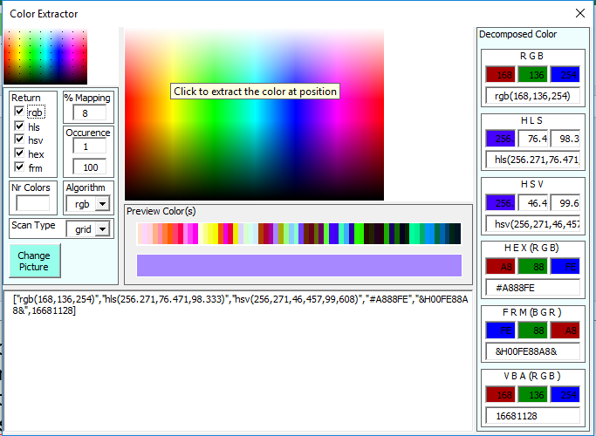
Tools Section
Contains custom tools such as :
ColorPicker form launcher button.
Addin-Mode button that allows to switch between add-in or document mode form of current project
(default is DexTools) in order to modify the default pages and interface data pages.
3 Extra buttons for tools to be added or linked to.

Slide 7
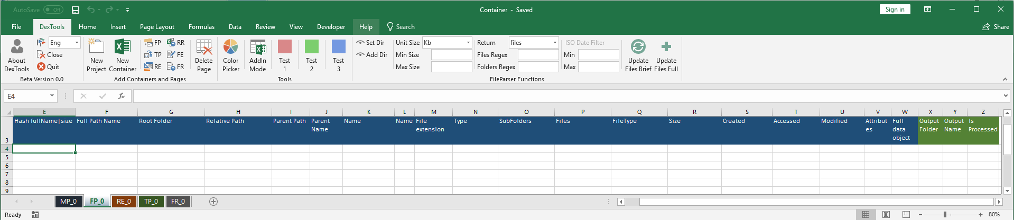
File Parser Section/Page
Contains the Ribbon Section and Functions for handling files scanning at selected locations. It contains some regex and bounds for the return lists. It can scan for all metadata (exif) info of files.
Some planned improvements:
- add metadata matching
- allow for copy/moving files to specified folders
- add in-file content matching

Slide 8
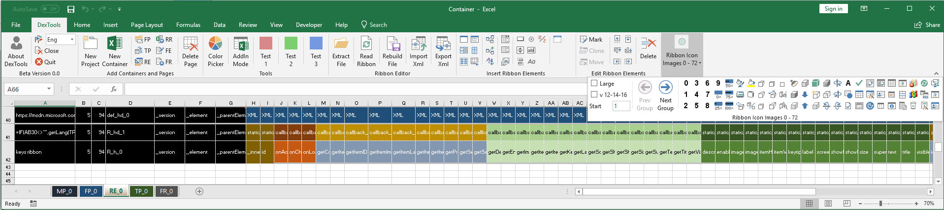
Ribbon Editor Sections/Page
Contains the Ribbon Section and Functions for editing the Ribbon interface. It can read a macro enabled file (Excel and Word for now) and decompose it. It then reads the Ribbon xml content and insert move, delete components. In the end it can recompose the file with the new ribbon and save is as Name_new in the same folder.
Some planned improvements:
- scan and decompose Access files
- implement more tests for the ribbon interface to make it more stabile

Slide 9
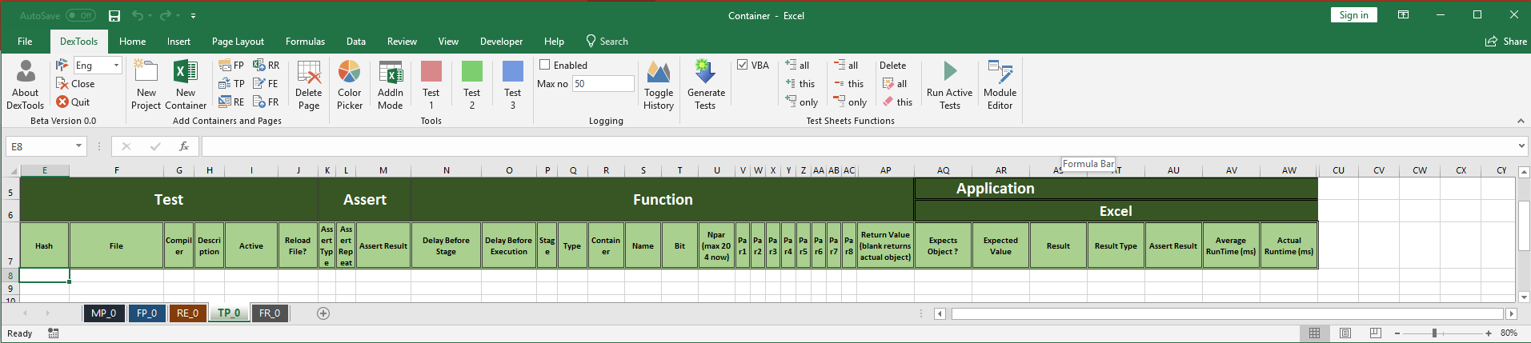
Test Runner Sections/Page
Contains all functions to autogenerate, import/export, enable/disable/delete, run and evaluate history of tests.
Some planned improvements:
add much more tests
fix the unit tests ode and add stage update/creation for test
fix the javascript testing extension
add php testing
implement more tests for the ribbon interface functionality to make it more stabile

Slide 10
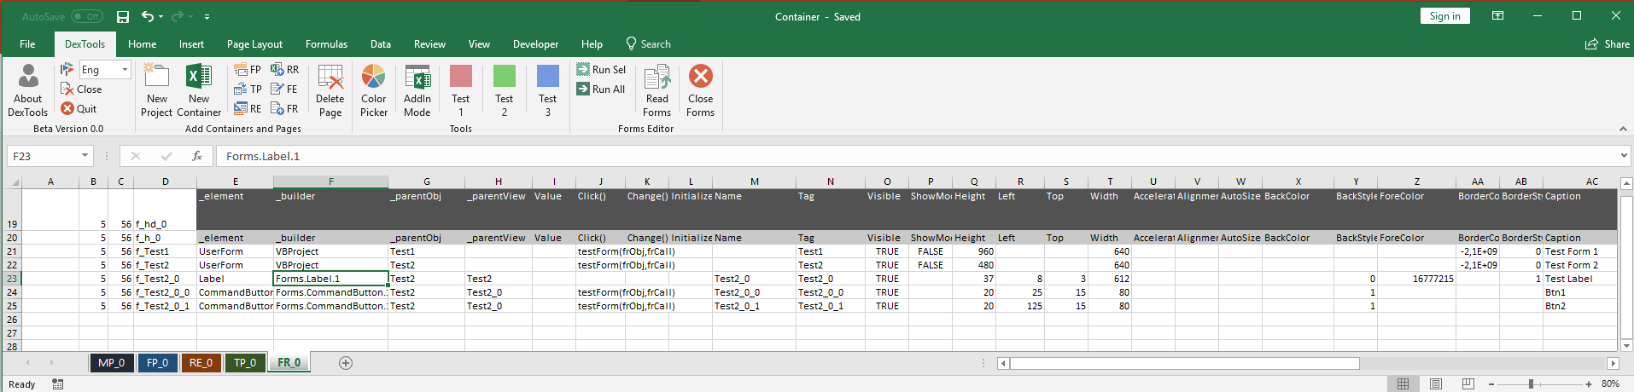
Form Runner/Editor
Contains all functions to read/run/edit user forms
Some planned improvements:
export/import serialized forms
add more tests

