Slide 1
Ph.D. Qualifying Exam
Efficient and Privacy-Aware Machine Learning Systems for Resource-Constrained Devices
TE-YI KAN
Department of Electrical and Computer Engineering, USC
April 20th, 2026
Committee: Konstantinos Psounis (Chair), Bhaskar Krishnamachari,
Leana Golubchik, Peter A. Beerel, and Sai Praneeth Karimireddy
Notes:
I will discuss my approaches to make machine learning practical on resource-constrained devices under latency, privacy, and deployment constraints.

Slide 2
Outline
Motivation & Research Focus
Thrust I: Efficient Distributed Execution
Thrust II: Privacy-aware Distributed Inference
Thrust III: Deployment-Faithful Model Adaptation
Future Direction: Fine-Grained Collaborative LLM Inference
Conclusion
Notes:
future direction on fine-grained collaborative inference for large language models

Slide 3
Motivation & Research Focus

Slide 4
Motivation:
The Need for ML on Resource-constrained Devices
ML is increasingly moving closer to end users and data sources.
ML workloads are becoming increasingly resource-demanding.
Many applications impose strict requirements on utility, latency, and privacy.
End devices are typically constrained in compute, memory, connectivity.
Practical ML for resource-constrained devices requires coordinated system design beyond strong models or compact model design alone.
Notes:
So practical ML for resource-constrained devices is not just a matter of building accurate models or designing compact models.
It requires coordinated system design under realistic deployment constraints.

Slide 5
Utility-Latency-Privacy Tradeoff
 | Purely Local ML | Fully Remote ML | Local–Remote Collaboration
Utility | Limited by local resource | Strong with larger models | balanced under practical constraints
Latency | High for demanding workloads | Increased by coordination overhead | Reduced through selective collaboration
Privacy | Strong | Weak | Preserved with proper design
Local-remote collaboration provides a more balanced way to manage utility, latency, and privacy.
Notes:
If we look at the two extremes, each may perform well on some of the three objectives, but usually gives up a lot on the others.
This balance does not come automatically. Instead, it requires proper design and coordination.

Slide 6
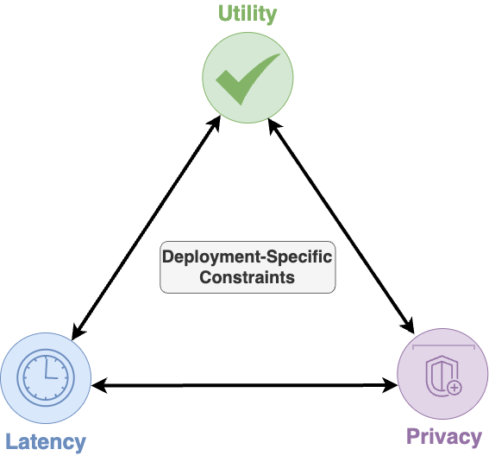
Practical ML for Resource-constrained Devices
Objective: Develop efficient and privacy-aware ML systems for resource-constrained devices across diverse deployment settings.
Central premise: Practical ML should not optimize a single objective in isolation.
Practical ML for resource-constrained devices requires balancing utility, latency, and privacy under deployment-specific constraints.
Notes:
1. Taken together, these observations motivate the overall objective of my research.
2. practical ML in these settings requires jointly considering utility, privacy, and latency under deployment-specific constraints. Instead of optimizing a single objective in isolation.

Slide 7
Key Dimensions and Research Thrusts
Design Space | Response
Latency is the dominate concern | Thrust I: TODORA — efficient distributed execution
Privacy on top of utility and latency | Thrust II: LLPRI — privacy-aware distributed inference
Privacy is strongly emphasized | Thrust III: Cloud–Edge HW-NAS — adaptive model optimization and selection
Fine-grained generative collaboration | Future Direction: Collaborative speculative decoding across edge and cloud
Different deployment settings place different emphasis on three objectives.
Notes:
Different deployment settings place different emphasis on these objectives, and therefore the research projects in this talk focus on different parts of this design space.
1. settings where the workload or model requirement is fixed, and latency is the dominant concern.
2. studies distributed inference when privacy must be considered jointly with utility and latency.
3. remote inference is less desirable, especially when privacy is strongly emphasized -> select and adapt on-device model based on device’s conditions
4. future direction considers generative inference, where iterative decoding makes collaboration even more challenging

Slide 8
Thrust I: Efficient Distributed Execution
Online Distributed Offloading of Time-Sensitive Vehicular Tasks in Edge-Cloud Systems
Te-Yi Kan, and Konstantinos Psounis. “Online Distributed Offloading of Time-Sensitive Vehicular Tasks in Edge-Cloud Systems,”
in IEEE Transactions on Vehicular Technology, vol. 74, no. 12, pp. 19681-19697, Dec. 2025
Notes:
Efficient distributed execution for delay-sensitive settings

Slide 9
Motivation
Vehicular workloads provide a representative case of delay-sensitive ML tasks.
  Timely results are critical for safety and driving support systems.
Purely local execution is insufficient.
  Vehicles often cannot complete demanding ML tasks within deadlines.
  Vehicle size, energy, and cooling constraints further limit onboard execution.
External servers introduce overhead.
  Edge/cloud support creates resource contention and coordination overhead.
Efficient execution for vehicular ML requires more than simply offloading tasks.
Te-Yi Kan, and Konstantinos Psounis. “Online Distributed Offloading of Time-Sensitive Vehicular Tasks in Edge-Cloud Systems,”
in IEEE Transactions on Vehicular Technology, vol. 74, no. 12, pp. 19681-19697, Dec. 2025
Notes:
Latency is the domain concern
Task model and its intended utility as fixed by the application
Offloading introduces system overhead
How to coordinate local and remote execution under system overhead and resource constraints

Slide 10
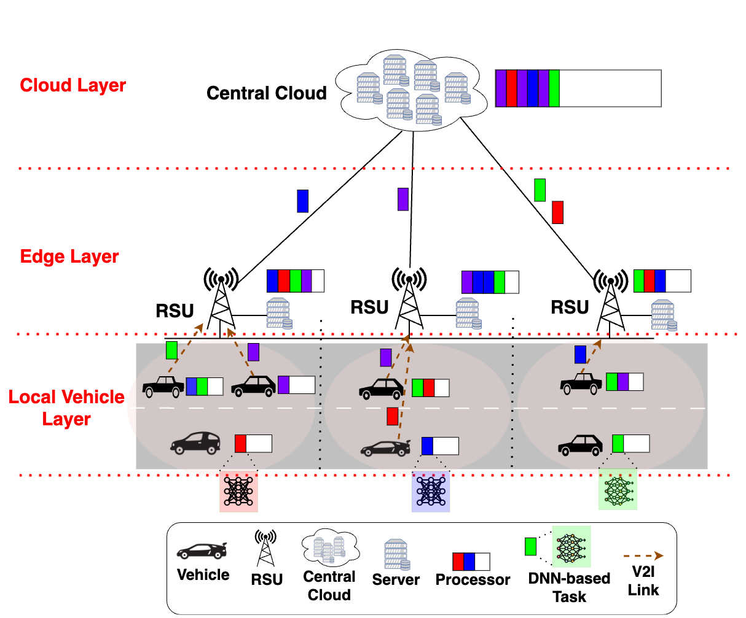
Vehicular Offloading System Architecture
* RSU: Road-Side Unit
Tasks can be executed locally, at the edge, or in the cloud.
Tasks share and contend for computation and radio resources.
Te-Yi Kan, and Konstantinos Psounis. “Online Distributed Offloading of Time-Sensitive Vehicular Tasks in Edge-Cloud Systems,”
in IEEE Transactions on Vehicular Technology, vol. 74, no. 12, pp. 19681-19697, Dec. 2025
Notes:
Importantly, offloading introduces additional overhead through communication, request–response procedures, and coordination.
As a result, end-to-end task duration is shaped not only by execution time, but also by these offloading-related overheads.

Slide 11
Task Duration Minimization Problem
Objective
Main Constraints
Minimize average end-to-end task duration
Task-specific deadlines
Limited compute
Limited radio resources
Non-preemptive execution
Task Duration
Execution delay
Queuing / transmission / propagation delay
Coordination overhead
Te-Yi Kan, and Konstantinos Psounis. “Online Distributed Offloading of Time-Sensitive Vehicular Tasks in Edge-Cloud Systems,”
in IEEE Transactions on Vehicular Technology, vol. 74, no. 12, pp. 19681-19697, Dec. 2025
Notes:
Importantly, task duration here includes queuing, transmission, and propagation delay, as well as coordination overhead, which are important in realistic offloading systems.

Slide 12
What is Missing in Prior Vehicular Offloading Work?
Research Dimension | Typical Setting | Limitation
Offloading Topology | Local-edge or local-cloud | Limited flexibility across deployment settings
Resource Allocation | Compute-only or radio-only | Missing couple effects
Decision Strategy | Offline or periodic | Less suitable for dynamic environments
Control Mechanism | Centralized | High coordination overhead
Task Duration Modeling | Only execution delay | underestimates end-to-end delay
Existing methods often optimize only part of the system and do not fully capture realistic end-to-end behavior.
Te-Yi Kan, and Konstantinos Psounis. “Online Distributed Offloading of Time-Sensitive Vehicular Tasks in Edge-Cloud Systems,”
in IEEE Transactions on Vehicular Technology, vol. 74, no. 12, pp. 19681-19697, Dec. 2025
Notes:
the limitation of prior vehicular offloading work is that many methods still optimize only part of the overall problem.
Does not match the dynamic nature of vehicular systems
Most importantly, much of the literature focuses primarily on execution delay, without fully accounting for offloading-related overhead.
Do not fully capture realistic end-to-end behavior

Slide 13
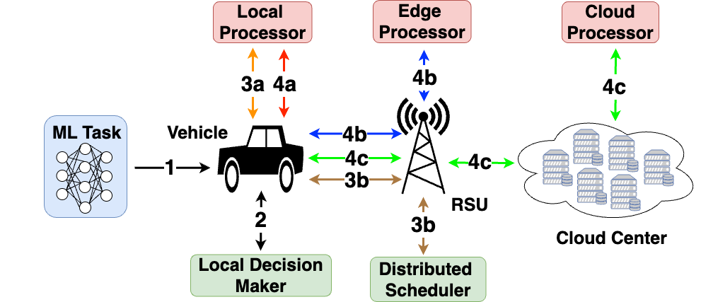
TODORA:
Online Distributed Offloading and Resource Allocation
Tasks are assigned priority
Perform local feasibility screening
Send uncertain cases to the RSU scheduler
Allocate radio and computation resources by priority
Te-Yi Kan, and Konstantinos Psounis. “Online Distributed Offloading of Time-Sensitive Vehicular Tasks in Edge-Cloud Systems,”
in IEEE Transactions on Vehicular Technology, vol. 74, no. 12, pp. 19681-19697, Dec. 2025
Notes:
Once a task is generated, it will be assigned a priority value for resources contention.
Specifically, a task has a higher priority value can occupy uplink transmission time slot earlier
Computation resources on a server are shared in proportion to the tasks’ priority values.
uses the priority value and the workload information from the RSU to estimate the offloading delay. If that estimated delay is likely to exceed the deadline, the task is executed locally right away.
Because the RSU information is piggybacked in the previous offloading result, it may already be outdated. So, we intentionally make the decision rule conservative.

Slide 14

TODORA: Key Ideas
A unified priority function
  Prioritizes urgent and small tasks.
  Inspired by Earliest Deadline First and Shortest Job First scheduling mechanism.
  The square root moderates overly aggressive penalization of large or less urgent tasks.
$$Priority=\frac{1}{\sqrt{deadline × required compute}}$$
A two-layer decision system for low-overhead offloading
  Local-first feasibility screening with piggybacked RSU state at the local vehicle.
    The RSU information is piggybacked in the latest offloading result received from the RSU.
    Executes locally when local completion is feasible and offloading cannot satisfy the same deadline.
  Distributed delay-estimation-based scheduling at each RSU
Te-Yi Kan, and Konstantinos Psounis. “Online Distributed Offloading of Time-Sensitive Vehicular Tasks in Edge-Cloud Systems,”
in IEEE Transactions on Vehicular Technology, vol. 74, no. 12, pp. 19681-19697, Dec. 2025
Notes:
Inverse square root of deadlines times required compute
Earliest deadline first scheduling helps push urgent tasks to finish before their deadline
Shortest job first scheduling helps reducing the average completion time
Reciprocal would penalize large or less urgent tasks too aggressively
priority-based mechanism keeps the control logic lightweight
Quick but less informed decision -> reduce overhead due to request-response procedure
More informed decision with more complete information
avoiding unnecessary request–response and centralized control.
TODORA is to make offloading decisions with low overhead.

Slide 15
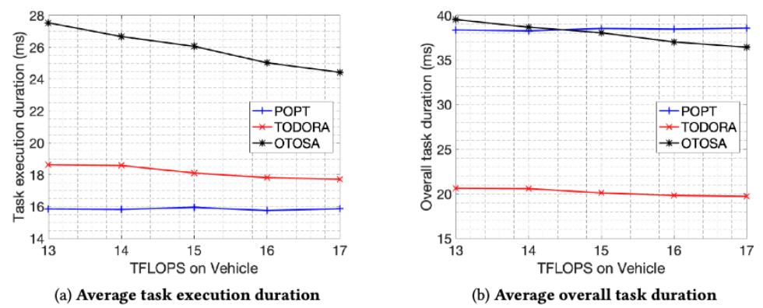
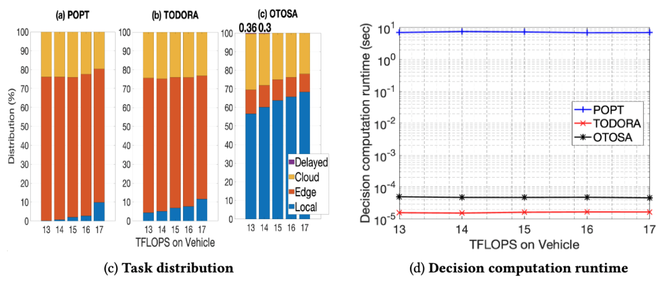
TODORA Performance under Varying Vehicle Compute
POPT: periodic centralized optimal reference
OTOSA: Online centralized baseline adapted from prior work
TODORA achieves the lowest end-to-end task duration and a task distribution similar to the optimal solution.
Te-Yi Kan, and Konstantinos Psounis. “Online Distributed Offloading of Time-Sensitive Vehicular Tasks in Edge-Cloud Systems,”
in IEEE Transactions on Vehicular Technology, vol. 74, no. 12, pp. 19681-19697, Dec. 2025
Notes:
The x-axis plots varying vehicle compute over a realistic vehicular range. The farther right indicates more resources on vehicles.
If we look at task execution duration for which the coordination overhead from the request–response process is removed. In addition, the waiting overhead caused by the periodic mechanism is also omitted.

Slide 16
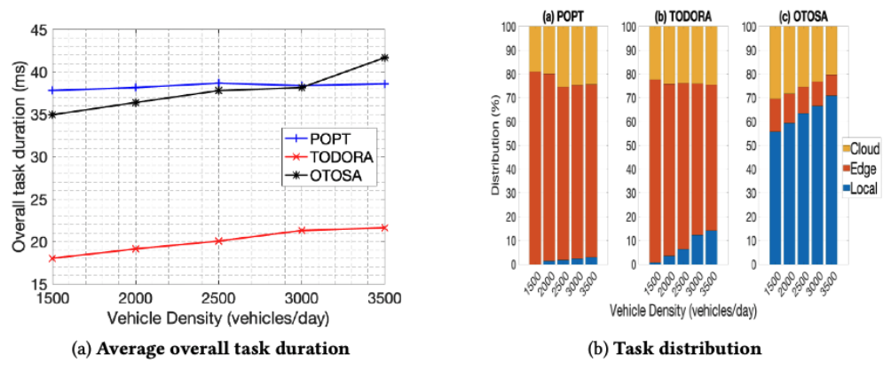
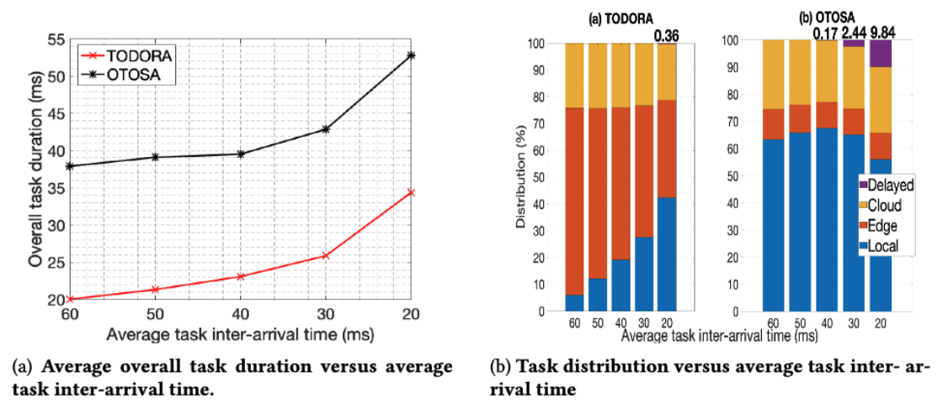
TODORA Performance Under System Stress
TODORA maintains the best end-to-end performance under system stress.
Te-Yi Kan, and Konstantinos Psounis. “Online Distributed Offloading of Time-Sensitive Vehicular Tasks in Edge-Cloud Systems,”
in IEEE Transactions on Vehicular Technology, vol. 74, no. 12, pp. 19681-19697, Dec. 2025
Notes:
we examine TODORA’s performance under system stress in two ways: by increasing vehicle density as shown on the left and by increasing task arrival rate as shown on the right.
POPT uses optimization tools to solve the minimization problem previous mentioned in which there is a deadline constraint and in the high arrival-rate region, this constraint cannot be satisfied and hence POPT cannot generate a scheduling plan.

Slide 17
Thrust II: Privacy-Aware Distributed Inference
LLPRI: Low-Latency Private ML Inference for Vision Tasks in Distributed Environments
Te-Yi Kan, and Konstantinos Psounis. “LLPRI: Low-Latency Private ML Inference for Vision Tasks in Distributed Environments,”
under review in IEEE Transactions on Dependable and Secure Computing
Notes:
This project asks how to utilize external support when privacy becomes an additional concern.

Slide 18
Motivation
Vision applications often require low-latency inference on resource-constrained devices.
Utility
Latency
Privacy
On-device high-performance model
Compact on-device model
Remote inference
Remote inference with traditional privacy protection
✅
❌
✅
❌
✅
✅
✅
✅
❌
✅
A practical privacy-preserving inference system that balances privacy, utility, and latency.
Te-Yi Kan, and Konstantinos Psounis. “LLPRI: Low-Latency Private ML Inference for Vision Tasks in Distributed Environments,”
under review in IEEE Transactions on Dependable and Secure Computing
Notes:
Visual inputs often naturally contain sensitive information
Vision applications often require low-latency inference on resource-constrained devices, but they also cannot afford to lose too much utility.
None of these straightforward options satisfies all three objectives at once.
The goal of this project is to develop a practical privacy-preserving inference system that balances all three.

Slide 19
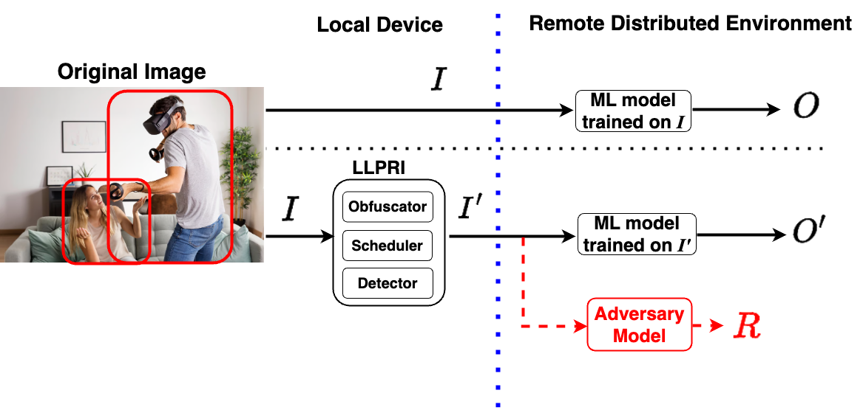
Challenging Scenario
Remote execution is needed to achieve strong utility under low-latency requirements.
Remote execution is supported by a distributed set of moderately powerful servers.
Sensitive objects are also utility-critical.
Te-Yi Kan, and Konstantinos Psounis. “LLPRI: Low-Latency Private ML Inference for Vision Tasks in Distributed Environments,”
under review in IEEE Transactions on Dependable and Secure Computing
Notes:
high-utility vision models are often too expensive to run directly on mobile devices with low latency, so remote assistance is still needed to achieve strong utility and responsiveness.
once inference is offloaded to remote servers, privacy becomes a critical concern because the user’s visual data must be shared.
Here, we assume remote execution is supported by several moderately powerful servers, because we expect multi-server settings to become more common as edge computing becomes more prevalent.

Slide 20
What is Missing in Prior Privacy-Preserving Inference
Prior Approach | Limitation
Cryptography-based methods | Too slow for delay-sensitive applications
Hardware approaches | Limited flexibility for complex ML models and do not protect transmission privacy
Noise addition approaches | Utility often drops significantly
Model splitting | Intermediate features may still leak private information
Representation learning | Often obfuscate the full input, causing utility degradation and extra latency
Existing methods in general | Rarely consider distributed multi-server settings
Existing methods do not jointly consider privacy, utility, latency, and distributed execution.
Te-Yi Kan, and Konstantinos Psounis. “LLPRI: Low-Latency Private ML Inference for Vision Tasks in Distributed Environments,”
under review in IEEE Transactions on Dependable and Secure Computing
Notes:
More broadly, most existing methods also do not really consider distributed multi-server settings.
So, the missing piece is not just privacy protection alone, but a practical system that can preserve privacy while still maintaining utility, low latency, and compatibility with distributed execution.

Slide 21
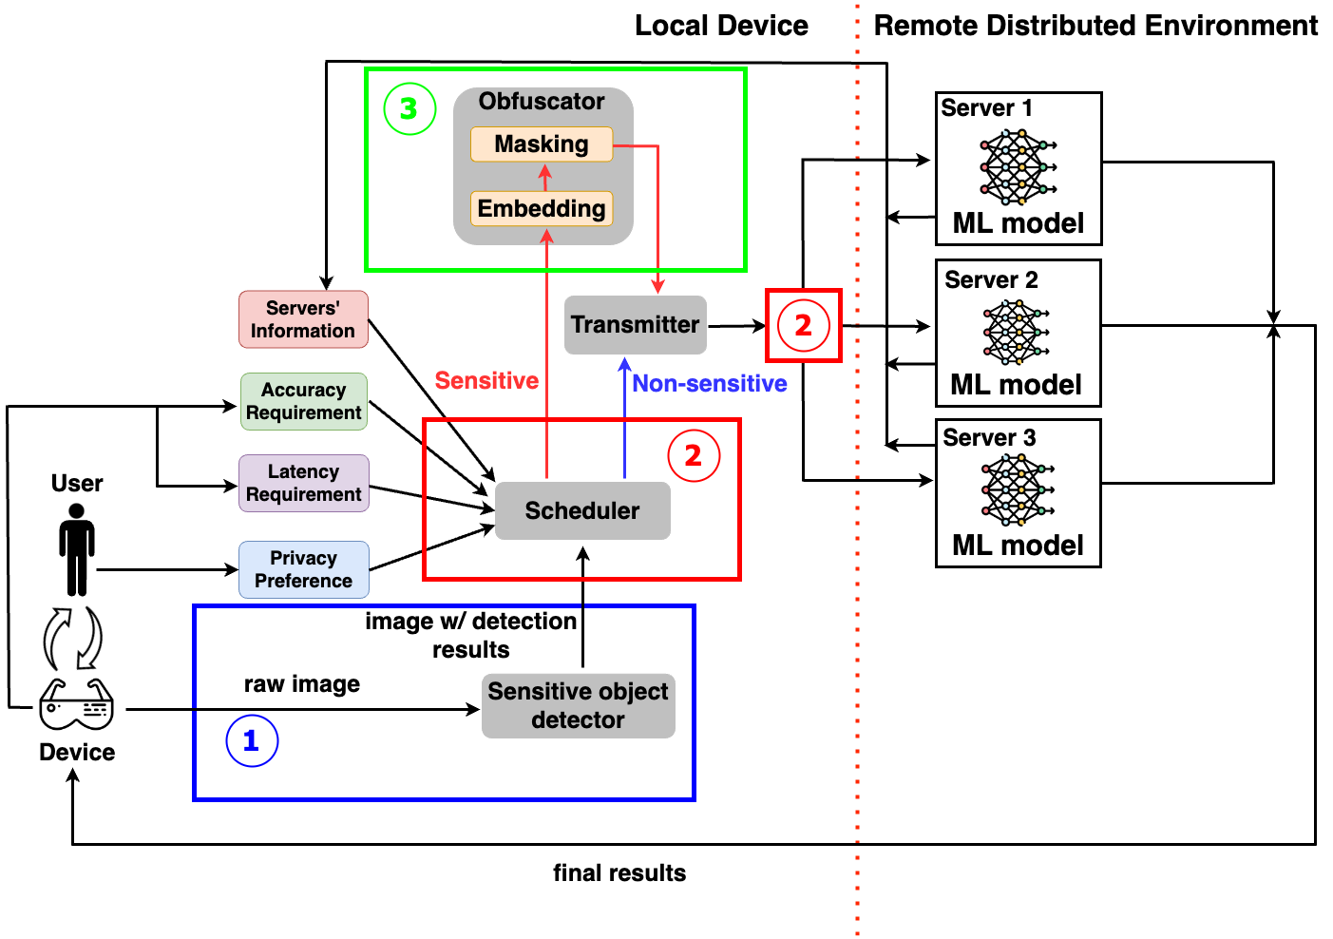
LLPRI: System Overview
Sensitive Object Detector
  Identifies sensitive regions.
  Enhanced by privacy-aware loss and knowledge distillation.
Scheduler
  Separates and partitions image regions.
  Assigns chunks based on size, network condition, and server load.
Obfuscator
  Obfuscates only sensitive regions.
  Reuses early model layers to reduce latency.
Te-Yi Kan, and Konstantinos Psounis. “LLPRI: Low-Latency Private ML Inference for Vision Tasks in Distributed Environments,”
under review in IEEE Transactions on Dependable and Secure Computing

Slide 22
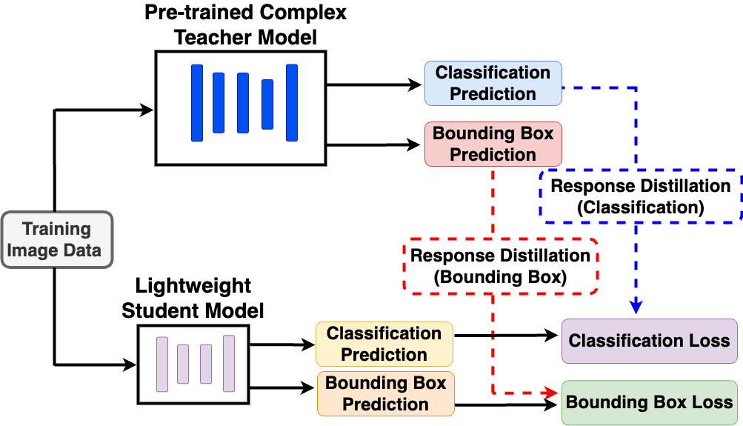
Core Module I: Sensitive Object Detector
Lightweight detector
  Keep the detector compact and maintain low latency.
Privacy-aware training improves reliability
  Missing detections cause privacy leakage.
  Privacy-enhanced loss
    Modified YOLOv8 loss to prioritizes sensitive-object recall over precision.
  Sensitive-class-aware knowledge distillation
    Transfers both classification and localization cues.
    Put extra emphasis on sensitive categories.
Te-Yi Kan, and Konstantinos Psounis. “LLPRI: Low-Latency Private ML Inference for Vision Tasks in Distributed Environments,”
under review in IEEE Transactions on Dependable and Secure Computing
Notes:
false-negative loss: Boosts sensitive-object recall by increasing sensitive confidence on anchors aligned with sensitive ground truth.

Slide 23
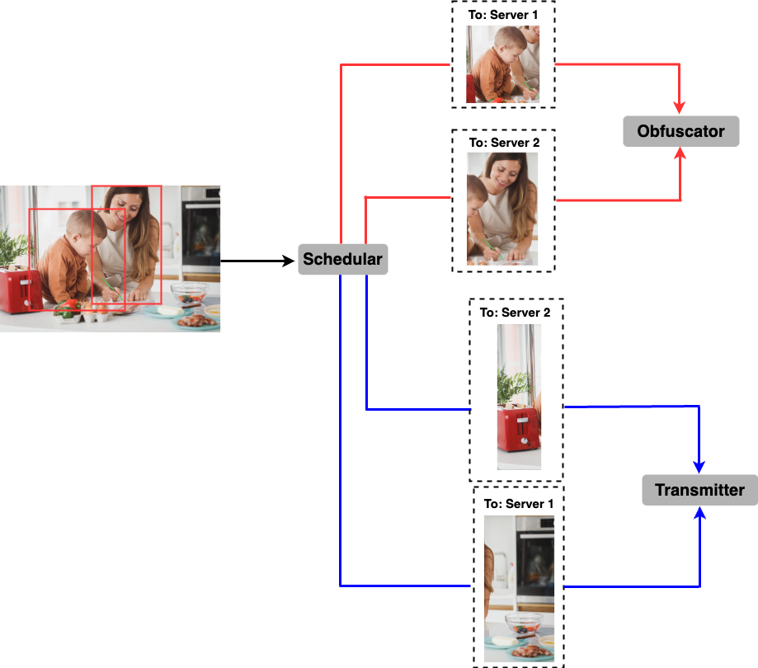
Core Module II: Scheduler
Separates sensitive and non-sensitive image regions
  Sensitive and non-sensitive regions are scheduled differently.
  Sensitive objects are sent to the obfuscator before transmission.
  Non-sensitive region are further partitioned into chunks.
Adapts to server load and image size
  The scheduler assigns chunks to reduce latency in distributed environments.
Te-Yi Kan, and Konstantinos Psounis. “LLPRI: Low-Latency Private ML Inference for Vision Tasks in Distributed Environments,”
under review in IEEE Transactions on Dependable and Secure Computing

Slide 24
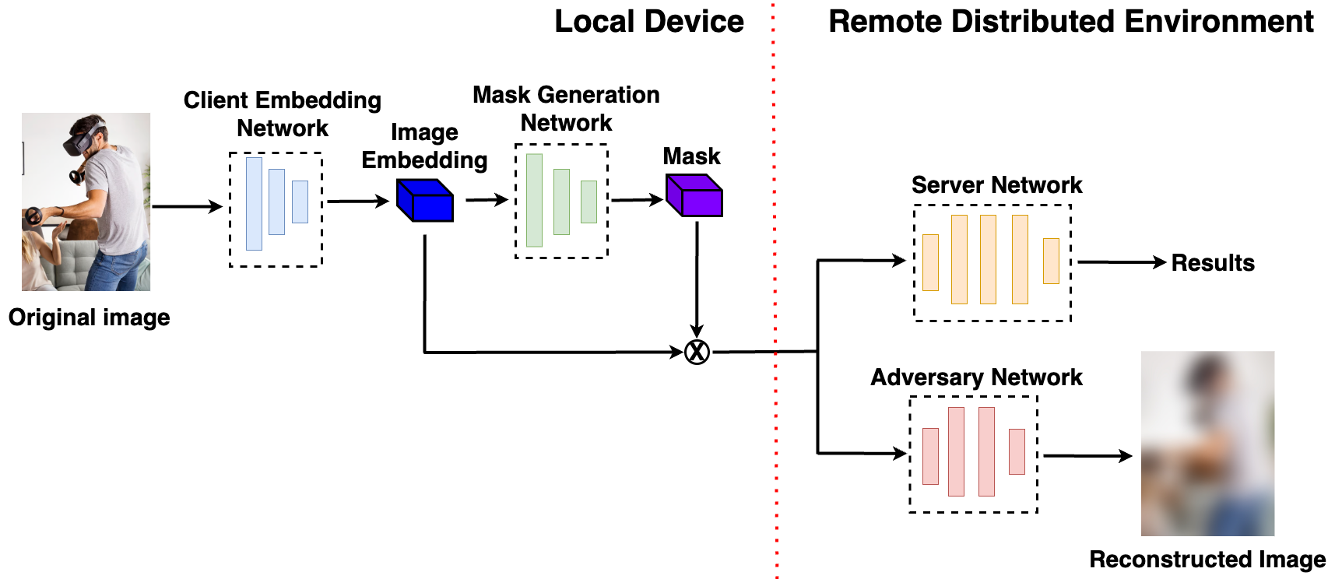
Core Module III: Obfuscator
Applies obfuscation only where needed
  By protecting only sensitive regions, LLPRI reduces utility loss and obfuscation overhead.
Reuses early model layers for embedding
  LLPRI avoids adding a separate encoder by using the early backbone layers of the target model.
Masks privacy-sensitive activations in latent space
  A mask generation network is trained to simultaneously minimize the utility loss and maximize adversarial loss.
Te-Yi Kan, and Konstantinos Psounis. “LLPRI: Low-Latency Private ML Inference for Vision Tasks in Distributed Environments,”
under review in IEEE Transactions on Dependable and Secure Computing
Notes:
Client & server are trained to maximize utility -> stabilized the training

Slide 25
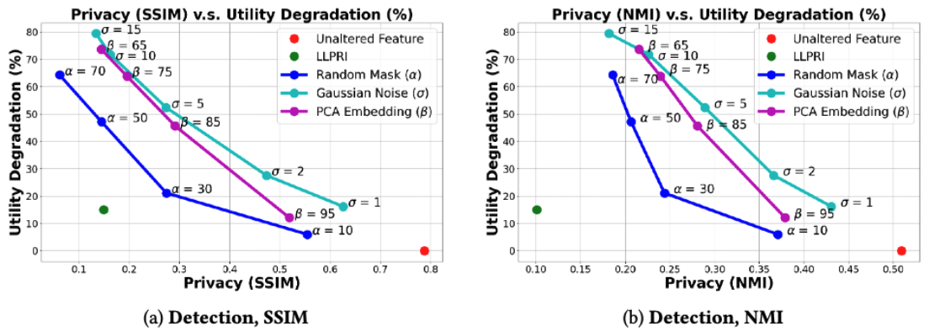
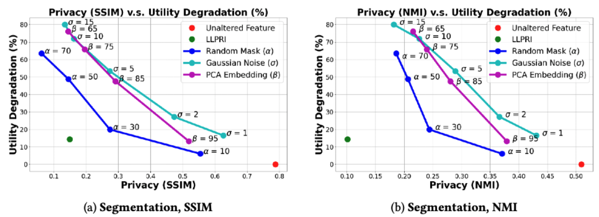
Privacy–Utility Tradeoff
SSIM: Structure Similarity
NMI: Normalized Mutual Information
Better utility
Better utility
Better privacy
Better privacy
Unaltered Feature: Split-inference baseline without masking
Gaussian Noise: Add Gaussian noise directly to the input image
Random Mask: Latent-space masking with a random mask instead of a learned one
PCA Embedding: Transmit a PCA-compressed image embedding instead of the raw image
Te-Yi Kan, and Konstantinos Psounis. “LLPRI: Low-Latency Private ML Inference for Vision Tasks in Distributed Environments,”
under review in IEEE Transactions on Dependable and Secure Computing
Notes:
Reconstruction threat
SSIM is a widely used image quality assessment metric in computer vision for examining the similarity between two images. It compares attributes, such as luminance and contrast, to capture perceptual differences.
-> reflecting perceptual discrepancies as perceived by the human visual system
MI formally describes how much knowing one random variable reduces uncertainty about another
Activation removal percentage
The variance for the Gaussian noise
The retained spectrum percentage

Slide 26
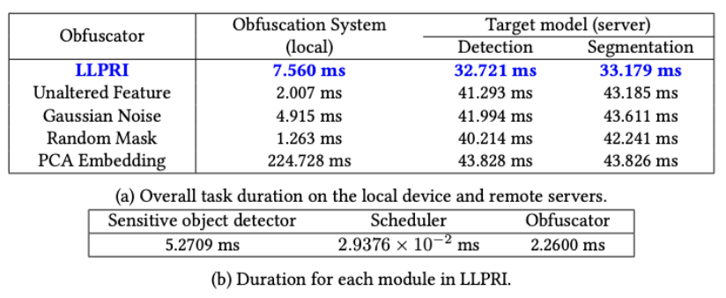
Latency on Detection and Segmentation
LLPRI remains practical for real-time vision tasks, and distributed scheduling further reduces latency in multi-server settings.
Te-Yi Kan, and Konstantinos Psounis. “LLPRI: Low-Latency Private ML Inference for Vision Tasks in Distributed Environments,”
under review in IEEE Transactions on Dependable and Secure Computing

Slide 27
Thrust III: Deployment-Faithful Model Adaptation
Neural Architecture Search for Edge Devices via Cloud-Edge Collaboration
Te-Yi Kan, and Konstantinos Psounis. “Neural Architecture Search for Edge Devices via Cloud-Edge Collaboration,”
under review in the International Conference on Machine Learning (ICML)
Notes:
I now move to the third project, which asks a different question. When privacy requirements are strong enough that remote inference becomes less desirable, how can we select and strengthen on-device models under device constraints and device conditions.

Slide 28
Motivation
If privacy is emphasized, executing models directly on edge devices is the most natural solution, but reliable on-device deployment remains challenging.
Device resources vary across devices and over time
  Latency and memory depend on the current hardware and workload conditions.
  A model that is feasible in one setting may later become suboptimal or even violate device constraints.
Local data distributions may differ from public data
  Models selected using only public datasets may not perform well on local on-device data.
We need a model adaptation mechanism that is faithful to actual dynamic device conditions instead of finding a compact model once.
Te-Yi Kan, and Konstantinos Psounis. “Neural Architecture Search for Edge Devices via Cloud-Edge Collaboration,”
under review in the International Conference on Machine Learning (ICML)
Notes:
In particular, when privacy is strongly emphasized, executing models directly on the device becomes the more natural direction.
reliable on-device deployment is difficult in practice.
So, the problem here is not just to find a compact model once, but to build a system that supports model adaptation under dynamic device condition.

Slide 29
Deployment-Faithful Model Adaptation Problem
Objective
Select an on-device model for the target deployment
Deployment Constraints
System Constraints
Cloud cannot access private local data
Cloud cannot directly profile the target device
Device condition may change over time
Latency constraints
Memory constraints
The challenge is to make the competitive model that is feasible under real deployment conditions, which cannot be achieved solely in the cloud.
Te-Yi Kan, and Konstantinos Psounis. “Neural Architecture Search for Edge Devices via Cloud-Edge Collaboration,”
under review in the International Conference on Machine Learning (ICML)
Notes:
So, the main challenge here is to make the final model both feasible and useful under dynamic device conditions, which cannot be achieved solely in the cloud.

Slide 30
What is Missing in On-Device Model Adaptation
Prior Approach | Limitation
Hand-crafted efficient models | Require expert effort and are usually tuned to static deployment settings
Model compression methods | Often optimize proxy metrics that may misalign with real latency and memory
Cloud-centric HW-NAS | Relies on public data and hardware surrogate, which may mispredict on-device behavior and cannot fully capture dynamic operating conditions
Fully on-device HW-NAS | Too expensive for resource-constrained edge devices
* HW-NAS: Hardware-Aware Neural Architecture Search
Te-Yi Kan, and Konstantinos Psounis. “Neural Architecture Search for Edge Devices via Cloud-Edge Collaboration,”
under review in the International Conference on Machine Learning (ICML)
Notes:
how to stay aligned with local data, actual devices constraints under dynamic device conditions

Slide 31
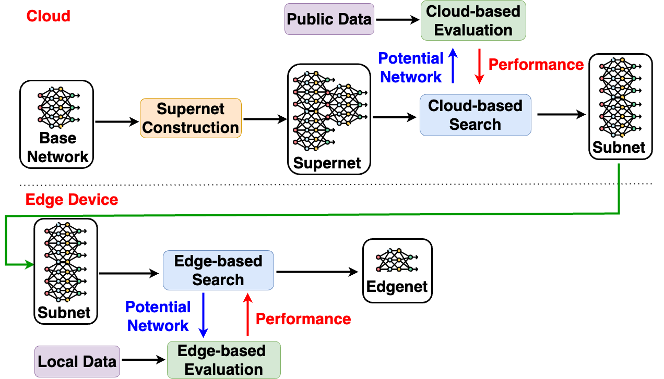
Two-Stage Cloud-Edge Collaborative HW-NAS
Cloud Stage
  Narrow the search space by retaining only promising architectures.
  Rely on public data and heavy search algorithm.
Edge Stage
  Refine the subnet using local data and current device conditions.
  Lightweight enough to be restarted to handle real-time resource changes and distribution shifts.
Cloud search provides scalability, while edge refinement ensures deployment-faithful adaptation.
Te-Yi Kan, and Konstantinos Psounis. “Neural Architecture Search for Edge Devices via Cloud-Edge Collaboration,”
under review in the International Conference on Machine Learning (ICML)
Notes:
At a high level, the cloud stage is there to narrow the search space so that the later edge refinement can be done efficiently.
the edge stage aims to turn that reduced subnet into a final on-device model.

Slide 32
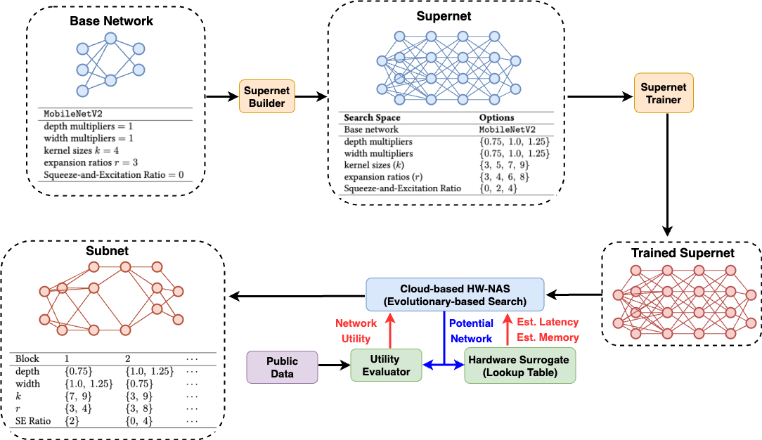
Cloud Stage: Supernet Construction and Search
Replace each mutable block with a super-block containing multiple candidate choices.
The supernet induces a search space.
Shared weights can be reused for evaluation.
Subnet is compact while still retaining promising candidates.
Te-Yi Kan, and Konstantinos Psounis. “Neural Architecture Search for Edge Devices via Cloud-Edge Collaboration,”
under review in the International Conference on Machine Learning (ICML)
Notes:
Each mutable block is replaced by a super-block with multiple candidate choices, so the search space can span several architectural dimensions at once, such as depth, width, kernel size.
Ever candidate network is a subnet of the supernet, so with the trained supernet, we do not need to retrain the network from scratch for evaluation
Since the cloud only sees surrogate hardware costs, we also relax the constraints slightly at this stage so that promising candidates are not pruned too aggressively before edge refinement.

Slide 33
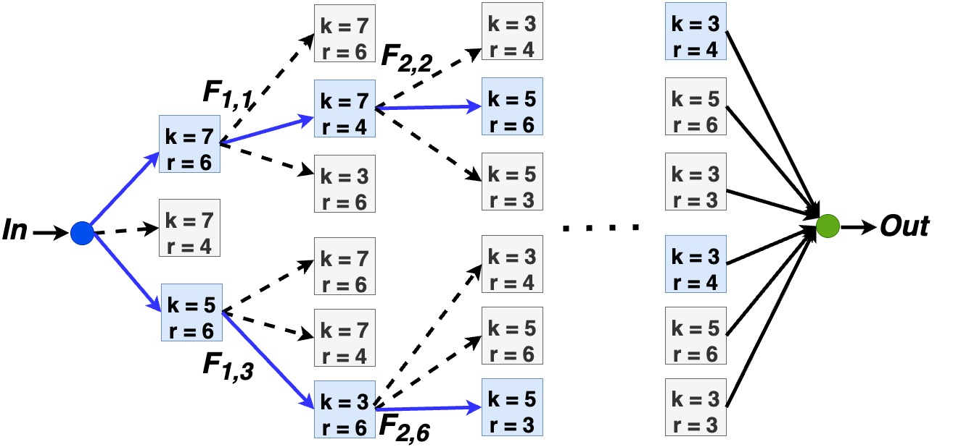
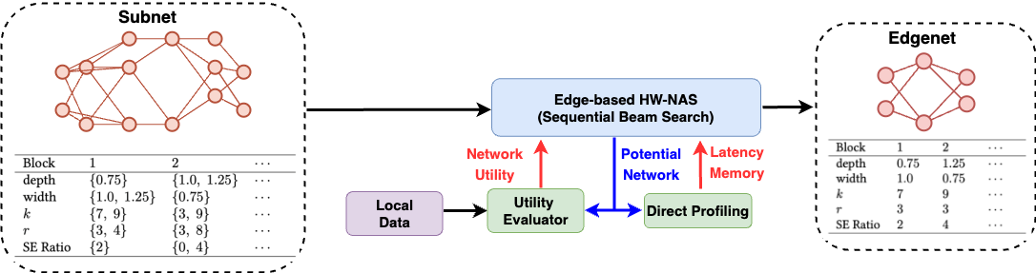
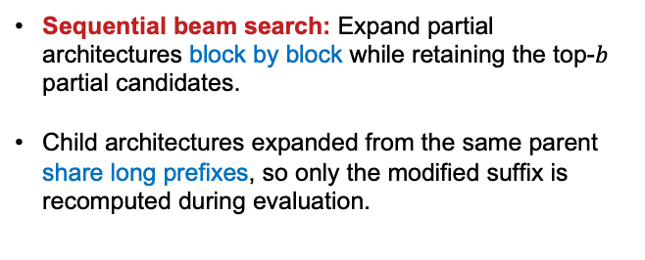
Edge Stage: Lightweight On-Device Refinement
Edge Stage: Refine the cloud-proposed subnet on the target device using local data and direct profiling.
Sequential beam search: Expand partial architectures block by block while retaining the top-$b$ partial candidates.
Child architectures expanded from the same parent share long prefixes, so only the modified suffix is recomputed during evaluation.
Utility evaluation is accelerated through caching, stage-aware evaluation, and intermediate feature reuse
Te-Yi Kan, and Konstantinos Psounis. “Neural Architecture Search for Edge Devices via Cloud-Edge Collaboration,”
under review in the International Conference on Machine Learning (ICML)
Notes:
grows the architecture block by block while keeping only the top-b partial architectures at each step.
candidates expanded from the same parent share a long common prefix. That means we can reuse intermediate activations from the shared prefix and recompute only the newly added suffix, instead of running the whole network from the input every time.

Slide 34
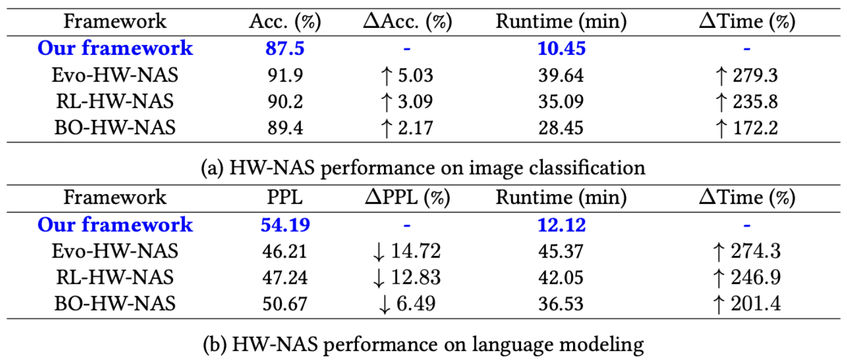
Results Across Vision and NLP Tasks
Evo-HW-NAS: Evolutionary cloud-based HW-NAS baseline
RL-HW-NAS: PPO-based cloud-based HW-NAS baseline
BO-HW-NAS: Bayesian-optimization cloud-based HW-NAS baseline
Across both vision and NLP tasks, our framework reduces HW-NAS search time by about 3X on average while maintaining competitive utility.
Te-Yi Kan, and Konstantinos Psounis. “Neural Architecture Search for Edge Devices via Cloud-Edge Collaboration,”
under review in the International Conference on Machine Learning (ICML)
Notes:
Evolutionary HW-NAS: Use evolutionary search to explore architectures through selection, mutation, and crossover, and keep the best feasible architecture under the hardware constraints.
RL HW-NAS: Use a PPO-based controller to sample architecture decisions, and optimize a reward that reflects utility while penalizing constraint violations.
Bayesian Optimization HW-NAS: Use a Gaussian-process surrogate to predict architecture utility, and iteratively choose promising architectures through an acquisition function under the hardware constraints

Slide 35
Future Direction
Collaborative Speculative Decoding across Edge and Cloud
Notes:
So far, the research projects work on discriminative inference workloads. An important extension of this same systems perspective is generative inference, especially large language models. In this future direction, I consider collaborative speculative decoding across edge and cloud.

Slide 36
Motivation
Generative inference poses a harder systems challenge than conventional discriminative inference.
  Sequential decoding introduces repeated computation, accumulated latency, and substantial memory demand.
  Purely local generation still faces difficult quality–latency–memory tradeoffs on edge devices.
  Fully cloud-based generation reduces local cost but adds communication delay, connectivity dependence, and server-side burden.
These tradeoffs motivate finer-grained edge–cloud collaboration during decoding.
Notes:
generation happens token by token rather than in a single forward pass, so computation, latency, and memory costs accumulate over time.
That makes purely local generation even more difficult on edge devices, because the system has to sustain quality, latency, and memory over the full decoding process.
So, the main motivation is to move away from these two extremes and toward finer-grained edge–cloud collaboration during decoding

Slide 37
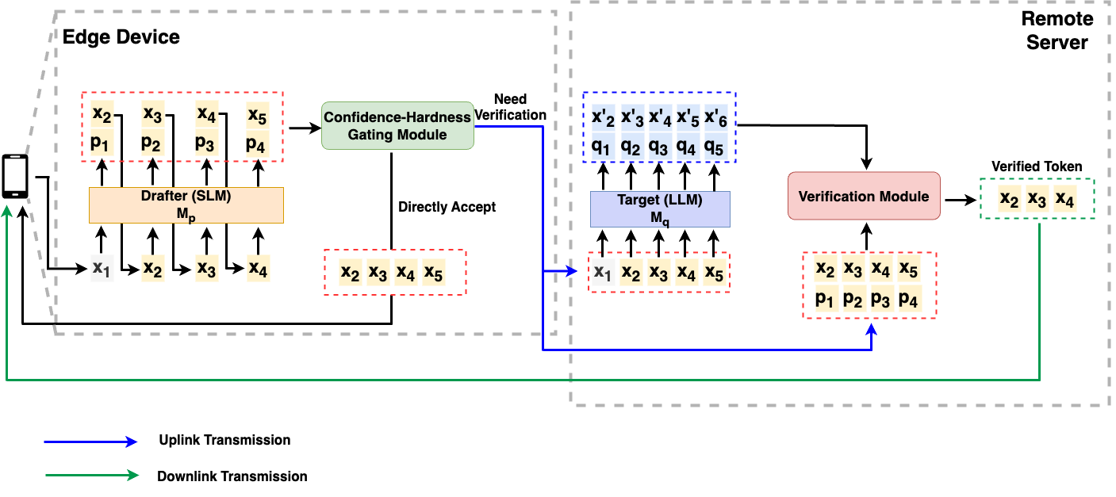
Cloud-Edge Collaborative Speculative Decoding Mechanism
Edge Drafter
  Generate candidate tokens locally with a small language model.
Remote Target Model
  Invoked only when additional verification is needed.
Confidence-Hardness Gating
  Decide whether to accept locally or escalate for remote verification based on drafter’s confidence and token hardness.
Confidence measures how certain the drafter appears to be.
Hard tokens are tokens that are more likely to be mispredicted w.r.t. the target model.
Notes:
So, the key point is that the remote model is not invoked for every decoding step. Verification is selective.
The edge handles easier steps locally, while the cloud is used only when stronger confirmation is needed.
In principle, this can reduce communication overhead and server-side computation compared with cloud-only generation, while still letting difficult decoding steps benefit from the stronger remote model instead of forcing the edge to handle everything alone.

Slide 38
Open Questions & Goal
Open Questions
What signals best capture confidence and hardness during decoding?
How should these signals be combined to decide when remote verification is needed?
How much latency, communication overhead, and cloud cost can be reduced without hurting generation quality too much?
Goal: Enable finer-grained edge–cloud collaboration that reduces latency and cloud cost while maintaining competitive generation quality.
Notes:
The central open problem in this future direction is how to decide when a decoding step should stay local and when it should be escalated for remote verification.
confidence and hardness are related, but they are not the same thing. How to
The difficulty is that this decision has to be made from imperfect local signals, as the true error risk of a decoding step is not directly observable.

Slide 39
Conclusion

Slide 40
Dissertation Proposal Contributions
Overall Contribution: Advancing practical ML for resource-constrained devices by jointly considering efficiency, privacy, utility, and deployment adaptation.
Thrust I: TODORA – Distributed execution under strict latency constraints with explicit consideration of coordination overhead.
Thrust II: LLPRI – Privacy-preserving distributed inference that jointly balances privacy, utility, and latency.
Thrust III: Cloud–edge collaborative model adaptation for local data shifts and dynamic device conditions.

Slide 41
Conclusion
Practical ML for resource-constrained devices requires jointly balancing utility, latency, and privacy under deployment-specific constraints.
Notes:
To close, the central message of this dissertation is that practical machine learning for resource-constrained devices is fundamentally a joint-design problem.
Utility, latency, privacy, and deployment conditions cannot be treated in isolation.
They must be addressed together with the consideration of various deployment scenarios through coordinated systems design.

Slide 42
Thank You!
Q&A

Slide 43
Appendix

Slide 44
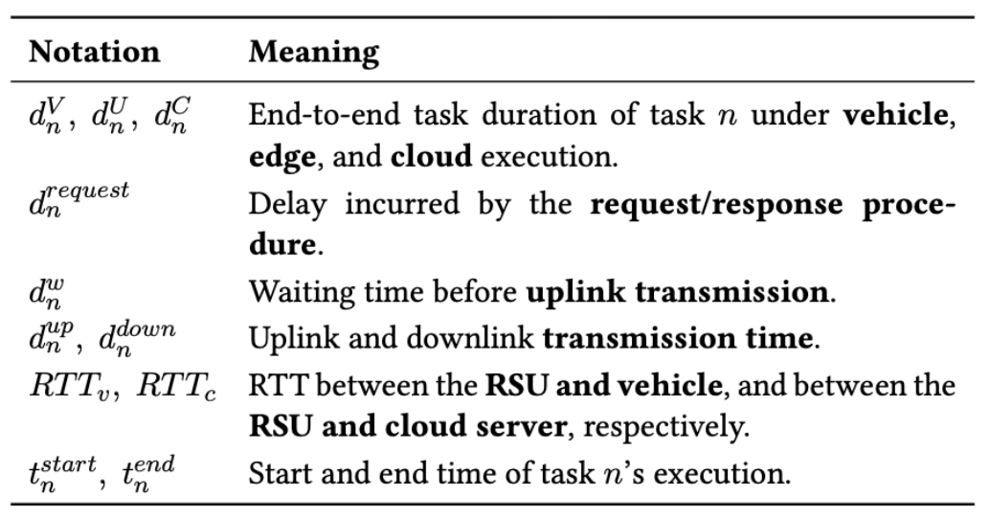

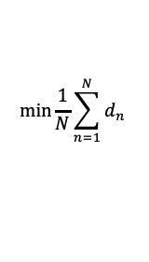
TODORA Objective and Delay Formulation
Optimize objective
Local Processing
Edge Processing
Cloud Processing
$$\min{\frac{1}{N}\sum_{n=1}^{N}{d_{n}}}$$
$$d_{n}^{V}=d_{n}^{request}+(t_{n}^{end}−t_{n}^{start})$$
$$d_{n}^{R}=d_{n}^{request}+d_{n}^{w}+d_{n}^{up}+{RTT}_{v}+\left(t_{n}^{end}−t_{n}^{start}\right)+d_{n}^{down}$$
$$d_{n}^{C}=d_{n}^{request}+d_{n}^{w}+d_{n}^{up}+{RTT}_{v}+{RTT}_{c}+\left(t_{n}^{end}−t_{n}^{start}\right)+d_{n}^{down}$$
Te-Yi Kan, and Konstantinos Psounis. “Online Distributed Offloading of Time-Sensitive Vehicular Tasks in Edge-Cloud Systems,”
in IEEE Transactions on Vehicular Technology, vol. 74, no. 12, pp. 19681-19697, Dec. 2025

Slide 45
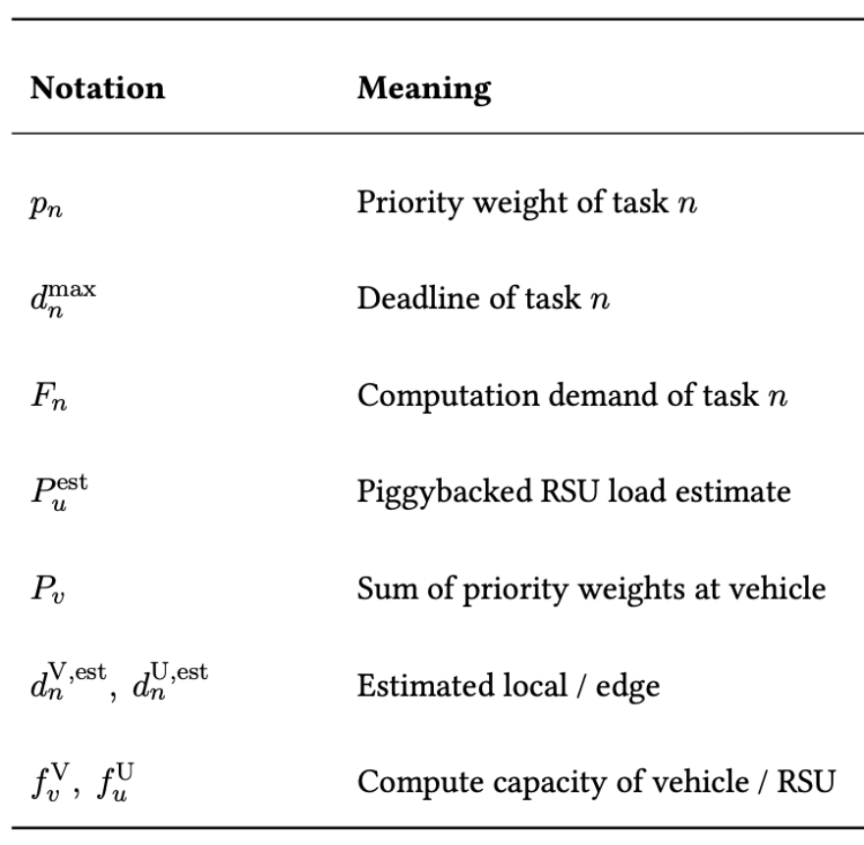
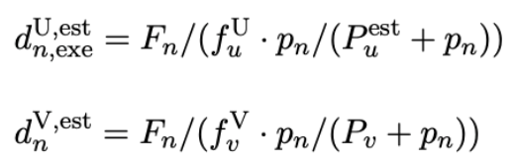
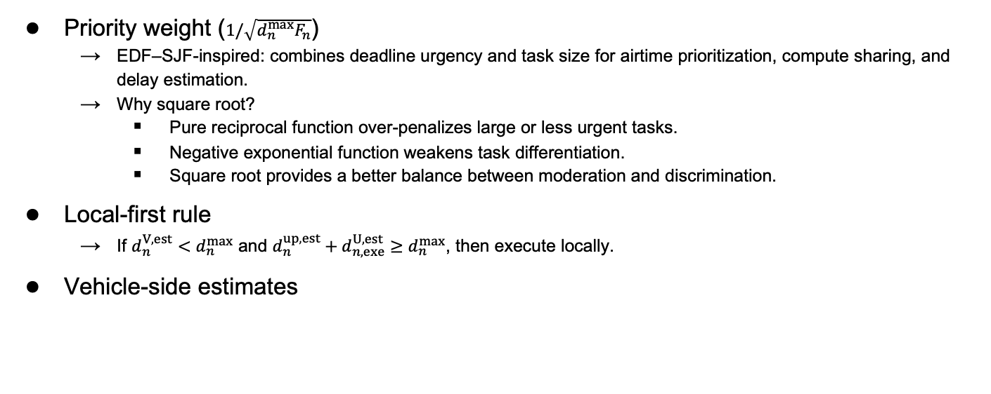
TODORA Priority Function and Decision Rules
Priority weight ($1/\sqrt{d_{n}^{max}F_{n}}$)
  EDF–SJF-inspired: combines deadline urgency and task size for airtime prioritization, compute sharing, and delay estimation.
  Why square root?
    Pure reciprocal function over-penalizes large or less urgent tasks.
    Negative exponential function weakens task differentiation.
    Square root provides a better balance between moderation and discrimination.
Local-first rule
  If $d_{n}^{V,est}<d_{n}^{max}$ and $d_{n}^{up,est}+d_{n,exe}^{U,est}≥d_{n}^{max}$, then execute locally.
Vehicle-side estimates
Te-Yi Kan, and Konstantinos Psounis. “Online Distributed Offloading of Time-Sensitive Vehicular Tasks in Edge-Cloud Systems,”
in IEEE Transactions on Vehicular Technology, vol. 74, no. 12, pp. 19681-19697, Dec. 2025

Slide 46
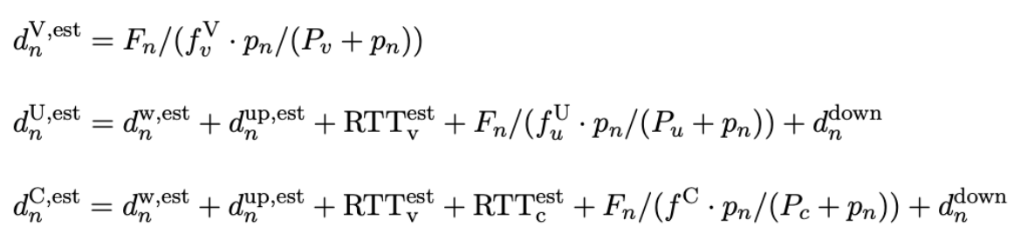
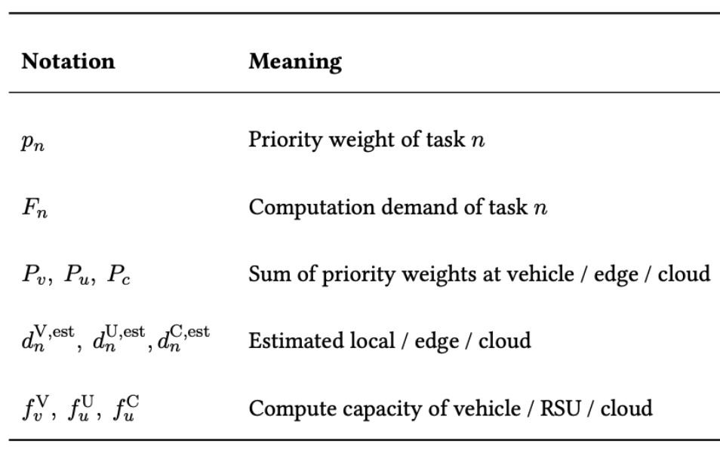
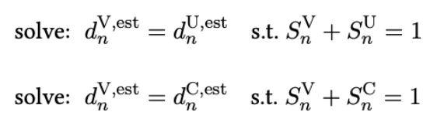
TODORA: RSU-side Scheduling and TODORAP Extension
RSU-side delay estimates
TODORAP decision rule
Te-Yi Kan, and Konstantinos Psounis. “Online Distributed Offloading of Time-Sensitive Vehicular Tasks in Edge-Cloud Systems,”
in IEEE Transactions on Vehicular Technology, vol. 74, no. 12, pp. 19681-19697, Dec. 2025

Slide 47
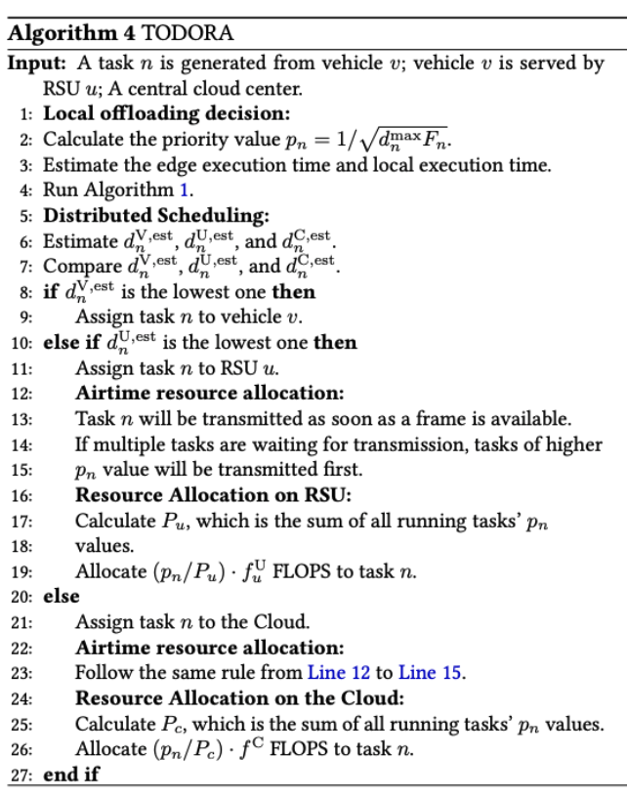
TODORA Algorithm
Te-Yi Kan, and Konstantinos Psounis. “Online Distributed Offloading of Time-Sensitive Vehicular Tasks in Edge-Cloud Systems,”
in IEEE Transactions on Vehicular Technology, vol. 74, no. 12, pp. 19681-19697, Dec. 2025

Slide 48
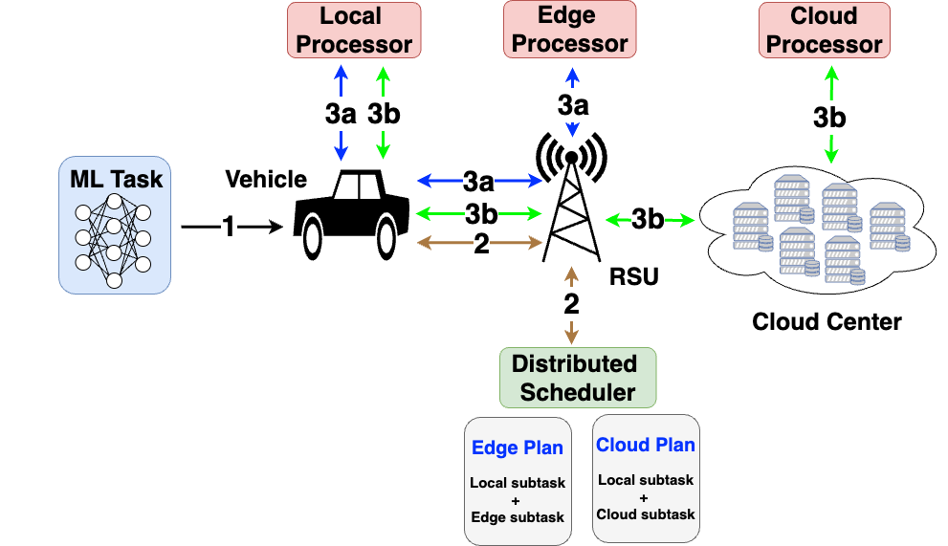
TODORAP: Partial Offloading Extension
Split tasks into local and remote parts
Select edge or cloud for the remote part
Reuse TODORA’s priority-based allocation
Enable parallel execution across computing layers
Te-Yi Kan, and Konstantinos Psounis. “Online Distributed Offloading of Time-Sensitive Vehicular Tasks in Edge-Cloud Systems,”
in IEEE Transactions on Vehicular Technology, vol. 74, no. 12, pp. 19681-19697, Dec. 2025
Notes:
The scheduler first determines the local–remote split by balancing the estimated delay of the two branches, so that the local and remote parts are expected to finish at about the same time.

Slide 49
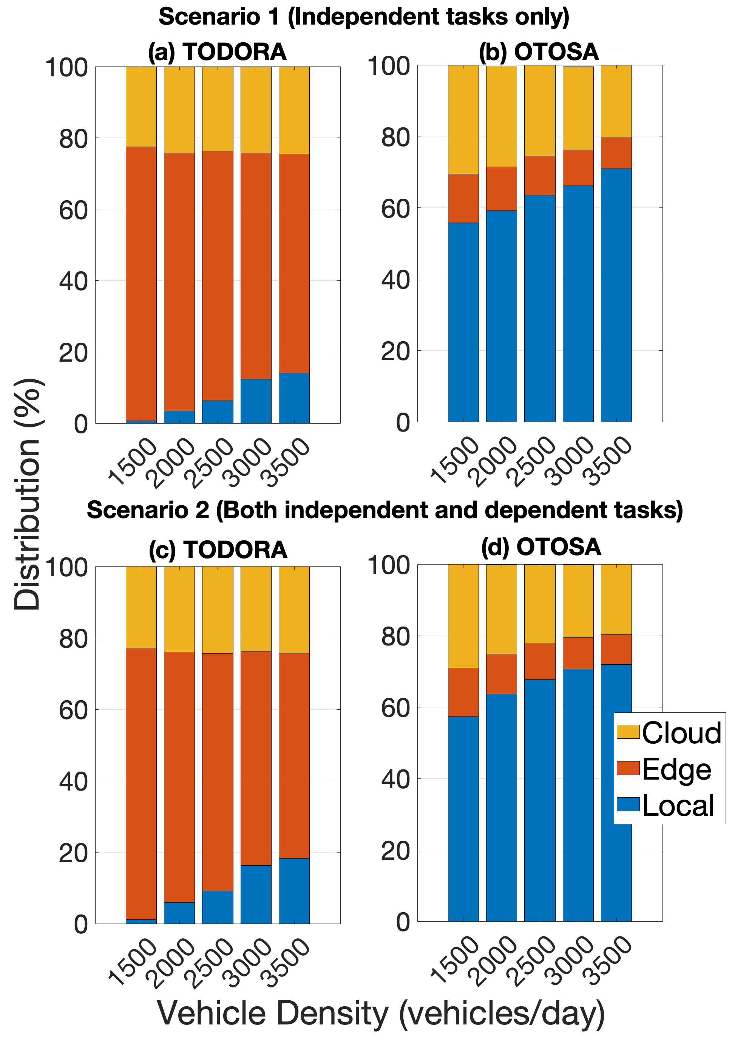
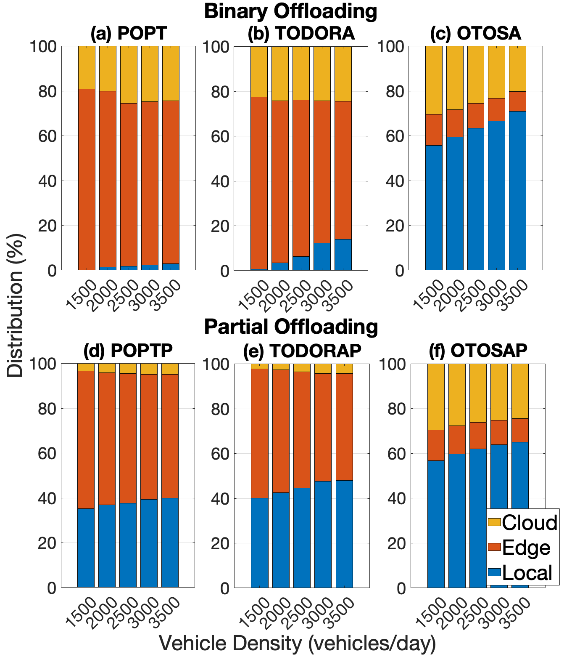
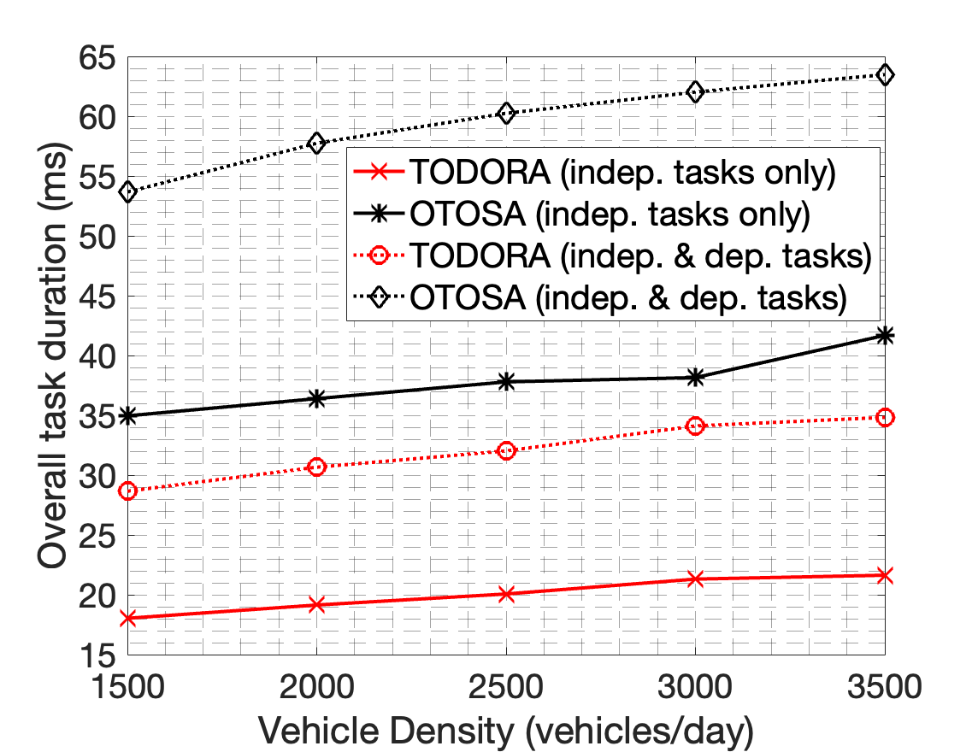
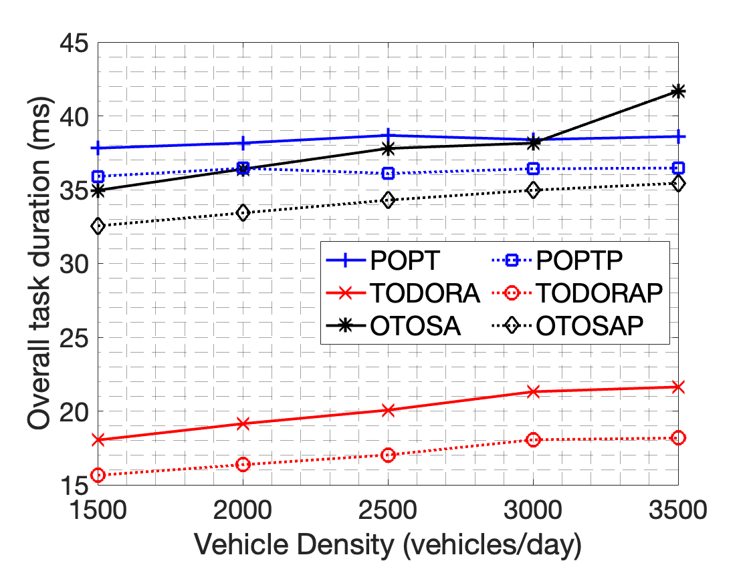
Extension Results: Dependency and Partial Offloading
Sequential two-task dependency; the second task is scheduled only after the first task completes.
TODORA remains effective under task dependency, and its partial-offloading extension further improves flexibility and resource utilization.
Te-Yi Kan, and Konstantinos Psounis. “Online Distributed Offloading of Time-Sensitive Vehicular Tasks in Edge-Cloud Systems,”
in IEEE Transactions on Vehicular Technology, vol. 74, no. 12, pp. 19681-19697, Dec. 2025

Slide 50
LLPRI Details
Privacy-aware sensitive object detection
  Privacy-enhanced false-negative loss: Boosts sensitive-object recall by increasing sensitive confidence on anchors aligned with sensitive ground truth.
  Privacy-enhanced false-positive loss: Suppresses false sensitive predictions on non-sensitive images to avoid unnecessary obfuscation.
  Sensitive-class-aware knowledge distillation: Transfers both classification and localization cues from a larger teacher to a lightweight detector with extra emphasis on sensitive categories.
Selective latent-space obfuscation with explicit privacy-utility optimization
  Selective obfuscation: Obfuscates only sensitive regions.
  Backbone reuse: Uses the target model’s early backbone as the client embedding network to reduce extra latency.
  Latent-space masking with joint objective: Optimizes the mask generator to minimize utility loss and maximize adversarial privacy loss.
Te-Yi Kan, and Konstantinos Psounis. “LLPRI: Low-Latency Private ML Inference for Vision Tasks in Distributed Environments,”
under review in IEEE Transactions on Dependable and Secure Computing

Slide 51
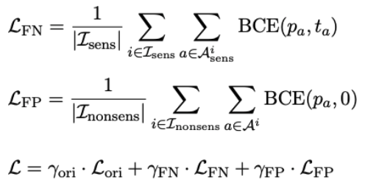
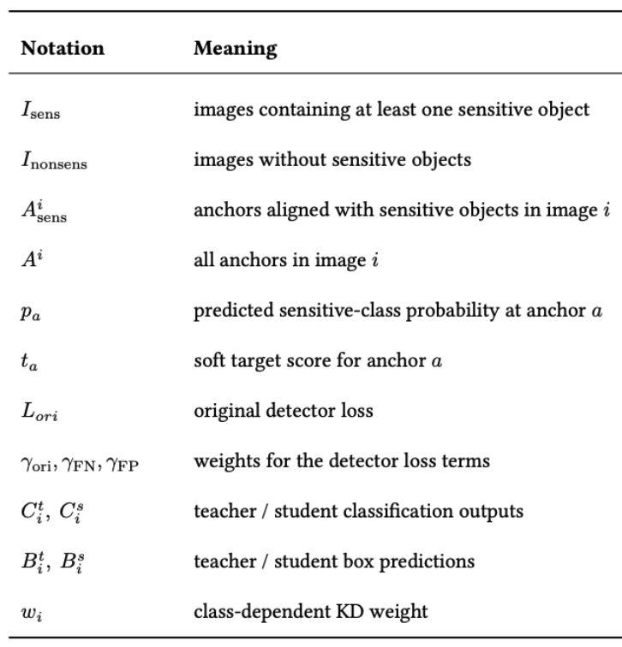
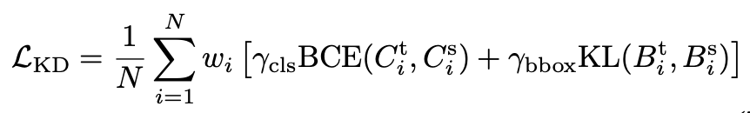
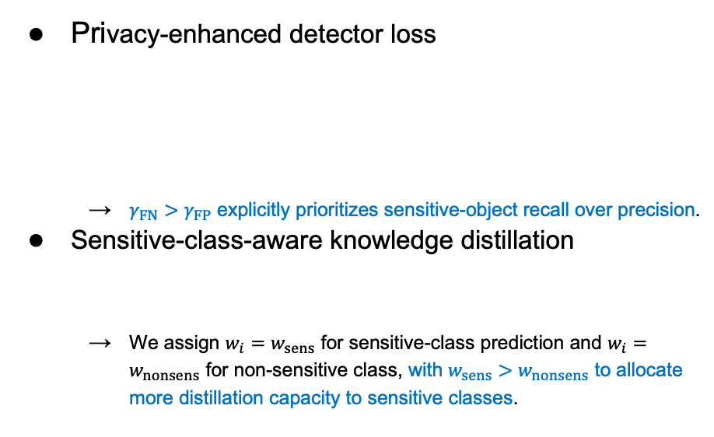
LLPRI: Privacy-Aware Sensitive-Object Detector
Privacy-enhanced detector loss
  $γ_{FN}>γ_{FP}$ explicitly prioritizes sensitive-object recall over precision.
Sensitive-class-aware knowledge distillation
  We assign $w_{i}=w_{sens}$ for sensitive-class prediction and $w_{i}=w_{nonsens}$ for non-sensitive class, with $w_{sens}>w_{nonsens}$ to allocate more distillation capacity to sensitive classes.
Te-Yi Kan, and Konstantinos Psounis. “LLPRI: Low-Latency Private ML Inference for Vision Tasks in Distributed Environments,”
under review in IEEE Transactions on Dependable and Secure Computing

Slide 52

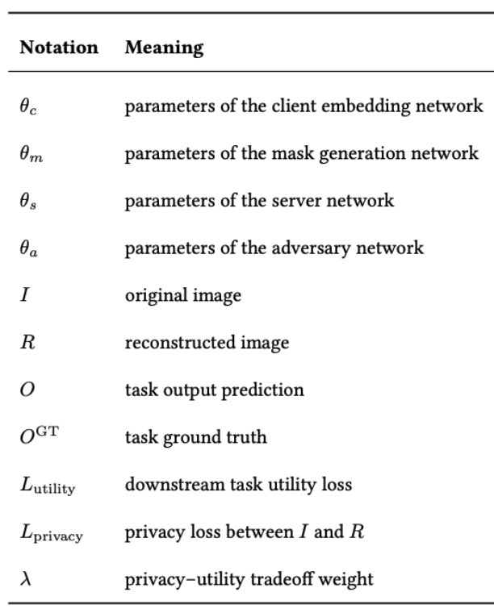



LLPRI: Obfuscator with Joint Privacy-Utility Training
Client/server network
  Optimize downstream task utility.
Adversary network
  Optimize the reconstruction quality.
Mask generation network
  Minimize utility loss while maximizing adversarial privacy loss.
Privacy loss used in implementation
$$ℒ_{privacy}\left(I,R\right)=1−SSIM(I,R)$$
Te-Yi Kan, and Konstantinos Psounis. “LLPRI: Low-Latency Private ML Inference for Vision Tasks in Distributed Environments,”
under review in IEEE Transactions on Dependable and Secure Computing

Slide 53

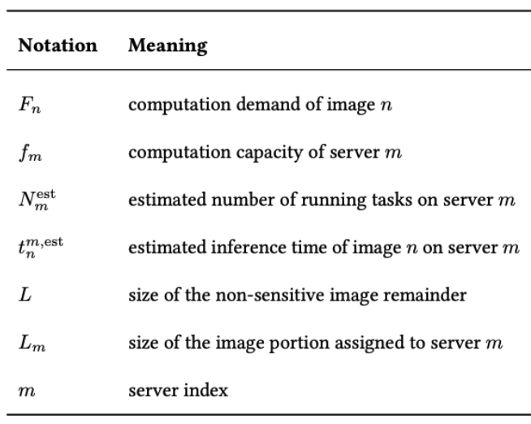
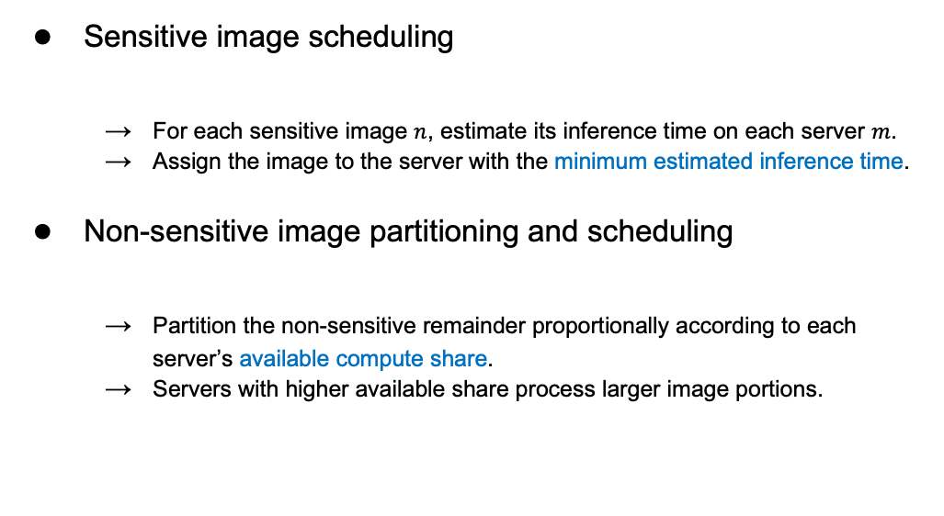
LLPRI: Scheduler for Distributed Inference
Sensitive image scheduling
  For each sensitive image $n$, estimate its inference time on each server $m$.
  Assign the image to the server with the minimum estimated inference time.
Non-sensitive image partitioning and scheduling
  Partition the non-sensitive remainder proportionally according to each server’s available compute share.
  Servers with higher available share process larger image portions.
Te-Yi Kan, and Konstantinos Psounis. “LLPRI: Low-Latency Private ML Inference for Vision Tasks in Distributed Environments,”
under review in IEEE Transactions on Dependable and Secure Computing

Slide 54
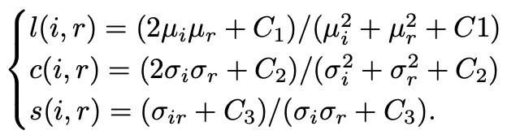

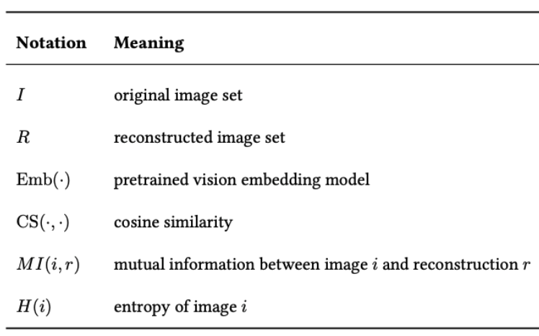

LLPRI: Evaluation Metrics
SSIM: Structural Similarity
SIM: Semantic Embedding Similarity
NMI: Normalized Mutual Information
with
with
Te-Yi Kan, and Konstantinos Psounis. “LLPRI: Low-Latency Private ML Inference for Vision Tasks in Distributed Environments,”
under review in IEEE Transactions on Dependable and Secure Computing
Notes:
SSIM is a widely used image quality assessment metric in computer vision for examining the similarity between two images. It compares attributes, such as luminance and contrast, to capture perceptual differences.
-> reflecting perceptual discrepancies as perceived by the human visual system
SIM -> semantic similarity
MI formally describes how much knowing one random variable reduces uncertainty about another

Slide 55
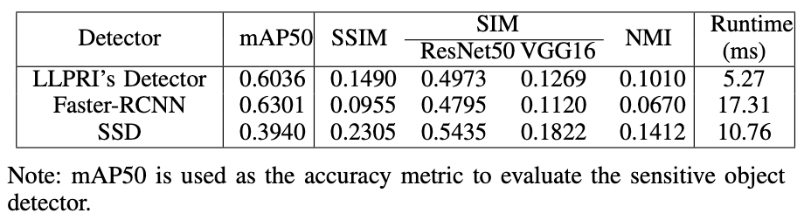
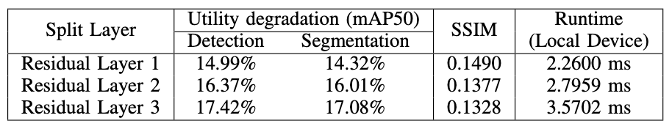
LLPRI: Ablation Studies
Comparison of Sensitive Object Detector Variants
Impact of Split Point on Performance
Te-Yi Kan, and Konstantinos Psounis. “LLPRI: Low-Latency Private ML Inference for Vision Tasks in Distributed Environments,”
under review in IEEE Transactions on Dependable and Secure Computing

Slide 56
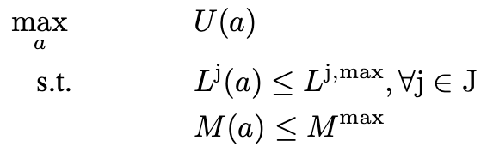
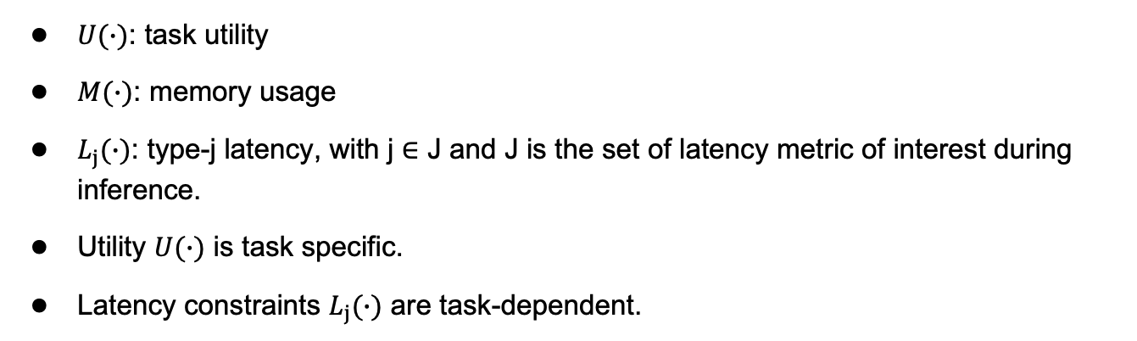
Cloud-Edge HW-NAS: Problem Formulation
$U(∙)$: task utility
$M(∙)$: memory usage
$L_{j}(∙)$: type-j latency, with j $∈$ J and J is the set of latency metric of interest during inference.
Utility $U(∙)$ is task specific.
Latency constraints $L_{j}(∙)$ are task-dependent.
Te-Yi Kan, and Konstantinos Psounis. “Neural Architecture Search for Edge Devices via Cloud-Edge Collaboration,”
under review in the International Conference on Machine Learning (ICML)

Slide 57
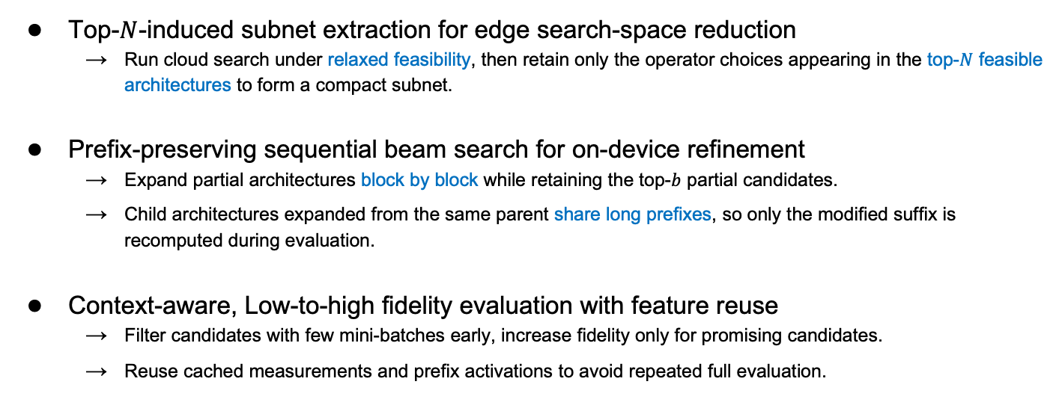
Cloud-Edge HW-NAS Details
Top-$N$-induced subnet extraction for edge search-space reduction
  Run cloud search under relaxed feasibility, then retain only the operator choices appearing in the top-$N$ feasible architectures to form a compact subnet.
Prefix-preserving sequential beam search for on-device refinement
  Expand partial architectures block by block while retaining the top-$b$ partial candidates.
  Child architectures expanded from the same parent share long prefixes, so only the modified suffix is recomputed during evaluation.
Context-aware, Low-to-high fidelity evaluation with feature reuse
  Filter candidates with few mini-batches early, increase fidelity only for promising candidates.
  Reuse cached measurements and prefix activations to avoid repeated full evaluation.
Te-Yi Kan, and Konstantinos Psounis. “Neural Architecture Search for Edge Devices via Cloud-Edge Collaboration,”
under review in the International Conference on Machine Learning (ICML)

Slide 58
Cloud-Edge HW-NAS: Evaluation Pipeline
Context-aware caching
  Store utility / latency / memory measurements together with device-context information, and reuse them when the same architecture is evaluated under a similar system state.
Stage-aware evaluation
  Use a few mini-batches for coarse ranking in early stages, then progressively increase fidelity only for promising architectures.
Intermediate feature reuse
  Reuse cached prefix activations and recompute only the modified suffix for child architectures generated by sequential beam search.
Te-Yi Kan, and Konstantinos Psounis. “Neural Architecture Search for Edge Devices via Cloud-Edge Collaboration,”
under review in the International Conference on Machine Learning (ICML)

Slide 59
Cloud-Edge HW-NAS: Baselines
Evolutionary HW-NAS
  Use evolutionary search to explore architectures through selection, mutation, and crossover, and keep the best feasible architecture under the hardware constraints.
RL HW-NAS
  Use a PPO-based controller to sample architecture decisions, and optimize a reward that reflects utility while penalizing constraint violations.
Bayesian Optimization HW-NAS
  Use a Gaussian-process surrogate to predict architecture utility, and iteratively choose promising architectures through an acquisition function under the hardware constraints.
Te-Yi Kan, and Konstantinos Psounis. “Neural Architecture Search for Edge Devices via Cloud-Edge Collaboration,”
under review in the International Conference on Machine Learning (ICML)

Slide 60

Cloud-Edge HW-NAS: Ablation Studies
Te-Yi Kan, and Konstantinos Psounis. “Neural Architecture Search for Edge Devices via Cloud-Edge Collaboration,”
under review in the International Conference on Machine Learning (ICML)

Slide 61
Back up

