Slide 1
FACE-MASK-DETECTION

Slide 2
FACE DETECTION SYSTEM
A facial recognition system is a technology capable of identifying or verifying a person from a digital image or a video frame from a video source. There are multiple methods in which facial recognition systems work, but in general, they work by comparing selected facial features from given image with faces within a database. It is also described as a Biometric Artificial Intelligence based application that can uniquely identify a person by analyzing patterns based on the person's facial textures and shape.

Slide 3
FACE-MASK DETECTION
It is basically a face detection system , in addition to that it recognises whether a person is wearing mask or not. It is very essential that a person should wear mask in these COVID-19 outbreak situation. This system helps in identifying whether a person is wearing a mask or not

Slide 4
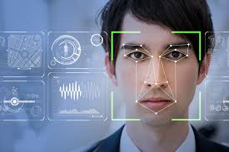
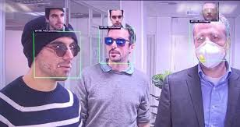
It is not easy to detect faces with masks on it and still there will be need of two things 1. Face Detection 2. Checking whether there is mask on face or not

Slide 5
TECH STACK
OpenCV
Tensorflow
Keras
Deep learning

Slide 6
OUTPUTS

Slide 7
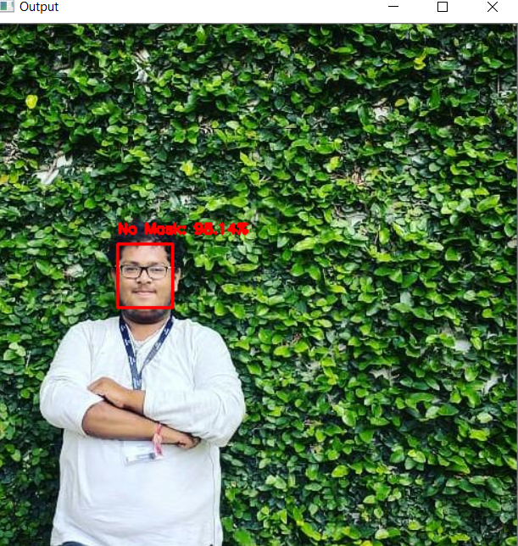
OUTPUT:1 WITHOUT MASK

Slide 8
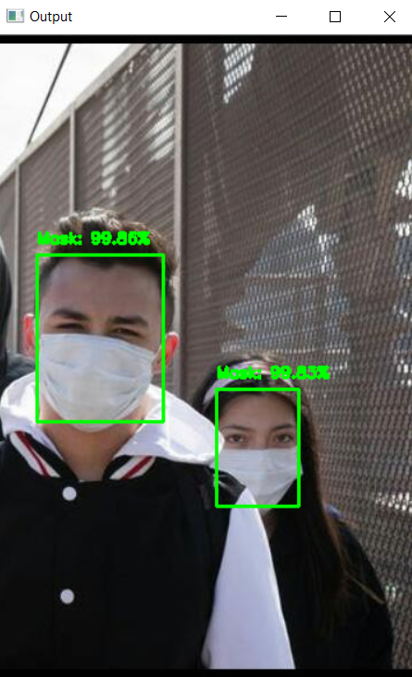
OUTPUT2: WITH MASK

Slide 9
THANK YOU

