Slide 1
Theme : Emergency Services
Team - Avocado

Slide 2
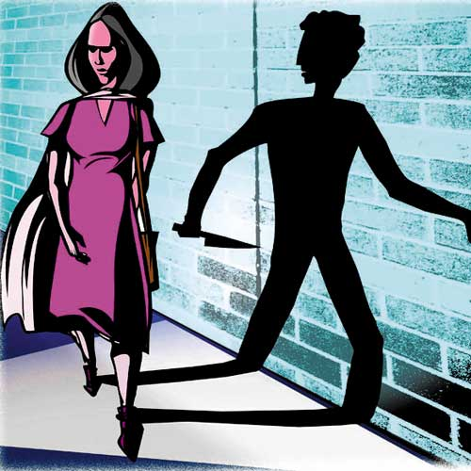
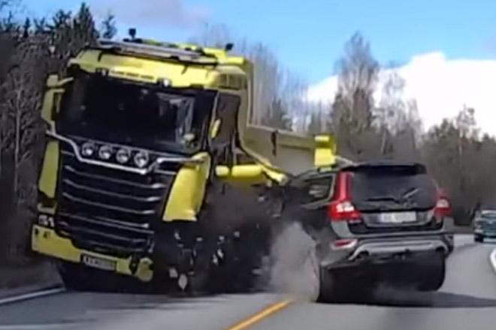
Women Safety
Car Crash Savior

Slide 3
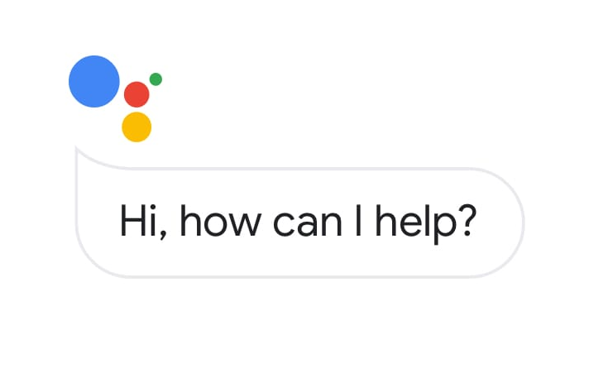

Women Safety
Nearest Police Stations
Power of VOICE

Slide 4


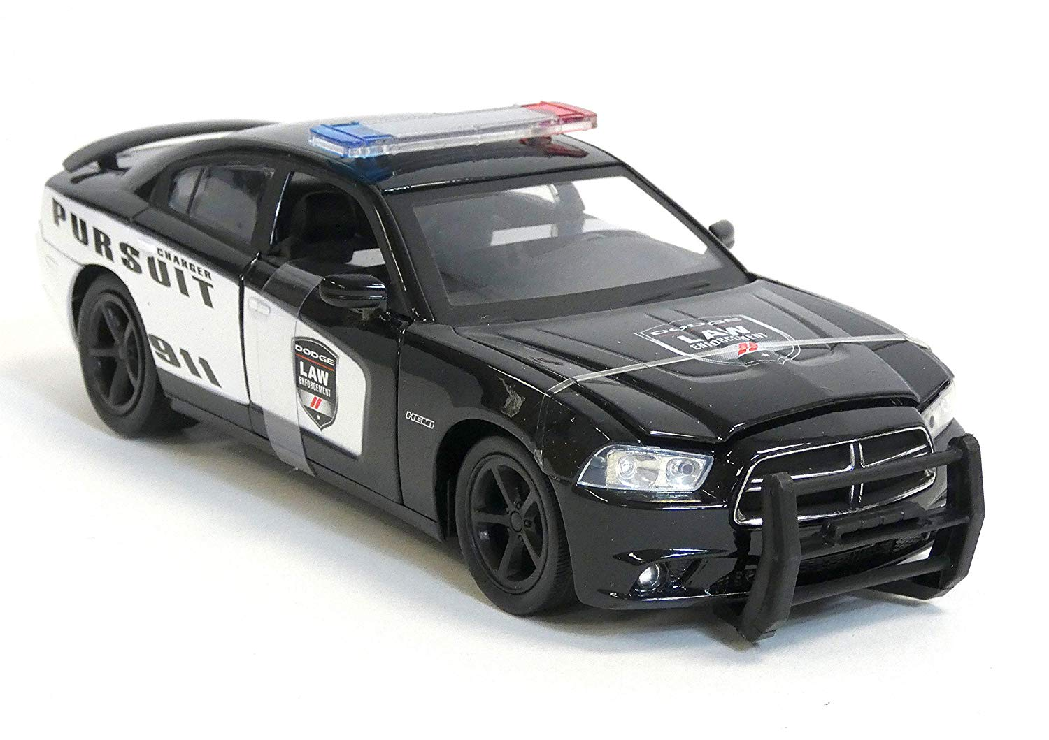

Siren

Slide 5
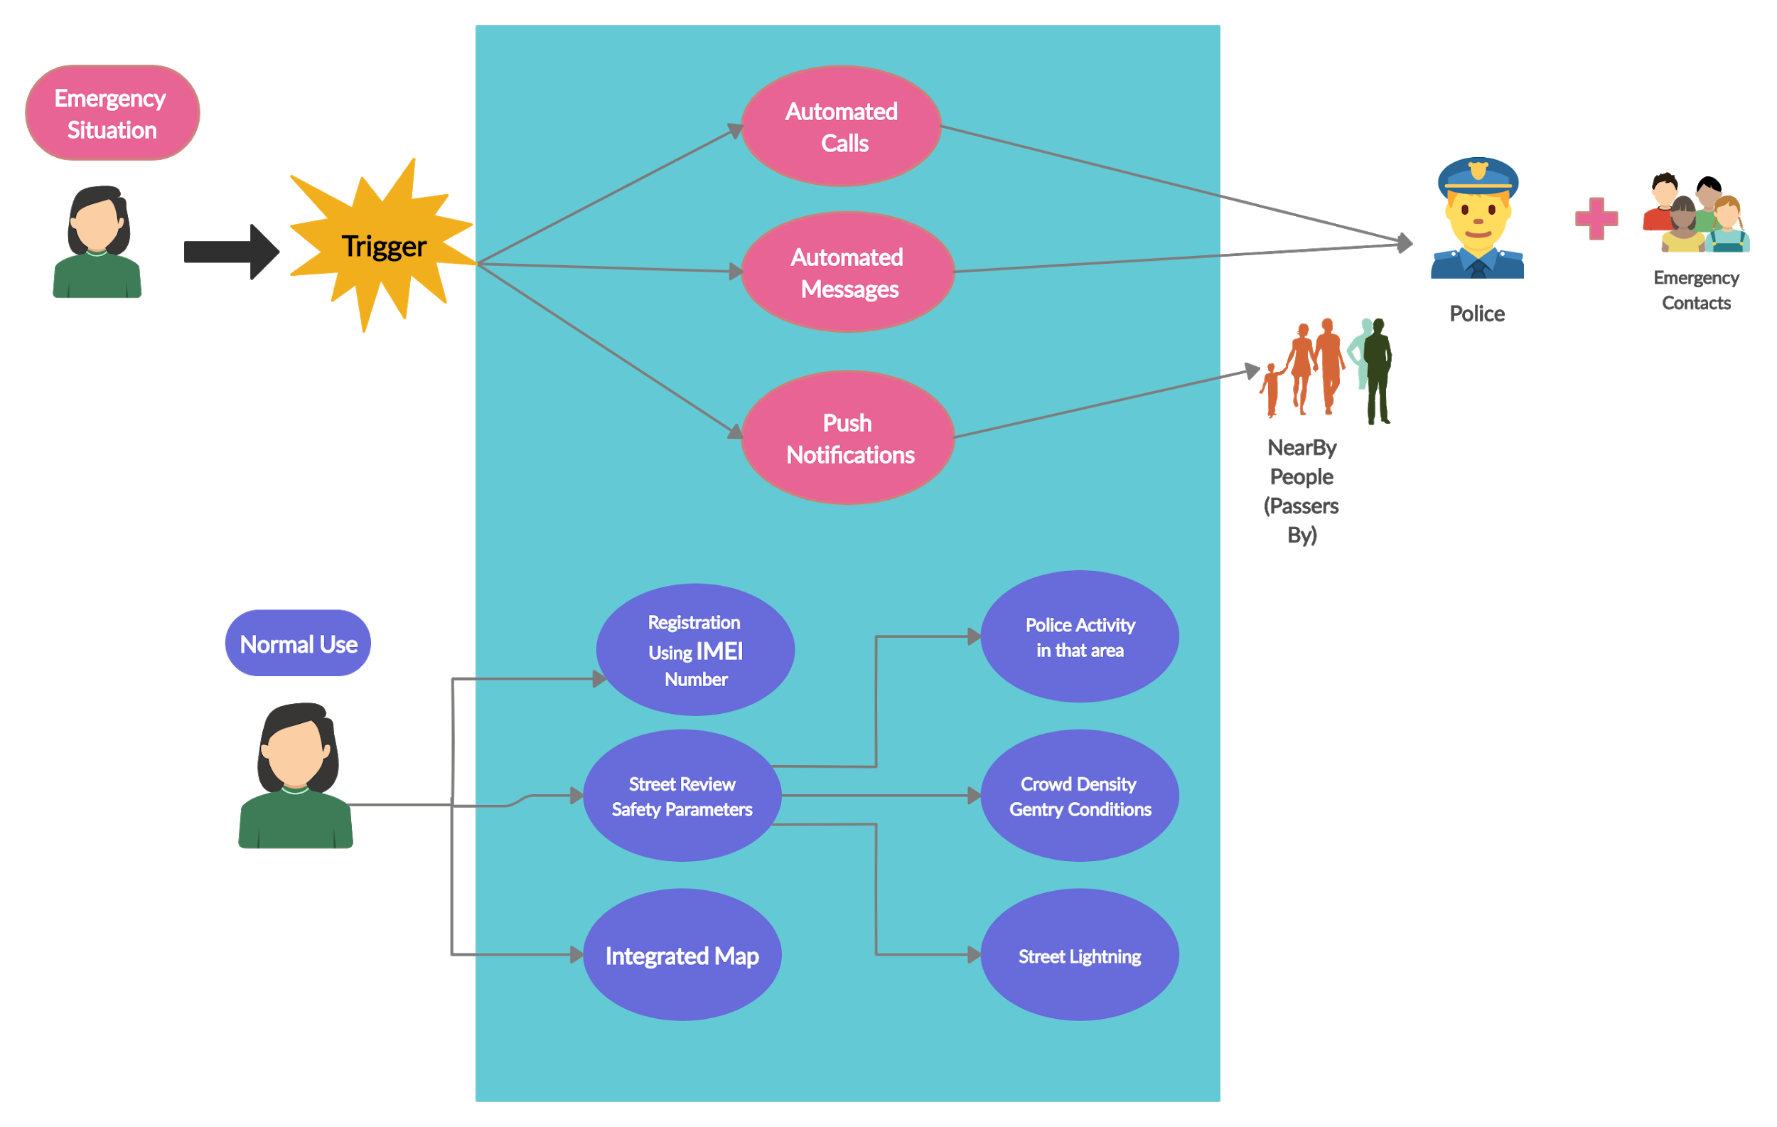
UML

Slide 6
Car Crash Savior
Around 3 Lakh car accident victims die every year because of the late response in getting medical attention.
Every 1 minute delay in response time correlates to a six percent difference in number of lives saved.

Slide 7

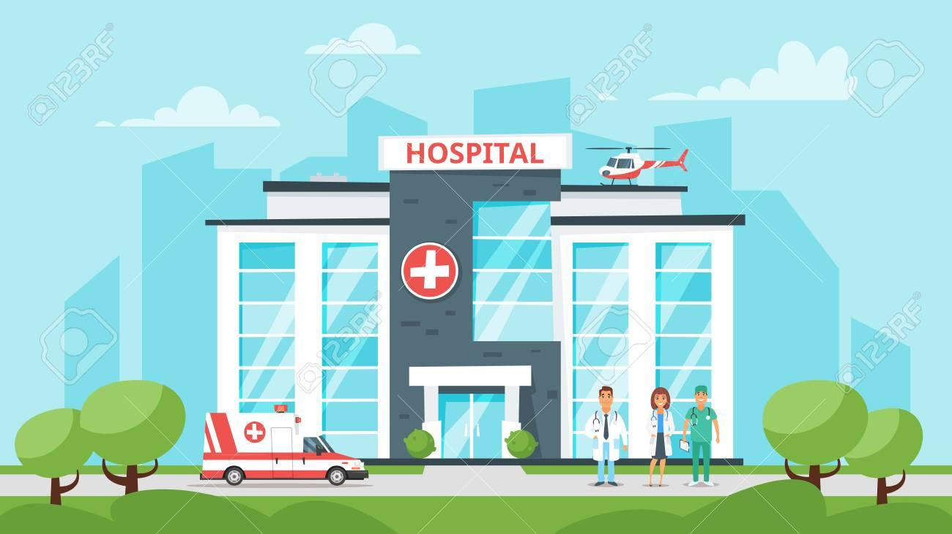

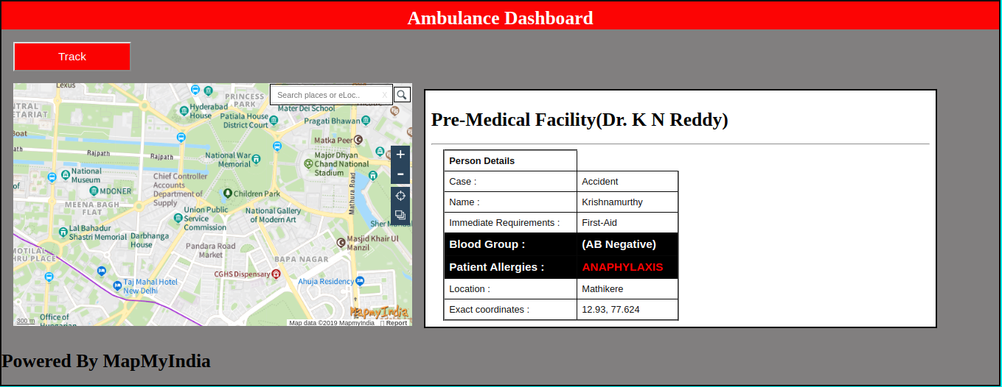

Slide 8
Market Viability:
Crowd Insights

Slide 9
Crowd Insights Advantages
Understanding how many people pass by a given location at a given time helps urban planners to better understand and meet people's’ needs:
Helps the business know the popularity of a particular place
Allows them to know the insights of a place through which they can know about the needs of the crowd in that particular region.
Helps them understand crowd flow at large-scale events and where to position different amenities like food stalls, parking in case of large gathering events.

Slide 10









Tech Stack
Dialogflow
Flutter
Firebase
Android Studio
Apify
Twilio

Slide 11
THANK YOU

