Slide 1
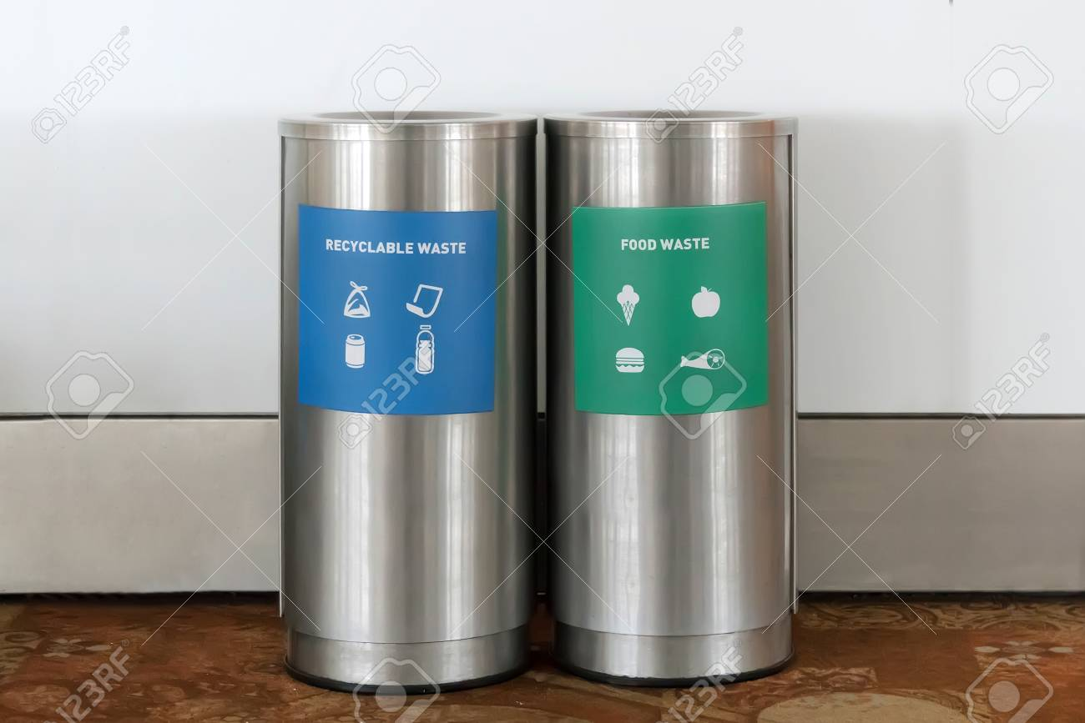
Which bin?

Slide 2
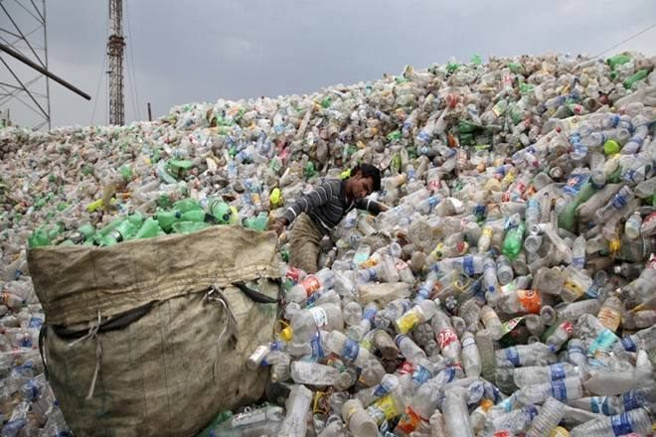
Problem: What is the pain point?
Lack of awareness of waste segregation and management among common folks.
Definition of type of waste.

Slide 3
Solution: WhichBin?
WhichBin- ML-AI powered trained module which identifies Waste and instruct user to dispose waste to its respective color Bin.

Slide 4
DEMO:
http://whichbin.azurewebsites.net/

Slide 5
Value proposition what makes this unique?
User friendly.
Self learning.

Slide 6
BUSINESS VALUE:
Licensing of Trained module/ software for Bin technologies.

Slide 7
SOCIAL IMPACT:
Self learning and awareness.
Development of Good habits.

Slide 8
WHY US?
We are young energetic team on a mission to bring social awareness and encourage good habit among the common folks about Waste life cycle.

Slide 9
TEAM
Santosh A, Kumarasamy.
THANK YOU.

