Slide 1

DotCOM
Created by: Sailee Salgaokar
&
Jahnvi Thakkar

Slide 2
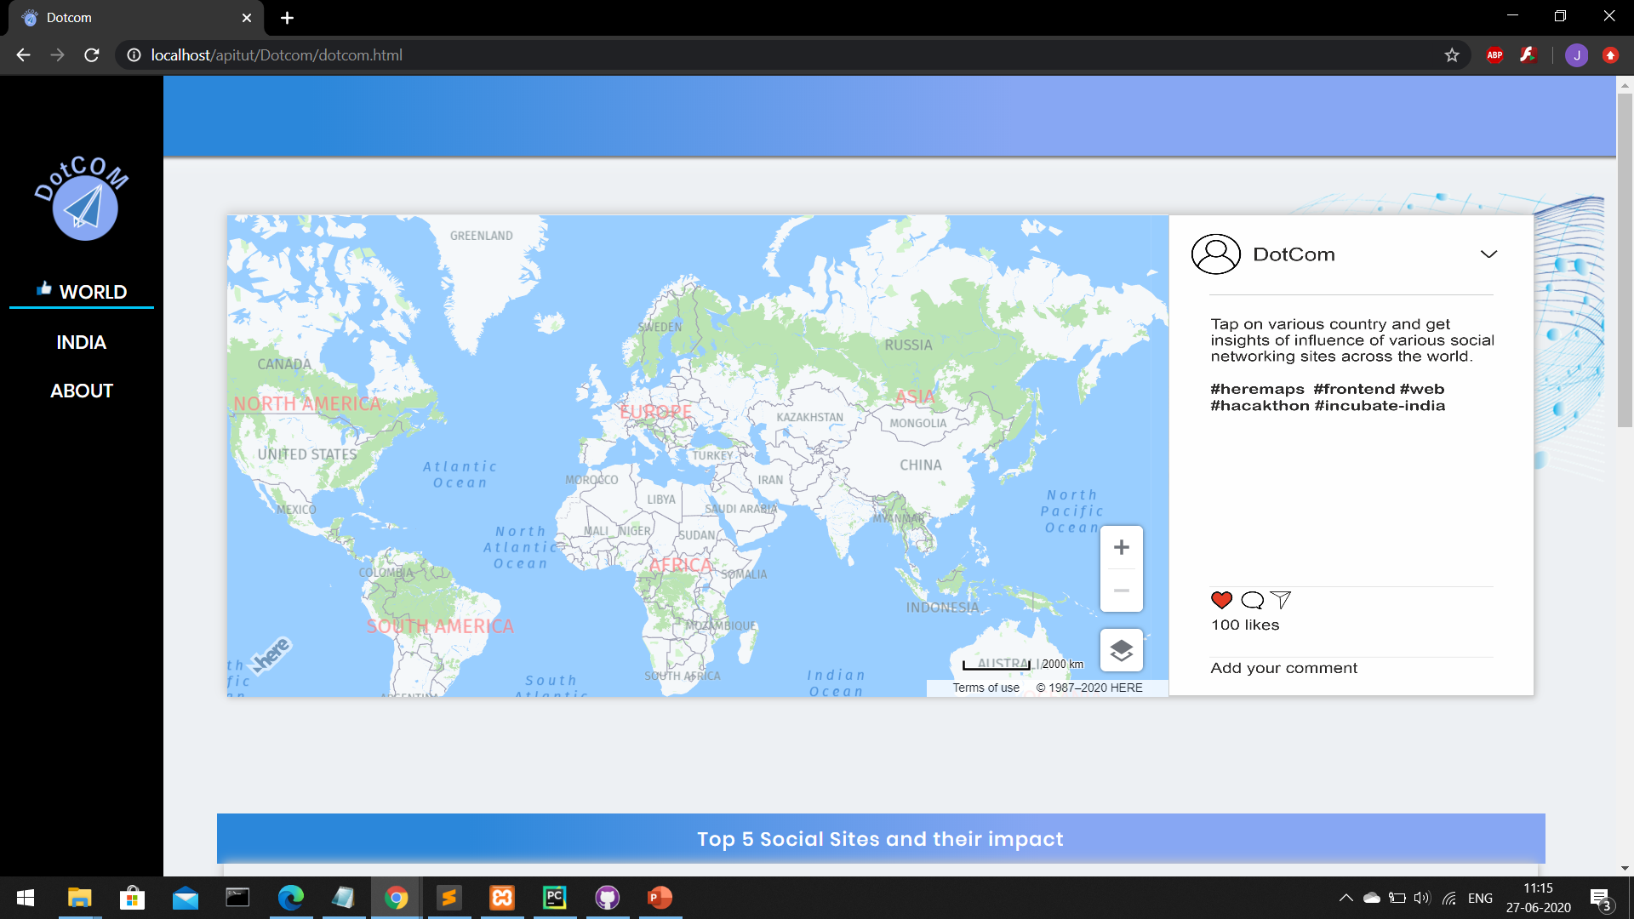
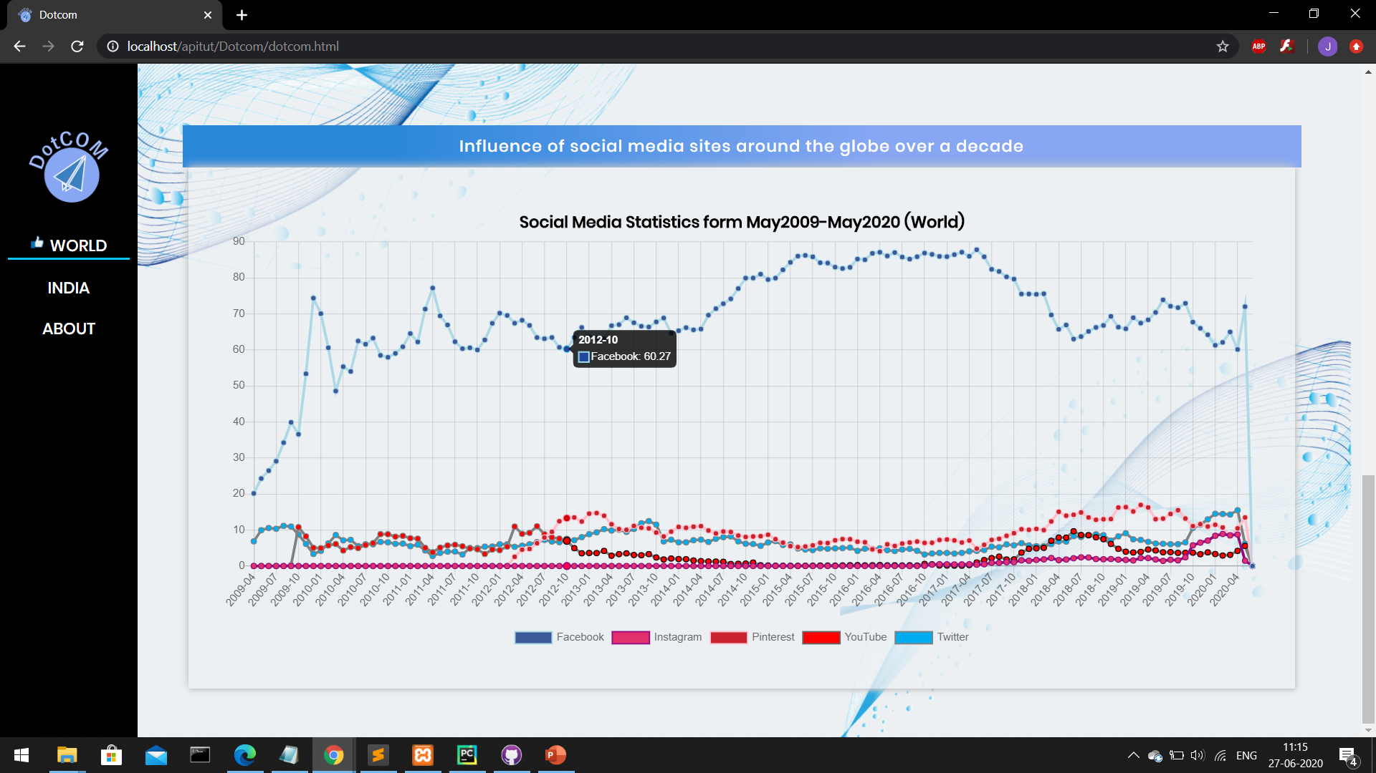
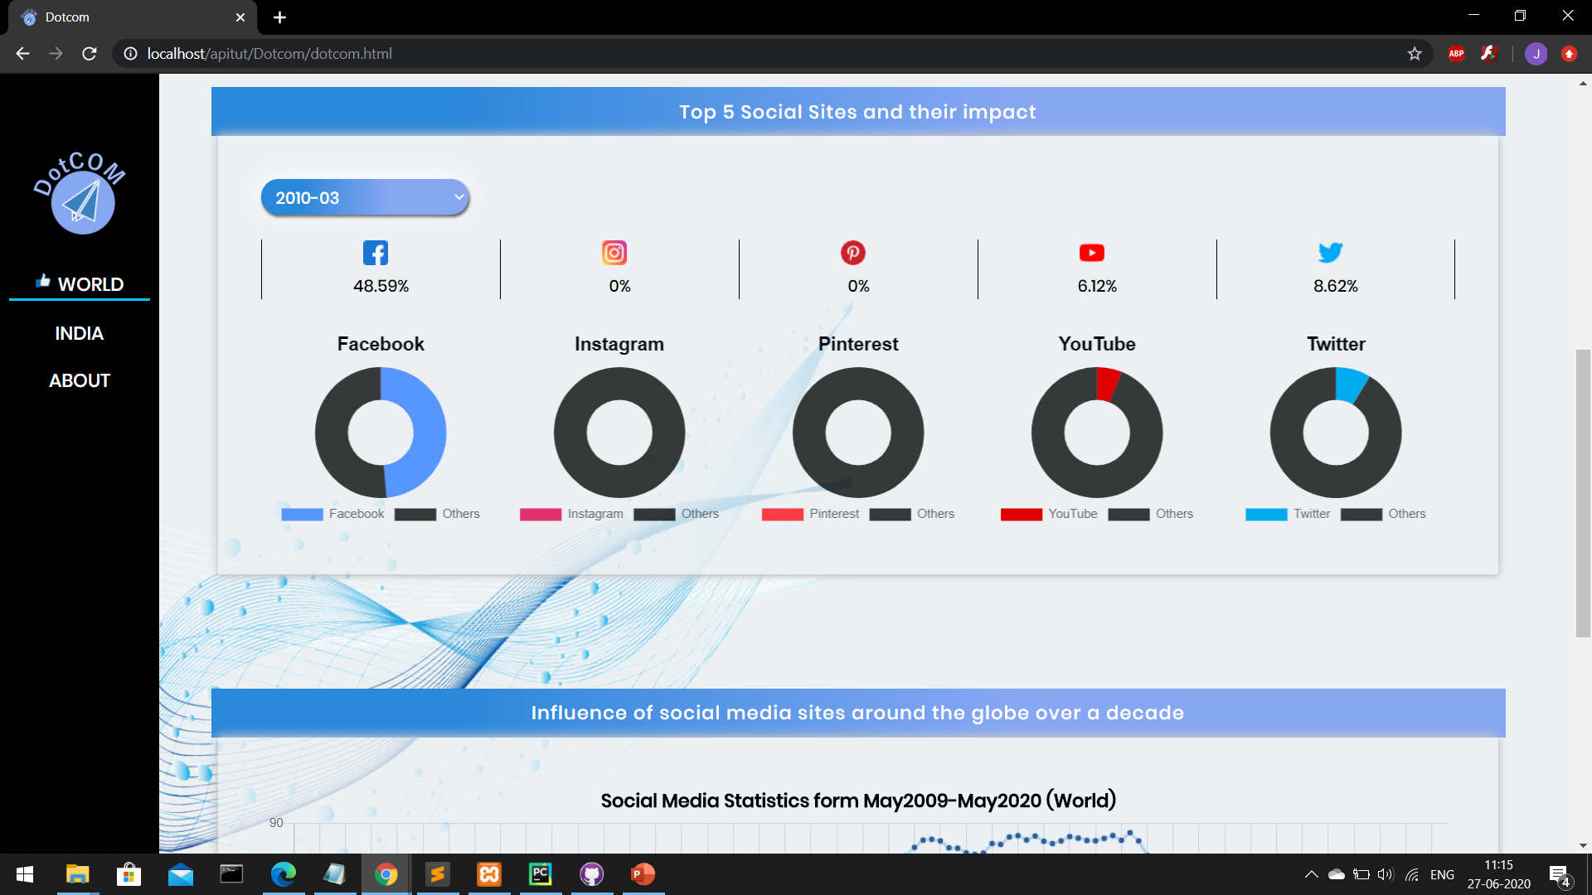
WORLd Page
First section shows the Here Map of world and with the help of position we get Social Media Statistics.
Second section shows the Doughnut chart and table showing the percentage depending on the month and year selected.
Third section shows the line chart of last 10years, and use of top5 Social Media Applications.
1
3
2

Slide 3
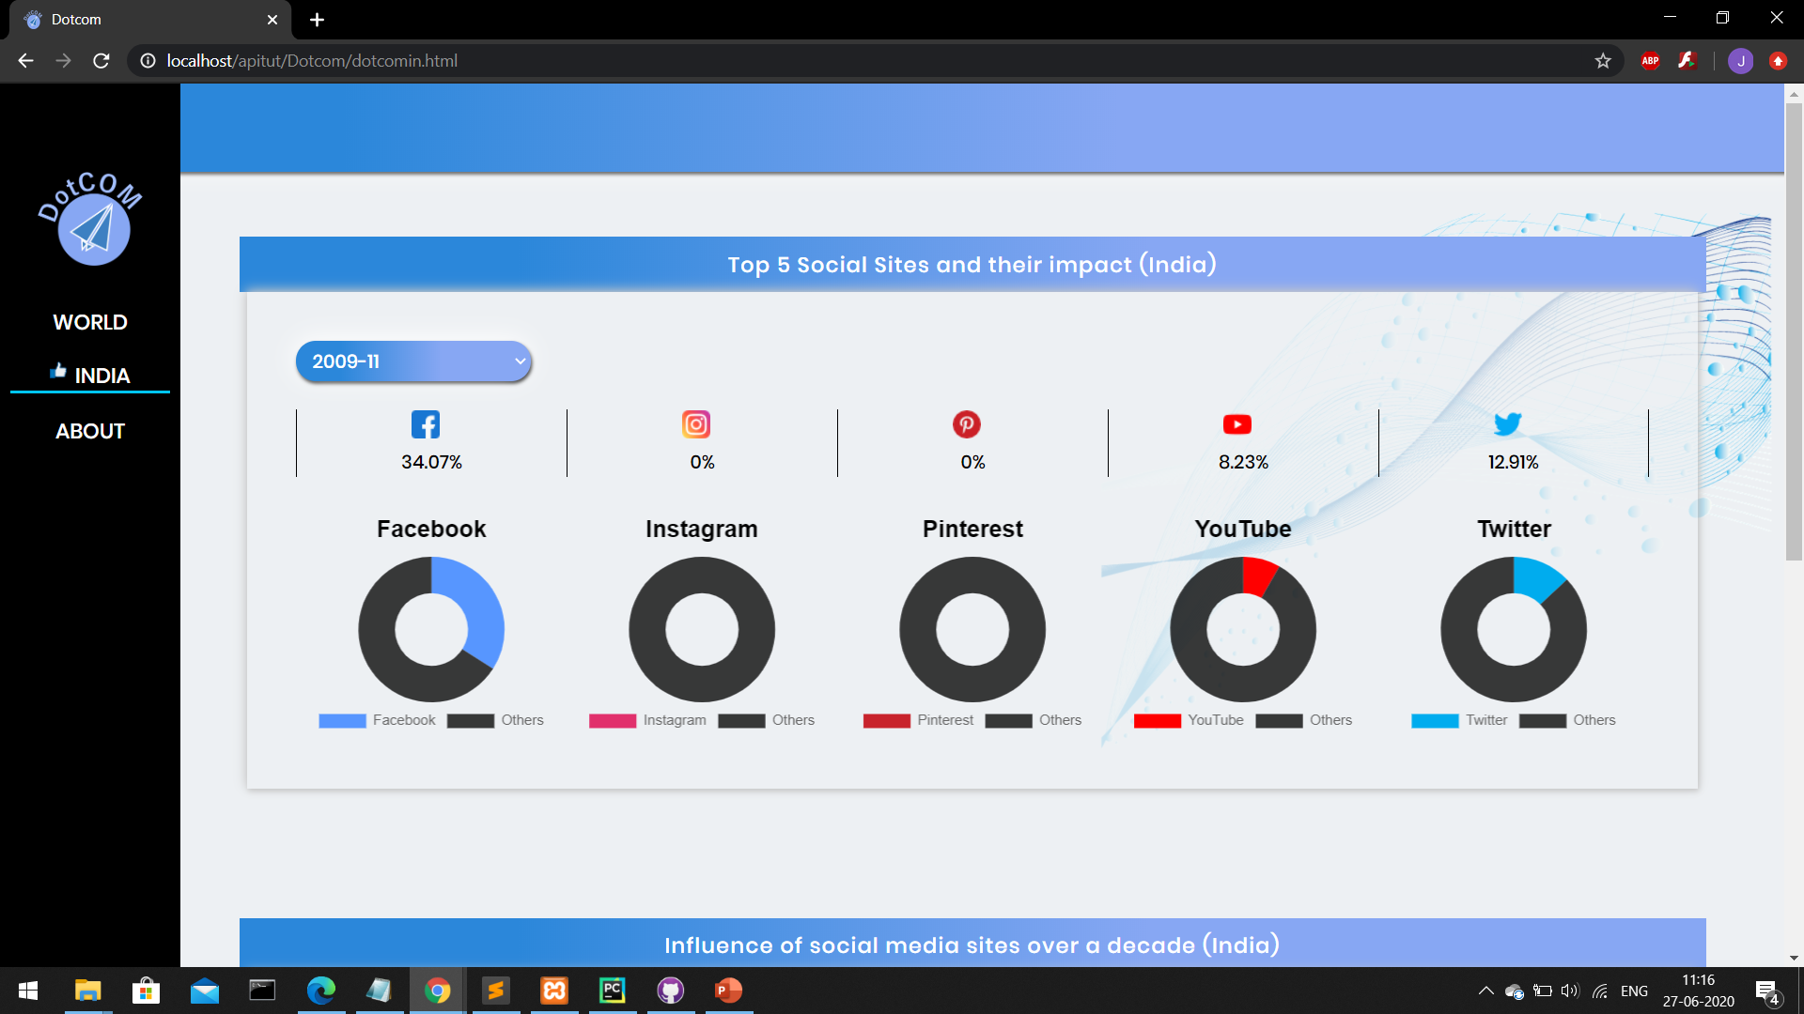
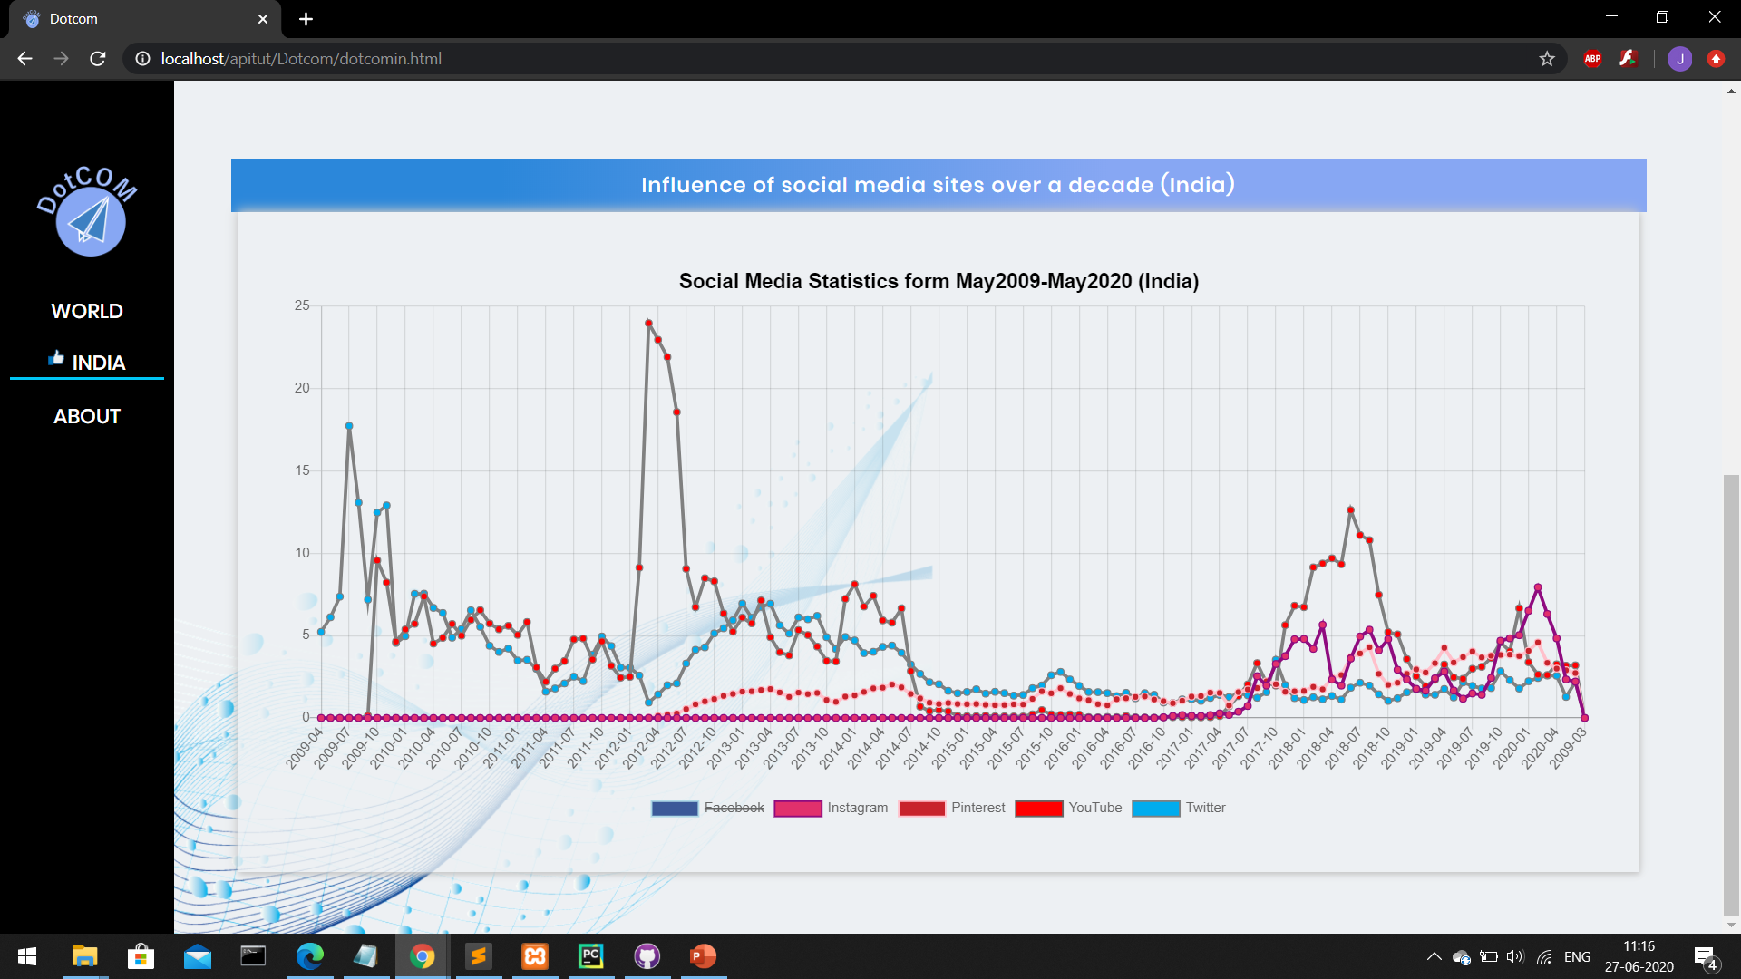
India Page
1
First section shows the Doughnut chart and table showing the percentage depending on the month and year selected of India.
2
Second section shows the line chart of last 10years, and use of top5 Social Media Applications in India.

Slide 4
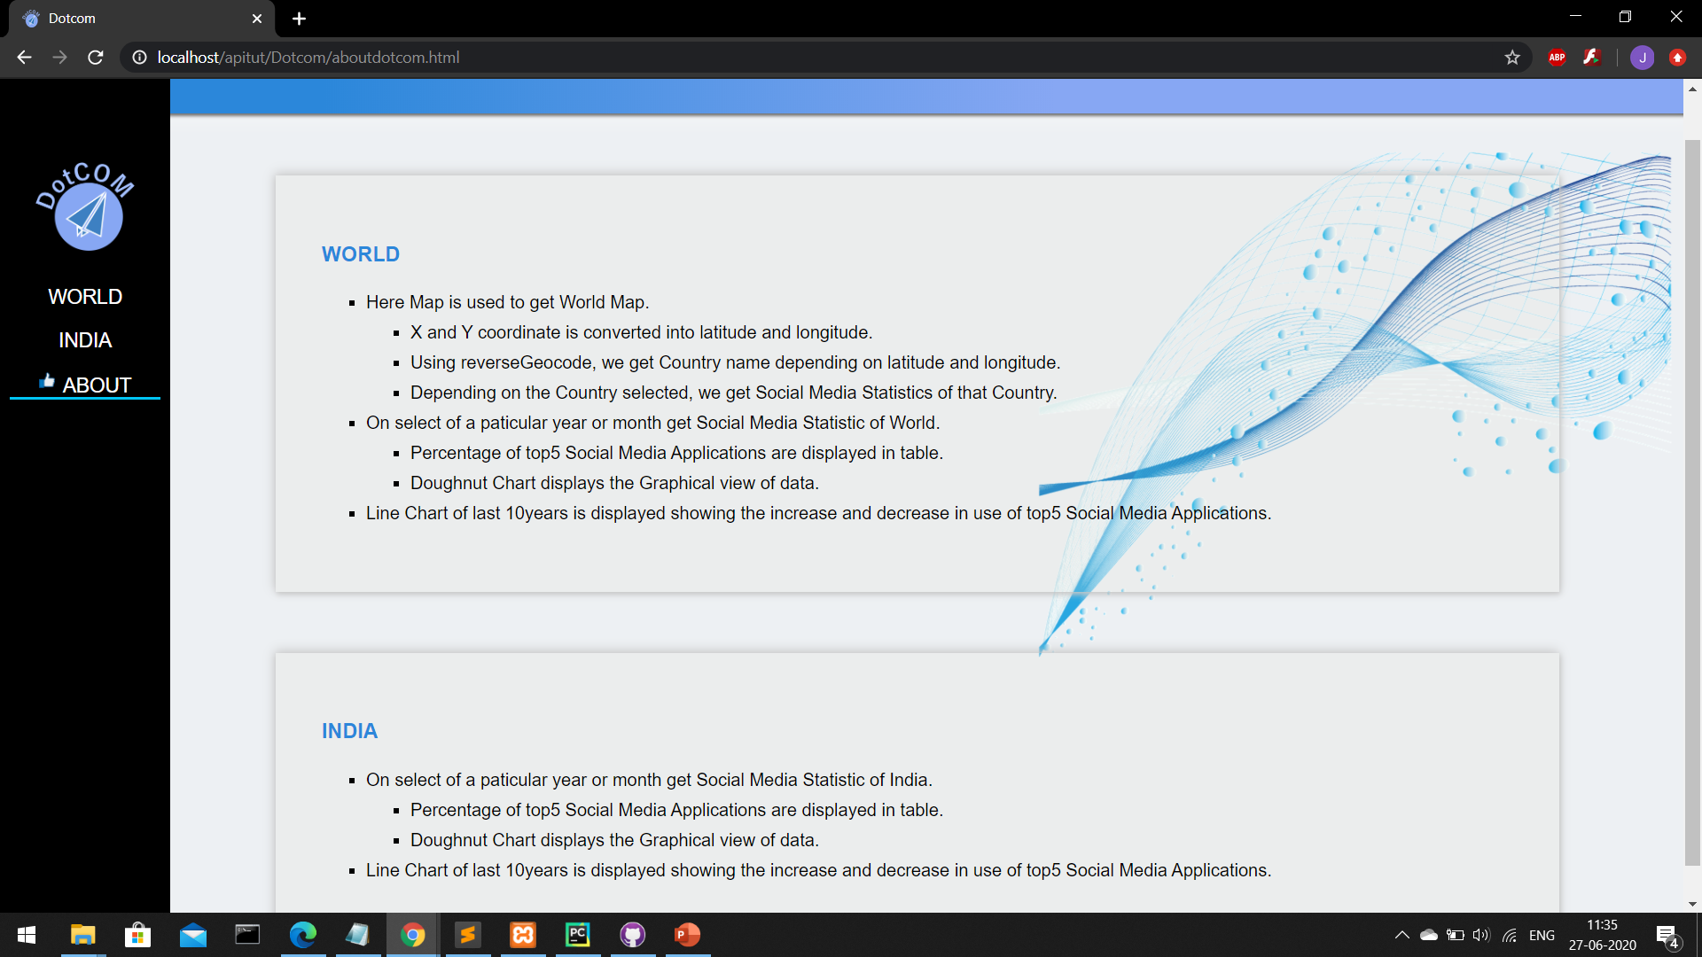
About Page
Gives over all information of both the pages

