Slide 1
IMAGE BASED CAPTCHA
Submitted by – Pratyaksh Saini, 51
Aaditya Sharma, 46
Sai Abhinay, 48

Slide 2

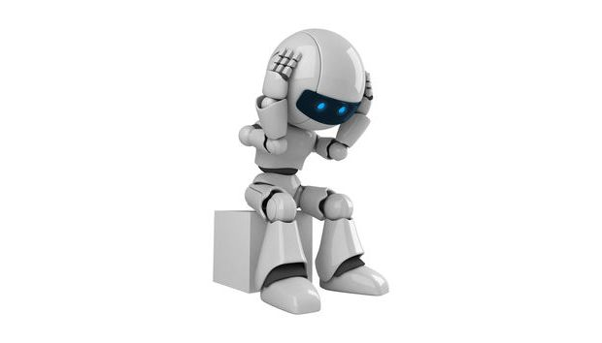
Intro
Captcha is used for human verification.
Image captcha is more secure than text based captcha.

Slide 3
Requirements
Requirements of this project is to display some images
Based on the images user has to select that image which specify the question
After clicking the submit button, Answers should be verify with the user response
If captcha is more complex then user can skip that for the next captcha

Slide 4
Design and GUI
We python to write the code and tkinter for implementation our Graphical User Interface.
We used PIL for putting the images on the GUI
Tkinter – is a python library user for GUI
PIL – Python Image Library
from tkinter import *
from PIL import Image, ImageTk

Slide 5
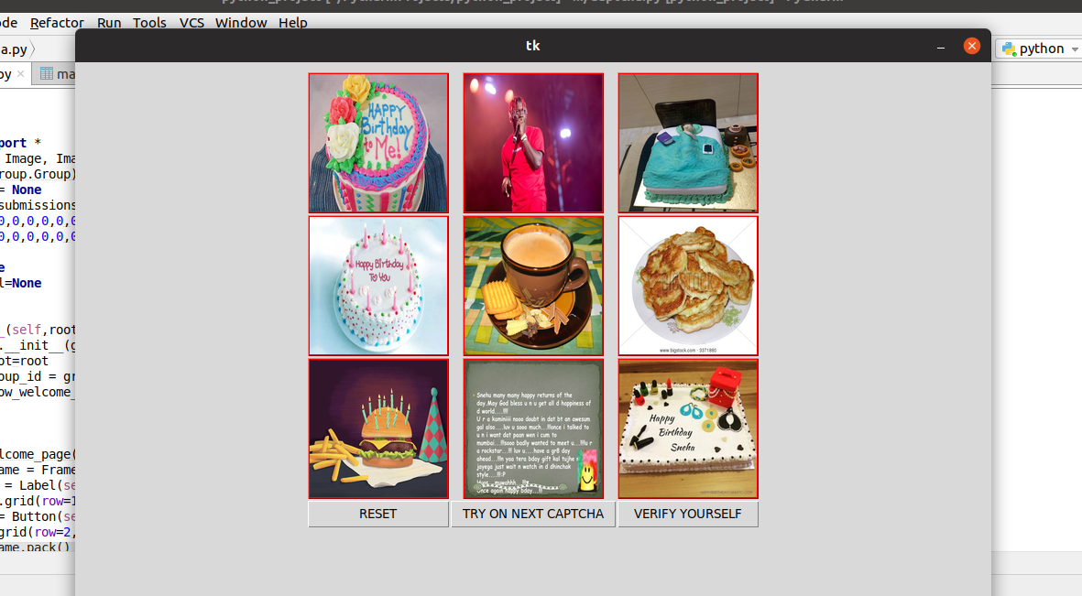
CAPTCHA WINDOW[GUI]

Slide 6
Coding
Python – To write the code
SQLITE3 – To handle the database for the project
import sqlite3
We make use of classes in our coding part so that we have to write less code.
Also we uses the inheritance of the classes for reusing the code again and easy access to the require data.

Slide 7
Classes
Image class
for a single image and its attributes
Group class
It will consist of its attributes and 9 images
Captcha class
It inherited by Group class and the use of the captcha is displaying, user response and validation of response.

Slide 8
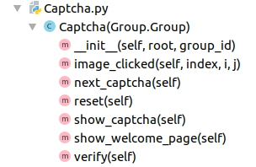
Captcha class

Slide 9
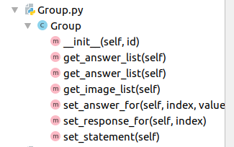
Group class

Slide 10
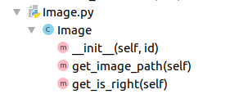

Slide 11
FILES
Main.py
Captcha.py
Group.py
Image.py
Database.db

Slide 12

Features
RESET
User can reset what ever he/she selected
NEXT CAPTCHA
if the cpatcha is more complex then user has a choice to skip that cpatcha
VERIFY
this is a button to verify the image selection

Slide 13
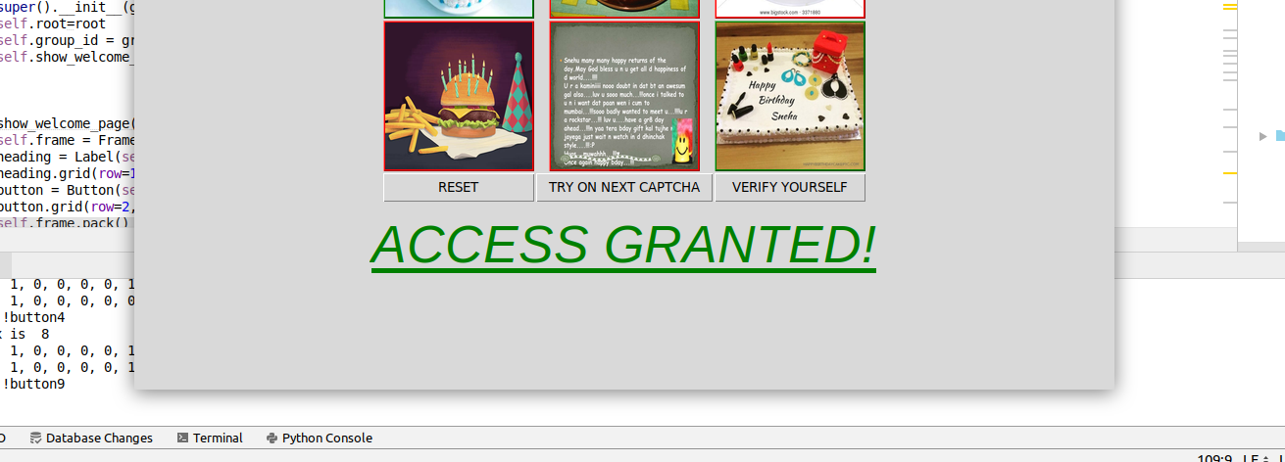
After a successful response, this page will open.
Thanks<3

