Slide 1
Initiating Background Check Sooner to Improve Hiring Funnel
Problem Statement
Applicants are dropping out in the shopper hiring funnel and the hiring department wants to know if initiating background checks earlier would improve conversion rates.
Solution Summary
We’ve completed A/B testing and found significant evidence supporting earlier initiation of background checks:
Conversion Rates increased by 60% (0.27 to 0.43).
The time taken to move applicants through the hiring funnel decreased by 30% (from 10 days to 7 days)
Notes:
Need to clarify what we can conclude about his a/b test.
How confident should we be?

Slide 2
Assessing the Cost-Effectiveness of Proposed Change to Hiring Funnel
Is the Change Cost Effective?
We believe this is a highly viable option and well worth the cost even under scenario 3 below ($100/background-check).
Let’s assume we have 100 Applicants and also that the lifetime value of a shopper is conservative at $500
We are already paying for 85% of background checks under current methods ($2,568 per 100 applicants at $30 each)
To get the other 15% would only cost ~$430 more under scenario 1 AND ~$1400 more under scenario 3.
Return on Investment + Key Takeaway(s)
By the organization investing 17% in dollars to get that other 15% we in turn get:
Applicants to keep momentum through hiring funnel.
The 60% increase in Conversion. In this case, 43 new shoppers instead of 27 under current baseline.
At a LV of $500 that equates to: 500*43 = $21,500 AND is well above even Scenario 3 below.

Slide 3
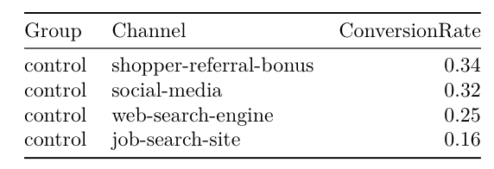
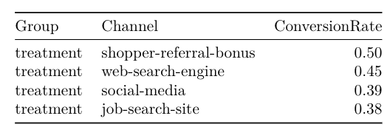
Other Observation and Recommendations
Final Recommendations
Update changes in hiring funnel and implement monitoring of conversion and retention moving forward (build dashboard).
Other Observations and Recommendations
Clear indication that other drivers are at play for conversion rates (tables below).
Recommend further investigation and measuring of the drivers impacting the shopper hiring funnel.
Think of new ideas and begin development of next AB Test
Next Actions
Schedule time with stakeholders to design dashboard (Shiny Web-App) for monitoring conversion/retention.
Complete thorough statistical analysis to understand other drivers at play in conversion of applicants.
Conversion Rates by Group and by Channel

