Slide 1
Project Benson
Team 5: Dexter, Keerthi, Nikhil, Andrew

Slide 2
Goal:
Find the best times and locations to place teams at subway stations to collect email addresses of potential contributors and attendees to the summer gala.

Slide 3
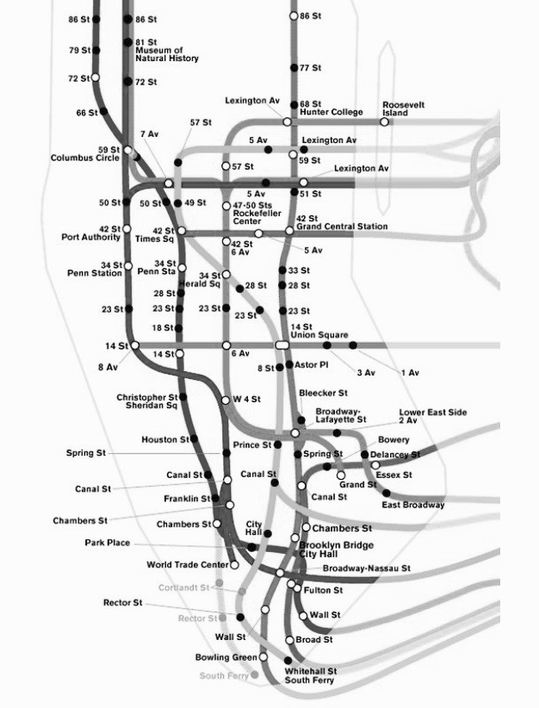
Recommendation
Based on our analysis, we recommend you place street teams at the following stations on weekdays between 4PM and 9PM.
14 St. Union Square
23 St.
28 St.
Wall St.
Fulton St.
Spring St.

Slide 4
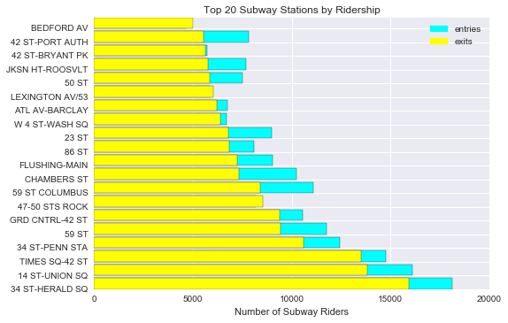
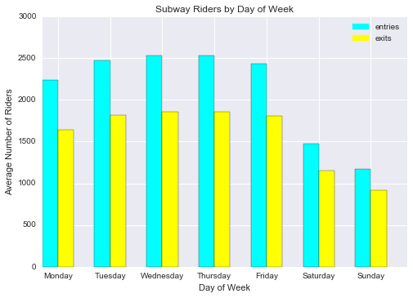
Insights
Station Traffic
Daily Traffic

Slide 5
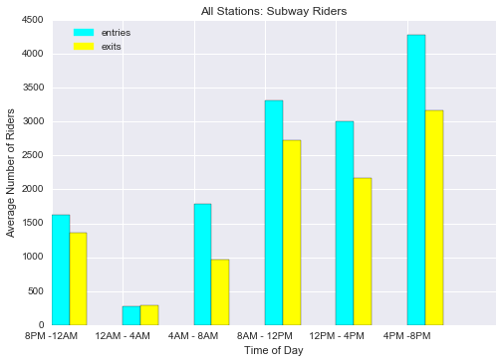
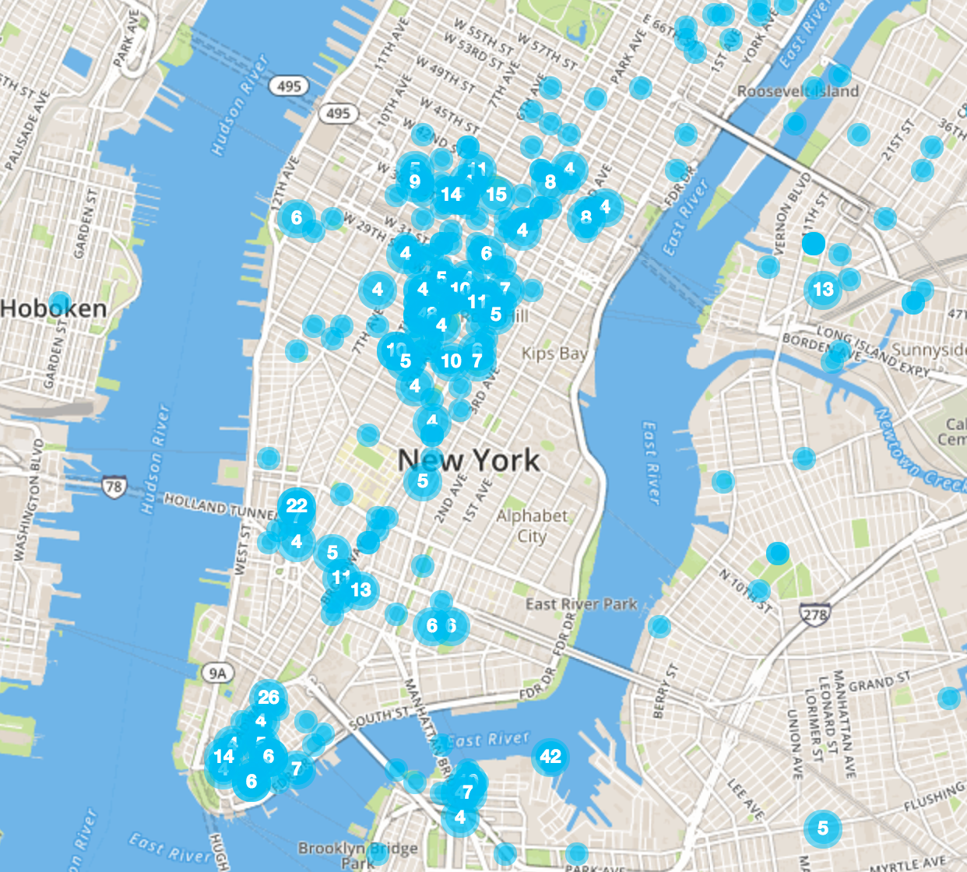
Insights (cont.)
Hourly Traffic
Tech Clusters

Slide 6
Tech Clusters
Cluster A:
28 St
23 St
14 St Union Square
A
Cluster B:
Spring St
B
Cluster C:
Fulton St
Wall St
C

Slide 7
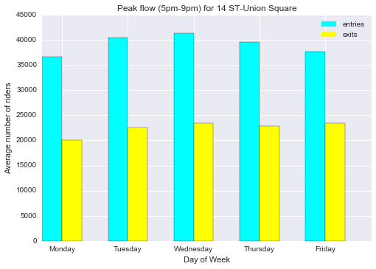
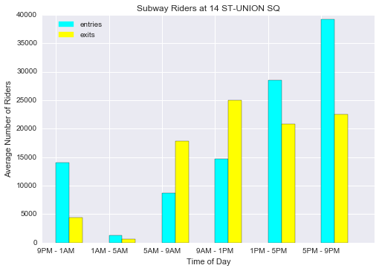
14 St. Union Square
Daily Traffic
Hourly Traffic

Slide 8
Conclusions
Time matters: ridership varies significantly by time of day
Location matters: a minority of stations account for the majority of traffic
Quality matters: target traffic around technology clusters

