Slide 1
A complete digital marketing solution for a visible increase in online sale of DPD journals and Employment News issues through various available/new online sale channels (like website, apps , amazon, social media) by optimising various available or new digital marketing tools like email marketing, SEO.
CSE7101- Capstone Project
Review-2
Batch Number : CSE-242
Under the Supervision of,
Dr. ChandraSekhar M
Professor
School of Computer Science and Engineering
Presidency University
Roll Number | Student Name
20221CSE0268 | PIRUTHVIRAJ S
20221CSE0270 | RAFAEL V
20221CSE0260 | REVANTH ADITHYA V
Name of the Program : Computer Science and Engineering
Name of the HoD : Dr. Asif Mohammed
Name of the Program Project Coordinator : Dr. Jayavadivel Ravi
Name of the School Project Coordinators : Dr. Sampath A K , Dr. Geetha A

Slide 2
Problem Statement Number
Organization : Ministry of Information and Broadcasting
Category (Hardware / Software / Both) : Software
Problem Description : A powerful, all-in-one digital marketing solution to drive visible growth in online sales through our website, mobile app, Amazon, and social media. Using smart SEO, engaging email campaigns, and targeted online ads, we ensure will be able to your publications reach the right audience at the right time—turning visibility into sales.

Slide 3
Content
Abstract
Literature Survey
Objectives
Existing Methods and Drawbacks
Proposed Method and Feasibility Study
Architecture Diagram
Modules
Hardware and Software Details
Timeline (GANTT CHART)
References

Slide 4
Abstract
This study proposes a complete digital marketing solution aimed at enhancing the online sales of DPD journals and Employment News issues through multi-channel strategies. The approach integrates website and mobile app optimization, marketplace presence (Amazon, Flipkart), and the use of advanced digital marketing tools such as SEO, email marketing, social media campaigns, influencer tie-ups, and paid advertisements. By leveraging targeted communication and personalized engagement, the solution focuses on reaching students, job seekers, and career aspirants while ensuring a seamless subscription experience. Performance tracking through analytics tools ensures continuous improvement and measurable growth. The expected outcome is a visible increase in subscriptions, improved brand reach, and long-term audience retention.

Slide 5
Literature Survey
[1] M. Cioppi et al., “Digital transformation and marketing: a systematic and thematic literature review,” 2023 - Reviews literature on how digital technologies reshape marketing strategies, identifying themes like customer engagement, analytics, and organizational change.
[2] U. F. Ahmad et al., “SEO strategy as determinants for online brand positioning,” 2024 - Explores SEO as a determinant of brand positioning and visibility; shows how keyword and ranking strategies impact perception.
[3] J. Wang, “Impact of social media influencers’ relatability on purchase intention,” 2025 - Empirical study showing that influencer relatability (trust, authenticity) significantly affects consumer purchase decisions.
[4] T. T. S. Tran and N. T. T. Le, “Digital marketing in community-based enterprises: A systematic review,” 2024 - Reviews digital marketing adoption in small/community enterprises, highlighting benefits and challenges.

Slide 6
Literature Survey
[5] R. A. Khan and S. Verma, “Systematic review on SEO and digital marketing strategies for SMEs,” 2024 - Summarizes SEO and digital tactics that improve SME competitiveness, focusing on customer reach.
[6] T. Yogananda, “Influence of email marketing on customer loyalty in Indian e-commerce,” 2024 - Case study on Indian e-commerce showing how targeted email marketing boosts customer loyalty and repeat purchases.
[7] S. Sharma and P. Gupta, “Effectiveness of push notifications on user conversion and retention,” 2023 - Analyzes user behavior with push notifications; shows positive effects on conversion/retention if used moderately.
[8] Airship, “How push notifications impact mobile app retention rates,” 2019 - Industry report analyzing millions of app users, showing retention improvements with personalized push notifications.

Slide 7
Literature Survey
[9] A. Erdmann and M. Ponzo, “SEO: The long-term strategy of organic keywords,” 2022 - Demonstrates SEO’s compounding benefits through long-term organic keyword strategies.
[10] G. A. Athaide and S. Moorman, “Marketing innovations and digital technologies,” 2025 - Conceptual review linking digital innovations with marketing practices, proposing future research agenda.

Slide 8
Objectives
Increase Online Sales : Achieve a 30% growth in subscriptions for DPD journals and Employment News within the next 6 months through website, app, and marketplace channels.
Boost Digital Visibility : Improve search engine ranking for at least 10 target keywords (e.g., Employment News online, government job updates) to appear on the first page of Google within 4 months.
Expand Social Media Reach : Grow combined social media followers by 40% and achieve an average engagement rate of 5% on posts within 6 months.
Enhance Customer Engagement : Attain a 20% open rate and 5% click-through rate for targeted email campaigns within the first 3 months.
Strengthen Retention & Renewals : Increase subscription renewal rate by 15% through push notifications, remarketing, and loyalty offers within 1 year.
Optimize Conversion Funnel : Improve website/app conversion rate by 25% by enhancing user experience, reducing cart abandonment, and streamlining checkout in 6 months.

Slide 9
Existing Methods & Drawbacks
Existing Methods:
Traditional Print & Offline Sales:
1. Distribution through bookstores, newsstands, and government outlets.
2. Limited subscription-based models.
Basic Websites & Portals :
1. Static websites offering PDF downloads or online subscription forms.
2. Minimal focus on user experience (slow, outdated designs).
Email & SMS Alerts :
1. One-way communication with subscribers (new issue notifications).
2. No personalization or automation.
Social Media Announcements :
1. Simple posting of updates on platforms like Facebook/Twitter.
2. Low engagement due to lack of targeted campaigns or interactive content.
Third-Party Marketplaces (Amazon/Flipkart) :
1. Listings exist but with low visibility due to poor SEO and no paid promotion.
2. Limited digital subscription integration.

Slide 10
Existing Methods & Drawbacks
Drawbacks and Limitations:
Limited Reach – Reliance on offline sales and basic online presence restricts visibility among digital-first audiences.
Poor User Experience – Outdated websites/apps with complex navigation discourage younger users.
Low Engagement – One-way email/SMS and generic social media posts fail to retain or excite subscribers.
Lack of Targeted Marketing – No proper use of SEO, paid ads, or segmentation to reach competitive exam aspirants/job seekers effectively.
Weak Analytics & Tracking – Minimal use of tools to measure campaign success, customer behavior, or subscription funnel drop-offs.
Subscription Retention Issues – Existing methods focus on acquisition, not renewals or long-term engagement.

Slide 11
Proposed Method & Feasibility Study
Proposed Method:
A digital marketing framework to boost online sales of DPD journals and Employment News through website/app optimization, SEO, email automation, social media, influencer tie-ups, and marketplace integration.
Feasibility Solution:
Technical: Easily implementable with existing tools and platforms.
Financial: Moderate investment, high ROI via subscriptions.
Operational: Can be managed by a small team with automation.
Market: Strong demand among students/job seekers ensures success.

Slide 12
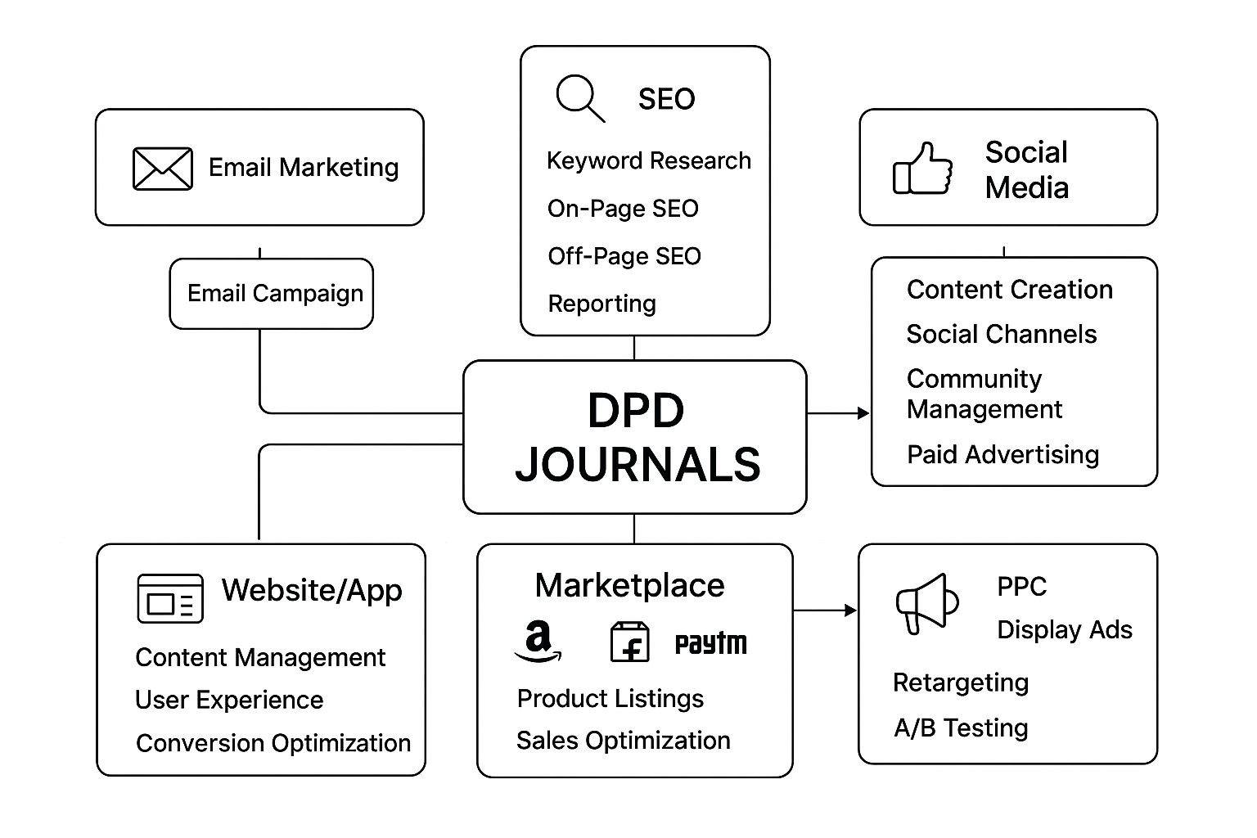
Architectural Diagram

Slide 13
Modules
Website & App Module
SEO & Content Module
Email & Notification Module
Social Media & Engagement Module
Marketplace Integraton Module
Analytics & Tracking Module

Slide 14
Hardware & Software Details
Hardware:
Servers/Laptop
Mobiles
Software:
Web : HTML5, CSS3, JavaScript, React/Angular
Backend : Node.js / PHP / Python Django
Database :MySQL / MongoDB
SEO : Google Search Console
Email Marketing : Mailchimp
Social Media : Meta Ads Manager
Designing : Canva / CapCut
Hosting : AWS EC2
Payment : Razorpay

Slide 15
Github Link
The Github link provided should have public access permission.
Github Link :
https://github.com/revadithya/dpdjourns.git

Slide 16
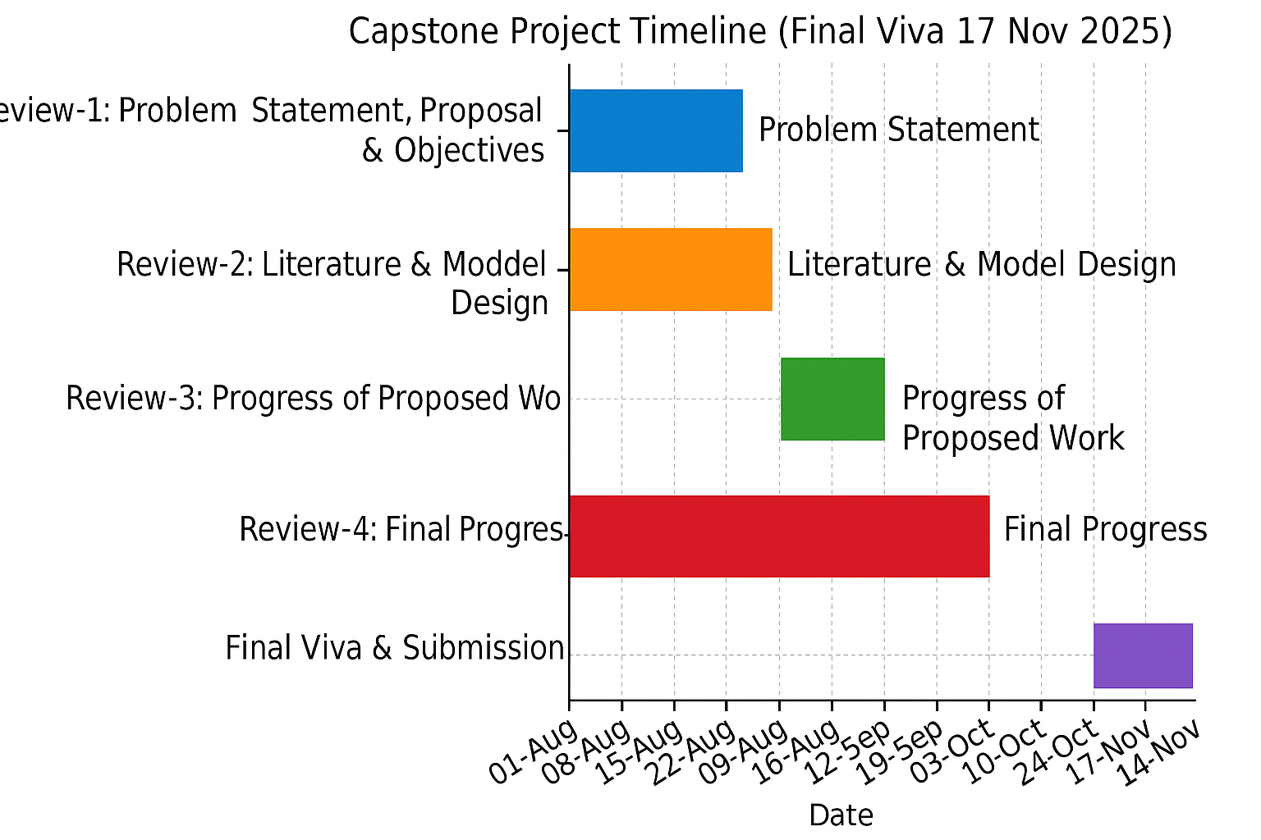
Timeline of the Project (Gantt Chart)

Slide 17
References (IEEE Paper format)
  [1] D. Petrov[SEO], “Evolving SEO for 2025: What needs to change,” Search Engine Land, Jan. 17, 2025. https://searchengineland.com/evolving-seo-for-2025-what-needs-to-change-450911
  [2]. Semrush, “Data-Driven Marketing Tools to Grow Your Business,” Semrush.com.
  https://www.semrush.com
  [3]. TechTarget, “Google Analytics,” SearchBusinessAnalytics.
  https://www.techtarget.com/searchbusinessanalytics/definition/Google-Analytics
  [4]. Mailchimp, “Marketing, Automation & Email Platform,” Mailchimp.com.
  https://mailchimp.com
  [5]. ChatGPT
  [6]. Canva
  [7]. Ministry of Information and Broadcasting, “Directorate of Publication Division (DPD),” mib.gov.in. https://mib.gov.in/ministry/organizations/publication-division
  [8]. National Payments Corporation of India, “Enabling Digital Payments in India,” npci.org.in. https://www.npci.org.in

Slide 18


