Slide 1
A complete digital marketing solution for a visible increase in online sale of DPD journals and Employment News issues through various available/new online sale channels (like website, apps , amazon, social media) by optimising various available or new digital marketing tools like email marketing, SEO.
CSE7101- Capstone Project
Review-3
Batch Number : CSE-242
Under the Supervision of,
Dr. ChandraSekhar M
Professor
School of Computer Science and Engineering
Presidency University
Roll Number | Student Name
20221CSE0268 | PIRUTHVIRAJ S
20221CSE0270 | RAFAEL V
20221CSE0260 | REVANTH ADITHYA V
Name of the Program : Computer Science and Engineering
Name of the HoD : Dr. Asif Mohammed
Name of the Program Project Coordinator : Dr. Jayavadivel Ravi
Name of the School Project Coordinators : Dr. Sampath A K , Dr. Geetha A

Slide 2
Problem Statement Number
Organization : Ministry of Information and Broadcasting
Category (Hardware / Software / Both) : Software
Problem Description : A powerful, all-in-one digital marketing solution to drive visible growth in online sales through our website, mobile app, Amazon, and social media. Using smart SEO, engaging email campaigns, and targeted online ads, we ensure will be able to your publications reach the right audience at the right time—turning visibility into sales.

Slide 3
Content
Chapter 1 : Introduction to DPD Journals – Brand Overview, Mission, and Products
Chapter 2 : Market Analysis – Stationery Market Trends and Online Competition
Chapter 3 : Target Audience – Students, Professionals, Artists, and Planners
Chapter 4 : SEO Strategy – Keyword Research, On-Page/Off-Page Optimization
Chapter 5 :Social Media Marketing – Instagram Campaigns, Influencer Reach
Chapter 6 : Email Marketing – Newsletters, Promotions, Customer Retention
Chapter 7 : E-commerce & Amazon Strategy – Optimizing Listings and Ads

Slide 4
Content
Chapter 8 : Content Marketing – Blogs, YouTube, Tutorials,
Customer Stories
Chapter 9 : Analytics & ROI – Using Data-Driven Insights
for Improvement
Chapter 10 : Conclusion & Future Roadmap – Scaling
Sales and Employment Growth

Slide 5
Chapter 1: Introduction to DPD Journals – Brand
Overview, Mission, and Products
DPD Journals is a leading provider of premium stationery and publishing products,
specializing in high-quality journals, diaries, planners, and employment-related
publications. With a legacy of trust and reliability, the brand aims to empower individuals
in their academic, professional, and creative pursuits.
Mission:
To provide innovative, accessible, and user-friendly stationery and publishing solutions
that inspire productivity, creativity, and lifelong learning.
Products:
• Academic and professional journals
• Planners and organizers
• Employment News and career-oriented publications
• Custom stationery solutions

Slide 6
Chapter 2: Market Analysis – Stationery Market Trends and Online Competition
The global stationery market is witnessing steady growth, driven by the rising demand for
personalized, eco-friendly, and digitally integrated stationery. In India, the market has
shifted significantly toward online channels, with customers preferring e-commerce
platforms for convenience.
Key Trends:
• Increased adoption of eco-friendly paper and sustainable products.
• Growing interest in aesthetic stationery among students and young professionals.
• Integration of stationery with productivity tools and digital solutions.
Competition:
• Online platforms like Amazon, Flipkart, and niche stationery e-shops dominate
sales.
• Competitors include Classmate, Navneet, and international brands like Moleskine.
• Social media-driven stationery startups are gaining popularity among Gen Z.

Slide 7
Chapter 3: Target Audience – Students, Professionals, Artists, and Planners
• Students: Journals and planners for note-taking, exam prep, and self-organization.
• Professionals: Employment News, career-oriented journals, and productivity
planners.
• Artists: Sketch-friendly journals and customizable stationery.
• Planners/Organizers: Daily, weekly, and monthly planners designed for goal_x0002_setting and task management.
The target audience values affordability, quality, and ease of availability through online
channels.

Slide 8
Chapter 4: SEO Strategy – Keyword Research, On_x0002_Page/Off-Page Optimization
Keyword Research: Focus on long-tail keywords like “best academic journals India,”
“career planners online,” “buy employment news digital,” and “stationery for students.”
On-Page SEO:
• Optimize product titles, descriptions, and meta tags.
• Create blogs on productivity, career tips, and study hacks.
• Improve site speed and mobile responsiveness.
Off-Page SEO:
• Backlink building through collaborations with education portals and career
websites.
• Guest posts on productivity and career growth blogs.
• Directory listings on stationery and e-commerce aggregators.

Slide 9
Chapter 5: Social Media Marketing – Instagram
Campaigns, Influencer Reach
Instagram Campaigns:
• Launch hashtag campaigns like #PlanWithDPD or #JournalYourSuccess.
• Showcase user-generated content (UGC) of planners and journals in daily use.
• Post reels on productivity hacks and stationery unboxing.
Influencer Reach:
• Partner with micro-influencers in education, lifestyle, and productivity niches.
• Collaborations with YouTubers and Instagram educators for review videos.
• Seasonal campaigns during exam season, job fairs, and New Year resolutions.

Slide 10
Chapter 6: Email Marketing – Newsletters, Promotions,Customer Retention
• Newsletters: Regular updates on new product launches, educational insights, and
productivity tips.
• Promotions: Exclusive discounts, bundle offers, and festive sales sent directly to
subscribers.
• Customer Retention: Personalized email flows for abandoned carts, re_x0002_engagement campaigns, and loyalty rewards for frequent buyers.
Email marketing ensures a consistent relationship with the audience, driving repeat
purchases and long-term engagement.

Slide 11
Chapter 7: E-commerce & Amazon Strategy – Optimizing Listings and Ads
Amazon Storefront Optimization:
• Create detailed product listings with keyword-rich titles, bullet points, and
descriptions.
• Use high-quality images and infographics highlighting features like durability, eco_x0002_friendliness, or career benefits.
• Leverage A+ content (enhanced brand content) for storytelling and product
comparisons.
Amazon Ads & Promotions:
• Run Sponsored Products Ads to boost visibility in relevant stationery and career_x0002_related searches.
• Target competitor keywords and related categories to capture audience attention.
• Use Lightning Deals and seasonal offers (exam seasons, New Year, Independence
Day, Diwali) to drive sales.
Other E-commerce Platforms:
• Expand presence on Flipkart, Snapdeal, and niche stationery e-shops.
• Offer subscription models for journals and Employment News to ensure repeat
sales.

Slide 12
Chapter 8: Content Marketing – Blogs, YouTube, Tutorials, Customer Stories
Blogs & Articles:
• Topics like “Top 5 Planners for Students in 2025,” “How to Journal for Success,”
“Best Career Planning Tips.”
• SEO-optimized content to drive organic traffic and build brand authority.
YouTube Tutorials:
• Short videos demonstrating how to use planners for productivity.
• Career guidance content tied to Employment News.
• Collaborations with educators and productivity coaches.
Customer Stories:
• Share testimonials and success stories of students cracking exams, professionals
advancing careers, or artists showcasing their creativity with DPD Journals.
• Use blog features and video shorts for authenticity

Slide 13
Chapter 9: Analytics & ROI – Using Data-Driven Insights for Improvement
Key Metrics to Track:
• Website traffic, bounce rate, and conversion rates.
• Amazon and e-commerce sales volume, ad performance, and CTR.
• Social media engagement (likes, comments, shares, UGC participation).
• Email open rates, CTR, and subscription growth.
ROI Improvement Strategies:
• A/B testing product page designs, ad creatives, and email subject lines.
• Use analytics dashboards (Google Analytics, Amazon Seller Central, Meta Ads
Manager).
• Retargeting campaigns for customers who visited but didn’t purchase.
• Continuous refinement of keywords and campaign spending.

Slide 14
Chapter 10: Conclusion & Future Roadmap – Scaling
Sales and Employment Growth
Conclusion:
DPD Journals has the potential to become a leading digital-first stationery and publishing
brand by combining strong online presence, targeted marketing strategies, and customer_x0002_centric innovation.
Future Roadmap:
• Short-term (1 month): Boost Amazon sales, expand Instagram influencer
collaborations, and build SEO-driven content hubs.
• Medium-term (4 months): Launch mobile app for direct purchases, implement
subscription-based models for Employment News, and scale YouTube presence.
• Long-term (8 months): Expand internationally, partner with global stationery
marketplaces, and become a recognized productivity brand for students,
professionals, and creatives.
The ultimate goal is not only to scale product sales but also to empower employment and
productivity growth, aligning with DPD’s mission.

Slide 15
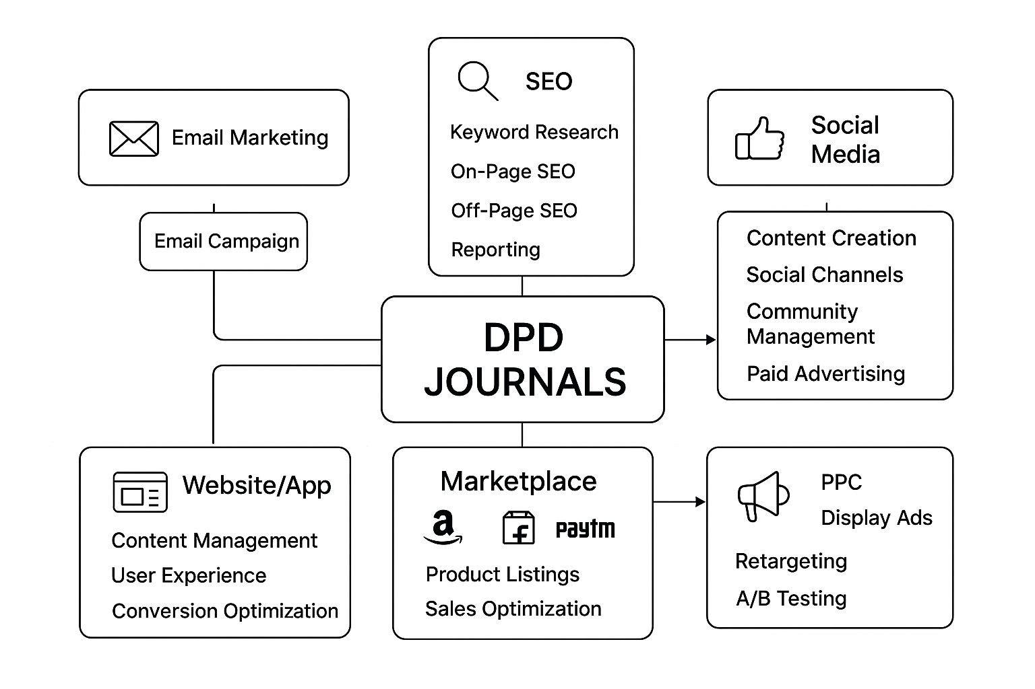
Architectural Diagram

Slide 16
Modules
Website & App Module
SEO & Content Module
Email & Notification Module
Social Media & Engagement Module
Marketplace Integraton Module
Analytics & Tracking Module

Slide 17
Hardware & Software Details
Hardware:
Servers/Laptop
Mobiles
Software:
Web : HTML5, CSS3, JavaScript, React/Angular
Backend : Node.js / PHP / Python Django
Database :MySQL / MongoDB
SEO : Google Search Console
Email Marketing : Mailchimp
Social Media : Meta Ads Manager
Designing : Canva / CapCut
Hosting : AWS EC2
Payment : Razorpay

Slide 18
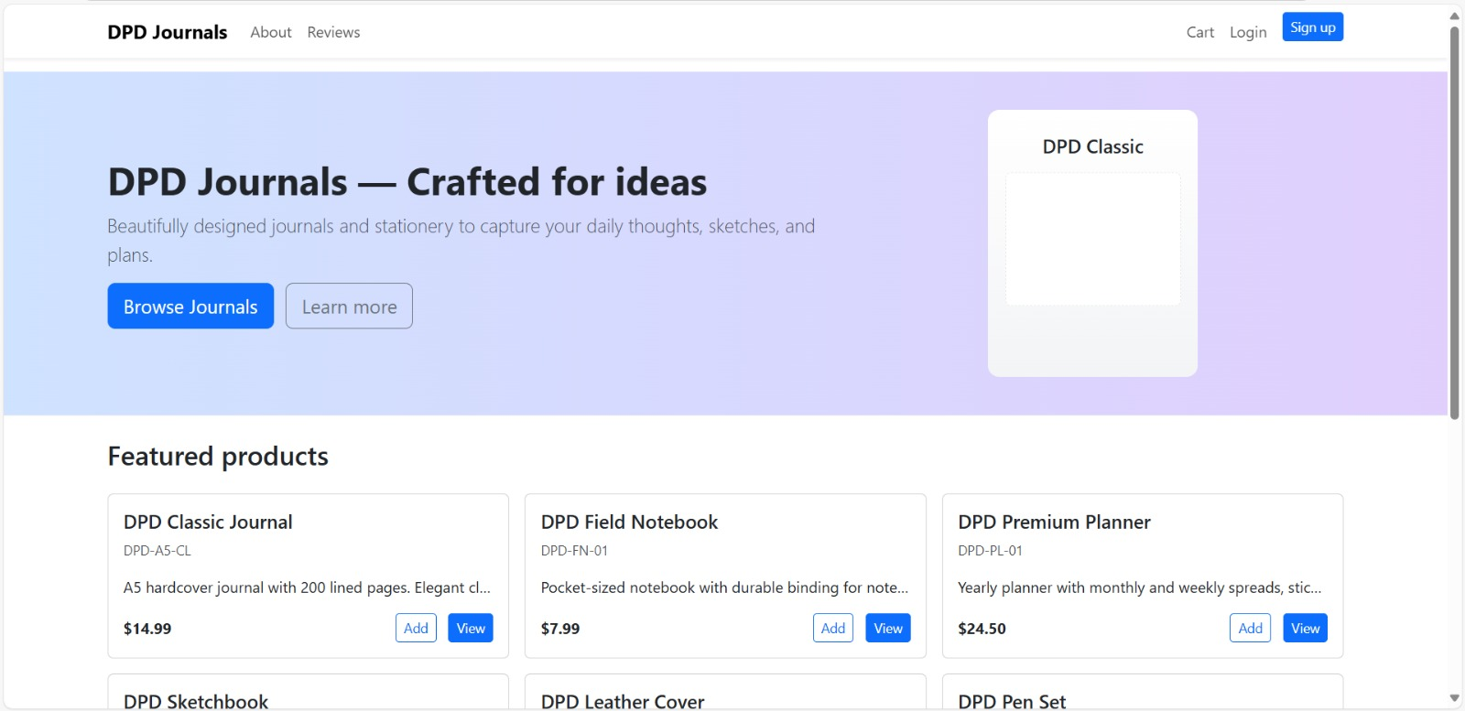
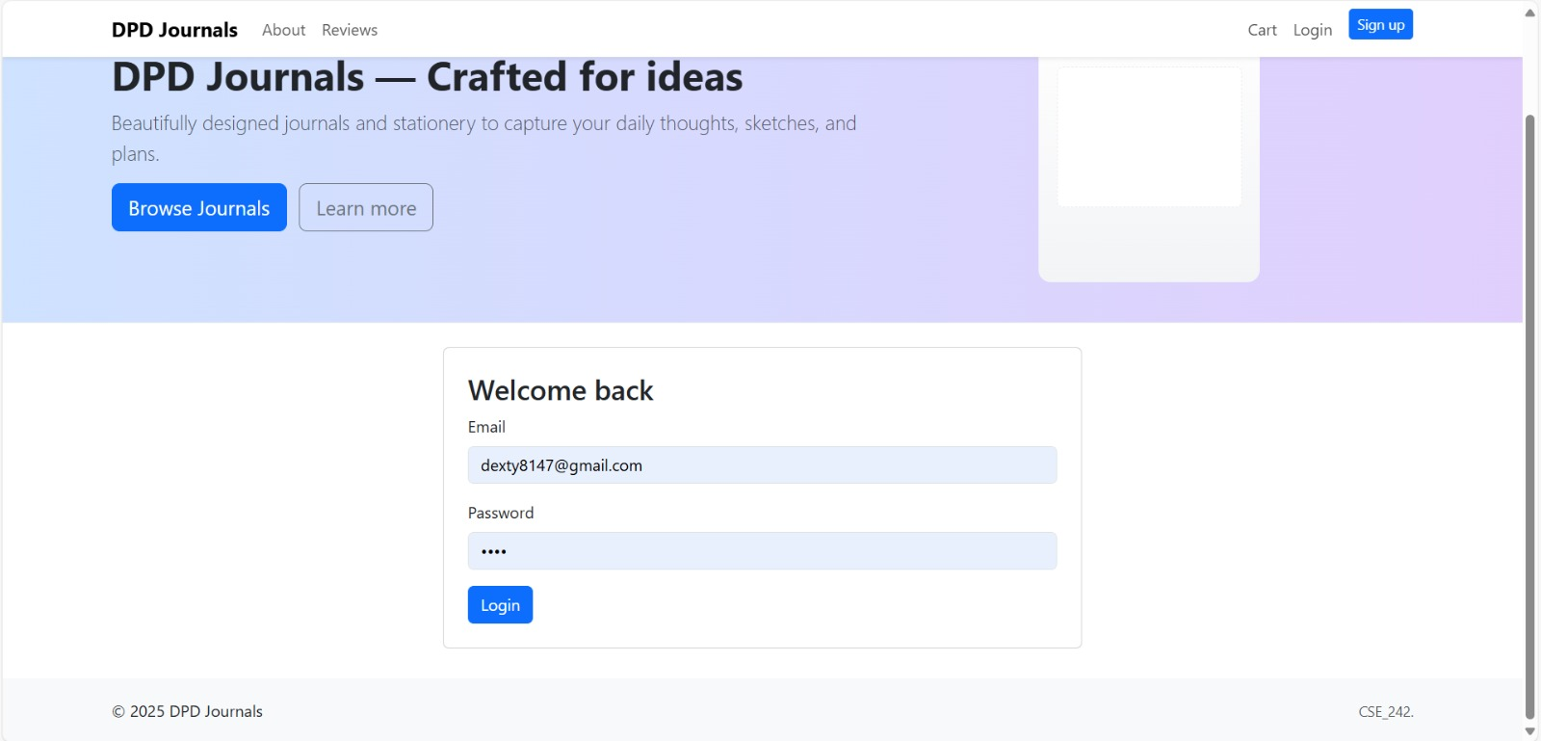
Github Link
The Github link provided should have public access permission.
Github Link :
https://github.com/revadithya/DPDJourn.git
Output:

Slide 19
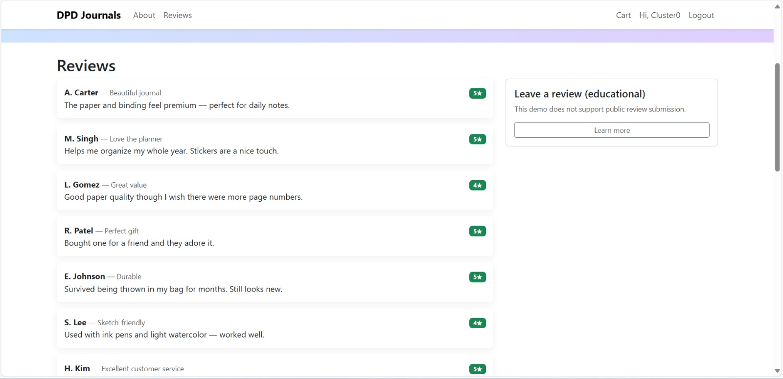
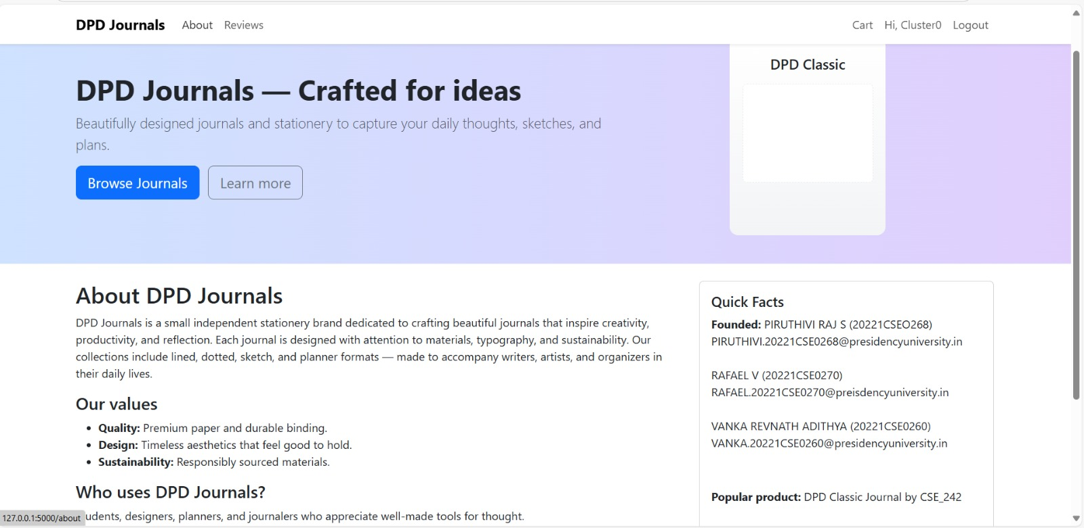
Output :

Slide 20
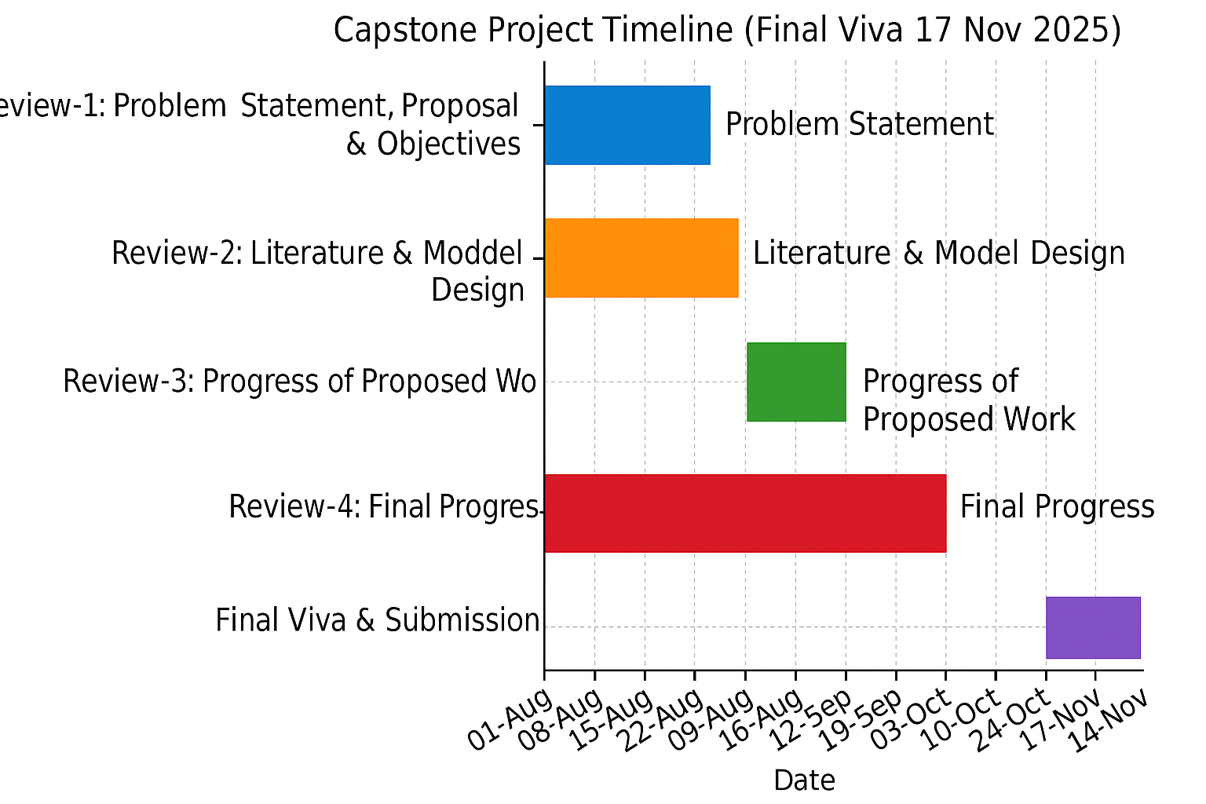
Timeline of the Project (Gantt Chart)

Slide 21
References (IEEE Paper format)
  [1] D. Petrov[SEO], “Evolving SEO for 2025: What needs to change,” Search Engine Land, Jan. 17, 2025. https://searchengineland.com/evolving-seo-for-2025-what-needs-to-change-450911
  [2]. Semrush, “Data-Driven Marketing Tools to Grow Your Business,” Semrush.com.
  https://www.semrush.com
  [3]. TechTarget, “Google Analytics,” SearchBusinessAnalytics.
  https://www.techtarget.com/searchbusinessanalytics/definition/Google-Analytics
  [4]. Mailchimp, “Marketing, Automation & Email Platform,” Mailchimp.com.
  https://mailchimp.com
  [5]. ChatGPT
  [6]. Canva
  [7]. Ministry of Information and Broadcasting, “Directorate of Publication Division (DPD),” mib.gov.in. https://mib.gov.in/ministry/organizations/publication-division
  [8]. National Payments Corporation of India, “Enabling Digital Payments in India,” npci.org.in. https://www.npci.org.in

Slide 22


