Slide 1
Insulin Resistance Prediction from Wearables and Routine Blood Biomarkers
Using Multimodal Artificial Intelligence for Early
Detection of Type 2 Diabetes
Based on the WEAR-ME
Clinical Study
Presented by: Marwa Alrafayia , Doha Aldababseh, Qabas Arbiat

Slide 2
Clinical Background
The Pathological Precursor: IR is the primary driver of Type 2 Diabetes (T2D), developing silently years before clinical diagnosis or changes in HbA1c.
Systemic Complications: Chronic IR is strongly linked to Prediabetes, Cardiovascular Disease (CVD), and Metabolic Dysfunction-Associated Steatotic Liver Disease (MASLD).
Clinical Window of Opportunity: Early detection enables targeted lifestyle interventions (diet, exercise) that can fully reverse metabolic decline before permanent pancreatic beta-cell damage occurs.

Slide 3
Limitations of Current Diagnostic Methods
The Clinical Dilemma: Standard diagnostics require invasive, episodic laboratory infrastructure, making population-wide screening non-scalable.
Existing Clinical Standards:
Hyperinsulinemic-Euglycemic Clamp: The absolute Gold Standard; highly invasive, complex, and restricted to research settings.
Oral Glucose Tolerance Test (OGTT): Time-consuming (2+ hours) and requires multiple blood draws.
HOMA-IR (Homeostatic Model Assessment): Requires fasting blood samples, capturing only a single static snapshot in time.
The Missing Link: Current clinical pathways fail to capture continuous, real-world physiological and behavioral dynamics.

Slide 4
Scalable Multimodal AI Framework
Primary Aim: To develop and validate a scalable, non-invasive multimodal framework that predicts insulin resistance by blending passive continuous data with static clinical metrics.
Core Inputs:
1. Continuous time-series data from consumer-grade wearables.
2. Routine, low-cost blood biomarkers.
3. Standard demographic information.
Innovation: Shifting metabolic health assessment from reactive, episodic lab visits to proactive, continuous, real-world screening.

Slide 5
WEAR-ME Study Design & Dataset
Conducted via a large-scale decentralized remote infrastructure using the Google Health Studies application.
The Discovery Cohort (n = 1,165):
Demographics: Median Age = 45 years | Median BMI = 28 kg/m² (Overweight spectrum) | Median HbA1c = 5.4% (Normal spectrum).
Note for the Panel: The normal median HbA1c highlights that many IR participants would go completely unnoticed using standard glycemic screening alone.
Data Collection Protocol: Continuous 24/7 passive data collection for up to 3 months using Fitbit and Google Pixel Watch devices, paired with standardized lab blood testing via Quest Diagnostics.

Slide 6
Ground Truth & Inclusion Criteria
Mathematical Definition: Insulin resistance was quantified using the standard HOMA-IR formula:
Classification Cut-offs:
HOMA-IR < 1.5 → Insulin Sensitive (IS)
1.5 ≤ HOMA-IR ≤ 2.9 → Impaired Insulin Sensitivity
HOMA-IR > 2.9 → Insulin Resistant (IR)
Inclusion Rigor: US residents aged 21–80, owning a compatible Android device paired with a continuous heart-rate tracking wearable, with confirmed compliance on fasting blood draws.

Slide 7
Wearable Feature Space (Passive Physiological & Behavioral Signals)
1. Autonomic Nervous System (ANS) Indicators
Continuous Resting Heart Rate (RHR): Monitors baseline cardiac activity.
Heart Rate Variability (HRV): Captures autonomic nervous system stress and recovery responses.

Slide 8
2. Physical Activity Metrics
Daily Step Counts: Tracks total daily movement.
Movement Intensity: Classifies activity levels into light, moderate, or vigorous.
Sedentary Bouts: Measures periods of prolonged inactivity.

Slide 9
3. Sleep Architecture
Duration: Total hours of sleep per night.
Sleep Stages: Tracks light, deep, and REM sleep cycles.
Sleep Fragmentation: Monitors disturbances and waking episodes during sleep.

Slide 10
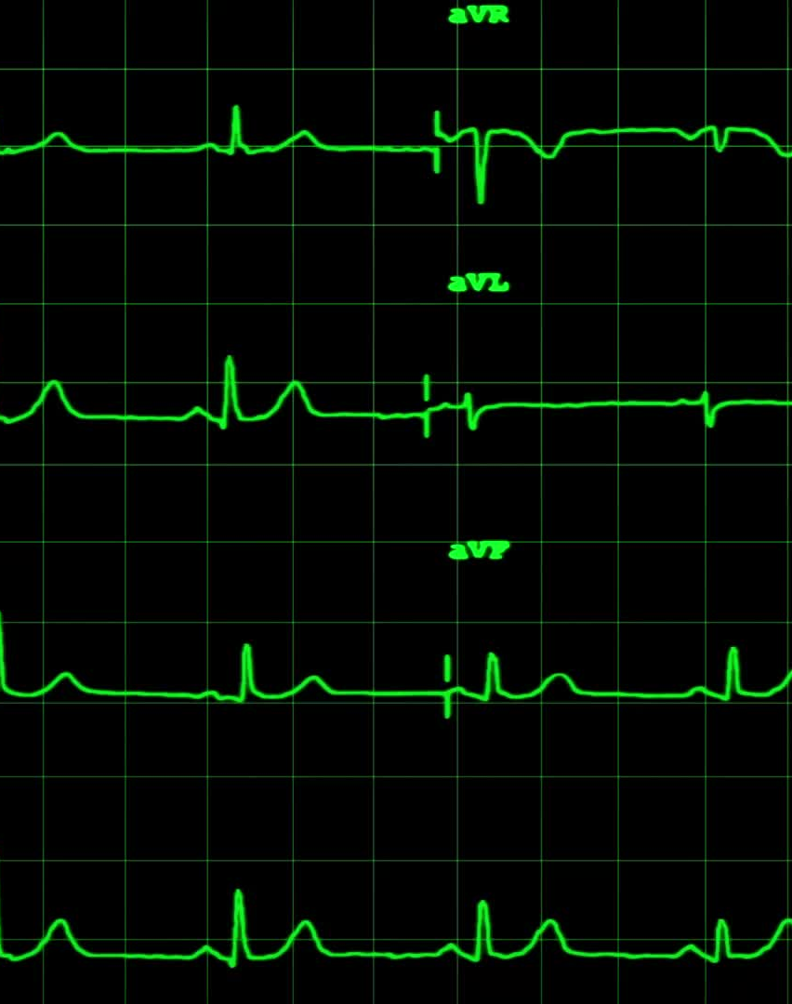
4. Circadian Dynamics
24-Hour Temporal Patterns: Analyzes the natural daily rhythm of physical activity and physiological changes over a 24-hour cycle.

Slide 11
Rationale: These signals reflect subtle, chronic autonomic disruptions caused by underlying metabolic dysfunction long before glucose levels spike.

Slide 12
Multimodal AI Pipeline & Architecture
Deep Representation Learning Framework
Phase 1: Time-Series Preprocessing
Processes millions of hours of high-frequency raw sensor data.
Cleans the data through artifact removal and aligns it daily for consistency.

Slide 13
Phase 2: Wearable Foundation Model (WFM)
A deep neural network pre-trained on >40 million hours of diverse sensor data.
Extracts high-dimensional physiological embeddings (capturing complex body signals).

Slide 14
Phase 3: Dimensionality Reduction (PCA)
Uses Principal Component Analysis (PCA) to compress sparse, high-dimensional WFM embeddings.
Transforms raw embeddings into robust, dense, and manageable feature vectors.

Slide 15
Phase 4: Multimodal Late Fusion
Integrates Static Features (Demographics + Blood Biomarkers) with Dynamic Features (WFM Wearable Embeddings).
Feeds the combined data into a gradient-boosted ensemble model to predict continuous HOMA-IR values and perform classification.

Slide 16
Key Feature Associations
Physiological & Biomarker Correlations with Insulin Resistance (IR)
Laboratory & Anthropometric Biomarkers
Positive Correlation Fasting Glucose, BMI, Triglycerides, HbA1c (Higher levels align with severe Insulin Resistance).
Negative Correlation HDL Cholesterol (Good cholesterol drops as IR worsens).

Slide 17
Wearable Physiological Signals
Positive Correlation: Continuous Resting Heart Rate (RHR) increases with metabolic stress.
Negative Correlation: Daily Step Count and Heart Rate Variability (HRV) decrease, indicating lower physical activity and autonomic dysfunction.

Slide 18
Critical Interpretation
Wearable physiological biomarkers mirror traditional lab results. This proves that machine learning can successfully capture metabolic degradation using entirely non-invasive sensors.

Slide 19
Primary Model Performance
Discovery Cohort Results & Explainable AI
Classification Performance
AUROC: 0.80 (High discriminative power for Insulin Resistance).
Sensitivity: 76% (Accurately identifying individuals with IR).
Specificity: 84% (Minimizing false positives).

Slide 20
Explainable AI (XAI) Insight
SHAP Analysis: Revealed a profound shift in how the model prioritizes data.
The Core Finding: In baseline models, the system favored static clinical lab data. However, introducing WFM embeddings boosted the model's feature reliance on wearable data from 43% to 82%.

Slide 21
Core Takeaway
The WFM (Wearable Foundation Model) successfully unlocks hidden, non-linear temporal patterns within wearable data that traditional statistical averages (like mean heart rate) completely miss.

Slide 22
Robustness & Independent Validation
Generalizability on Unseen Populations & Newer Wearables
Independent Cohort Validation
Tested on a completely independent, blind validation cohort (n = 82).
Utilized a newer generation device (Fitbit Charge 6) to ensure cross-device generalizability and rule out overfitting.

Slide 23
Performance Jump (Ablation Study Results)
Baseline Model (Demographics + Labs Only): AUROC = 0.78
Proposed Multimodal Framework (Labs + Demographics + WFM): AUROC = 0.87 ( Significant clinical improvement).

Slide 24
Clinical Screening Utility
Tuned at an operational threshold (HOMA-IR > 2.5):
  Sensitivity: 82%
  Specificity: 78%
The Verdict: Vastly outperforms traditional clinical screening proxies, such as using BMI alone.

Slide 25
Introduction to the WEAR-ME Framework
Leading the Future of Metabolic Health
• The Clinical Challenge: Insulin Resistance (IR) affects up to 40% of the population, yet diagnostics are highly invasive.
• The WEAR-ME Solution: A cutting-edge, multi-modal AI framework that leverages everyday consumer wearables to screen for early metabolic risk.
• Dual-Cohort Validation: Trained on a remote cohort of 1,165 participants and validated on an independent, in-person cohort of 72 participants.

Slide 26
Powering Predictions with Wearable Foundation Models (WFM)
Going Beyond Simple Step Counts
Advanced Feature Extraction: Traditional models rely on basic daily averages. WEAR-ME uses a Wearable Foundation Model (WFM).
Massive Pre-training: The WFM was trained on over 40 million hours of continuous sensor data from 1.4 million individuals.
Capturing Hidden Signals: Unlocks high-resolution physiological data, detecting subtle variations in HRV, circadian rhythms, and micro-patterns of activity.

Slide 27
Diagnostic Performance Boost (AUROC Breakthroughs)
Wearables as a Diagnostic Game-Changer
HOMA-IR Prediction: The primary objective was predicting insulin resistance based on a HOMA-IR threshold of 2.9.
Demographics Only: AUROC increased from 0.66 to 0.75 when adding WFM data.
Full Clinical Panel: AUROC jumped from 0.76 to a powerful 0.88 when enhanced by the WFM.
The Core Shift: Wearable data's feature importance skyrocketed from 43% to 82% under the WFM, proving its immense diagnostic value.

Slide 28
The IR Agent – LLM Integration for Patient Care
InsightsTranslating Data into Actionable
The ReAct Architecture: Integrates a Reasoning and Acting (ReAct) LLM Agent to bridge complex AI predictions and patient communication.
Powered by Gemini 2.0 Flash: Utilizes the open-source OneTwo library to seamlessly process multimodal inputs.
Clinical Capabilities: Interprets complex metabolic risk scores, answers follow-up health questions, and delivers personalized lifestyle recommendations.

Slide 29
Expert Clinical Validation & Safety
Built to Physician Standards
Blinded Evaluation: Five board-certified endocrinologists conducted rigorous evaluations comparing the IR Agent against baseline LLMs.
Expert Preferences (IR Agent vs. Baseline): Won 80% on Comprehensiveness, 92% on Trustworthiness, and 73.3% on Personalization.
Uncompromising Safety: Achieved a remarkable 96% clinical safety rating for safe, tailored metabolic health guidance.

Slide 30
This is Just the Beginning... ??
Moving from Project 1 to Project 2
Project 1 Goal Achieved: We fully analyzed and understood how this advanced AI model works.
The Blueprint is Ready: This isn't the final result; it is the strong foundation we built upon.
Next Stop -> Project 2: We are moving from 'understanding the model' to 'hands-on development and optimization.'
Stay Tuned... The exciting part is coming up next semester!

Slide 31
Thank you

