Slide 1
Executive summary

Slide 2
Sweet Spot Inc
CHALLENGE
Sweet Spot Inc seeks to improve employee retention and answer the following question:
What’s likely to make the employee leave the company?
RESPONSE
I have to know if the employee would leave or not and then know what factors contribute to their leaving.
Because the variable I want to predict is categorical, I will use both logistic regression and tree-based machine learning models.
The random forest model outperforms the decision tree model by a small margin.
IMPACT
These models assists in predicting whether an employee will depart and identifying the most influential factors. These insights can assist HR in making decisions that enhance employee retention.
RECOMMENDATIONS
To increase employee satisfaction:
limit the number of projects
promote long-tenured workers, and either reward or discourage longer work hours.
Inform employees of overtime pay policies and clarify workload and vacation expectations. To comprehend the work culture and address high evaluation scores, hold company-wide and team-based discussions. Consider a proportional scale for rewarding employees who make greater contributions and exert greater effort.

Slide 3
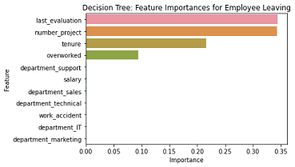
RECOMMENDATIONS
To increase employee satisfaction:
Limit the number of projects
Promote long-tenured workers, and either reward or discourage longer work hours.
Inform employees of overtime pay policies and clarify workload and vacation expectations.
To comprehend the work culture and address high evaluation scores, hold company-wide and team-based discussions.
Consider a proportional scale for rewarding employees who make greater contributions and exert greater effort.

Slide 4
