Slide 1
CS677 Final Project - All Pair Shortest Path
May.1.2019
By. Yiding Yang

Slide 2
1, APSP Revisited
-What's the problem and why is it important
Aiming to determinate the shortest distances between every pair of vertices in a directed graph
The result in the form of matrix called distance matrix
What we can do with the distance matrix:
Get the shortest path from every pair of vertices
Base problem for many other problems

Slide 3
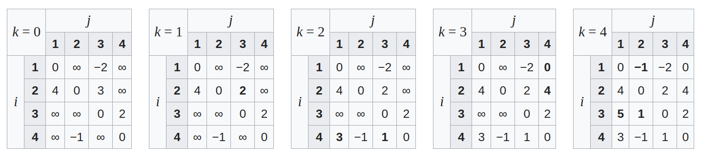
2, CPU implementation
Floyd-Warshall algorithm
an iteration algorithm over k(number of vertices)
relax the shortest distance for every pair of vertices by insert a new vertice
three for loops which runs in O(N^3) time
*picture from wikipedia

Slide 4
3, Why is GPU suitable for APSP
In place computation
potential low memory bandwidth
Almost 100% computing
An recursive algorithm which makes the compute for each pair of vertices independent
assign each pair of vertices to one thread without communication

Slide 5
4, Experiments setup
Graph generation
random graph generated by Erdos-Renyi model
average degree is 6.5
doesn't influence the running time of algorithm unless we use a sparse version
number of vertices from 100 to 20000

Slide 6
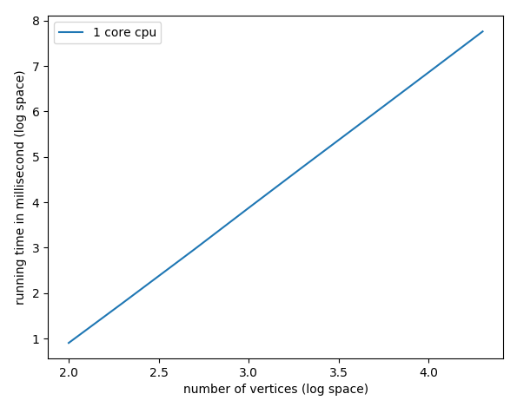
5, CPU Performance
CPU version
Floyd-Warshall algorithm
exact a linear curve when we set the x and y-axes in log space

Slide 7
6, GPU implementation
Iteration version which is same as CPU
GPU version Floyd-Warshall
Recursive version which make it more suitable for GPU
R-Kleene algorithm
Some improvement versions based on R-keene

Slide 8
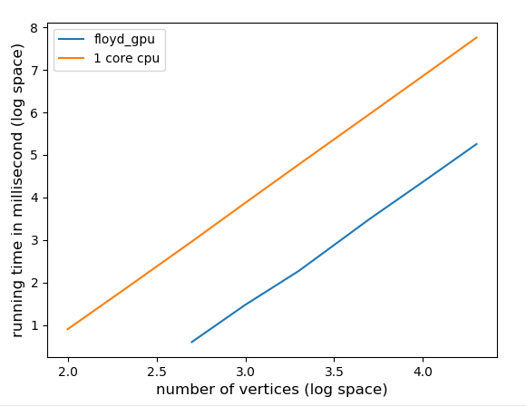
6, GPU implementation
version 1: GPU version of Floyd-warshall with global memory
For each k, call GPU kernel
each thread calculate one pair of vertices by relaxing the shortest path for all other vertices
The GPU kernel will be called #vertices times
Using shared memory next?
Problem: Each thread needs to access one row and one col of the whole matrix to get the result which make it hard to use shared memory
319x

Slide 9
6, GPU implementation
version 2: Recursive with global memory
Recursive R-Kleene algorithm is more friendly for GPU
min(d(i,k)+d(k,j) ...)
j
R-Kleene(*):
1, R-Kleene(A)
2, Update B using A
3, Update C using A
4, Update D using C and B
5, R-Kleene(D)
6, Update B using D
7, Update C using D
8, Update A using B and C
A | B
C | D
 | *
i

Slide 10
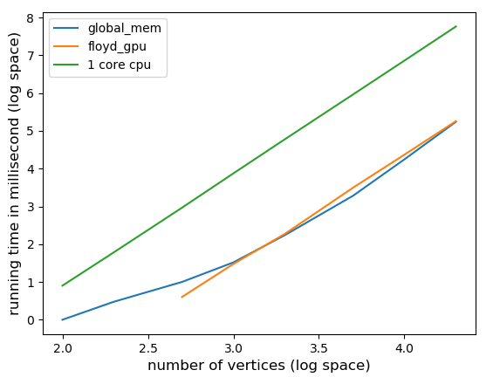
6, GPU implementation
version 2: Recursive with global memory
continue
The performance of the R-Kleene is no better than the Floyd-Warshall algo.
But now, we can make use of shared memory
1x

Slide 11
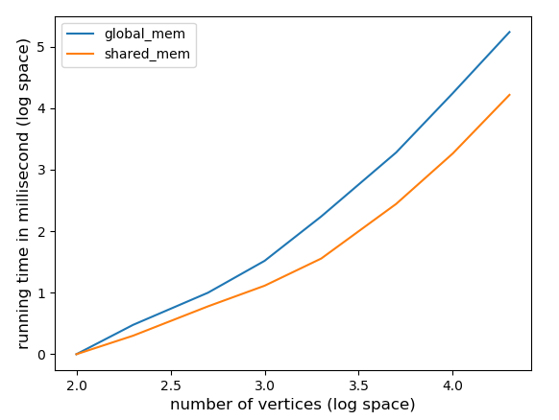
6, GPU implementation
version 3: Recursive with shared memory
For a single matrix minplus calculation, it is likes the matrix multiplication.
We can now load a block of matrix once and calculate it's contribution to the target output block
10.5x

Slide 12
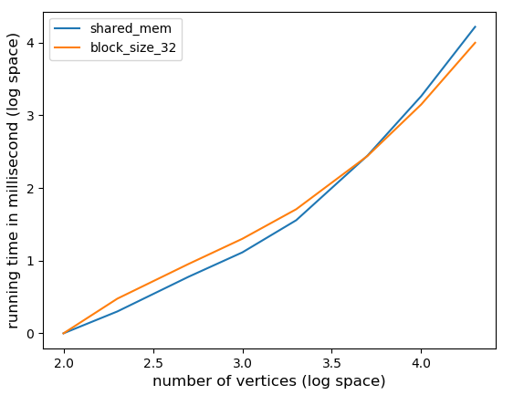
6, GPU implementation
version 4: Recursive with shared memory
- with larger blocksize (32)
We can even improve the performance by simply making a larger blocksize
We get a 1.65x speed up by change the blocksize from 16 to 32
Now, the problem is we have slow speed in small graph respect to the large one
1.65x

Slide 13
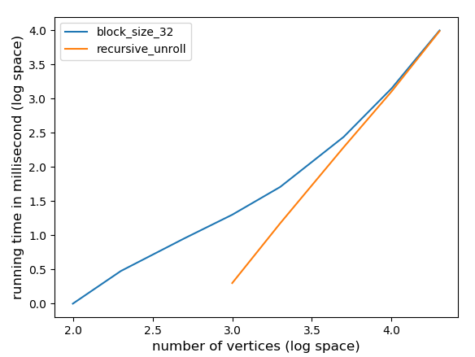
6, GPU implementation
version 5: Unroll the recursive
The bottleneck for small graph is in the end of recursive where the overhead kernel launch cann't be ignored
Unroll in the end of recursive
When we get a matrix which is smaller than blocksize, we can just calculate the APSP by using floyd-warshall algo.
Now, we can load the whole matrix to shared memory
Finally, we get an almost linear curve in log space

Slide 14
6, GPU implementation
version of gpu-floyd-warshall
Used 12 registers, 336 bytes cmem[0]
version with global memory
Used 32 registers, 385 bytes cmem[0], 4 bytes cmem[2]
version with shared memory
Used 27 registers, 2048 bytes smem, 385 bytes cmem[0]
version with shared memory and recursive unroll
-threads per block increace to 32
Used 28 registers, 8192 bytes smem, 385 bytes cmem[0]
Used 12 registers, 4096 bytes smem, 344 bytes cmem[0]
all of these versions have a 100% occupancy

Slide 15
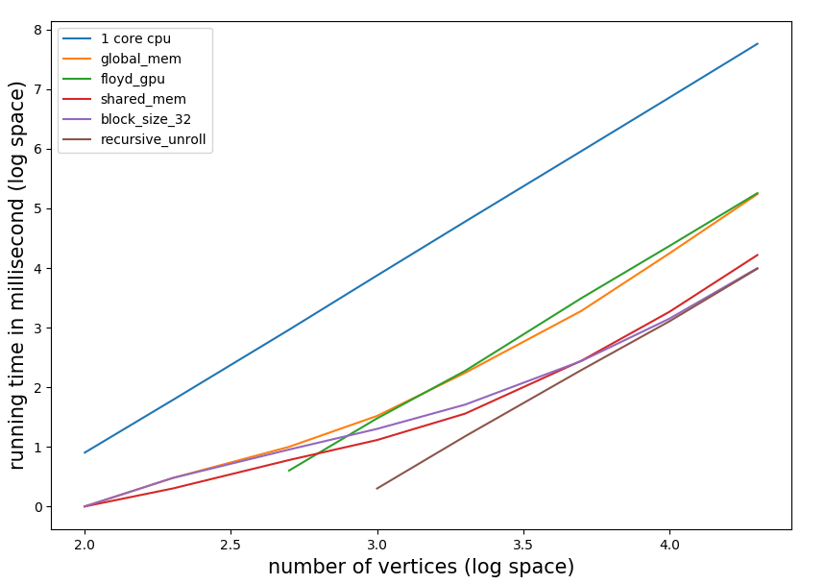
7, A big picture
16 hours' computing can now be reduced to only 10 seconds

